Slide 1
Emotional Health Challenges in
Prostate Cancer
Marissa Fors, MSW, LCSW, OSW-C, CCM
Director of Specialized Programs
CancerCare

Slide 2
Emotional Health Challenges in Prostate Cancer
What are we going to talk about today?
Common responses to a diagnosis of prostate cancer
Range of emotions while in treatment and post treatment
How to recognize the signs of emotional health challenges
Ways to better manage changing feelings and concerns
How to communication to others about your feelings
Where to seek support services and ask for help

Slide 3
Impacts of a prostate cancer diagnosis

Slide 4
Emotional Health Challenges in Prostate Cancer
When someone is diagnosed…
Why did this happen to me?
How did I get cancer?
Should I tell my family, friends and employers?
Will I still be able to work?
How will I be able to afford or pay for treatment?
How will I support my family?
Who will support me?

Slide 5
Emotional Health Challenges in Prostate Cancer
When someone is diagnosed…
Common Responses
Anxiety or Worry
Fear
Sadness
Depression
Anger
Stress
Uncertainty
Shame

Slide 6
Emotional Health Challenges in Prostate Cancer
When someone is in treatment/post treatment…
Common Responses
Anxiety
Fear
Sadness
Depression
Loneliness
Reactions to treatment
Loss of control
Change in roles
Change in body image
Change in self esteem

Slide 7
Recognizing the signs

Slide 8
Emotional Health Challenges in Prostate Cancer
Common warning signs of emotional distress include:
Changes in eating patterns
Changes in sleeping patterns
Anger, feeling edgy or lashing out at others
Overwhelming sadness
Pulling away from people and things
Lack of energy or always feeling tired
Feeling like you have to keep busy
Having unexplained aches and pains
Feeling helpless or hopeless
Excessive smoking, drinking, or using drugs
Excessive worry, anxiety, fear
Difficulty readjusting to home or work life
Thinking of hurting or killing yourself or someone else

Slide 9

Emotional Health Challenges in Prostate Cancer
Common warning signs of emotional distress include:
Anxiety can feel like:
You can’t breathe, shortness of breath
You can’t concentrate, or make decisions
Feelings of dizziness, or that you might faint
Feelings of nausea
Irritability
Restlessness
Muscle tension, pain
Heart attack
Feeling like you are going crazy
Hard to describe

Slide 10

Emotional Health Challenges in Prostate Cancer
Common warning signs of emotional distress include:
Depression can feel like:
Feelings of sadness that is overwhelming
Helplessness or hopelessness
Loss of motivation or enjoyment in activities
Numb emotionally and physically
Angry outbursts, irritability
Trouble concentrating, with memory, making decisions
Changes in appetite, sleep
Feelings of worthlessness
Loss of libido
Feelings of hurting yourself or others

Slide 11
Communication

Slide 12
Emotional Health Challenges in Prostate Cancer
Friends, Family, Work:
Family and friends may be excited to see patients outwardly showing improvement from cancer treatments, making sharing emotional hardships difficult.
Worries about finding a job, disclosing to employers, or being treated differently by colleagues can affect a person’s ability to be open with those around them, increasing feelings of isolation.
There can be a pressure to appear back to normal when only beginning to process the diagnosis, though varies on the person.

Slide 13
Emotional Health Challenges in Prostate Cancer
Tips for Difficult Conversations
Plan what you want to say and do (Goals, objectives, outcomes)
Understand your needs to effectively communicate them
Set a date and time to talk
Find a comfortable location, free from distractions
Use effective communication strategies
Take breaks when needed
Remain calm and grounded
Learn to ask for and accept help when needed

Slide 14

Emotional Health Challenges in Prostate Cancer
Talking to your doctor:
Prepare for the conversation, write down how feel
Describe how you have been feeling
Important to be honest
Come with questions and write down the answers
Consider family history information
Bring someone with you
There is no one size fits all
Know yourself!
Your doctor may prescribe medication, refer you to a mental health professional

Slide 15
Getting the Support You Need

Slide 16

Emotional Health Challenges in Prostate Cancer
Seeking Support
Find your support network
Seek counseling from an oncology social worker
Oncology social workers are licensed experts who counsel
people affected by cancer and provide emotional support
Join a support group
Building a support network can lessen the isolation that often comes with a cancer diagnosis. A support group is a unique opportunity to connect with others impact by cancer
Speak with your health care team about your concerns
Oncology social workers can help with guidance on patient-doctor communication

Slide 17

Emotional Health Challenges in Prostate Cancer
Constructive Ways to Cope and Relieve Stress
Mindfulness exercises
Breathing techniques
Meditation
Guided imagery
Journaling
Take a break
Go for a walk or exercise if you can
Enjoy nature
Read a book, listen to music
Get enough sleep, eat healthy, drink plenty of water
Get active – enjoy a sport or new hobby

Slide 18

Emotional Health Challenges in Prostate Cancer
Asking for help
Allow yourself to ask for help, you deserve it
Who can I rely on?
Lean on those you can trust to follow through with your requests
Assign someone in your support system to be your point person
Each member of your support system might have a different or unique role
My Cancer Circle
Allows patients or caregivers to share treatment updates, tasks that require some extra help, schedules and fundraisers
https://mycancercircle.net/

Slide 19

Emotional Health Challenges in Prostate Cancer
What is stopping you?
Talking about feelings is not a weakness
Asking for help is an act of strength
Society says, “Take it like a man.”
Family traditions, culture, expectations
Feeling like you have to be strong for others
Don’t know where to get help

Slide 20
Resources

Slide 21
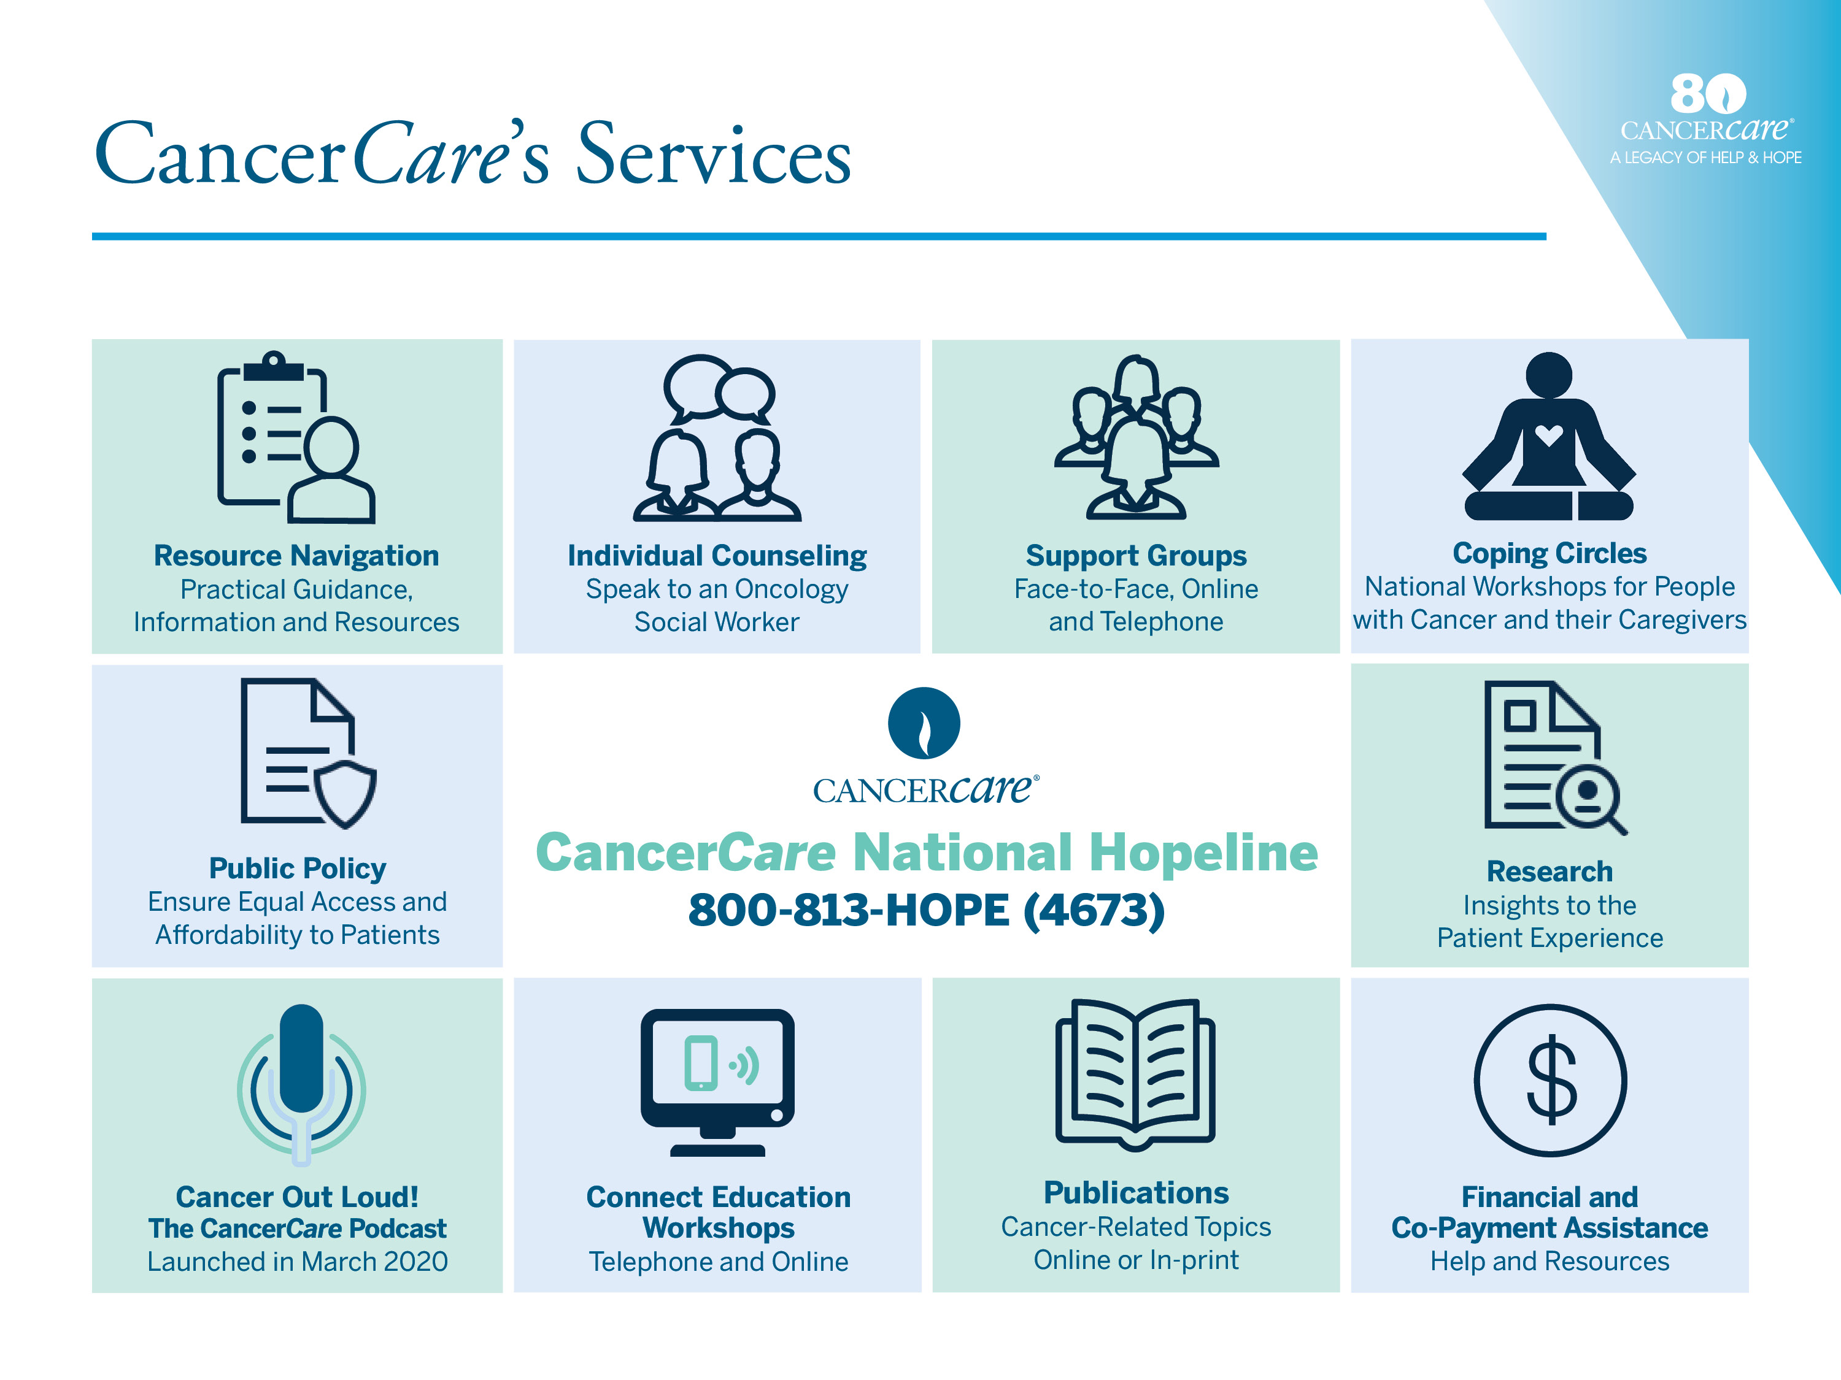
Emotional Health Challenges in Prostate Cancer

Slide 22

Emotional Health Challenges in Prostate Cancer
NASPCC is a nation-wide organization comprised of state PCa coalitions dedicated to saving
men’s lives and enhancing the quality of life of prostate cancer patients and their families,
through awareness and education and the development of a public policy network.
Goals
To be a resource to foster, encourage and promote the development of state prostate cancer coalitions;
To be a collective voice for state prostate cancer coalitions on a national basis;
To be a resource for the state prostate cancer organizations and a clearinghouse of ongoing best practices;
To support and encourage state prostate cancer organizations in their efforts involving prostate cancer awareness, education, treatment and clinical trials.
Objectives
To continue to establish the Alliance as the recognized national
network for state prostate cancer organizations;
2. To increase the national awareness of prostate cancer;
3. To support states in their efforts to reduce health disparities and
improve access to care in high risk, medically underserved communities;
4. To encourage state organizations to mobilize patients and those
interested in prostate cancer; and
5. To collaborate with other organizations and stakeholders interested
in prostate cancer.

Slide 23
Emotional Health Challenges in Prostate Cancer
National Alliance of State Prostate Cancer Coalitions
NASPCC is a nation-wide organization comprised of state PCa coalitions dedicated to saving
men’s lives and enhancing the quality of life of prostate cancer patients and their families,
through awareness and education and the development of a public policy network.
Contact information:
Website: www.naspcc.org/index.php
Email: info@naspcc.org
Phone: 424-253-1168
Fax: 424-253-1101

Slide 24
Questions

