Slide 1
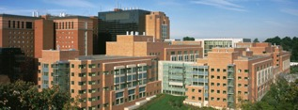
Immunotherapy for Prostate Cancer: What is new?
James L. Gulley, M.D., Ph.D., F.A.C.P.
Co-Director, Center for Immuno-Oncology, CCR
Clinical Director, National Cancer Institute
& Acting Co-Director, Center for Cancer Research (CCR)
National Institutes of Health
Notes:
Webinar (virtual) Speaker for a special NASPCC Webinar
National

Slide 2
Outline
Vaccines
Immune Checkpoint inhibitors
Bispecific Ab
Cell Therapy (CAR-T)
Conclusions

Slide 3
Greatest medical advance in the last century: Active vaccination
Percent
97% decrease
Year
Notes:
Startling statistic, why did they work—immunologic memory, don’t have to start from scratch, to design new targeting capabilities to build an army of cells, already have the plans and can just manufacture.
http://wheressputnik.com/wheres-sputnik.pdf
http://www.cdc.gov/vaccines/vac-gen/whatifstop.htm
http://www.efmoody.com/estate/lifeexpectancy.html

Slide 4

Give a man a fish and you feed him for a day. Teach a man to fish and you feed him for a lifetime.

Slide 5
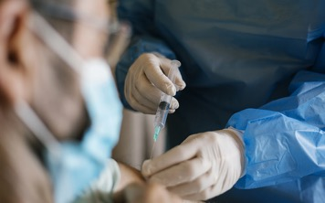
Vaccine
Designed to train immune system to recognize a target
Preventive: HPV, HBV
Therapeutic: Provenge, TVEC

Slide 6
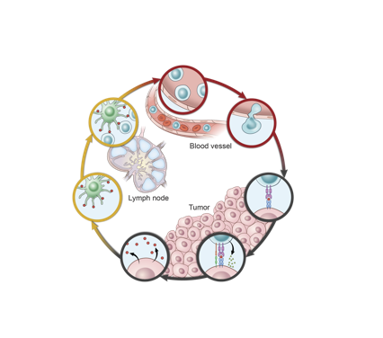
Cancer Immunity Cyclical Evolution (E⁸)
4
Expedition
3
Expand
5
Excursion
2
Engage
6
Establish ID
1
Emit antigen
7
Enable
Modified from Chen and Mellman, Immunity 2013
Notes:
Works well for tumors where there are a lot of non-self targets (mutations or viral antigens e.g., HPV). We will come back to that.

Slide 7
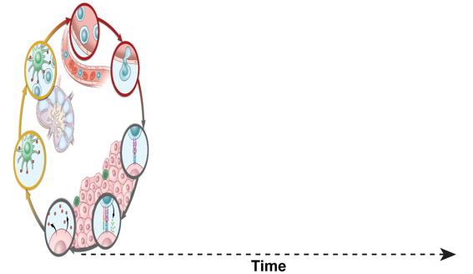
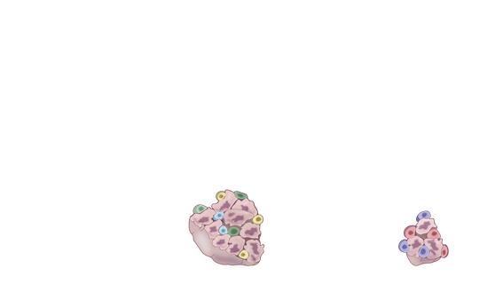
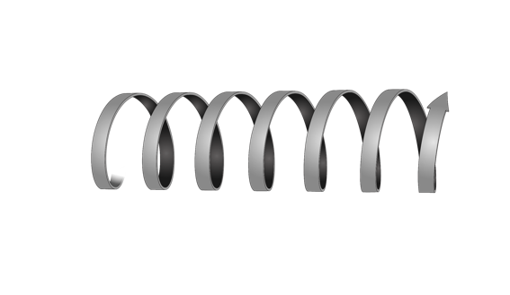
Cancer Immunity Cyclical Evolution (E⁸): Antigen spreading

Slide 8
Cancer Immunity Cyclical Evolution (E⁸)
4
Expedition
3
Expand
5
Excursion
2
Engage
6
Establish ID
Vaccine
1
Emit antigen
7
Enable
Notes:
In many tumors, there is limited or no underlying immune response. One way to prime this TIC is to give a vaccine.

Slide 9
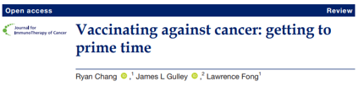
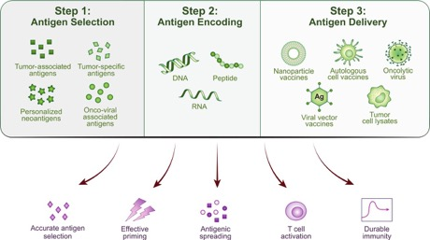
Vaccines
May 2023

Slide 10
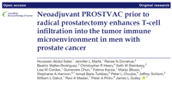
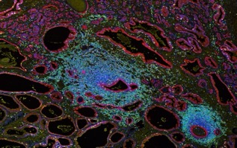
Prostvac increases intra/peritumoral immune infiltrate in patients with localized prostate cancer undergoing radical prostatectomy (n=27)
Baseline | Day 1 | Day15 | Day 29 | Day 57 | 64
Biopsy | Priming Vaccination s.c. | Booster Vaccination s.c. | Booster Vaccination s.c. | Booster Vaccination s.c. | RP
 | ≥ 2X ↑ CD4 Infiltrate |  | ≥ 2X ↑ CD8 Infiltrate
 | No | Yes | No | Yes
No Peripheral IR | 3 | 9 | 6 | 6
Peripheral IR | 4 | 8 | 4 | 8
Total |  | 17/24 |  | 14/24
RNA expression profiles consistent with an activated immune response post vaccine
Houssein et al., JITC 2020

Slide 11
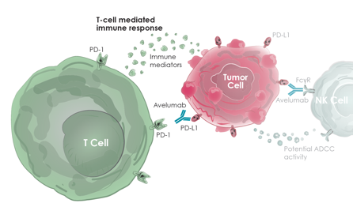
Importance of PD-1/PD-L1 blockade
NIH. News Headlines: https://ccr.cancer.gov/news/article/investigators-lead-first-human-trials-of-new-immunotherapy-drug (accessed August 2017)

Slide 12
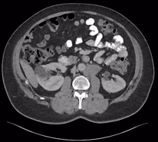
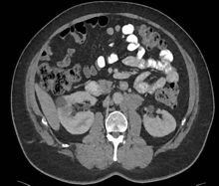
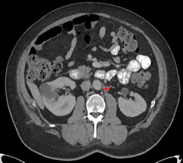
Spider Plot
bigger
Change in Size of Tumor
smaller
Time

Slide 13









PD-1/PD-L1 inhibition
Rapid, deep, durable responses
Across a wide range of tumours
Seen in a subset of patients
NSCLC: avelumab
Gulley JL et al. Lancet Oncol 2017
MSI hi CRC: nivolumab
Overman MJ et al. Lancet Oncol 2017
Urothelial: atezolizumab
Powles T et al. Nature 2014
NSCLC (squamous only): nivolumab
Rizvi NA et al. Lancet Oncol 2015
Urothelial: avelumab
Apolo AB et al. J Clin Oncol 2017
Urothelial: durvalumab
Massard C et al. JCO 2016
HNSCC: pembrolizumab
Seiwert TY et al. Lancet Oncol 2016
Urothelial: pembrolizumab
Plimack ER P et al. Lancet Oncol 2017

Slide 14
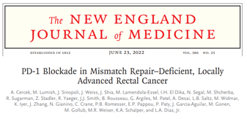
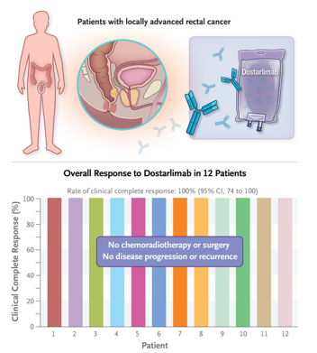
dMMR stage 2-3 rectal CA (n=12)
Tx: dostarlimab (anti PD-1 Ab) 6 months
100% CR (follow-up 6-25 months)
Avoid surgery / chemo / RT
Notes:
Feb 2023 Fast Track Designation. Example of MSI hi and activity that is not seen when fewer targets.

Slide 15
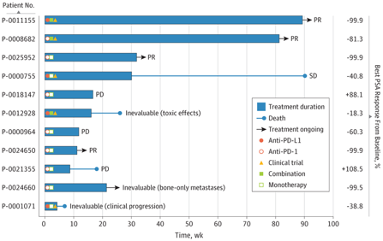
MSI hi Prostate Cancer
1033
Sequenced
32
11
Tx PDXi
MSI hi (3.1%)
Non-CRPC 2.4%
CRPC 4.5%
Post abi/enza 5.4%
Abida et al, JAMA Onc 2019
Notes:
MSKCC
6/11 with PSA response
Six of these (54.5%) had a greater than 50% decline in prostate-specific antigen levels, 4 of whom had radiographic responses. As of May 2018, 5 of the 6 responders (5 of 11 total [45.5%]) were still on therapy for as long as 89 weeks.

Slide 16
Current Standard of Cancer
Asymptomatic mCRPC: sipuleucel-T (Provenge)
MSI-hi / TMB hi mCRPC: Pembrolizumab or Dostarlimab
McNeel et al., SITC Clinical Practice Guidelines, JITC, 2016
Gulley, https://www.uptodate.com/contents/immunotherapy-for-castration-resistant-prostate-cancer 2024

Slide 17
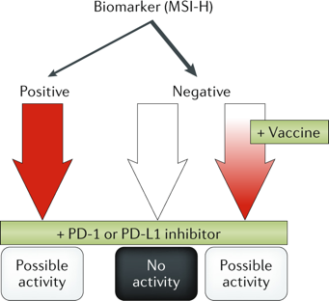


Experimental algorithm for immunotherapy for mCRPC
Biomarker (MSI-H; TMB)
~5%
~95%
Pembrolizumab
~50% response
Madan and Gulley Nature Rev. Urology, 2018

Slide 18
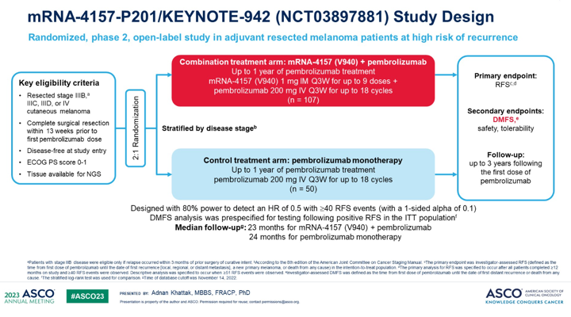
Notes:
Recent story with Moderna’s vaccine and Merke’s Pembrolizumab in Melanoma as an example

Slide 19
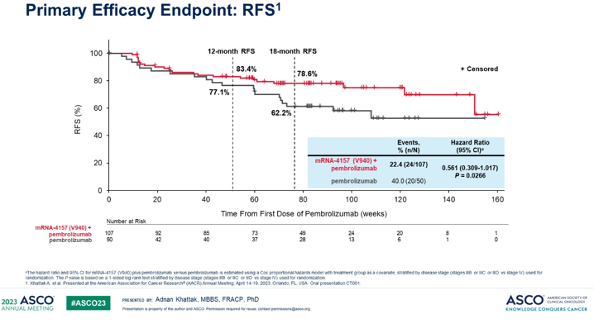
Notes:
44% reduction in risk of progression

Slide 20
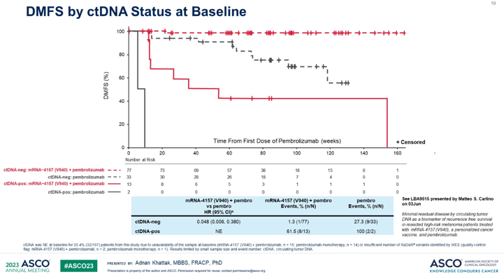
Notes:
Distant metastasis free survival but ctDNA at baseline.

Slide 21
4
Expedition
3
Expand
5
Excursion
2
Engage
6
Establish ID
1
Emit antigen
7
Enable

Slide 22
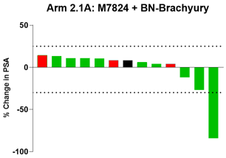
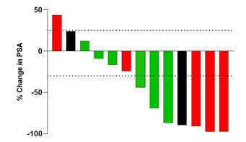

Best PSA Responses
MSI/dMMR
*
MSS/pMMR
12 weeks
31 weeks
24 weeks
38+ weeks
47+ weeks
11 weeks
59 weeks
*Maximal PSA response occurred after palliative radiation. Prior to radiation, maximal PSA response = 29%. Not counted as a response.
Redman…Gulley, ESMO 2020
Notes:
Context with ICI expect about 2.5% response (PSA/ORR) in unselected patients
38+ week response, patient then came off treatment for toxicity but PSA still below 70% of baseline
47+ week response, patient then came off for toxicity and started enzalutamide, PSA still was below 70% of baseline
11 week response ended when steroids given for rash, PSA has since plummeted again, PD in LN but disease otherwise, persistent bone response, PSA curve on next slide

Slide 23
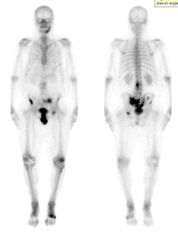
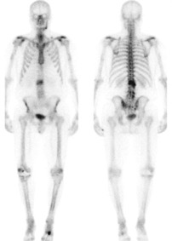
Patient 34
Baseline
~1 Year On Treatment
Prior Treatment
-Sipuleucel-T
-Enzalutamide
-Radium-223 + Niraparib (Trial)
-Adenoviral vaccine targeting PSA, MUC1, Brachyury
steroids
Notes:
Anterior superior iliac spine / iliac crest AND Sacrum
Abx dental infection→ rash solumedrol Trunk and extremeties
Rash → prednisone
Call for more selective options for irAE than steroids

Slide 24
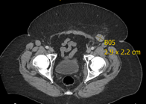
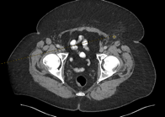
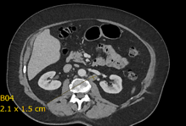
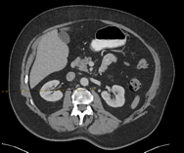
Patient 29 (59-week PSA response)
Baseline
On treatment
Prior Treatment
-Docetaxel (for castration sensitive disease)
-Sipuleucel-T
-Abiraterone
-Enzalutamide

Slide 25
Examples of some combination approaches at NCI
Prostate Cancer
QuEST (vaccine, IL-15, bintrafusp alfa) ESMO and AACR
Initial Response Rate ~40%
HPV Associated Malignancies
HPV Triple (vaccine, IL-12, bintrafusp alfa) ASCO
Response Rate ~21% in ICI refractory

Slide 26
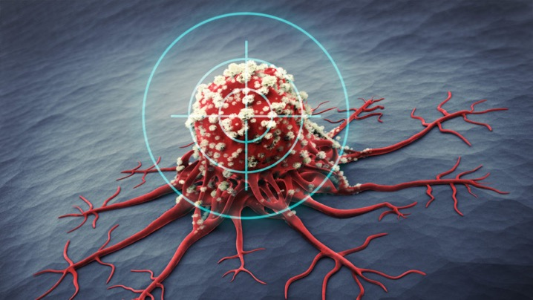
Cancer Targeting
Notes:
Dragging t-cells to tumor

Slide 27
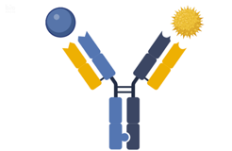

Bispecific Abs
Bispecific Ab
Tumor Cell T-cell
James Gulley @gulleyj1

Slide 28
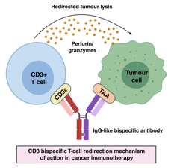
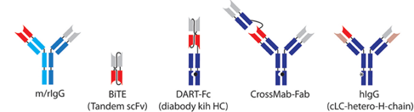
Singh et al., British J of Cancer 2021
James Gulley @gulleyj1

Slide 29
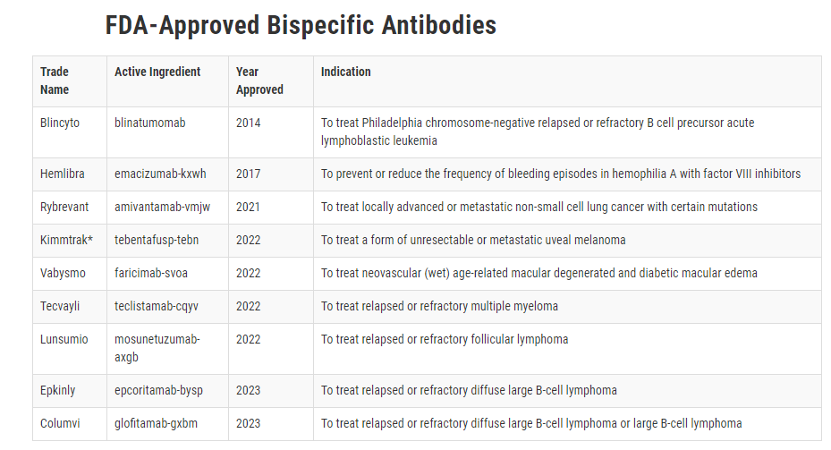
Bispecific Abs
James Gulley @gulleyj1
Notes:
Compared with ipi / nivo or nivo / rela
Chemo + IO, mostly additive

Slide 30
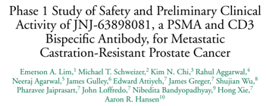
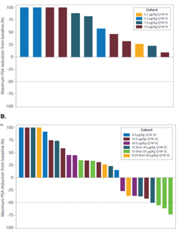
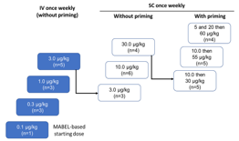
PSA Responses
i.v. cohorts
Dose escalation study of JNJ-081
Study Design
s.c. cohorts
minimum anticipated biological effect level – based level
39 patients treated
At high doses, JNJ-081 demonstrated a transient, substantial decrease in PSA levels.
Lim et al., Clin Genit Cancer 2023

Slide 31

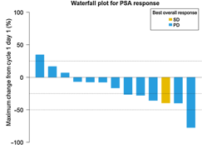
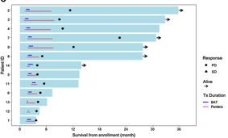
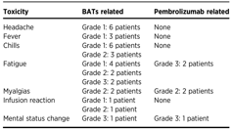
HER2 overexpressed 40%-70% mCRPC.
T cells armed with anti-CD3 x anti-Her2 bi-specific Ab (HER2BAT).
Pembrolizumab q3 weeks
HER2BAT twice weekly for 4 weeks
Favorable toxicity profile
Five out of fourteen (38.4%) patients were disease-free at 6 months.
Vaishampayan et al., Clin Cancer Res 2023

Slide 32
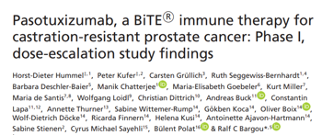
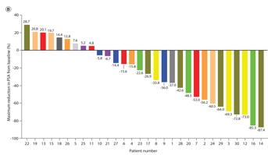
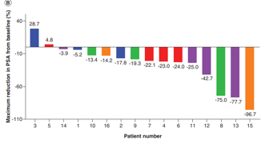
SC cohort
PSA₅₀ decline: n = 9/31
BiTE immune therapy designed to engage CD3 on T cells and PSMA
47 patients treated
IV cohort
SC cohort (n=31)
Daily administration over a 21-day cycle
(no breaks)
IV cohort (n=16)
continuous administration over a 21-day cycle
(5 weeks on/ 1 week off)
PSA₅₀ decline: n = 3/16
Hummel et al, Immunotherapy 2021

Slide 33
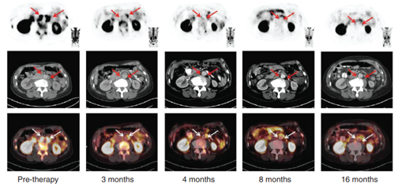
Patient 15 (IV cohort)
Near-complete regression of lymph node lesions and bone metastases as assessed by PSMA PET/CT and 16 months to tumor progression.
Hummel et al, Immunotherapy 2021

Slide 34
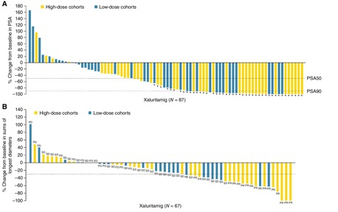
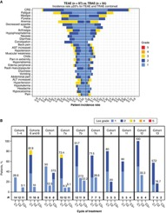
From: Xaluritamig, a STEAP1 × CD3 XmAb 2+1 Immune Therapy for Metastatic Castration-Resistant Prostate Cancer: Results from Dose Exploration in a First-in-Human Study
49% confirmed PSA 50
CRS
24% ORR
Cancer Discov. 2024;14(1):76-89. doi:10.1158/2159-8290.CD-23-0964
Date of Download: 4/14/2024
Copyright © 2024 American Association for Cancer Research. All rights reserved.
Notes:
Figure Legend: Clinical activity of xaluritamig in evaluable patients. A, Best PSA percentage change from baseline. Asterisk indicates confirmed PSA responders, and dashed lines indicate PSA50 and PSA90 declines. B, Best percentage change in size of tumor target lesions. Dashed line indicates 30% reduction in tumor SLD from baseline. C, Example of patient showing response by PSA and radiographic assessments: CT scan and PSA curve over time of a heavily pretreated 65-year-old patient with stage IV prostate adenocarcinoma. Patient was enrolled into Cohort 11 (3-step 1.5 mg target dose of xaluritamig). CT scans showed three target lesions (two liver, one lymph node) and multiple nontarget lesions in the liver as well as two lymph nodes during screening. Patient achieved 99% PSA decline from baseline on C7D1 and PR (37.3% reduction of target lesions) after 2 cycles, which was confirmed at 16 weeks and maintained after 24 weeks. AEs occurred during C1 of treatment and included recurrent CRS, tinea faciei (both grade 1), rash, and worsening of back pain (both grade 2). During further treatment cycles, rash (grade 1), myalgia, and hyperkalemia (both grade 2) were reported. Patient remains on treatment at the time of publication. Red arrows indicate sites of tumor. D, Time on treatment for patients in high-dose cohorts. PSA and RECIST responses [RECIST evaluable (gray bars) and non–RECIST evaluable (white bars)] are presented for patients in high-dose cohorts. Patients whose treatment was ongoing are noted by an arrowhead. Double parallel lines (//) represent patients who have extended beyond 48 weeks: one patient is ongoing treatment at 90 weeks, one is ongoing treatment at 84 weeks, and one ended treatment at 58 weeks. NE, not evaluable; PD, progressive disease; SD, stable disease; SLD, sum of longest diameters.

Slide 35
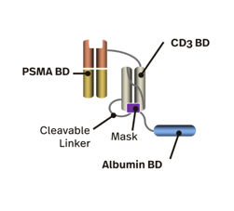
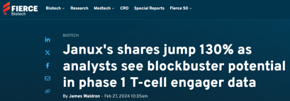
JANX007 – interim analysis on Phase 1 trial on PSMA-targeted Tumor Activated T cell Engager (TRACTr) for mCRPC
Dose escalation study
23 patients treated, median of 4+ prior lines of therapy.
Favorable toxicity profile. No grade 4-5 events. Only grade 1-2 cytokine release syndrome.
JANX007 dose | PSA declines
Starting dose 0.1 mg | 14/18 (78%) subjects achieved PSA₃₀ declines 10/18 (56%) subjects achieved PSA₅₀ declines
Starting step dose of 0.2 mg | 6/6 (100%) subjects achieved PSA₃₀ declines 5/6 (83%) subjects achieved PSA₅₀ declines
The T cell-specific binding domain (CD3e) is masked to help minimize CRS
Starting dose ≥ 0.2 mg showed deeper and more durable response, with one patient achieving PSA₉₀ decline.
Dose optimization is still ongoing.
Updates on doses for expansion are expected in late 2024.

Slide 36
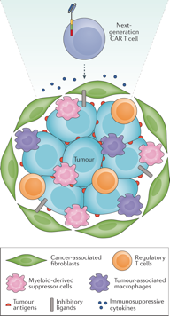
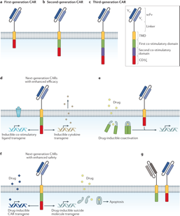
Chimeric Antigen Receptor T cells
Wolf P. et al., Nat Urol 2021
Notes:
a | First-generation chimeric antigen receptors (CARs) consist of a single-chain variable fragment (scFv) binding domain (blue), a linker region, a transmembrane domain (TMD; yellow) and an intracellular CD3ζ signalling domain (red). b | Second-generation CARs have an additional co-stimulatory domain derived from CD28, 4-1BB, OX40 or ICOS (green). c | Third-generation CARs have a second co-stimulatory domain (purple) for augmented signalling. d,e | Next-generation CAR T cells additionally harbour inducible transgenes that lead to expression of a co-stimulatory molecule or a cytokine for enhanced CAR T cell activity (part d), or that can be activated by drug-inducible co-activators (part e). f | For enhanced safety, CAR function can be regulated by drugs or, alternatively, CAR T cells can be switched off by a drug-inducible suicide system. g | In combinatorial CAR T cells, two CARs are expressed that bind to two different antigens and that either include a co-stimulatory domain or an activation domain, respectively. Full CAR T cell activation only occurs when both CARs bind simultaneously to their respective antigens on the target cell surface. V_{H}, variable domain of an antibody heavy chain; V_{L}, variable domain of an antibody light chain.

Slide 37

Potential Targets
- Prostate acid phosphatase
- Prostate Stem Cell Antigen
- Epithelial cell adhesion molecule
- Prostate specific membrane antigen
-HER2
-STEAP
Perera et al., Cancers 2022

Slide 38




CAR T cell engraftment
Vivek Narayan…Carl June, Naomi Haas et al., Nat Med 2022

Slide 39


Patient 9
Vivek Narayan…Carl June, Naomi Haas et al., Nat Med 2022

Slide 40



Phase I study of PSCA-targeted chimeric antigen receptor (CAR) T cells in patients with metastatic castration resistant prostate cancer (mCRPC) – ASCO 2023
14 participants treated
Prior chemotherapy in 86%
CAR-T cell manufacturing 14-21 days
Dorff et al., ASCO 2023
Notes:
DL1 – PSMA-specific CAR T cell 100 M
DL2 – PSMA-specific CAR T cell 100 M with Lymphodepletion – 2 dose limiting toxicity (hemorrhagic cystitis) so protocol was amended to reduce LD dose
DL3 – PSMA-specific CAR T cell 100 M with reduced intensity Lymphodepletion

Slide 41
Multiple Ongoing Clinical Trials on CAR-T cells in PC
NCT03873805: FluCy and PSCA-specific CAR-T cells in Subjects with PSCA positive mCRPC
NCT02744287: Safety and Activity Study of PSCA-Targeted CAR-T Cells (BPX-601) in Subjects With Selected Advanced Prostate Cancer
NCT05805371: PSCA-Targeting CAR-T Cells Plus or Minus Radiation for PSCA+ mCRPC
NCT05354375: PSMA-targeted CAR-T Cells in the Treatment of Castration-resistant Prostate Cancer
NCT04249947: P-PSMA-101 CAR-T Cells in the Treatment of Subjects With mCRPC
NCT04633148: Dose-escalating Trial With UniCAR02-T Cells and PSMA Target Module (TMpPSMA) in Patients With PSMA+ PC
NCT06228404: Clinical Study of Safety and Efficacy of Enhanced PSMA CAR- T in Refractory CRPC
And more…

Slide 42
Conclusions
Vaccines can train the immune system to recognize and kill cancer cells.
Effective vaccines may increase the activity of immune checkpoint inhibitors (e.g., adjuvant melanoma)
Combination approaches may be needed for the metastatic setting
Bi-specifics can redirect the immune system toward the elimination of tumor cells
CAR-T cells are engineered to directly recognize and kill tumor cells expressing specific surface antigens

Slide 43


Slide 44

Acknowledgements
Special Thanks to Elisabetta Xue, NCI Immunotherapy Fellow
CIO and NCI
Prostate cancer patients who volunteer for clinical trials

