Slide 1
Sexual Function Outcomes After Prostate Cancer Therapy
Know Your Goals
John P. Mulhall MD MSc FECSM FACS FRCSI
Director, Sexual & Reproductive Medicine
Urology Service
Memorial Sloan Kettering Cancer Center, NY, USA

Slide 2
Disclosures
Grants
•NIH
•DOD
•Sexual Medicine Society of North America
•Center for Intimacy after Cancer Therapy
Consultancies
•None
Other
•Past-President of the Sexual Medicine Society of North America
•Editor-in-Chief, The Journal of Sexual Medicine
Notes:
Unpublished data from a study at Baylor in 1996.

Slide 3
“It takes 50 years to get a wrong idea out of medicine and 100 years to get a right one into it”
John Hughlings Jackson
Neurologist

Slide 4
Optimal Outcomes
Achieving optimal outcomes requires full informed consent before treatment which requires that the clinician gives realistic expectations about the effectiveness and side effects of treatment
Notes:
Unpublished data from a study at Baylor in 1996.

Slide 5
The word CANCER is scary!
#4

Slide 6
My Goal
To give you advice to help you enter any treatment program with your eyes wide open
Notes:
Unpublished data from a study at Baylor in 1996.

Slide 7
Treatment Effects
The only sex-friendly prostate cancer management strategy is active surveillance
Notes:
Unpublished data from a study at Baylor in 1996.

Slide 8
Realistic Expectations
• Referral pre-therapy to a sexual medicine clinician
• Discussion of frequency of the major sexual problems
• Discussion of time-course of recovery
• Discussion of ways to minimize long-term effects
• Discussion of strategies to treat side effects

Slide 9
Sexual Dysfunctions
Erectile dysfunction (ED)
Decreased sex drive
Failure to ejaculate
Difficulty achieving orgasm
Reduced orgasm intensity
Orgasmic pain (Dysorgasmia)
Sexual incontinence (arousal, climacturia)
Penile length (volume) loss
Notes:
Unpublished data from a study at Baylor in 1996.

Slide 10
Cause of ED
Blood Vessel Damage
Nerve Injury
Muscle Damage

Slide 11
Erectile Function Preservation
Degree of nerve sparing (RP)
Preoperative erectile function (RP, RT)
Patient age (RP, RT, ADT)
Physician experience (RP, RT)
Physician volume (RP, RT)
Medical conditions: DM, OSA, low T levels (RP, RT, ADT)
Duration of ADT
Pre-treatment testosterone levels (RP)
Notes:
Unpublished data from a study at Baylor in 1996.

Slide 12
One Man’s Opinion …

Slide 13
Obsessive Oncocentricity
#2

Slide 14
You think that your treating clinician will tell you all you need to hear, when in fact, the physician will tell you what they think you need to hear
#2

Slide 15
Don’t be afraid to ask why active surveillance is not an option for you
#3

Slide 16
Before committing to a treatment think seriously about how important your future sex life is
#4

Slide 17
Understand what your treating physician means by “erectile function preservation/recovery”
#6

Slide 18
Get realistic expectations about the time-frame for sexual function recovery/preservation
#8

Slide 19
EF Recovery after RP

Slide 20
EF Recovery after RT
Teloken P, et al. JSM 2009

Slide 21
Beware physicians citing “incredible” figures for erectile function recovery/preservation
#17

Slide 22
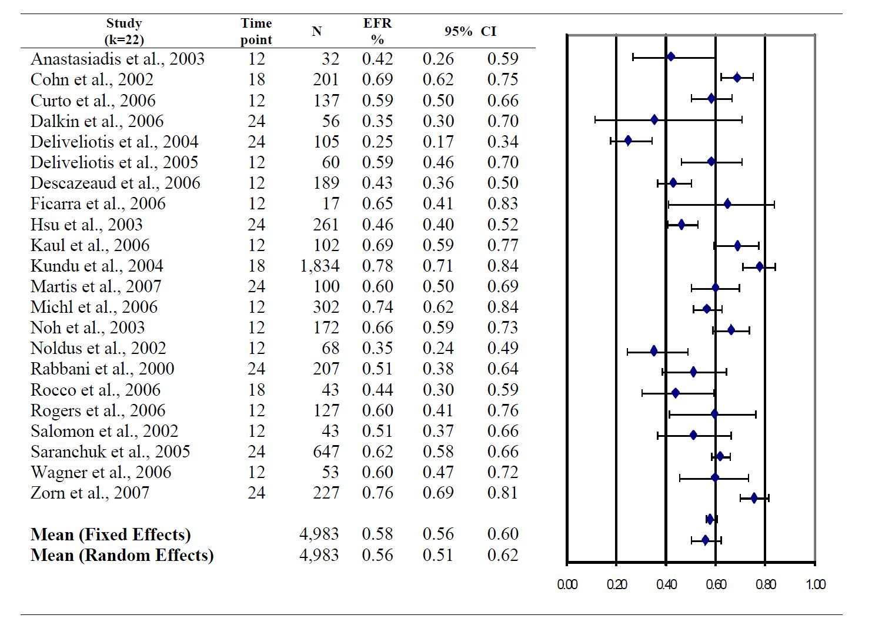
Systematic Review
Tal R., et al. JSM 2010

Slide 23
If you have ED before treatment and sexual intercourse is important, it is essential that you communicate its importance to the treating physician
#18

Slide 24
Open vs Robotic RP?
No proven difference in sexual function outcomes

Slide 25
Physician experience is key to success
#10

Slide 26
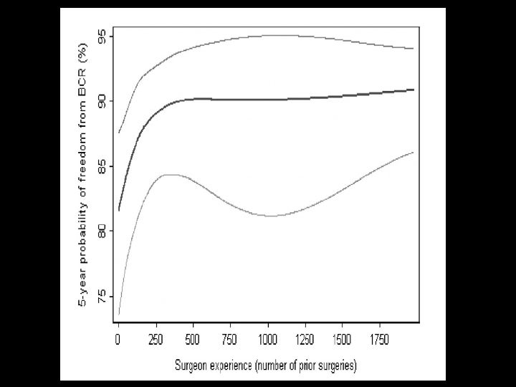
Vickers A, et al JNCI 2010

Slide 27
Ask about “penile rehabilitation”?
#14

Slide 28
There is no clear difference in sexual function outcomes between different radiation delivery modalities
#11

Slide 29
ADT is the most penis threatening thing you can be exposed to … think seriously in terms of “survival benefit”
#13

Slide 30
If you need ADT ask for how long you will be testosterone deficient
#13

Slide 31
Get clear instructions on how to use erection pills
#15

Slide 32
PDE5i Use
• Viagra (sildenafil), Levitra (vardenafil), Stendra (avanafil) - Peak levels within 1-2 hours - Empty stomach ideal (no fatty food, alcohol) - Sexual stimulation required - Viagra/Levitra = 8-10 hour window of opportunity - Stendra = 4-6 hour window of opportunity
- SEs: headache, flushing, congestion, heartburn, visual fx
Cialis (tadalafil) - No food impact - Slowly absorbed (peak levels at 2-4 hours) - Sexual stimulation required - 24-36 hour window of opportunity
- SEs similar to above plus muscle aches (low visual fx)

Slide 33
Penile injection therapy sounds awful … best drug therapy we have for ED. Do not base a decision on mental imagery!
#16

Slide 34
Triple therapy does not mean your sex life is over
#19

Slide 35
Remember … your ability to make PSA is dependent upon your testosterone level
#19

Slide 36
My testosterone level is low …. I have symptoms …. can I receive testosterone therapy?
#19

Slide 37
Beware of false advertising regarding “Restorative Therapies” (shock wave therapy, stem cell therapy, PRP)
#19

Slide 38
#20
Words of advice … for the partner!

Slide 39
“Let us not focus solely on adding years to life, but also pay attention to adding life to years”

Slide 40
#20
Q&A

