Slide 1

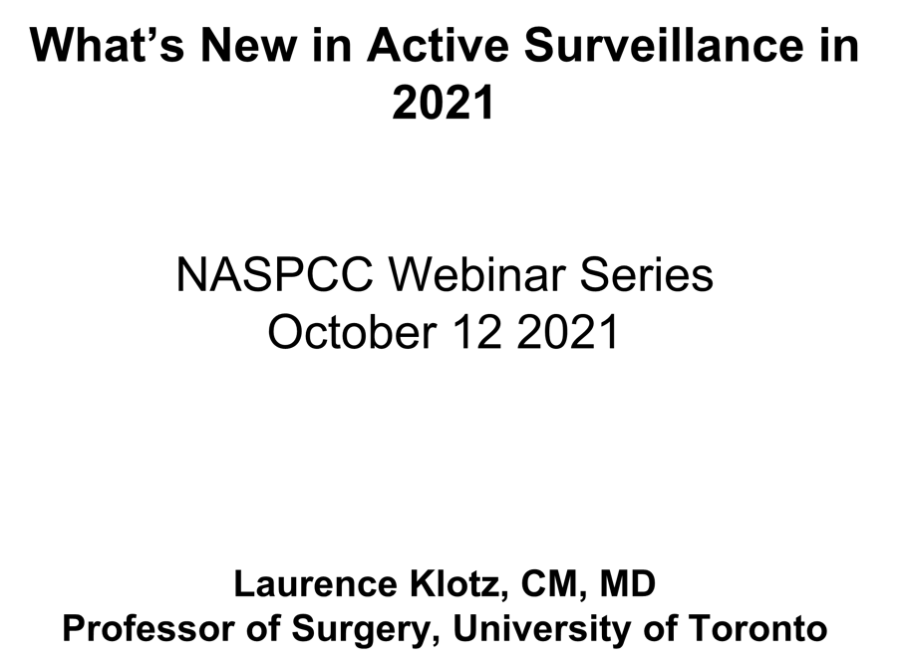
What’s New in Active Surveillance in 2021
NASPCC Webinar Series October 12 2021
Laurence Klotz, CM, MD Professor of Surgery, University of Toronto

Slide 2


Disclosures: L. Klotz
Research support, Exact Imaging
Consultant, miR Scientific

Slide 3

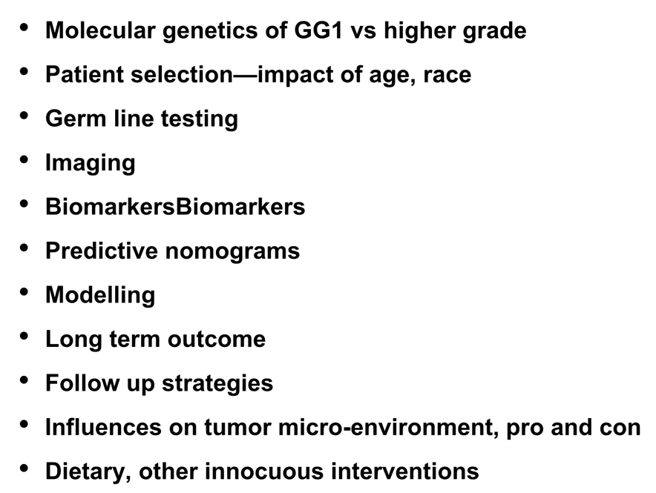
Progress in:
Molecular genetics of GG1 vs higher grade
Patient selection—impact of age, race
Germ line testing
Imaging
BiomarkersBiomarkers
Predictive nomograms
Modelling
Long term outcome
Follow up strategies
Influences on tumor micro-environment, pro and con
Dietary, other innocuous interventions

Slide 4

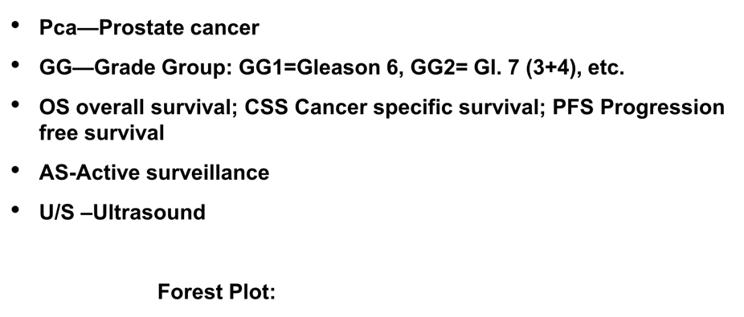
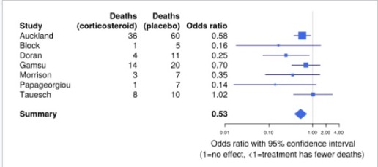
Acronyms in this talk (with apologies)
Pca—Prostate cancer
GG—Grade Group: GG1=Gleason 6, GG2= Gl. 7 (3+4), etc.
OS overall survival; CSS Cancer specific survival; PFS Progression
free survival
AS-Active surveillance
U/S –Ultrasound
‘Unity’ (no difference)
Forest Plot:
Individual studies
The ‘effect size’ overall

Slide 5

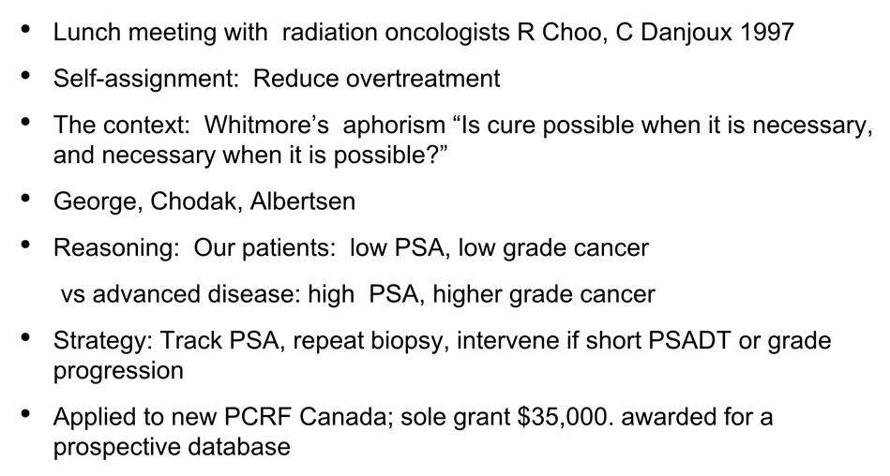
The start of Active Surveillance
Lunch meeting with radiation oncologists R Choo, C Danjoux 1997
Self-assignment: Reduce overtreatment
The context: Whitmore’s aphorism “Is cure possible when it is necessary,
and necessary when it is possible?”
George, Chodak, Albertsen
Reasoning: Our patients: low PSA, low grade cancer vs advanced disease: high PSA, higher grade cancer
Strategy: Track PSA, repeat biopsy, intervene if short PSADT or grade progression
Applied to new PCRF Canada; sole grant $35,000. awarded for a prospective database

Slide 6

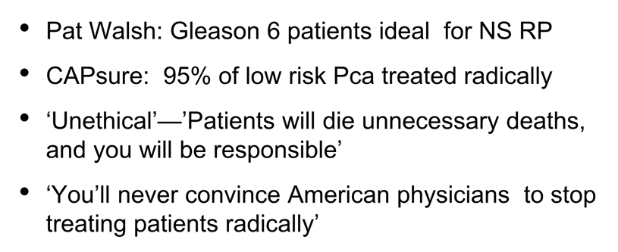
Initial reaction
Pat Walsh: Gleason 6 patients ideal for NS RP
CAPsure: 95% of low risk Pca treated radically
‘Unethical’—’Patients will die unnecessary deaths, and you will be responsible’
‘You’ll never convince American physicians to stop
treating patients radically’

Slide 7

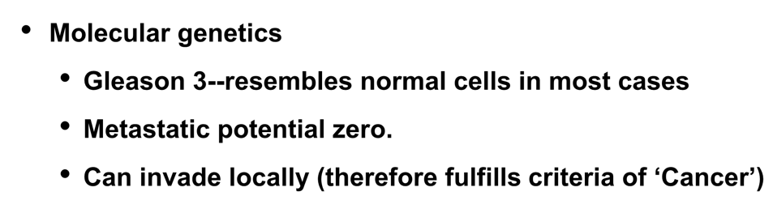
What we know
Molecular genetics
Gleason 3--resembles normal cells in most cases
Metastatic potential zero.
Can invade locally (therefore fulfills criteria of ‘Cancer’)

Slide 8
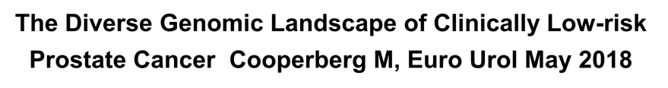
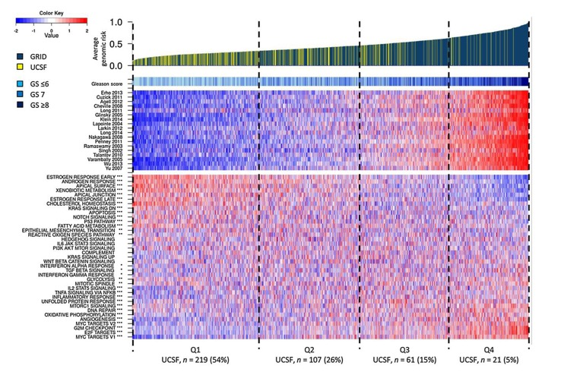
The Diverse Genomic Landscape of Clinically Low-risk Prostate Cancer Cooperberg M, Euro Urol May 2018
AGR: A ‘Meta-score’ of genetic aberrancy and aggressivity
GG1 and 2: 2% and 14% in highest AGR quartile
Average Genomic Risk(AGR)
Gleason
Scores for 18 prognostic signatures
Gene set scores and correlation to AGR

Slide 9
AS protocol | Clinical stage | PSA | Gleason | Positive cores | Core positivity (%) | 15 year Pca mortality
Tosoian (Hopkins) 1 | <T2a | – | ≤3 + 3 | ≤2 | ≤50 | 0.1%
Klotz (Toronto)1 |  | ≤ 20 | st ≤3 + 3(1 12 yrs, GG2 included; 25% of cohort) | – | – | 1.5%
Bul (PRIAS) | ≤T2 | ≤10 | ≤3 + 3 | ≤2
Dall'Era (UCSF) | ≤T2a | ≤10 | ≤3 + 3 | ≤33% | ≤50
Berglund (MSKCC) | ≤T2a | ≤10 | ≤3 + 3 | ≤3 | ≤50
Van As (Marsden) | ≤T2a | ≤15 | ≤3 + 3 | ≤50% | –
Soloway (Miami) | ≤T2a | ≤10 | ≤3 + 3 | ≤2 | ≤20

Slide 10

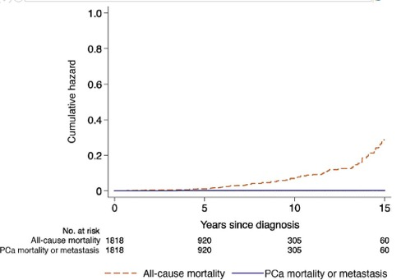
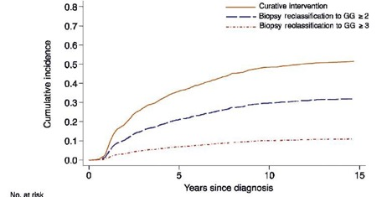
AS for GG1 Pca: Long term outcomes. Tosoian JJ et al Eur
Urol. 2020 Jun;77(6):675-682
N=1818, median F/U 5.0 yr (IQ 2.0–9.0)
88 non-PCa deaths, 4 PCa deaths, and 1 alive with mets
CSM 0.1% at 10 and 15 yr.
Grade reclassification at 5, 10, and 15 yrs was 21%, 30%, and 32%,

Slide 11

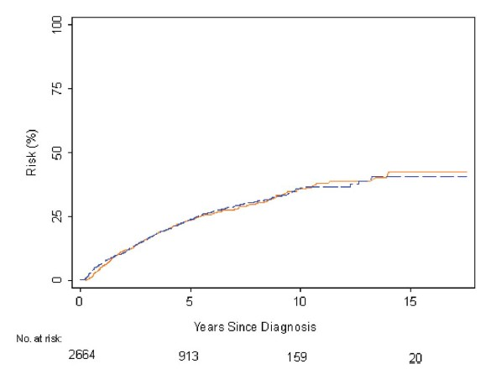
Long-Term Outcomes of Active Surveillance at MSCKK: .Carlsson S, et al. J Urol. 2020 Jun;203(6):1122-1127
N=2907, 2664 GG1
5 with mets; in retrospect, only 2 of these curable at Dx
Met rate:
-0.6% @ 10 years,
-1.5% @15 years
Risk of upgrading (blue) and of
treatment) orange) in GG1 pts.

Slide 12

What about active surveillance in very young men, or those with a strong family history?

Slide 13
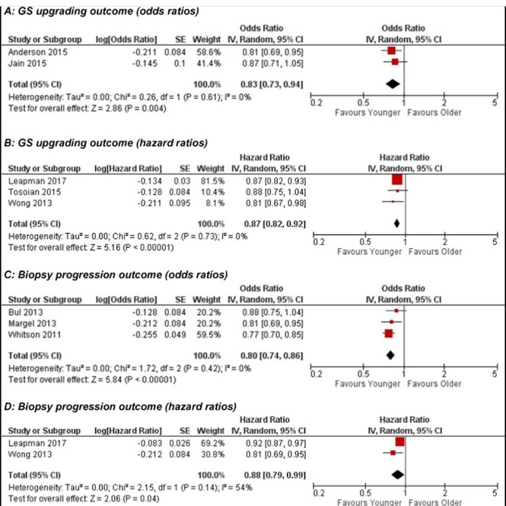
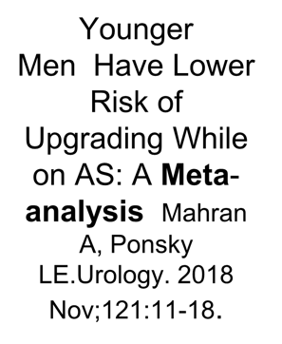
Younger Men Have Lower
Risk of Upgrading While on AS: A Meta-
analysis
Mahran
A, Ponsky LE.Urology. 2018 Nov;121:11-18.
Per decade decrease in age, the odds ratio for biopsy progression was 0.80

Slide 14

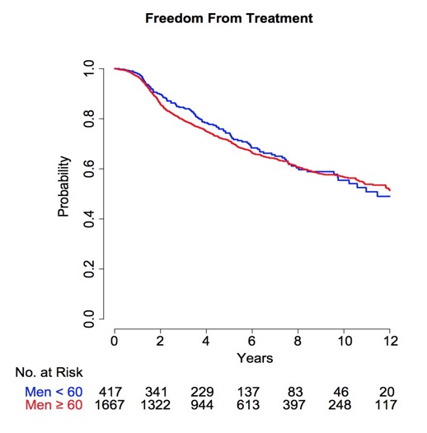
Is AS safe for young men (< 60 yrs)?
Salari K, Klotz L, Feldman A.J
Urol. 2019 Apr;201(4):721-727
417 men < 60 yrs and 1667 ≥60 yrs on AS
Median follow-up 6.2 years
No difference in:
Treatment rates (74%
vs. 71%)
MFS (99.7% vs. 99.0%),
CSS (100% vs. 99.7%).
Caveat: No 30 year follow
up!

Slide 15

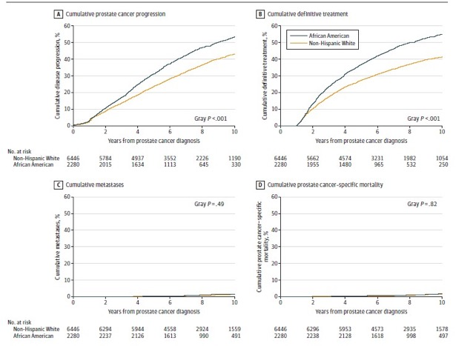
Black Race and Clinical Outcomes in Active Surveillance Deka R et al, Kane C et al JAMA. 2020;324(17):1747-1754
VA study of 8726 men, 25% AA, 75% White
Median F/U 7.6 years
Higher rates of progression and treatment, but no difference in mets or
mortality
% with each outcome | AA | White | P value
Progression* | 60 | 48 | <.001
Definitive Treatment | 55 | 41 | <.001
Metastasis | 1.5 | 1.4 | .49
Pca Mortality | 1.1 | 1.0 | .82
Overall Mortality | 22 | 23 | .01
*Grade progression, PSA>10, or mets

Slide 16

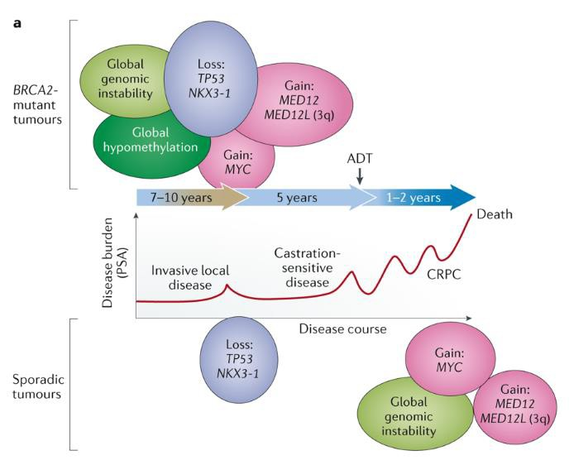
The influence of BRCA2 mutation on localized prostate
cancer.
Taylor A, Bristow R, Risbridger G, Nature Reviews Urology
Feb 2019

Slide 17

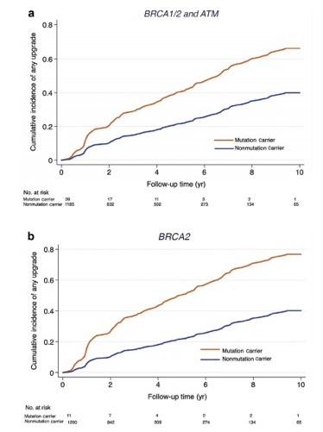
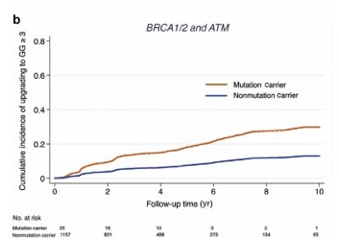
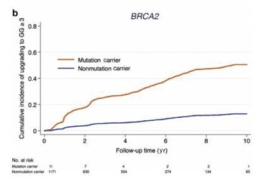
Germline Mutations in Men on Active Surveillance
Carter HB, Eur Urol. 2019 May;75(5):743-749
1211 men on active surveillance
26 with DNA repair germline mutations (BRCA1/2, ATM)
Any upgrading Upgrading to ≥ GG3
HR 2.0
HR 2.7

Slide 18

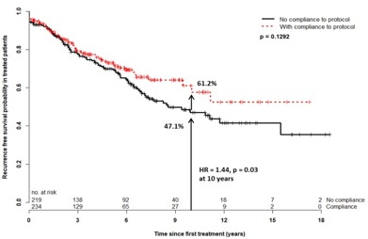
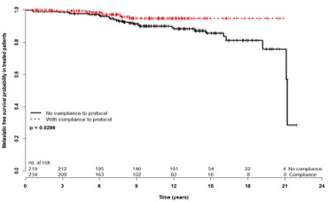
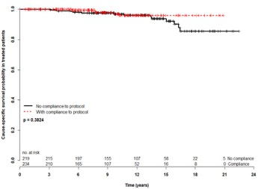
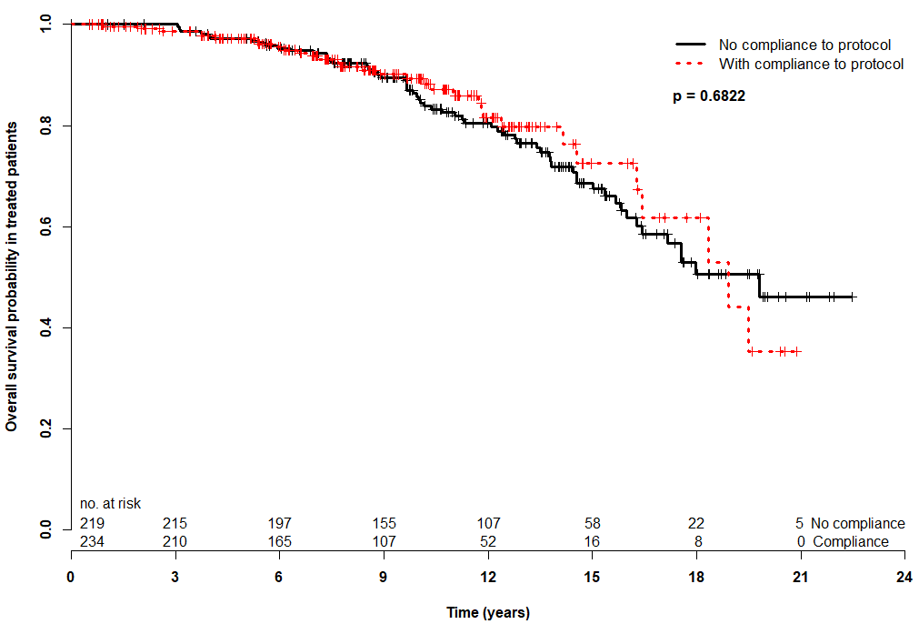
Impact of Biopsy Compliance on Outcomes for Patients on Active Surveillance
Detsky J, Klotz L et al J Urol April 2020
..
RFS
MFS
CCS
OS

Slide 19

Imaging and AS

Slide 20




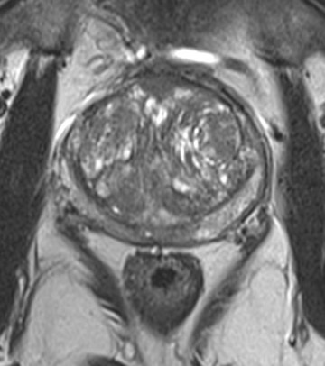
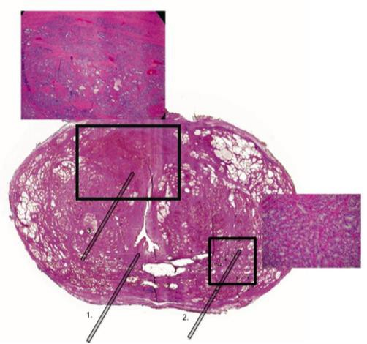
MRI targeting: Gleason 4+3 after prior biopsy showed 1 pos core 10% Gleason 3+3
Gl 4+3
Gl 3+3

Slide 21

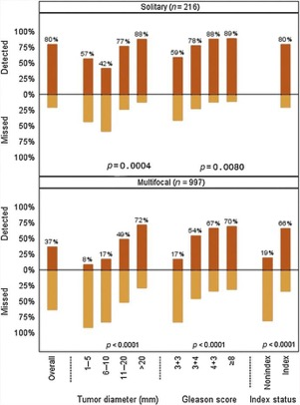
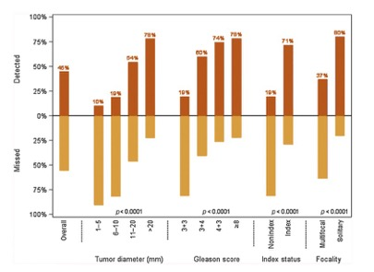
Detection of Individual Prostate Cancer Foci via MRI
Johnson D, Reiter R, Euro Urol 2019; 75: 712–720
588 men with intermediate-high-risk CaP having MRI and RP with whole mount path
MRI missed 40% of GG2 Ca, 26% of GG3, and ≥ 1 focus in GG ≥ 2 Ca
Overall Ca detection rates
Detection rates by focality
11/14/2021

Slide 22
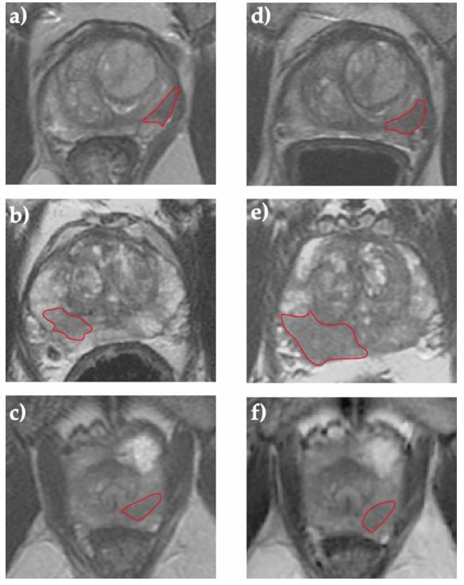
Stable 3+3 path, MRI stable
Grade progression (3+4) and MRI progression
Grade progression
(3+4), stable MRI

Slide 23
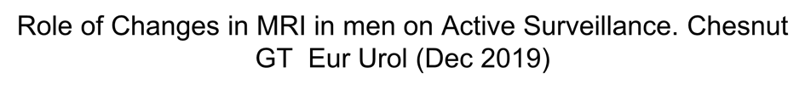
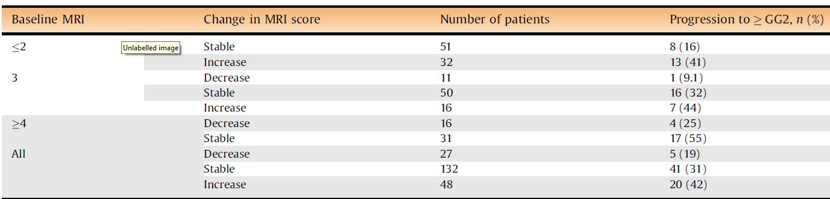
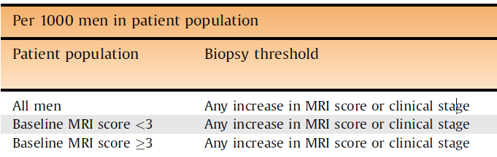
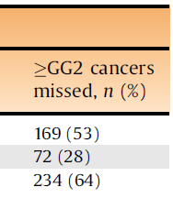
Role of Changes in MRI in men on Active Surveillance. Chesnut GT Eur Urol (Dec 2019)
207 men on AS with serial MRI and 3 year Bx
MRI progression did not correlate with upgrading
31% of men with stable MRI upgraded to ≥ GG2

Slide 24

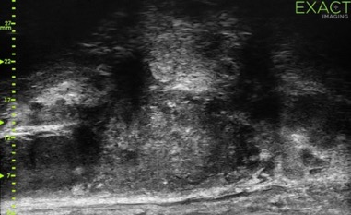
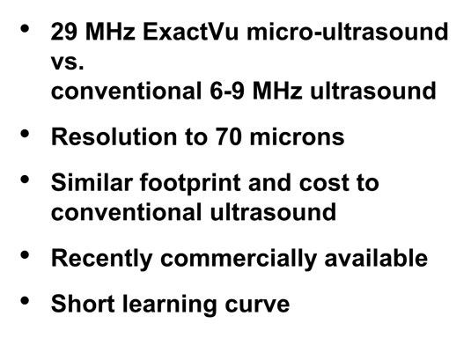



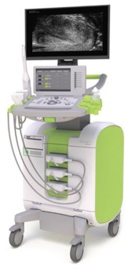
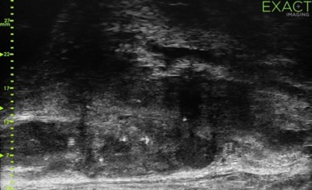

High Resolution Micro-Ultrasound
29 MHz ExactVu micro-ultrasound
vs.
conventional 6-9 MHz ultrasound
Resolution to 70 microns
Similar footprint and cost to
conventional ultrasound
Recently commercially available
Short learning curve

Slide 25
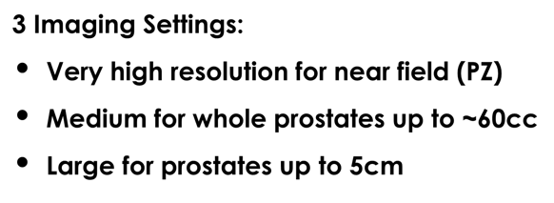
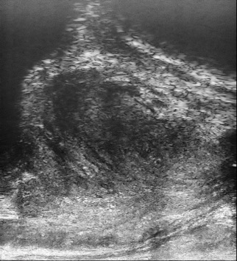

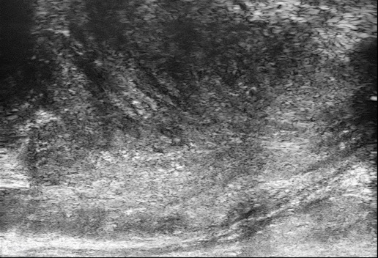

Micro-Ultrasound vs. Conventional Ultrasound
3 Imaging Settings:
Very high resolution for near field (PZ)
Medium for whole prostates up to ~60cc
Large for prostates up to 5cm
‘Large’ – 50mm View
High resolution

Slide 26
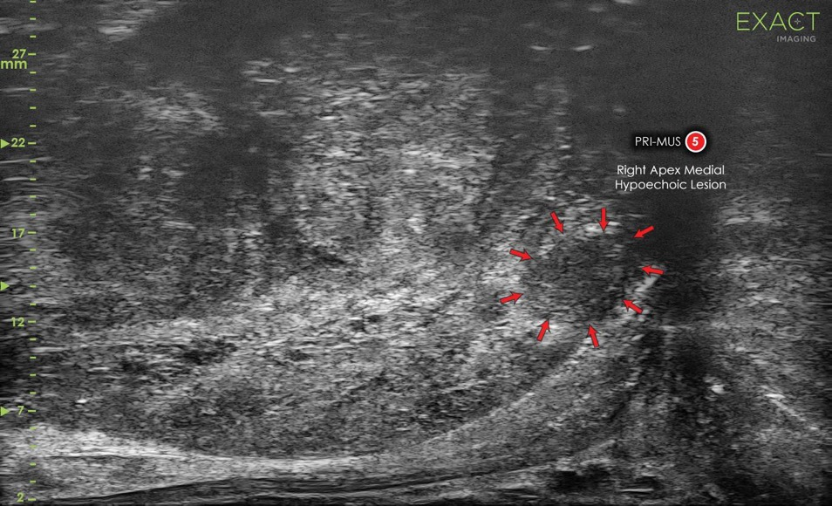


Slide 27
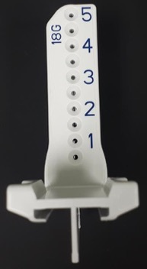
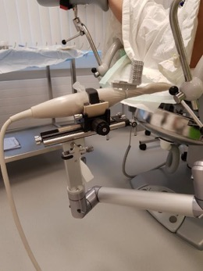
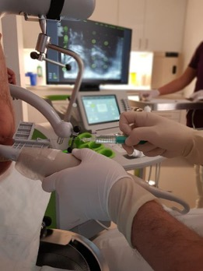
Trans-Perineal Biopsy
Trans-Perineal Guide
Stepper arm
Freehand

Slide 28

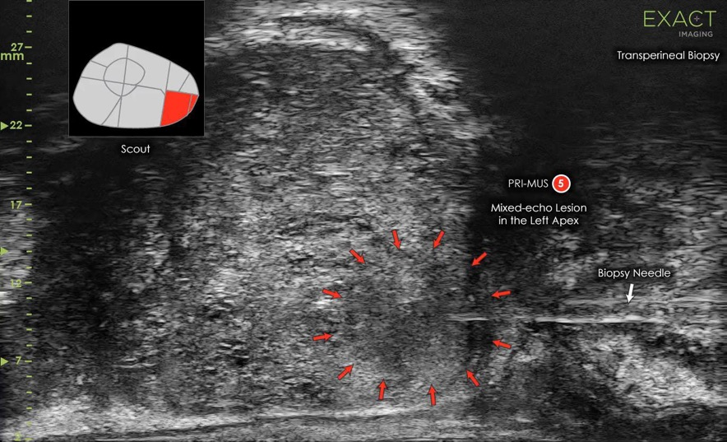
Transperineal approach
Mixed-echo, smudgy, lesion at posterior apex. Identified and targeted with fusion--Gleason 8 (4+4)

Slide 29

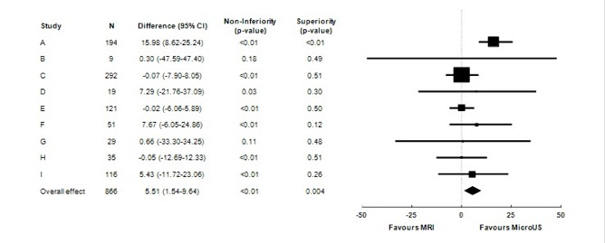
Sensitivity/specificity of MRI vs micro-U/S: Initial experience from 9 centres
11/14/2021

Slide 30

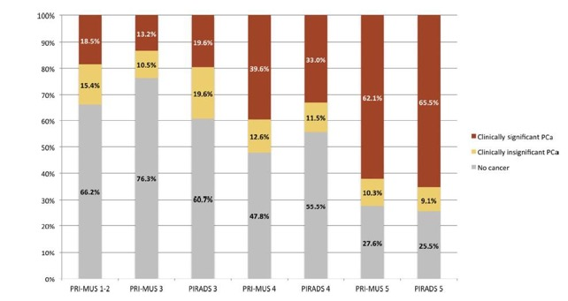
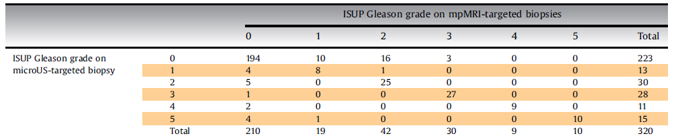
Diagnostic Accuracy of Micro-U/S in Patients with a
Suspicious MRI.
Lughezzani G. European Urology Focus, Sept 2020
N=320
Pirads >=3
U/S annotated blinded to MRI
Systematic and targeted biopsies

Slide 31

Transrectal vs transperineal Bx
 | Trans-rectal | Trans-perineal
Risk of sepsis | +++ | +
Risk of bleeding | +++ | +
Risk of retention | + | +++
Risk of death | + (.01-0.1%) | 0
General anesthesia | 0 | ++
Ease of Targeting | +++ | +
Sensitivity | +++ | +++
Specificity | ++ | ++
Equipment | ++ | +++
Template | 0 | +++

Slide 32

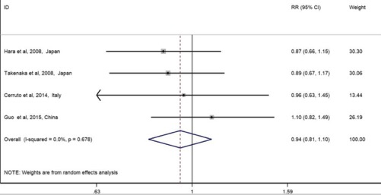
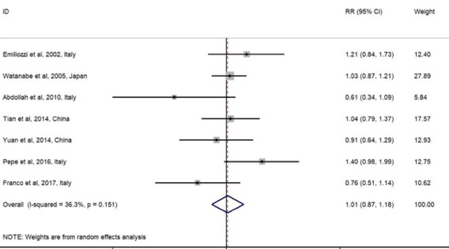
Diagnosis rate, TP vs TR approach. Xiang J, World J Surg Oncol. 2019 Feb 13;17(1):31
RCTs
Observational studies

Slide 33


Norway: Roar Gulbrandsen, 68, died a few days after a TRUS Bx
Wife and daughter created a public campaign to end TRUS Bx
Public enraged
Adoption of trans- perineal biopsy in Norway rapidly and universally adopted

Slide 34


AS for Intermediate risk disease
Many GG2 cancers (3+4) are indolent
But not all—Sunnybrook experience was 30% had metastases at 15 years (too high)
Key predictor is the percentage of pattern 4 (real cancer)
If ≤ 5% pattern 4, treat like GG1 (Surveillance)
If > 5%, consider AS based on patient age, general health status
This is the sweet spot for molecular markers
Focal therapy an appealing option in these patients

Slide 35


Liquid biomarkers: analytes and profiling options

Slide 36
Biomarker tests for significant prostate cancer
Test | Utility | Biomarker | Source | Provider, Cost | AUC for GG ≥ 2
PHI | Detection of aggressive Ca | Total PSA, fPSA, p2PSA | Blood | Bechman Coulter. $500 | 0.815
4K score | Agg Dis and risk of mets | Total, free, intact PSA, KLK2 | Blood | OPKO Labs $1900 | 0.82
Mi Prostate Score (MiPS) | Repeat Bx, risk of high grade dis | PCA3, TMPRSS2-ERG, KLK3 | Urine | Mlabs $783 | 0.77
Select MDx | Risk of high grade Ca | HOXC6, DLX1, KLK3 | Urine | MDxHealth $500 | 0.90
ExoDx | High vs low grade vs benign | PCA3, ERG, SPDEF | Urine | Exosome Diagnostics | 0.73
Promark | Adverse path | 8 proteins | Patented Bx kit | Metamark $3900
Oncotype Dx | AS vs Rad Rx | 12 Ca genes, 4 pathways | Tissue | Genomic Health. $4500 | 0.72 (adverse pathology)
Prolaris | Risk of Dis progression | 31 cell cycle genes | Biopsy or RP tissue | Myriad Genetic $3900 | 0.664 (bNED prediction)
Decipher | Post RP risk, AS | 22 Pca RNA markers | Biopsy or RP tissue | Decipher BioSc $5150. | 0.81 (10 yr mets)

Slide 37


Other serum/urine tests for Pca risk stratification
PCA3 (urine)
Telo PC (CTC Telomere assay)
Mito PC (serum based mitochondrial deletion assay)
Urinary exosome Micro-RNA assay (Exosome Dx, Sentinel assay)
Free DNA assay (serum)
Etc……

Slide 38


Multifocal Primary Prostate Cancer Exhibits High Degree of Genomic Heterogeneity Løvf M, Eur Urol. 2018 Sep 1.
N=41 patients
High-coverage whole-exome sequencing of 153 samples
two to three distinct tumor foci and one non-cancerous area
Grey: unique mutation/alteration
Orange: common mutation

Slide 39



17-Gene Genomic Test Results in the Canary PASS Cohort. Lin DW J Clin Oncol. 2020 Mar 4:JCO
432 men on active surveillance; 39% upgraded
No association with GPS and upgrading.
Adding GPS to PSAD and diagnostic GG did not improve stratification of risk for adverse pathology

Slide 40


The miRScientific Exosome miRNA platform
Analysis of urinary exosome small non-coding (nc) RNAs
Genome wide array of 6600 exosomal small ncRNAs
evaluated for independent prognostic value
442 miRNA sequences individually selected for predictive value
Interrogation platform developed for each indication
Presence or absence of cancer
GG1 vs GG ≥ 2
GG1-2 vs GG ≥ 3
Initial discovery cohort and several validation cohorts.

Slide 41


Urinary microvesicles by EM
Limiting membrane and unstructured matrix
500 nm
Exosomal surface markerCD63
100 nm

Slide 42


Expression of Small Non-coding RNAs in Urinary Exosomes Classifies Prostate Cancer into Indolent and Aggressive
Disease. Wang WW, Klotz L, Tenniswood M.
J Urol. 2020 Mar 19
Any Pca
GG ≥2 PCa

Slide 43


Dynamic risk profiling using serial biomarkers for personalized
outcome prediction:
Kurtz DM et al, Cell. 2019 Jul 25;178(3):699-713
Continuous Individualized Risk Index (CIRI)… dynamically determines outcome probabilities for individual patients utilizing risk predictors acquired over time.
Provides a real-time probability by integrating risk assessments throughout a patient’s course

Slide 44









Data integration and AI in active surveillance
Personal & Life Style
PSA (Blood Test)
Biopsy
mpMRI
Genetics / Genomics
Germ line and Somatic
Diet, Fitness
Urine Tests
PSMA-PET Imaging

Slide 45


Can we prevent ’failure’ by innocuous interventions?
Why:
Patients like to feel they are ‘doing something’
Most proposed interventions have other health benefits
Opportunity to improve diet, lifestyle
Perhaps reduce biological progression

Slide 46



Simple heart/prostate healthy advice for patients on AS
Stop smoking
Regular exercise
Dietary modification: weight management, moderate red meat intake, increase fruits/vegetables
Galvão, D. A. et al. Enhancing active surveillance of prostate cancer: the potential of exercise medicine Nat. Rev. Urol. 2016

Slide 47



Effects of Intense Exercise on Cardiorespiratory Fitness and Biochemical Progression in Men on Active Surveillance:
The ERASE Trial.
Kang D et al, JAMA Oncology Aug 2021
52 men on AS, mean age 63, randomized between high intensity interval training (HIIT) x 12 wks vs usual care.
HIIT increased cardiorespiratory fitness levels and decreased PSA

Slide 48


Obesity and the Tumor Immune Microenvironment.
Rathmell J, NEJM 2021;384:1160-1162
Metabolic single-cell atlas of the tumor immune landscape induced by obesity
Obesity induces a metabolic tug of war between tumor and T cells for lipids--tumor cells increase fat uptake; tumor- infiltrating CD8⁺ T cells do not
This leads to altered fatty acid partitioning in HFD tumors, impairing
CD8⁺ T cell infiltration and
function.

Slide 49


Effect of a Behavioral Intervention to Increase Vegetable Consumption on Cancer Progression Among Men With GG1
PCa: The MEAL Randomized Clinical Trial
JAMA. 2020;323(2):140-148
Parsons JK et al,

Slide 50


The MEAL Randomized Clinical Trial
Parsons JK et al, JAMA.
2020;323(2):140-148
.
.

Slide 51


For men who want to be very proactive
Vit D 1000-1500 IU/day (especially northern countries)
Low dose statin (eg, Atorvastatin 10 mgday)
Metformin 500-850 mg/day
NB: The evidence for these recommendations is inferential; there are no published controlled trials in the AS setting
.

Slide 52

For men who want to be very proactive
Vit D 1000-1500 IU/day (especially northern countries)
Pca mortality by Vit D level
Circulating vitamin D level and mortality in PCa: a meta- analysis.
Song ZY Endocr Connect. 2018 Dec 1;7(12):R294-R303.

Slide 53



Statin use and Pca risk Raval AD, Prostate Cancer Prostatic Dis. 2016 Jun;19(2):151-62
Low dose statin (eg, Atorvastatin 10 mgday)
.

Slide 54


For men who want to be very proactive
The anticancer potential of metformin on prostate cancer HK Ahn, Int J Mol Sci. 2020 Nov; 21(22): 8540
Metformin 500-850 mg/day
.

Slide 55



The effect of metformin in prostate cancer: A systematic review and meta-analysis Kancheng He, Sci Rep. 2019; 9: 2218.
30 cohort studies,
N=1,660,795
Improved OS (HR 0.72); CSS (HR 0.88), RFS (HR 0.60), P values ~ 0.001
RFS
CSS

Slide 56
Variation in the Use of AS for Low-Risk PCa Across US. Al
Hussein Al Awamlh B, Shoag JE.Front Oncol. 2021 May 19;11:644885.
Between 2010 and 2016, the proportion with low risk Pca managed with AS increased from 20.8% to 55.9% in the West, 11.5% to 50.0% in Northeast, 9.9% to 43.4% in the South and 15.1% to 56.2% in Midwest

Slide 57


AS current management protocol
Initial diagnosis based on 12 core biopsy +/- targeted
MRI within first year (> 3 months after biopsy)
PSA q 6 months
DRE: 1/yr but little value
Confirmatory biopsy within 1 year
With microfocal disease, low PSA density and negative
MRI, defer to year 3 (Etzioni R et al 2019)
MRI q 2-3 years, targeted biopsy if any change/ROI
Repeat systematic biopsy q 4-5 years if stable
Intervention for grade progression (clinical judgment)
Emerging: Dynamic risk profiling with accurate biomarkers will replace most serial biopsies

