Slide 1
Use of Genomics to Guide Treatment Decisions in Post-Prostatectomy Patients
Ashley E Ross, MD, PhD
Associate Professor of Urology
Northwestern University, Feinberg School of Medicine

Slide 2
Key Points
Genomics are independently prognostic and potentially predictive
  Decipher Genomic Classifier (GC)
Men with >1 risk factor can consider ADJUVANT Radiation: pT3b/T4, pN1, GG4-5, GC>0.6
Men with GC<0.45 receiving EARLY SALVAGE Radiation should strongly consider OMISSION of ADT

Slide 3
Overview
Review of prostate cancer genomics / the GC score
Review of recent clinical trials comparing adjuvant and early salvage radiation post-prostatectomy
Discuss role of genomics in guiding treatment decisions post prostatectomy
  Adjuvant vs Salvage
  Salvage +/- ADT

Slide 4
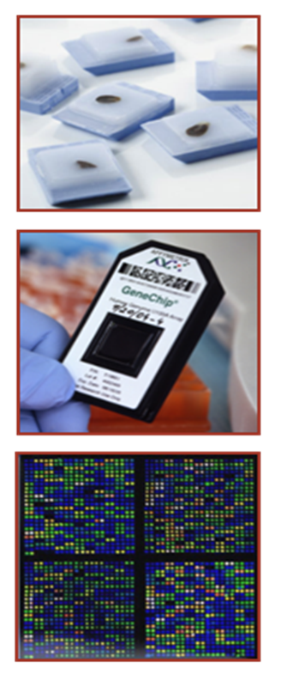
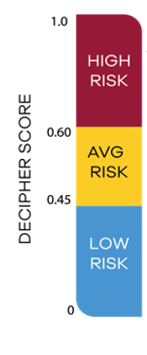
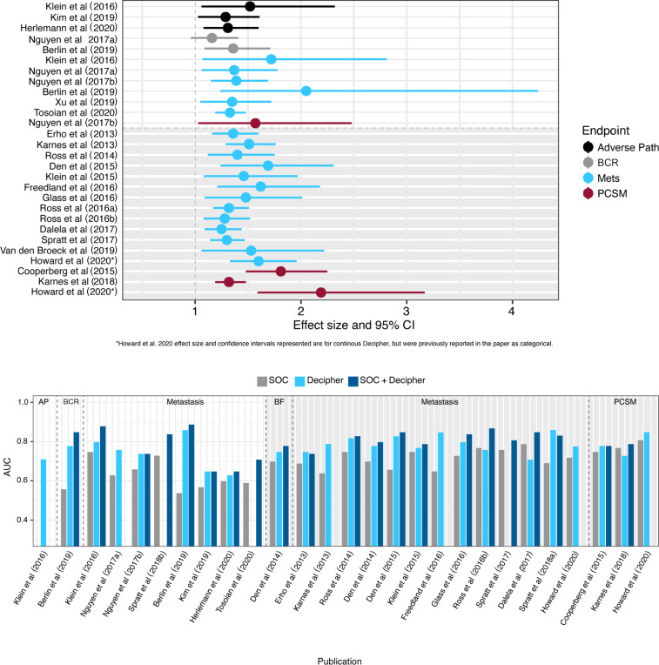
Prostate Cancer Genomic Classifier
Genome wide RNA array performed on FFPE tissue
Genomic Classifier (GC)–
  22 genes representing multiple oncologic pathways
  Heavily validated, independently prognostic of oncological outcomes
  0-1 score (continuous risk)
Other signatures in various stages of development
Widely available for clinical use
Jairath et al. A systematic review of the evidence for the Decipher genomic classifier in prostate cancer. Eur Urol. 2020 Dec 5; online ahead of print

Slide 5
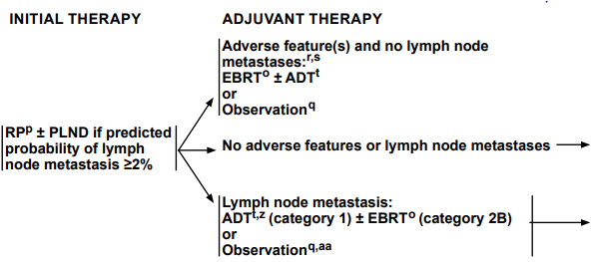
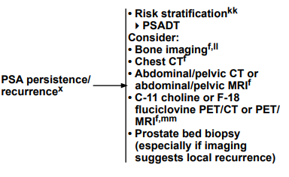


Post Prostatectomy Workflow
NCCN Guidelines. Prostate Cancer v3.2020. PROS-3 thru 7, 11

Slide 6
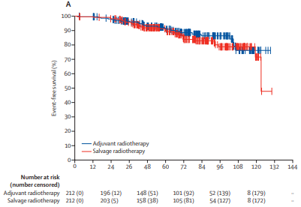
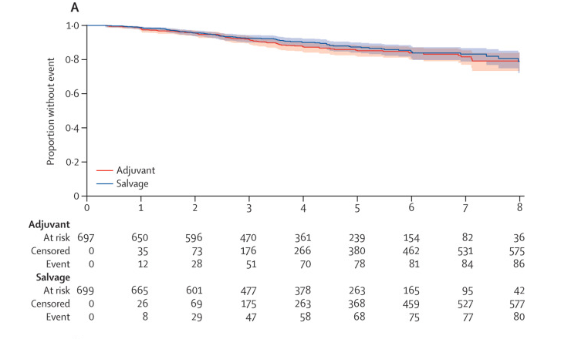
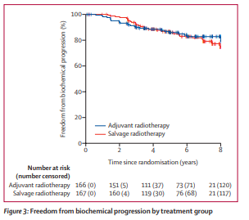
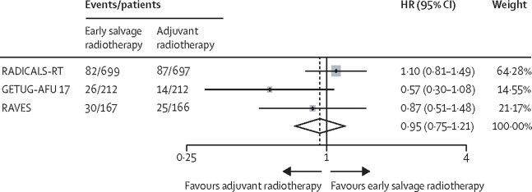
Adjuvant vs Early Salvage Radiation
RADICALS-RT
GETUG-AFU 17
RAVES
PSA<0.2 and any: pT3, R1, GG2-5, pre-op PSA >10
PSA<0.1,R1 and >pT3
PSA<0.1 and pT3 or R1
Adjuvant RT+/-ADT
Deferred RT+/-ADT
Adjuvant RT+sADT
Deferred RT+sADT
Adjuvant RT
Deferred RT
Sargos et al. Adjuvant radiotherapy versus early salvage radiotherapy plus short-term androgen deprivation therapy in men with localized prostate cancer after radical prostatectomy (GETUG-AFU 17): a randomized, phase 3 trial. Lancet Oncol. 2020; 21: 1341-1352.
Kneebone, et al. Adjuvant radiotherapy versus early salvage radiotherapy following radical prostatectomy (TROG08.08/ANZUP RAVES): a randomized, controlled, phase 3, non-inferiority trial. Lancet Oncol. 2020; 21: 1331-1340.
HR 0.8 [CI 0.5-1.4]
HR 1.1 [CI 0.8-1.5]
HR 1.1 [CI 0.7-1.9]
Parker et al. Timing of radiotherapy after radical prostatectomy (RADICALS-RT): a randomized, controlled phase 3 trial. The Lancet 2020; 396. 1413-1421.
Vale et al. Adjuvant or early salvage radiotherapy for the treatment of localized and locally advanced prostate cancer: a prospectively planned systematic review and meta-analysis of aggregate data. The Lance 2020; 396(10260): 1422-1431.

Slide 7
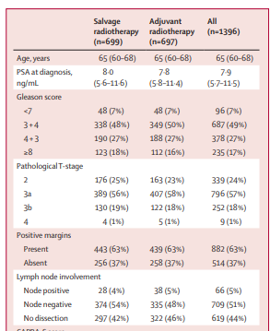
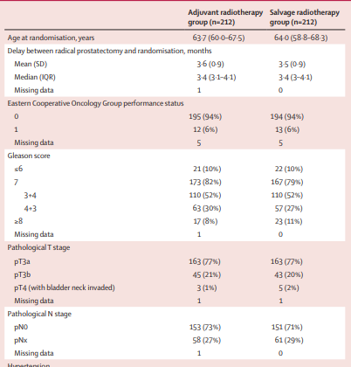
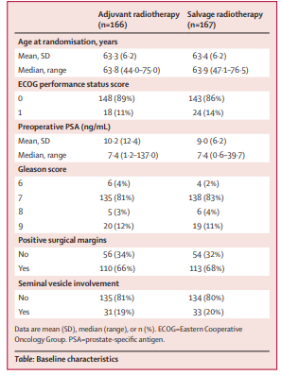
Adjuvant vs Early Salvage Radiation
RADICALS-RT
GETUG-AFU 17
RAVES
Early salvage radiatoin should be favored among men with pT2R1 or pT3a, GG1-3 disease
Sachdev et al. Assessment of postprostatectomy radiotherapy as adjuvant or salvage therapy in patients with prostate cancer. JAMA Onc 2020; 6(11): 1793-1800.
Tilki and D’Amico. Timing of radiotherapy after radical prostatectomy. The Lancet. 396 (10260): 1374-1375.

Slide 8
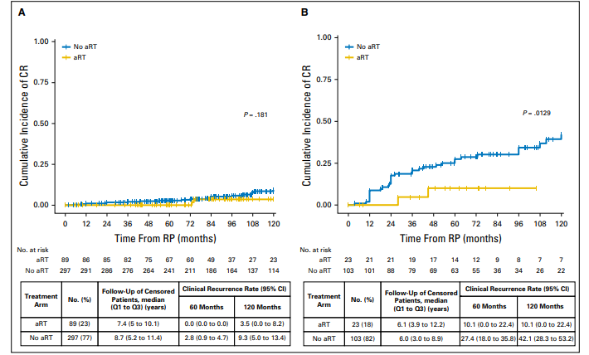
Risk Factors and Adjuvant Radiation
Retrospective, multi-institutional study
  512 men with APF p RP and GC scores
  8.3yr median f/u
Independent Predictors of Clinical Recurrence (mets, biopsy proven recurrence)
  pT3b/T4
  pN1
  GG4-5
  GC >0.6
If >1 Risk Factor: NNT =3 to prevent CR @ 10 yr
0-1 Risk Factor
>1 Risk Factor
Dalela et al. Genomic Classifier Augments the Role of Pathological Features in Identifying Optimal Candidates for Adjuvant Radiation Therapy in Patients with Prostate Cancer: Development and Internal Validation of a Multivariable Prognostic Model. JCO 2017, 35(18) 1982-1990.

Slide 9
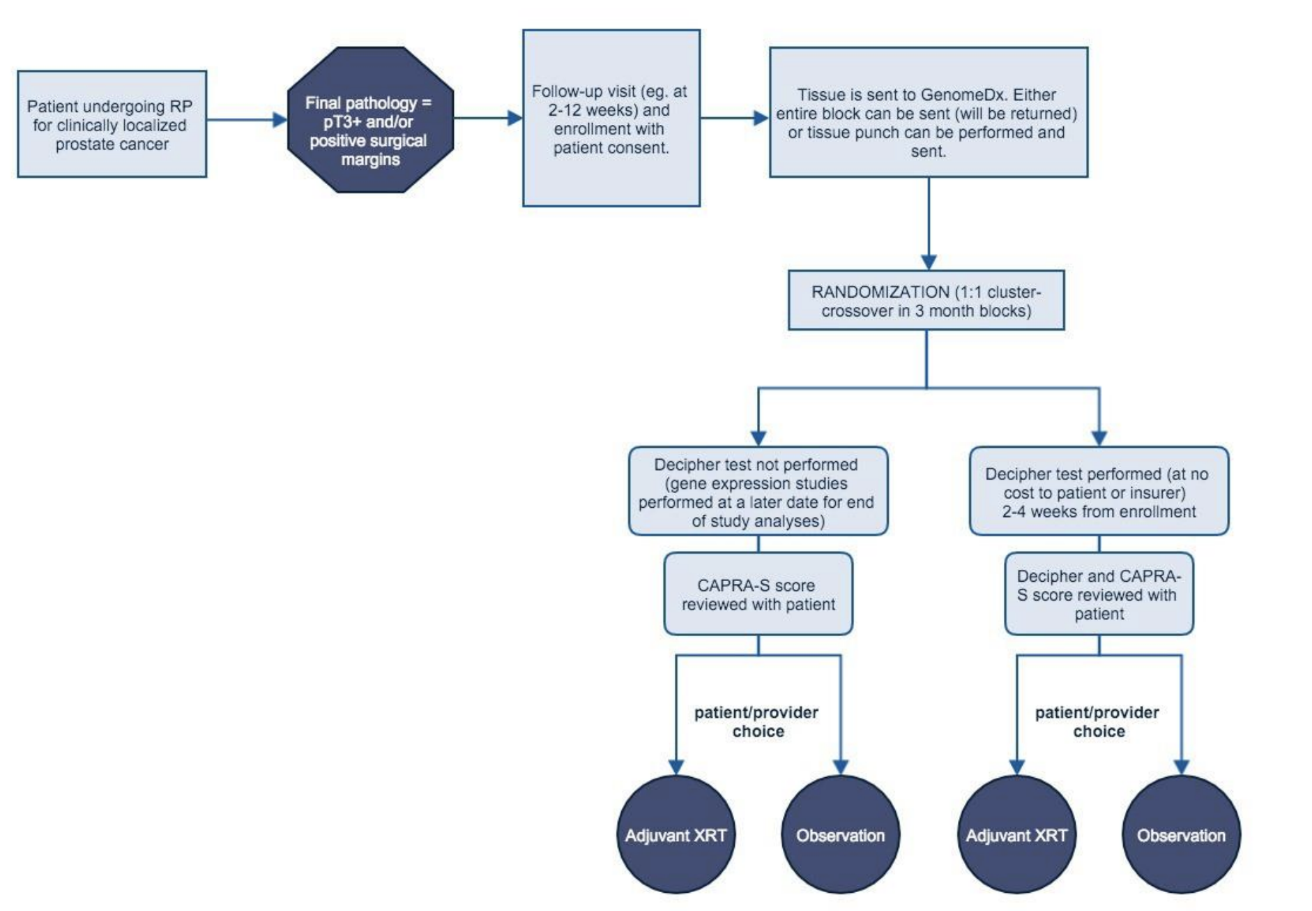
Next Steps: Ongoing Adjuvant Trials
MUSIC: Genomics in Michigan Impacting Observation or Radiation (G-MINOR), Study Chairs: Todd Morgan MD, Michael Cher MD

Slide 10
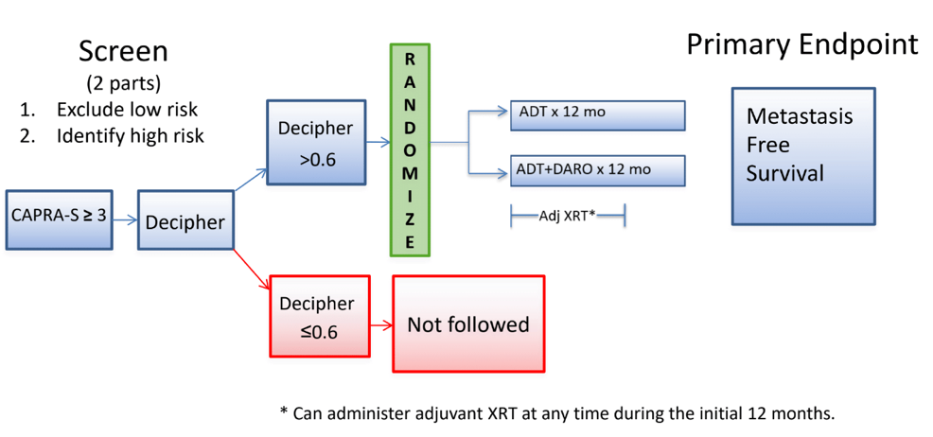
Next Steps: Ongoing Adjuvant Trials
ECOG-ACRIN: A Phase III Double Blinded Study of Early Intervention after RADICAl ProstaTEctomy with Androgen Deprivation Therapy with Darolutamide vs. Placebo in Men at Highest Risk of Prostate Cancer Metastasis by Genomic Stratification (ERADICATE) , Study Chair: Alicia Morgans MD MPH

Slide 11
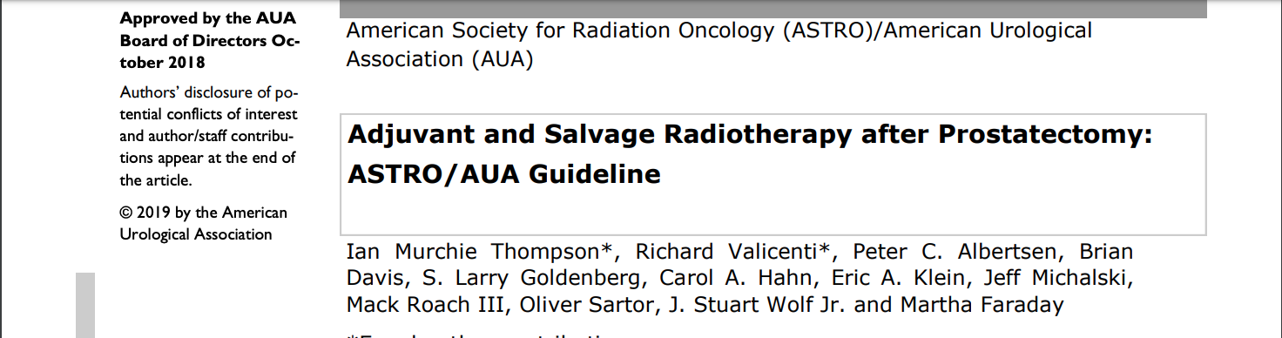
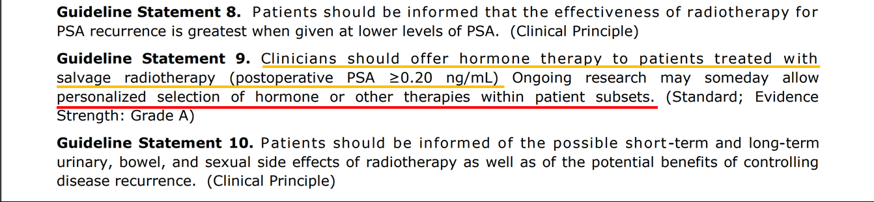
Salvage Radiotherapy After Prostatectomy

Slide 12
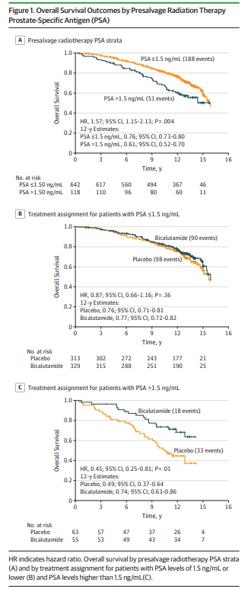
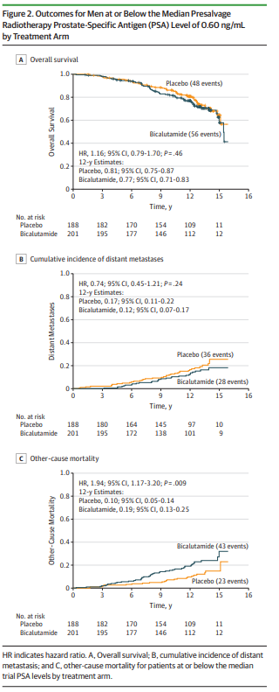
Salvage Radiotherapy:
Should Hormonal Therapy be Used?
OS
Secondary analysis of RTOG 9601 (sRT +/- 2yr bicalutamide)
  OS benefit only significant in men with PSA > 1.5ng/ml
  OCM significantly increased in men with PSA < 0.6 ng/ml
GETUG-AFU 16
  sRT + 6m ADT significantly improves MFS at but not OS with 10 year median f/u (HR 0.73 CI 0.54-0.98), log rank p=0.034
DM
Dess et al. Association of presalvage radiotherapy PSA levels after prostatectomy with outcomes of long-term anti-androgen therapy in men with prostate cancer. JAMA Oncol. 2020;6(5):735-743.
Carrie, et al. Short-term androgen deprivation therapy combined with radiotherapy as salvage treatment after radical prostatectomy for prostate cancer (GETUG-AFU 16): a 112-mo follow up of a phase 3, randomized trial. Lancet Oncol. 2019 Vol 20(12): 1740-1749.
OCM

Slide 13
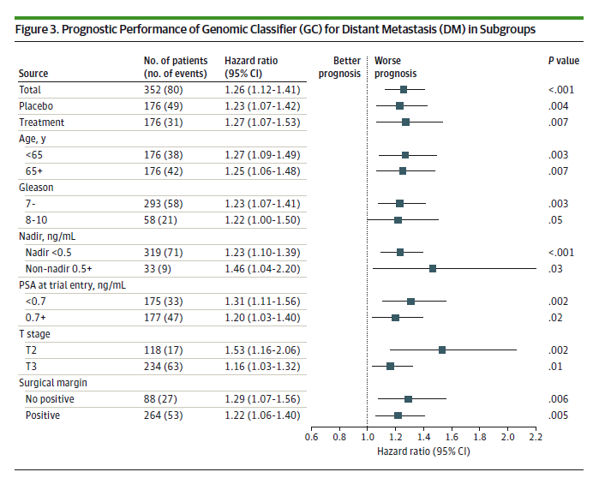
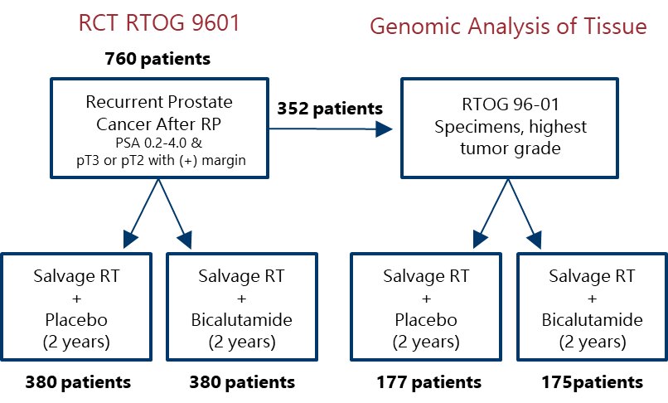
Salvage Radiation +/- Hormonal Therapy: Use of Genomics
Feng et al. Validation of a 22-gene genomic classifier in recurrent prostate cancer, an ancillary study of the NRG/RTOG 9601 randomized clinical trial. JAMA Oncol 2021. Feb Online.

Slide 14
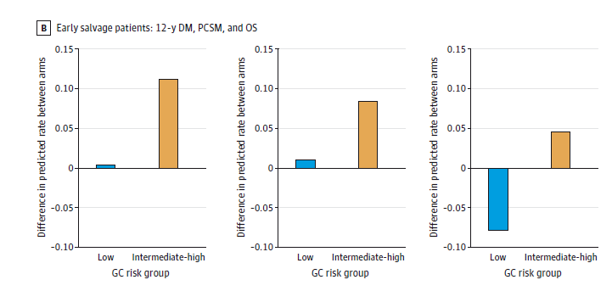
Salvage Radiation +/- Hormonal Therapy: Use of Genomics
PSA <0.7ng/ml at sRT
DM
PCSM
OS
Men with GC<0.45 have minimal oncologic benefit
Men with GC<0.45 harmed by hormonal therapy
Feng et al. Validation of a 22-gene genomic classifier in recurrent prostate cancer, an ancillary study of the NRG/RTOG 9601 randomized clinical trial. JAMA Oncol 2021. Feb Online.

Slide 15
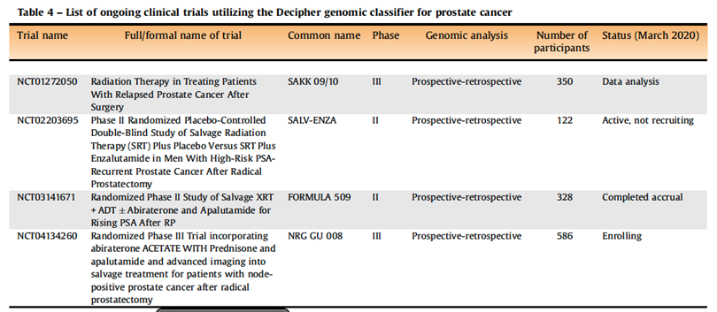
Next Steps: Salvage Trials
Jairath et al. A systematic review of the evidence for the Decipher genomic classifier in prostate cancer. Eur Urol. 2020 Dec 5; online ahead of print

Slide 16
Take-Away Points
The 22-Gene GC is independently prognostic of oncological outcomes post-prostatectomy
Men with >1 risk factor can consider ADJUVANT Radiation: pT3b/T4, pN1, GG4-5, GC>0.6(Hi)
Men with GC<0.45(Low) receiving EARLY SALVAGE Radiation should strongly consider OMISSION of ADT

