Slide 1



NASPCC Webinar Series Presents
TheraP/VISION Trial on
Lutetium-PSMA
Professor Michael Hofman, MBBS, FRACP, FAANMS, FICIS
Director, Prostate Cancer Theranostic and Imaging Centre of Excellence (ProsTIC)
Molecular Imaging & Therapeutic Nuclear Medicine, Centre for Cancer Imaging
Peter MacCallum Cancer Centre / The University of Melbourne
@DrMHofman michael.hofman@petermac.org
Notes:
What is the story?
PSMA journey: from NET, Ga-68 to PSMA
PSMA: remarkable bench-to-bedside. 2013
Collaboration
Future

Slide 2
Disclosures
Research Support | Endocyte and AAA (Novartis company) ANSTO
Consulting | MSD
Honoraria/travel support | Astellas, Astra Zeneca, Mundipharma, Janssen
Stock ownership | None
Grants | Prostate Cancer Foundation Movember Prostate Cancer Foundation of Australia U.S. Department of Defence Victoria Cancer Agency

Slide 3
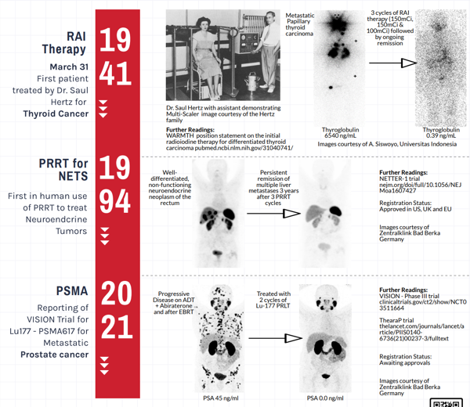


Slide 4
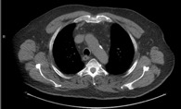

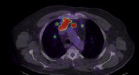
“My new research project is in cancer of the thyroid which I believe holds the key to the larger problem of cancer in general.“
- Saul Hertz 1946
?1mm
Iodine-124 PET/CT
SUVmax=430
Notes:
Saul Hertz had to treat “blindly” based on first-principals. He could use a gamma counter but this type of imaging was not available.
SUV 2000 !

Slide 5
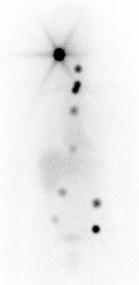
Curing Cancer since the 1940s
¹²⁴I PET/CT
7.4 GBq ¹³¹I
+6 months
25 SUV

Slide 7
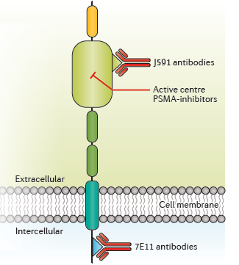
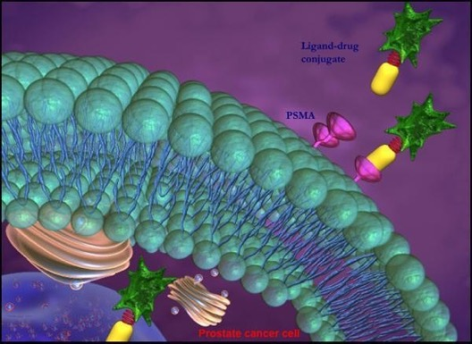

Prostate Specific Membrane Antigen (PSMA)
Image from Maurer T et al. Nat Rev Urol, 2016 Apr;13(4):226-35
⁶⁸Ga
HBED
PSMA
PSMA receptor
⁶⁸Ga-PSMA-11
¹⁸F-DCFPyL
¹⁸F-PSMA-1007
↑PSMA expression
higher grade tumours
metastatic disease
castration resistant
Prostate cancer cell
¹¹¹In-capromab (Prostascint®)
Notes:
PSMA – protein found on membrane of 90% of prostate Ca
Internalised into cells via endocytosis
PSMA-binding RNA aptamers: drug delivery vehicles

Slide 8
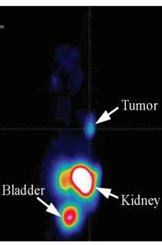
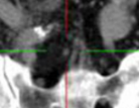
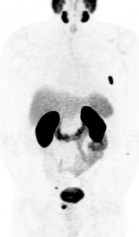
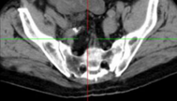
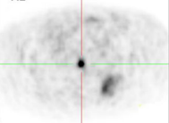
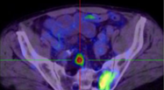



2012
2013
2014
Eder et al,
Bioconjug Chem. 2012
doi: 10.1021/bc200279b
Afshar-Oromieh et al,
Eur J Nucl Med Mol Imaging. 2013
doi: 10.1007/s00259-012-2298-2
1st patient imaged
at Peter Mac

Slide 9
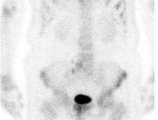
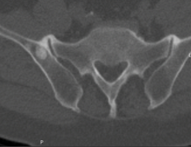
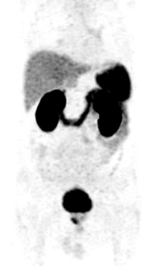
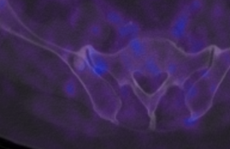
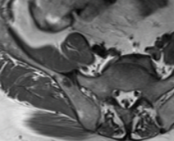

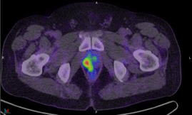
PSMA PET: very specific
Conventional staging: M1 on 3 modalities
⁶⁸Ga-PSMA PET: M0
no uptake in sclerotic lesion
intense uptake in prostate 1°
Gleason 5 + 4 = 9, staging
Patient proceeded to prostatectomy with undetectable PSA on follow-up
Notes:
101160871

Slide 10
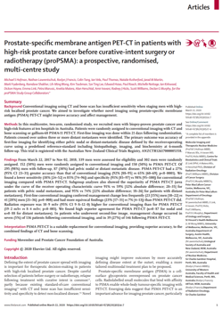


ProPSMA in The Lancet
March 2020

Slide 11
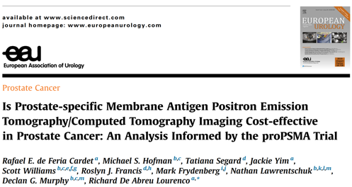

Slide 12
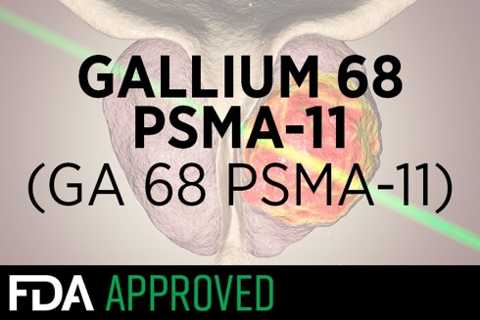

FDA Approval “Game Changing” Radiotracer
¹⁸F-DCFPyL
‘Game changer’ is almost an understatement for how prostate cancer patient care could be improved by this technique.
Dr. Jonathan W. Simons, CEO of the Prostate Cancer Foundation

Slide 13
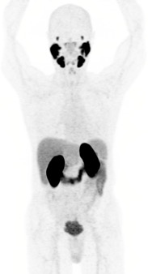
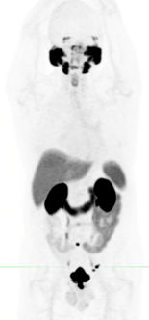
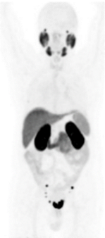
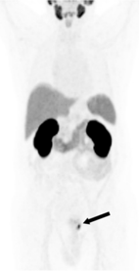
Library of PSMA PET radiotracers now available
Hofman MS, Iravani A et al, Urol Clin N Am 2018
https://doi.org/10.1016/j.ucl.2018.03.016
⁶⁸Ga-PSMA11
(HBED-CC)
¹⁸F-DCFPyL
(F-PSR)
¹⁸F-PSMA
-1007
¹⁸F-rhPSMA
-7
Notes:
Ga-68: onsite, ondemand, need infrastructure. Low radiation.
F-18: distribution, delayed imaging
More to come

Slide 14
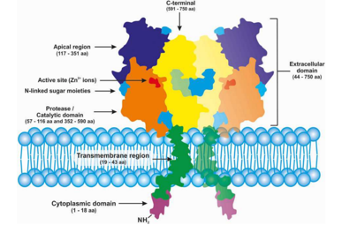
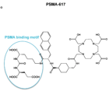
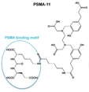
radioactive small molecule targeting prostate specific membrane antigen (PSMA) highly over-expressed in prostate cancer
TheranosticS
targeted therapeutic + diagnostic companion
¹⁷⁷Lu-PSMA-617 SPECT
⁶⁸Ga-PSMA-11 PET
Post-therapy
SPECT/CT
Pre-therapy
PET/CT
O’Driscott C et al, Br J Pharm 2016
doi:10.1111/bph.13576

Slide 15
Therapeutic Nuclear Medicine
Beta Auger electron Alpha
*LET: linear energy transfer (energy transferred to material as ionising particle travels through it)
Pouget JP et al, Nature Review Clinical Oncology 2011, 8

Slide 16
Lutetium-177 (¹⁷⁷Lu): short path-length beta emitter
Radionuclide | T½ | Targeting agent | Target | Type | Maximum Energy | Mean Energy | Avg. penetration
Radium-223 | 11.4 | None | bone | Alpha | 28 | 6.9 | <0.1 mm
Strontium-89 | 50.5 | None |  | Beta | 1.5 | 0.6 | 2.4 mm
Samarium-153 | 1.9 | EDTMP |  | Beta | 0.8 | 0.2 | 0.5 mm
Lutetium-177 | 6.7 | PSMA-617 | tumour | Beta | 0.5 | 0.14 | 0.3 mm

Slide 17
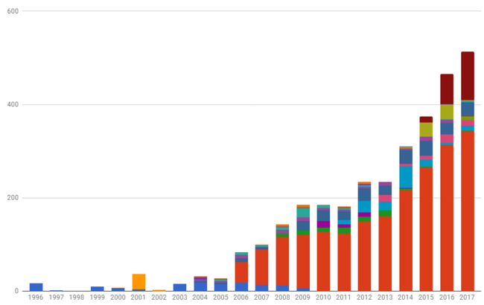
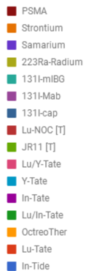
⁶⁸Ga/¹⁷⁷Lu Theranostics @ Peter Mac
No of therapies per year
600
¹⁷⁷Lu-PSMA
1st PSMA therapy in Australia
400
⁶⁸Ga-PSMA
⁶⁸Ga-DOTATATE
200
¹⁷⁷Lu-DOTATATE
0
Gastro-entero-pancreatic Neuroendocrine Tumours
Prostate
Notes:
Take you on my journey…
In the spirit of a joint session with ESMO, I want to provide an oncologic perspective

Slide 18
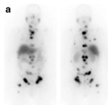
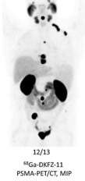
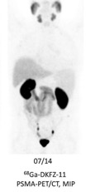
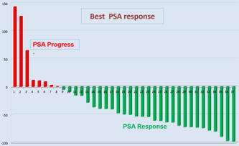
PRLT evidence starts mounting: MIP-1095, I&T, PSMA-617…
Serial ¹²⁴I-MIP-1095 PET
¹³¹I-MIP-1095
Zechmann CM et al, Eur J Nucl Med Mol Imaging 2014, 14:1280-1929
Best PSA Response in 37 patients
2 cycles
¹⁷⁷Lu-PSMA617
Baum R et al, 3rd World Congress in Theranostics,
John Hopkins Medical Centre, USA, March 2015
Kratochwil et al, Eur J Nucl Med Mol Imaging 2015. May;42(6):987-8
Notes:
J. Babich Cornell
U. Haberkorn DKFZ

Slide 19
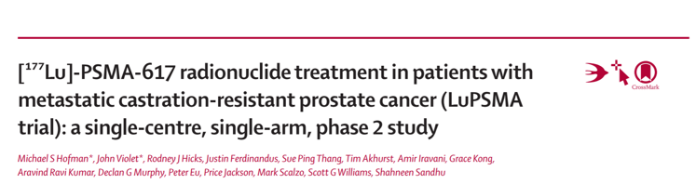


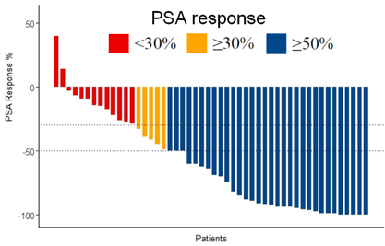
PSMA Therapy: First Prospective Study
PSA Response (%)
64%
Updated results of n=50 cohort:
Violet J, …, Hofman MS et al, JNM 2020
doi: 10.2967/jnumed.119.236414
Patients

Slide 20

IMAGE OF THE YEAR 2018
Violet J, …, Hofman MS et al, JNM 2020
Notes:
Story about Lancet Oncology vs SNMMI … lead into collaboration with Med Onc …

Slide 21
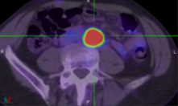
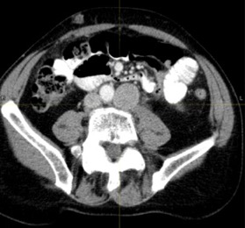
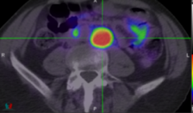
69yo progressed after docetaxel, enzalutamide, abiraterone & cabazitaxel
baseline
FDG
175 Gy after LuPSMA #1
PSMA
PSMA PET baseline
Notes:
3026582
NBS1, also known as Nibrin (NBN)

Slide 22
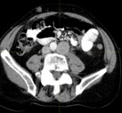
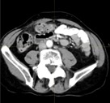
PSA (ug/L)
months from Lu-PSMA

Slide 23



*
PSA (ug/L)
*
months from Lu-PSMA

Slide 24
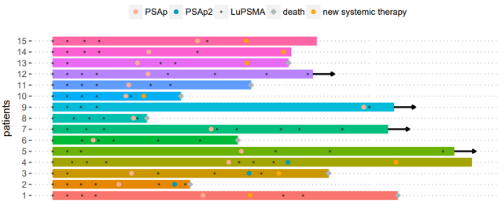
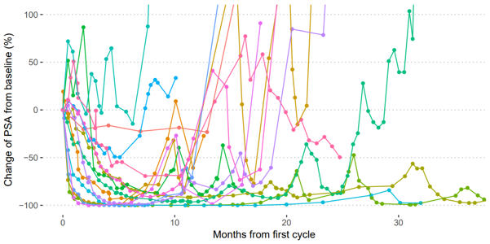
Lu-PSMA re-treatment
75 pt screened for eligibility
Up to 4 cycles ¹⁷⁷Lu-PSMA
50 included in analysis
#APCCC2019
15 (30%) received further
LuPSMA
PSA ≥50% response: 73%
Violet J, Sandhu S, …, Hofman MS et al, JNMMI 2020
doi: 10.2967/jnumed.119.236414

Slide 25
Quantify What You Treat
3 x qSPECT/CT
50 Gy
2 x 10⁶Bq/mL
Dose in Gy (tumour and normal tissue)
CT-CT deformable image registration
(Bq/mL)
mean voxel activity
voxelised kinetics
4
24
96
time (hours)
Violet J et al, JNM 2019, Apr;60(4)

Slide 26
Quantify What You Treat
50 Gy
Dose in Gy (tumour and normal tissue)
Violet J et al, JNM 2019, Apr;60(4)

Slide 27
Quantify What You Treat
<10 Gy:
10 non-responders
1 responder
Violet J et al, JNM 2019, Apr;60(4)

Slide 28
¹⁷⁷Lu-PSMA: is it a drug or type of radiotherapy?
Radiotherapy model
Use dosimetry to define dose to critical organs
Drug model
Don’t need dosimetry
Use phase 1 dose escalation study to determine maximum tolerated dose (MTD)
Don’t exceed known maximum tolerated limits to critical organs
Disadvantage: limits theoretical, extrapolated from external-beam radiotherapy
Advantage: avoid delayed toxicities
Disadvantage: predictable delayed cumulative toxicities (MDS / renal) will be missed
Advantage: acute toxicities observable & definable

Slide 29

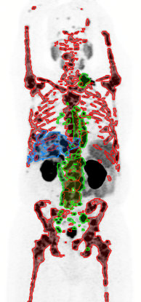
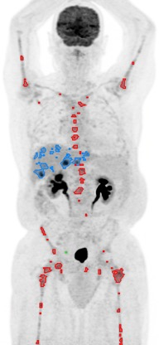
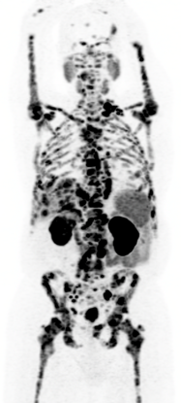
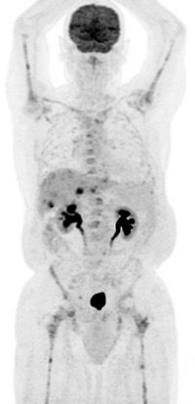
Semi-automated tumour contouring
Ferdinandus J, Hofman MS et al, EJNNMI 2020
doi: 10.1007/s00259-020-04723-z

Slide 30
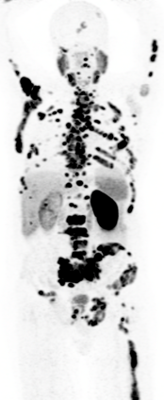
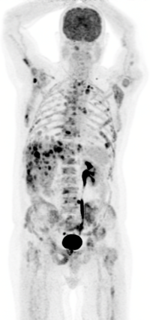
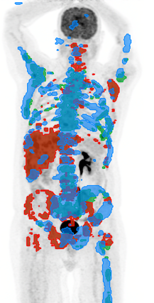
PSMA PET
FDG PET
PSMA / FDG
See What You Treat
20 SUV
(B)
10 SUV
(C)
Can target with ¹⁷⁷Lu-PSMA
Cannot target
(most aggressive sites)
Thang SP et al, Eur Urology Oncology 2019

Slide 31


































ProPSMA / TheraP Collaborative Network
nuclear medicine
medical oncology
urology
radiation oncology
clinical trials/other
Goh, Jeffrey
Pattison, David
Vela,
Ian
Rutherford, Natalie
Gedye, Craig
Martin, Jarad
Francis, Ros
Ng ,
Siobhan
Hsiao, Edward
Guminski,
Alexander
Roach, Paul
Tang, Colin
Chua,
Wei
Lin,
Peter
McDonald,
Bill
\
Nottage, Michelle
Kirkwood, Ian
Emmett, Louise
Joshua, Anthony
Redfern, Andrew
Sutherland, Peter
Tan,
Hsiang
Hayne, Dickon
Kwan,
Ed
Frydenberg, Mark
Ramdave, Shakher
Davis,
Ian
Lee,
Sze Ting
Scott, Andrew
Weickhardt, Andrew
Sandhu, Shahneen
Iravani,
Amir
Murphy,
Declan
McJannett, Margaret
Hicks,
Rod
Williams, Scott
Violet,
John
Taubman, Kim
Wong,
Lih-Ming
Azad,
Arun
Siva, Shankar
Lawrentschuk, Nathan
De Abreu Lourenco, Richard
Link, Emma
Stockler, Martin
Martin, Andrew
Hofman, Michael

Slide 32



Slide 33



Activity & safety of ¹⁷⁷Lu-PSMA-617 vs cabazitaxel
TheraP Study

Slide 34



Patient Characteristics
 | Cabazitaxel (N=101) | ¹⁷⁷Lu-PSMA-617 (N=99)
Age (Years): Median (IQR) | 72 (67 - 77) | 72 (67 - 77)
Prior androgen receptor-directed therapy abiraterone only enzalutamide only abiraterone and enzalutamide | 91 24 58 9 | 91 21 49 21
Disease burden (> 20 sites) | 79 | 77
ECOG performance status 0 1 2 unknown | 44 52 4 1 | 42 53 4
PSA: Median (IQR) | 110 (64 - 245) | 94 (44 - 219)
ALP: Median (IQR) | 130 (79 - 187) | 111 (83 - 199)
Gleason Score at diagnosis ≤ 7 ≥ 8 unknown | 35 50 16 | 25 53 21

Slide 35




PSMA + FDG PET/CT
`
PSMA- FDG+
PSMA+ FDG+ PSMA-
n=29 (10%) n=51(18%)
Ineligible (n=80, 28%)

Slide 36




PSMA + FDG PET/CT
PSMA+ FDG+
PSMA+ FDG-
Eligible (n=200)

Slide 37
Outcomes

Slide 38



PSA ≥ 50%
¹⁷⁷Lu-PSMA-617: 29% (95% CI 16%-42%; p<0.0001) greater PSA50-RR
37% (95% CI 27-46%)
66% (95% CI 56-75%)
cabazitaxel (N=101)
¹⁷⁷Lu-PSMA-617 (N=99)

Slide 39


PFS
¹⁷⁷Lu-PSMA-617 delayed progression
HR 0.63 95%CI 0.46-0.86 P=0.0028
Cabazitaxel
¹⁷⁷Lu-PSMA-617
PFS (95%CI) | Cabazitaxel | ¹⁷⁷Lu-PSMA-617
% without progression at 12 months | 3% (1-9) | 19% (12-27)
Median PFS (months) | 5.1 (2.8-6.0) | 5.1 (3.4-5.7)

Slide 40

RECIST 1.1 objective response rate
no partial response
partial response
no post-baseline assessment
Cabazitaxel (N=41)
Cabazitaxel (N=41)
¹⁷⁷Lu-PSMA-617 (N=37)
¹⁷⁷Lu-PSMA-617 (N=37)
ORR 24% 49%
(95%CI) (11-38%) (33-65%)

Slide 41
Adverse Events
 | Cabazitaxel (N=85) |  | ¹⁷⁷Lu-PSMA-617 (N=98)
 | G1-2 (%) | G3-4 (%) | G1-2 (%) | G3-4 (%)
Neutropenia (+/- fever) | 5 | 13 | 7 | 4
Thrombocytopenia | 5 | 0 | 18 | 11
Dry mouth | 21 | 0 | 60 | 0
Diarrhea | 52 | 5 | 18 | 1
Dry eye | 4 | 0 | 30 | 0
Dysgeusia | 27 | 0 | 12 | 0
Neuropathy (motor or sensory) | 26 | 1 | 10 | 0
Fatigue | 72 | 4 | 70 | 5
Nausea | 34 | 0 | 40 | 1
Anemia | 13 | 8 | 19 | 8
Vomiting | 12 | 2 | 12 | 1
TOTAL (all AEs) | 40 | 54 | 54 | 33

Slide 42


Patient Reported Outcomes

Slide 43

Deterioration Free Survival
Time to ≥10-point ↓EORTC QLQ-C30 global health status, progression, death,
or treatment discontinuation.
Cabazitaxel
¹⁷⁷Lu-PSMA-617

Slide 44




VISION in NEJM

Slide 45
Open-label study of protocol-permitted standard of care ± ¹⁷⁷Lu-PSMA-617 in adults with PSMA-positive mCRPC
Eligible patients
Previous treatment with both
  ≥ 1 androgen receptor
  pathway inhibitor
  1 or 2 taxane regimens
Protocol-permitted standard of care (SOC) planned before randomization
  Excluding chemotherapy immunotherapy, radium-223, investigational drugs
ECOG performance status 0–2
Life expectancy > 6 months
PSMA-positive mCRPC on PET/CT
with ⁶⁸Ga-PSMA-11
Protocol-permitted SOC +
¹⁷⁷Lu-PSMA-617
7.4 GBq (200 mCi) every 6 weeks
4 cycles, increasable to 6
Treatment
Final analysis
Follow-up
2:1
Protocol-permitted SOC
alone
  Randomization stratified by
    ECOG status (0–1 or 2)
    LDH (high or low)
    Liver metastases (yes or no)
    Androgen receptor pathway inhibitors in SOC (yes or no)
  CT/MRI/bone scans
    Every 8 weeks (treatment)
    Every 12 weeks (follow-up)
    Blinded independent central review

Slide 46
To reduce effect of drop-out on radiographic endpoints, primary analyses used different sets
June 2018
Enrollment start
March 2019
Measures implemented
October 2019
Enrollment end
Enhanced study site education and communication
Enrollment cap at selected sites
¹⁷⁷Lu-PSMA-617
+ SOC
n = 166
(1.2% early drop-out)
n = 385
(4.2% early drop-out)
n = 551
Overall
N = 831
n = 84
(56.0% early drop-out)
n = 196
(16.3% early drop-out)
SOC alone
n = 280
    rPFS analyzed in patients randomized after
    measures implemented: rPFS analysis set (n = 581)
    Overall survival analyzed in all randomized patients (N = 831)

Slide 47

Primary endpoints: ¹⁷⁷Lu-PSMA-617 improved rPFS
Primary
analysis
  rPFS
  analysis set
  (n = 581)

Slide 48

¹⁷⁷Lu-PSMA-617 improved rPFS in the OS analysis set
Additional
analysis
  All randomized
  patients
  (N = 831)

Slide 49

rPFS was generally consistent across prespecified stratification factor subgroups

Slide 50
Secondary endpoint: RECIST v1.1 responses favored the ¹⁷⁷Lu-PSMA-617 arm in patients with measurable disease
46.9%
45.3%
41.8%
¹⁷⁷Lu-PSMA-617 + SOC (n = 184)
35.3%
SOC alone (n = 64)
13.0%
9.2%
3.1%
4.7%
0.0%
0.5%
Complete
response
Partial
response
Stable
disease
Progressive
disease
Unknown
Best overall response per RECIST v1.1

Slide 51

Secondary endpoint: PSA responses favored the
¹⁷⁷Lu-PSMA-617 arm among evaluable patients

Slide 52
Treatment-emergent adverse events grouped as topics of interest: no unexpected or concerning safety signals
Patients, n (%) | All grades |  |  | Grade 3–5
 | ¹⁷⁷Lu-PSMA-617 + SOC (n = 529) | SOC alone (n = 205) |  | ¹⁷⁷Lu-PSMA-617 + SOC (n = 529) | SOC alone (n = 205)
Fatigue | 260 (49.1) | 60 (29.3) |  | 37 (7.0) | 5 (2.4)
Bone marrow suppression | 251 (47.4) | 36 (17.6) |  | 124 (23.4) | 14 (6.8)
Leukopenia Lymphopenia Anemia Thrombocytopenia | 66 (12.5) 75 (14.2) 168 (31.8) 91 (17.2) | 4 (2.0) 8 (3.9) 27 (13.2) 9 (4.4) |  | 13 (2.5) 41 (7.8) 68 (12.9) 42 (7.9) | 1 (0.5) 1 (0.5) 10 (4.9) 2 (1.0)
Dry mouth | 208 (39.3) | 2 (1.0) |  | 0 (0.0) | 0 (0.0)
Nausea and vomiting | 208 (39.3) | 35 (17.1) |  | 8 (1.5) | 1 (0.5)
Renal effects | 46 (8.7) | 12 (5.9) |  | 18 (3.4) | 6 (2.9)
Second primary malignancies | 11 (2.1) | 2 (1.0) |  | 4 (0.8) | 1 (0.5)
Intracranial hemorrhage | 7 (1.3) | 3 (1.5) |  | 5 (0.9) | 2 (1.0)

Slide 53



2 RCTs of ¹⁷⁷Lu-PSMA-617

Slide 54


Contrasting VISION: design
 | TheraP | VISION
¹⁷⁷Lu-PSMA-617 | 8.5 GBq (↓ 0.5 GBq) per cycle Up to 6 cycles: guided by SPECT/CT | 7.5 GBq per cycle Up to 6 cycles: 4 cycles ± 2 cycles
Median cycles | 5 | 5
Post therapy SPECT/CT | ✓ | ✗
Selection criteria: PSMA | PSMA SUVmax > 20 | PSMA > liver (≈ SUVmax >5-7)¹
Selection criteria: FDG | FDG+ PSMA- excluded | not performed PSMA-negative metastases identified on CT (LN > 2.5cm, visceral > 1cm)
% excluded | 28% | 12% (16% difference)
PSA ≥ 50% response | 66% | 46% (-20% difference)
¹ Ferreira G et al, Cancer Imaging 2019
doi:10.1186/s40644-019-0211-y

Slide 55




❶ Is this pt with “low” PSMA uptake in LN suitable?
Liver SUVmax 5
3.5cm SUVmax 7
2.2cm SUVmax 2
PSMA
FDG
TheraP ✗
►cabazitaxel x 10
excellent response
VISION ✓
Notes:
Patient went on to have cabazitaxel with excellent response

Slide 56
❷ Pt with variable PSMA uptake in bone suitable?
PSMA > liver
PSMA < liver
PSMA

Slide 57


❷ FDG makes PSMA invisible bone lesions visible
PSMA ---
FDG +++
PSMA > liver
PSMA neg
FDG pos
PSMA < liver
PSMA
FDG
TheraP ✗
►cord compression
VISION ✓

Slide 58





 Can SPECT/CT better personalise care?
PSMA restaging
PSA >99% decline
PSMA baseline
cycle #1
cycle #2
TheraP: 8% paused owing to “exceptional” response
recommenced upon progression

Slide 59
¹⁷⁷Lu-PSMA-617: new class of effective therapy
Improves patient outcomes in men with mCRPC following docetaxel and androgen receptor directed therapy
More active than cabazitaxel in PSMA-avid disease with fewer
G3-4 AEs and improved QoL
Optimal patient selection, sequencing and monitoring will evolve

Slide 60



Education & Leadership
3
Discovery Research
2
Prostate Theranostics & Imaging Clinical Trials
1
Enable world-class research & innovation; >10 practice-changing clinical trials
Defer ineffective and expensive therapies
https://www.petermac.org/prostic
Notes:
Vision for and impact of ProsTIC
Deliver new paradigms for standard of care treatment of prostate cancer patients driven by integrating innovative clinical trials, pre-clinical and discovery research

Slide 61

Advancing PSMA theranostics
Ravi Kumar A, Hofman MS Clin Canc Res 2020
DOI: 10.1158/1078-0432.CCR-20-0209

Slide 62
From Last Line to First Line: trials @ Peter Mac
Trial | Summary | Men with | Funding | PI | Started | Status
PMC Ph2 | World’s first Phase II trial of Lu-PSMA | mCRPC | good will | Hofman Sandhu | 09/15 | Lancet Oncology
TheraP | 1st RCT of Lu-PSMA vs cabazitaxel | mCRPC | Movember/MRFF | Hofman | 01/18 | Lancet
PRINCE | Lu-PSMA + immunotherapy (pembroluzimab) | mCRPC | VCA | Sandhu Hofman | 6/19 | Fully recruited ESMO 2021
LuPARP | Lu-PSMA + PARPi (olaparib) | mCRPC | PCF | Sandhu Hofman | 6/19 | highest dose level
Evolution | Lu-PSMA + immunotherapy (ipilimumab + nivolumab) | mCRPC | PCFA Novartis BMS | Sandhu Hofman | 9/21 | Ethics submission
ENZA-P | Lu-PSMA vs Lu-PSMA + enzalutamide | mCRPC | Movember | Emmett | 7/20 | 45/160
UpFront PSMA | Lu-PSMA + docetaxel vs. docetaxel alone | mCSPC (castration sensitive) | Movember DoD | Azad Hofman | 4/20 | 37/140
LuTectomy | Lu-PSMA prior to prostatectomy | Localised PC | Movember | Hofman Murphy | 6/20 | 10/20
last line to first line

Slide 63













clinicaltrials.gov: NCT04343885
UpFrontPSMA Ph 2 trial (+DoD)
#UpFrontPSMA: Using PSMA Theranostics “First Line” rather than “Last Line”
Participants
Pre-Randomisation
Randomisation
Endpoints
PSMA
PSMA
FDG
PSA
12 months
men with prostate cancer
Experimental Rx (n=70)
● ¹⁷⁷Lu-PSMA-617, 7.5 GBq x 2 cycles
● docetaxel 75mg/m² x 6 cycles
PET scans x 2
time
Primary:
Undetectable PSA
at 12 months
≤ 12 weeks since diagnosis
1:1 randomisation
stratified by ● disease volume
● duration of ADT
Secondary:
● safety
● time to
● castration resistance
● PSA progression
● radiologic progression
● early PSMA PET response
● health-related QoL and pain
● overall survival
metastases on CT and/or bone scan
PSMA PET:
●high tumour uptake
●high volume disease
FDG PET
● most disease PSMA+
Control arm (n=70)
● docetaxel 75mg/m² x 6 cycles
central
imaging
review
PSA > 10ng/ml
(pre ADT)
ADT given in both arms
Prostate Cancer Research Alliance
PI: A/Prof Arun Azad (Med Onc)
Prof Michael Hofman (Nuc Med)

Slide 64



Slide 65








Participants
Lu-PSMA
Surgery
Endpoints
biopsy proven prostate cancer
2nd PSMA PET
high risk features
PSA > 20mg/ml
ISUP grade group 3-5
cT2 or higher
N1 disease
5 GBq ¹⁷⁷Lu-PSMA-617
20 men
1-10: 1 cycle
11-20: 2 cycles,
6 weekly
Prostatectomy
+
Pelvic nodal dissection
6wks
Primary: dosimetry
absorbed radiation dose (mSv)
no distant metastases
Secondary:
Imaging response (PSMA PET)
Biochemical response (PSA)
Pathological response
Adverse events to Lu-PSMA
Surgical safety
Health-related QoL
PSMA PET: high uptake
SUVmax >20
@DrMHofman @DeclanGMurphy
#LuTectomy Trial
Prostate Cancer Research Alliance
PI: Prof Declan Murphy
Prof Michael Hofman
clinicaltrials.gov NCT04430192

Slide 66

LuTectomy
27th May 2020
  HREC approval
3rd June 2020
  Patient 1 underwent treatment
7Th June 2021
Surgery for patient 9
Timeline and Progress
Dhiantravan et al EU Focus 2020

Slide 67
LuTectomy Translational Project Strategy
Courtesy:
Renu Eapen
Paul Neeson
Simon Keam

Slide 68



Slide 69




PRINCE Trial
PSMA-lutetium Radionuclide therapy and ImmuNotherapy in prostate CancEr
Metastatic CRPC
Progressed after enzalutamide, abiraterone or apalutamide
@UCSFImaging
NCT03805594
Dr Rahul Aggarwal
Dr Tom Hope
PSMA + FDG PET/CT
Pembroluzimab 200mg
3 weekly
+
¹⁷⁷Lu-PSMA-617
6 weekly, 4 cycles
Day 4 ± 2 days
8.5 GBq, ↓0.5 GBq/cycle
clinicaltrials.gov: NCT03658447
PI: A/Prof Shahneen Sandhu

Slide 70


LuPARP Trial
Phase 1 trial of ¹⁷⁷Lu-PSMA-617 therapy and Olaparib (PARPi)
Metastatic CRPC
Progressed after 2nd generation AR-targeted agent
Post taxane chemotherapy
PSMA + FDG PET/CT
¹⁷⁷Lu-PSMA-617
6 weekly, 4 cycles
7.4 GBq
+
Olaparib day 2-15
3+3 dose escalation design
50mg to 300mg bd
(6 levels of increment)
clinicaltrials.gov: NCT03874884
PI: A/Prof Shahneen Sandhu

Slide 71



ENZA-p An imaging, biomarker and therapy trial
AIM A
AIM B,C
PI: Louise Emmett

Slide 72



Slide 73
Radionuclide | T½ | Type | Mean Energy (MeV) | Max. range (mm) | Imaging
Radium-223 | 11.4 d | Alpha | 6.9 | <0.1 mm | no
Lutetium-177 | 6.7 d | Beta | 0.14 | 2 | SPECT
Yttrium-90 | 2.7 d | Beta | 2.3 | 12 | PET
Iodine-131 | 6.7 d | Beta | 1.0 | 2 | SPECT
Copper-67 | 2.6 d | Beta | 0.5 | 21 | SPECT
Terbium-161 | 6.9 d | Beta/Auger | 0.2 | 0.03 | SPECT
Actinium-225 | 9.9 d | Alpha | 6.8 | 0.03 | no
Bismuth-213 | 46 min | Alpha | 8.4 | 0.08 | no
Throrium-227 | 19 d | Alpha | 6.1 | 0.1 | no
Lead-212 | 10.6 d | Alpha | 6.1 | 0.1 | no
commercially available
potentially available

Slide 74


²²⁵Ac-PSMA alpha Rx: extra-ordinary n=1’s
progressed with ¹⁷⁷Lu
complete response with ²²⁵Ac
Kratochwil C et al, JNM 2018
Notes:
spur the field
… we need to follow-up with well-designed and prospective data

Slide 75

Lu-PSMA: practical nuances and intricacies
Mixed response:
progression of
FDG+ PSMA- disease

Slide 76

LuPSMA is safe in men with PSMA “superscans”
43 men with diffuse bone marrow involvement on PSMA PET
Grade 3 anaemia, thrombocytopenia and neutropenia in 22%, 17% and 8%, respectively
Grade 4 thrombocypenia in 8%

Slide 77


doi:10.1111/bju.14814

Slide 78






Thank-you #GoNuclear
DrMHofman
Funding partners (alphabetical order)
ANSTO (¹⁷⁷Lu)
Cancer Australia
Endocyte / AAA (Novartis)
Movember
Peter MacCallum Foundation
Prostate Cancer Foundation (PCF)
Prostate Cancer Foundation of Australia (PCFA)
U.S. Department of Defence (DoD)
Victorian Cancer Agency (VCA)
Collaborative partners
ANZUP Prof Ian Davis | Margaret McJannett
ARTnet A/Prof Ros Francis
BaCT
NHMRC CTC
PropPSMA & TheraP & UpFrontPSMA investigators
A/Prof Louise Emmett (St Vs, Sydney)
Molecular Imaging | Nuclear Medicine
Tim Akhurst, Ramin Alipour, Anthony Cardin, Nattakorn (Knight) Dhiantravan, Rod Hicks,
Grace Kong, Kate Moodie, Aravind Ravi Kumar
(Nuc Med “Dream Team”)
Peter Eu (Radiopharmacist)
Mark Scalzo (Lead Technologist)
Price Jackson (Medical Physicist)
Elizabeth Medhurst (GU Nurse Specialist)
Uro-oncology Multi-Disciplinary Team
Scott Williams, Shankar Siva (Rad Onc)
Shahneen Sandhu, Arun Azad, Ben Tran (Med Onc)
Declan Murphy, Renu Eapan**, Nathan Lawrentschuk (Urology) **PhD candidate
Gail Risbridger, Renea Taylor, Luc Furic
(Laboratory Research)

Slide 79





Uro-oncology team
Prostate Lab team
Nuclear Medicine team

Slide 80




DrMHofman
feedback & comments: michael.hofman@petermac.org

