Slide 1
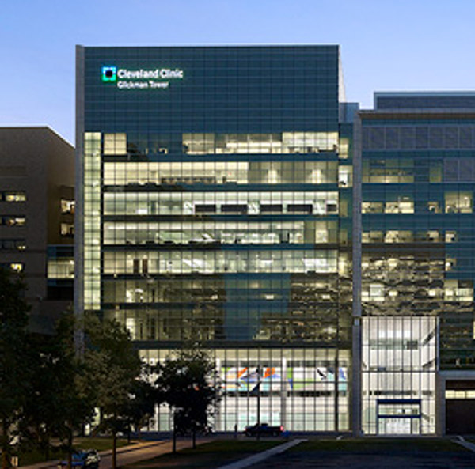
The State of Prostate Cancer 2021
Eric A. Klein, MD
Emeritus Professor and Chair
Glickman Urological and Kidney Institute
Cleveland Clinic
Fellow, Stanford University Distinguished Careers Institute

Slide 2
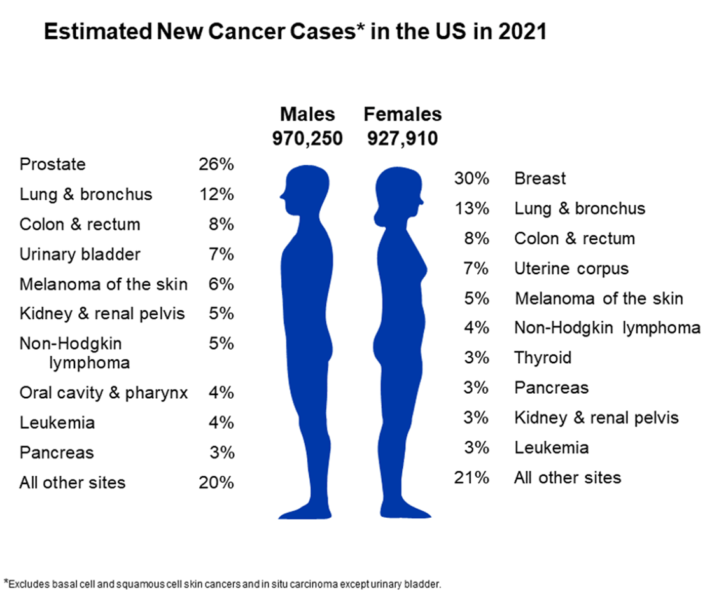
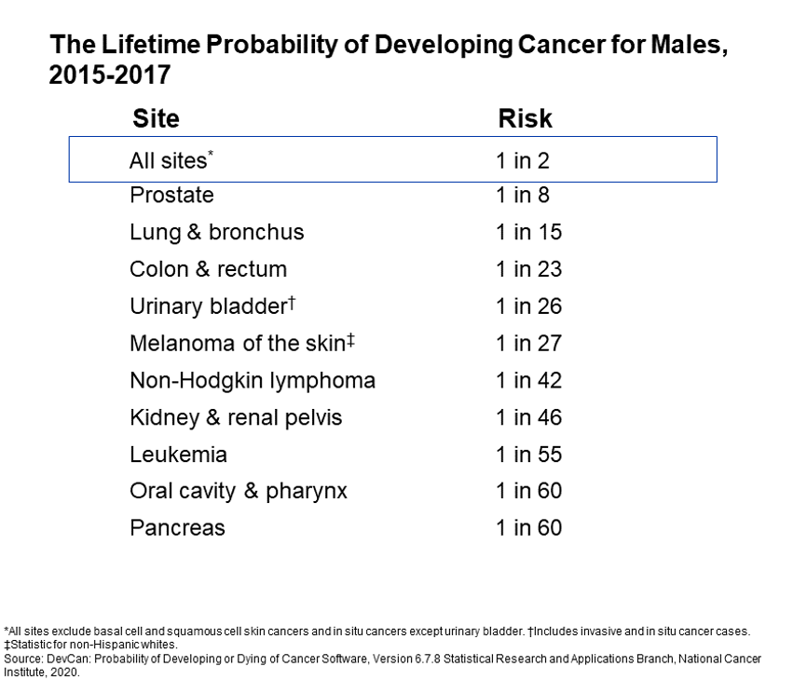
In 2021: ~ 250,000 new cases & ~ 34,000 deaths

Slide 3
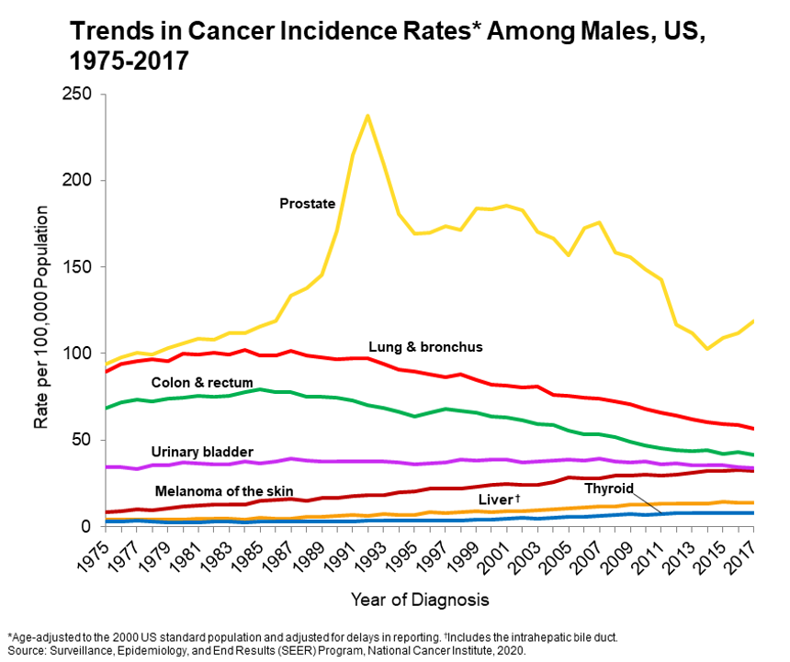
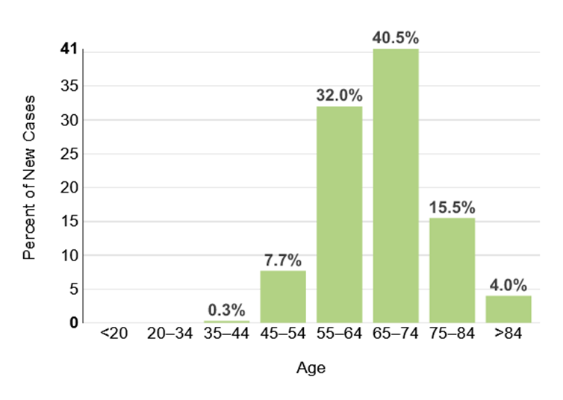
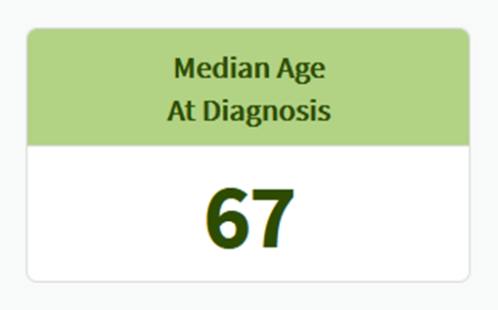

Slide 4
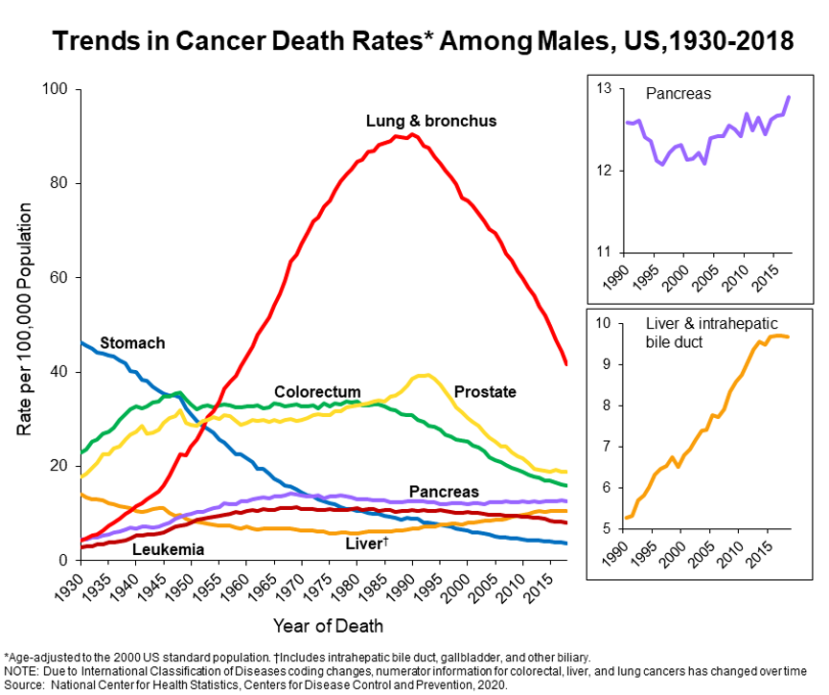
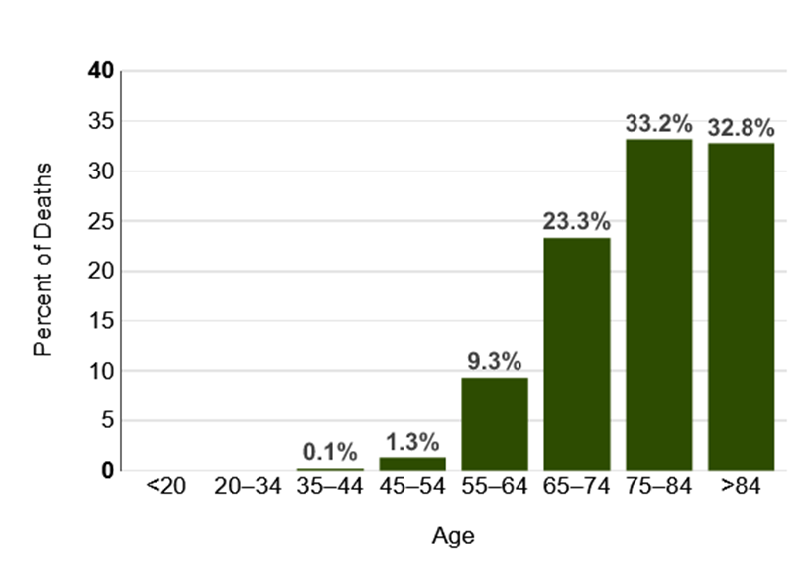
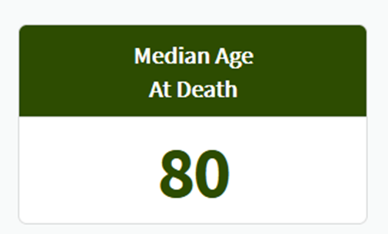

Slide 5
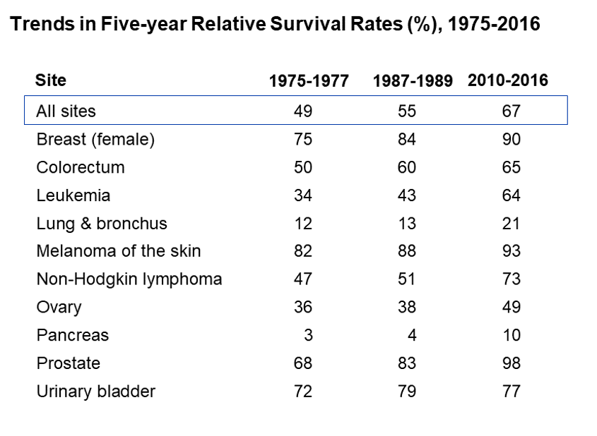

Slide 6
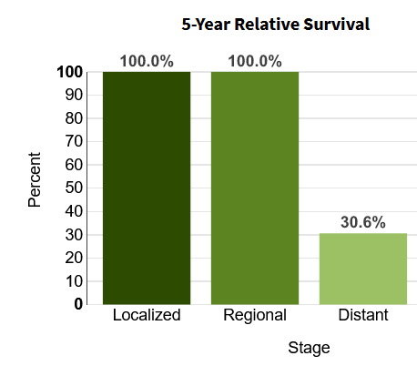
5-Year Survival
Based on Stage at Diagnosis
In 1989, 5 Year Survival for Distant Disease was 0%

Slide 7

3.65 million prostate cancer survivors in the US
=

Slide 8
PSA-based Screening
Limitations
Low specificity
  PSA is “prostate specific” but not “prostate cancer specific”
  Most men with “elevated” PSA do not have prostate cancer

Slide 9
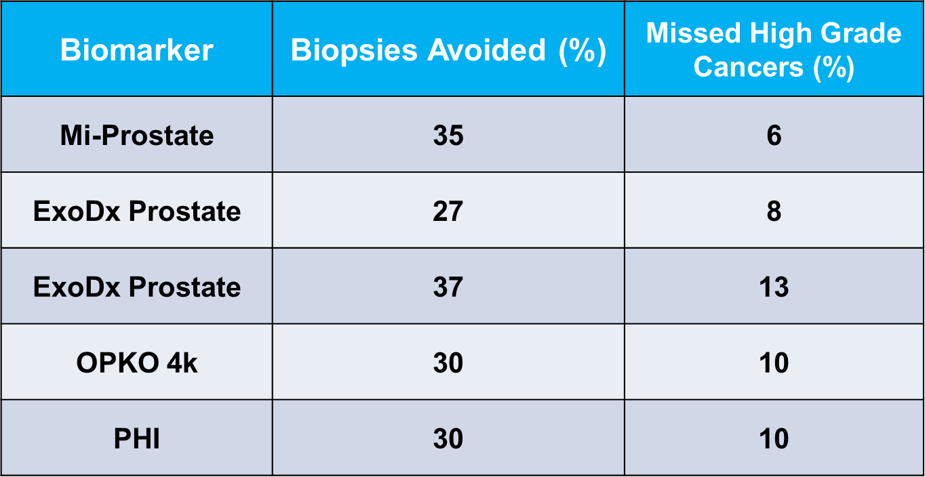
Tools to Improve Sensitivity & Specificity
Bradley et al, J Urol 190:389, 2013; Catalona et al, J Urol 185:1650, 2011
Vickers et al, J Clin Oncol 28:2493, 2014;Patel et al, JAMA Oncol March 31, 2106

Slide 10
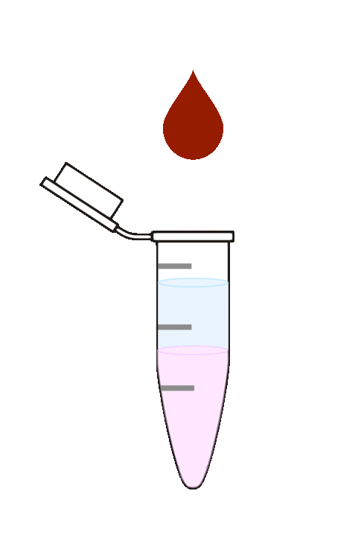
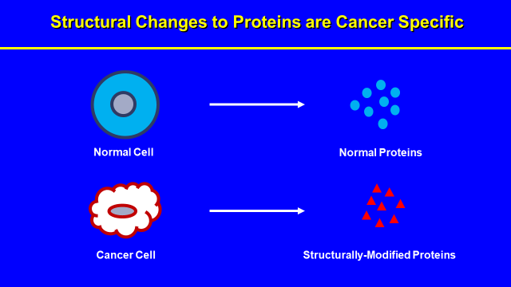

IsoPSA Assay
Aqueous phase
solvents
IsoPSA index = Ratio of isoforms

Slide 11
Tools to Improve Sensitivity & Specificity
IsoPSA | 55 | 8
Bradley et al, J Urol 190:389, 2013; Catalona et al, J Urol 185:1650, 2011
Vickers et al, J Clin Oncol 28:2493, 2014; Patel et al, JAMA Oncol 2016

Slide 12
Screening Algorithm
negative
Monitoring
Worrisome total serum PSA
Reflex Test
negative
TRUS guided Bx
positive
MRI
positive
MR-US
Fusion Bx
Notes:
Please feel free to correct – that’s what we understood you meant during our call. We will easily correct as needed.

Slide 13
How to Biopsy a Prostate
Imaging
    Ultrasound
    Ultrasound – MRI fusion
  Needle Passage
    Transrectal
    Transperineal
Notes:
Please feel free to correct – that’s what we understood you meant during our call. We will easily correct as needed.

Slide 14
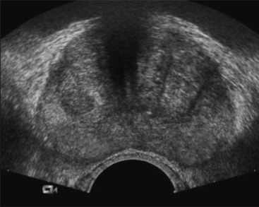
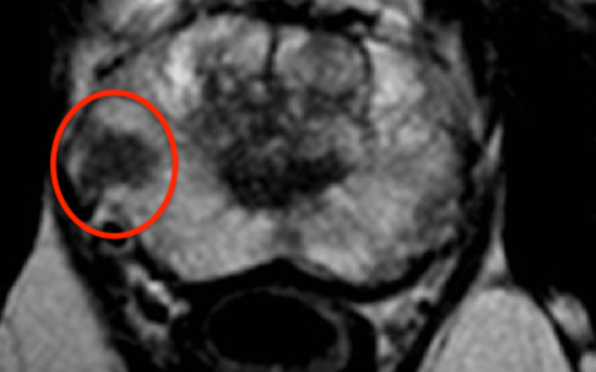
Prostate Imaging
Ultrasound
MRI
Notes:
Please feel free to correct – that’s what we understood you meant during our call. We will easily correct as needed.

Slide 15
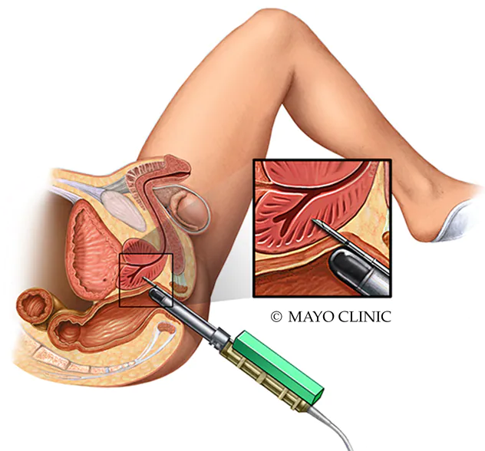
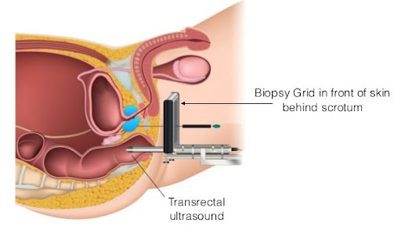
Needle Passage
Transrectal
Transperineal
Notes:
Please feel free to correct – that’s what we understood you meant during our call. We will easily correct as needed.

Slide 16
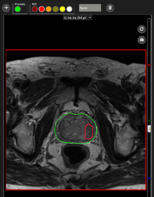
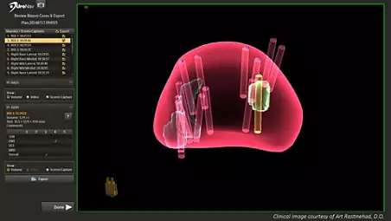
Ultrasound-MRI Fusion
Can be done Transrectally or Transperineally
Notes:
Please feel free to correct – that’s what we understood you meant during our call. We will easily correct as needed.

Slide 17
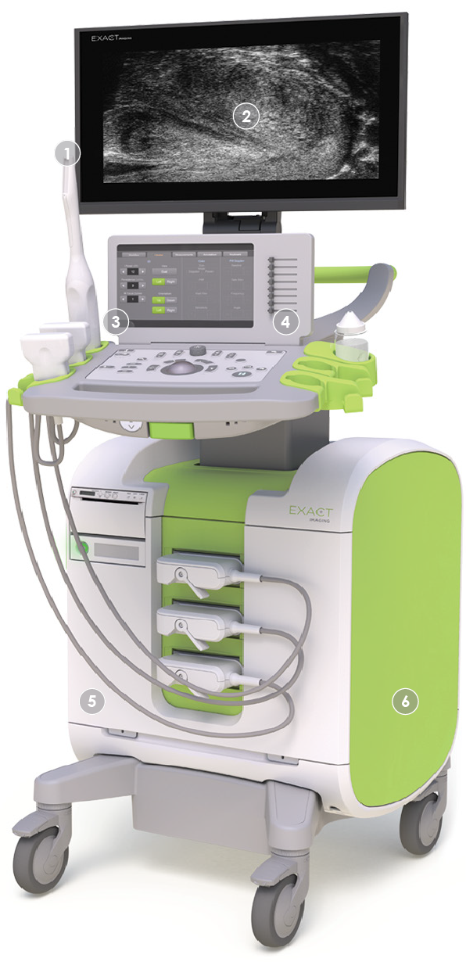
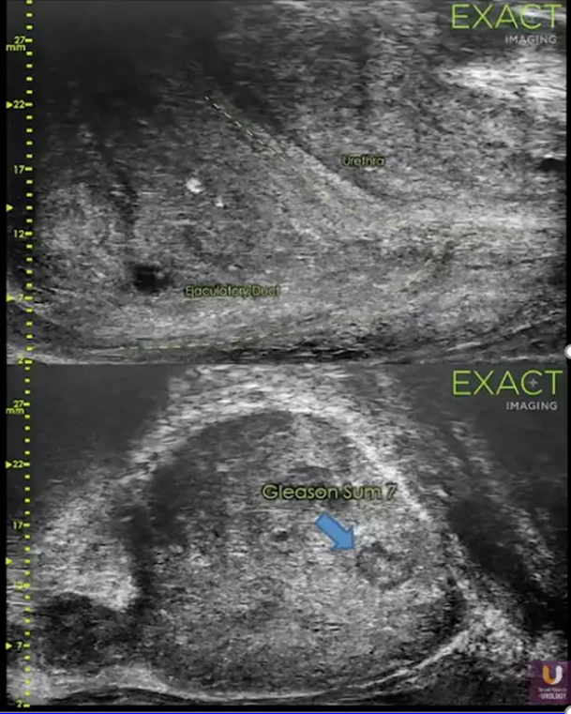
Microultrasound
Can be done Transrectally or Transperineally
May avoid need for MRI
Notes:
Please feel free to correct – that’s what we understood you meant during our call. We will easily correct as needed.

Slide 18
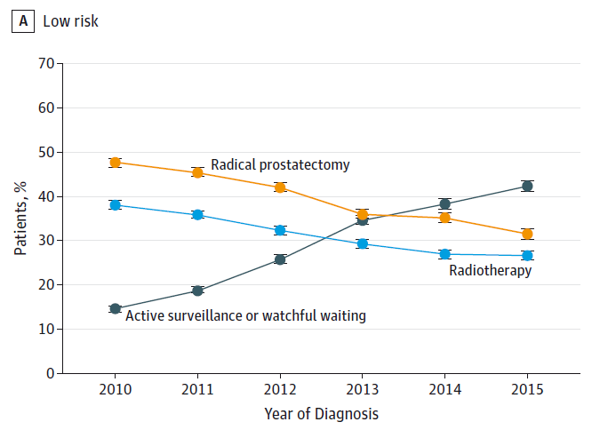
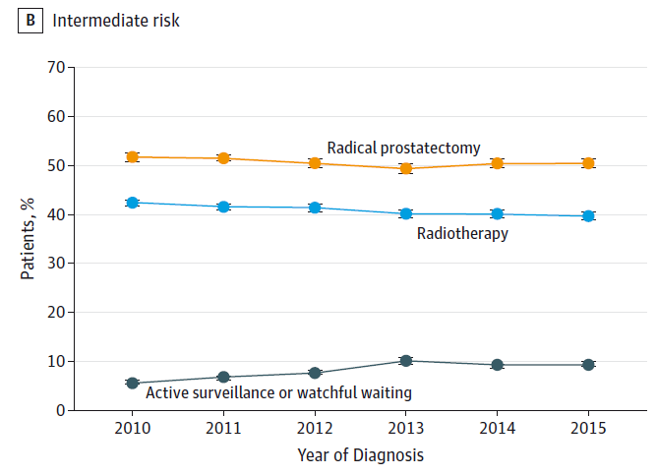
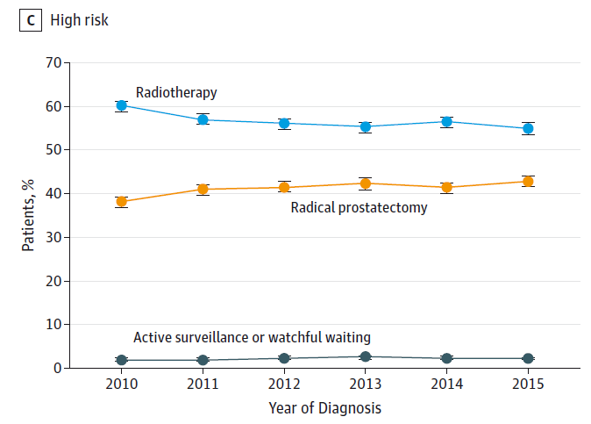
Trends in Initial Management
Low Risk
Intermediate Risk
High Risk
N = 164,760
Source: SEER Prostate Active Surveillance/WatchfulWaiting database
Mahal et al, JAMA , Feb 11 2019 (epub)

Slide 19
Prostate Cancer in 2022
Aspirational Goals
  Treat only those cancers that have
metastatic or lethal potential
  Put everyone else on Active Surveillance

Slide 20

What is Active Surveillance?
“Management Strategy”
  After initial diagnosis, no initial therapy
  Serial monitoring to detect progression to a tumor that has biologic potential to do harm
  Curative intervention when that occurs

Slide 21
Current Selection and Follow-up
Biologically indolent
tumor
+
Favorable mindset
6 months
DRE + PSA
Bx if
Worrisome
1 year
DRE + PSA
MRI + biopsy
Genomic test if indicated
Confirmatory Study
MRI + guided biopsy
Genomic test
Biologically indolent tumor
Low volume Gleason 6
GG2 with minor pattern 4
No cribriform or intraductal histology
PSAD < 0.15
Treat if :
Biologically significant tumor detected

Slide 22


MRI
GENOMICS
Notes:
Please feel free to correct – that’s what we understood you meant during our call. We will easily correct as needed.

Slide 23
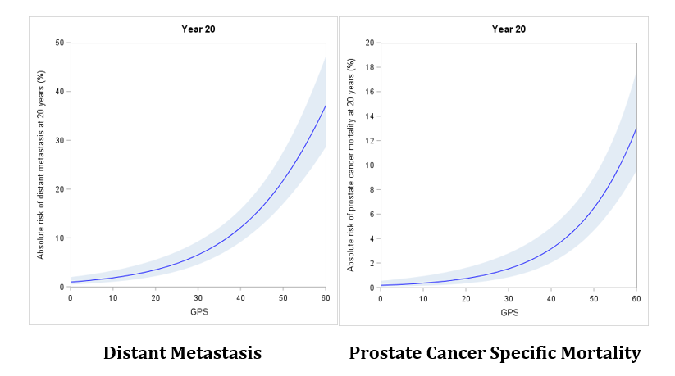
Long Term Outcomes Predicted by Oncotype GPS

Slide 24
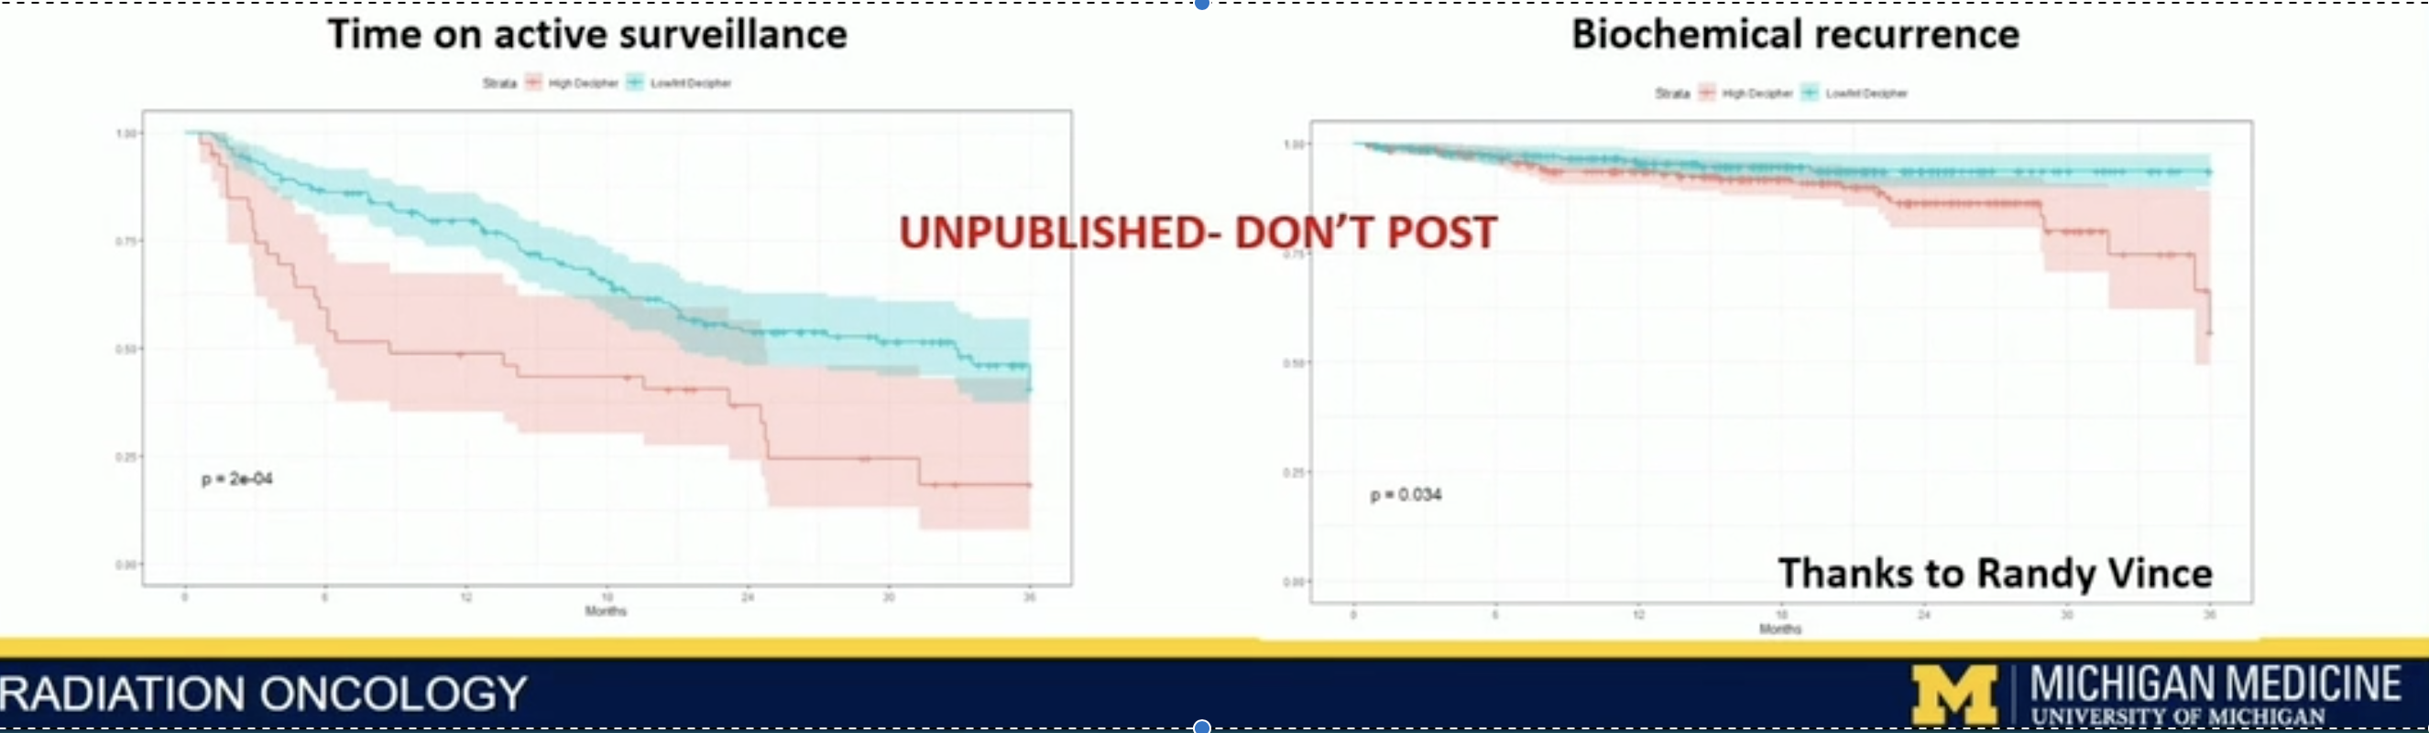
Prospective outcomes from clinical use of Decipher in men treated with active surveillance
MUSIC* Active Surveillance Genomics Study
Decipher Low
Decipher High
*Michigan Urology Surgical Improvement Collaborative (MUSIC) state-wide prostate cancer registry analysis of prospective Decipher biopsy testing in the active surveillance population (n=800).
Vince R et al., submitted

Slide 25
What's the Best Treatment?
Whole Gland Therapy
Focal Therapy
Radical Prostatectomy
External Beam Radiation
Brachytherapy
HIFU
Cryotherapy
Interstitial Laser Therapy
Follow-up
PSA
Follow-up
PSA
MRI
Biopsy

Slide 26
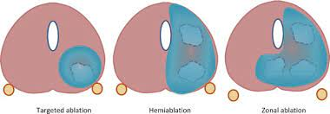
Focal Therapy or Subtotal Therapy

Slide 27
Questions after a New Diagnosis
Do I need treatment?
No
Active Surveillance
Yes
Am I a candidate for focal therapy?
Yes
HIFU, Cryo, or Laser
No
Which whole gland treatment suits my needs best?
RP, EBRT, Brachy

Slide 28
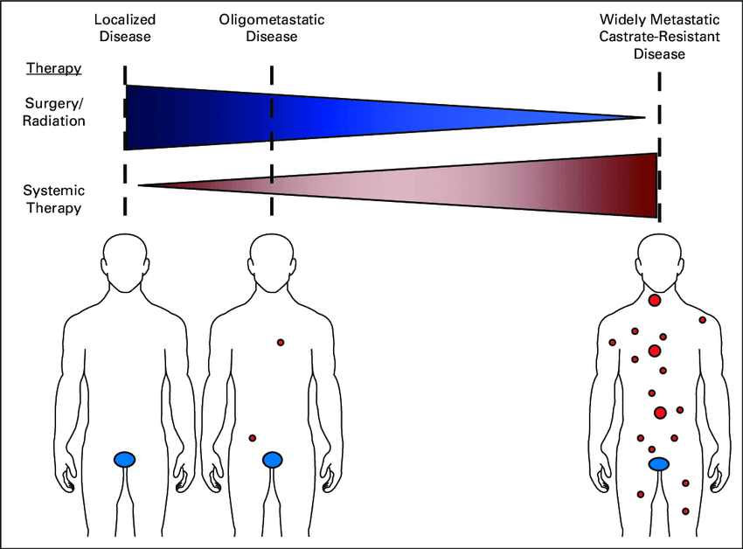
Oligometastatic Disease
Definition
Transitional state between localized
& widespread mets
Five or fewer mets on imaging
De novo or recurrent after definitive rx of the
primary
Spectrum of biology & clinical behavior
Tran & Antonarakis, J Oncol Practice 13:21, 2017

Slide 29
Oligometastatic Disease – Conceptual Framework
Think of the primary and metastases as two separate diseases
Treat each with best therapy available
Primary tumor – Surgery or Radiation
Regional Nodes – Surgery (if bulky)
Metastases – Castration + AR blockade + Radiation

Slide 30
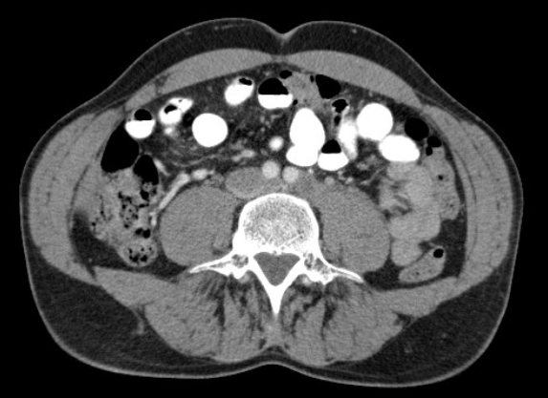
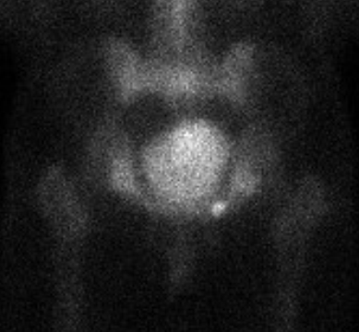

“Suspicious for metastasis”
“1.8 x 1.7cm node”
CT Guided Aspiration Bx:
Prostate Cancer”

Slide 31
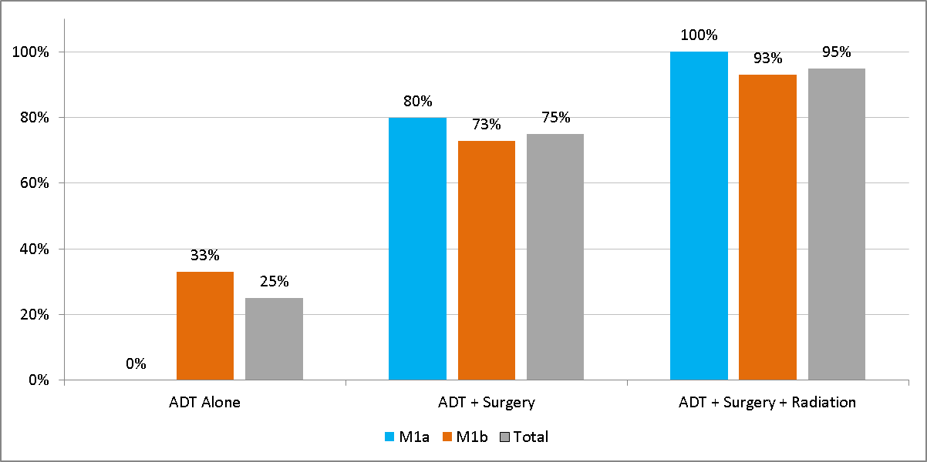
The “PSA ZERO” Paradigm
Patients achieving an undetectable PSA
N = 20
O’Shaughnessey et al, Urology 102:164, 2017

Slide 32
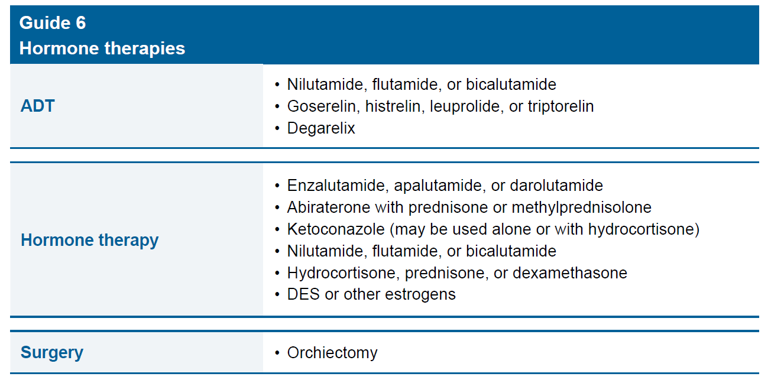


Slide 33
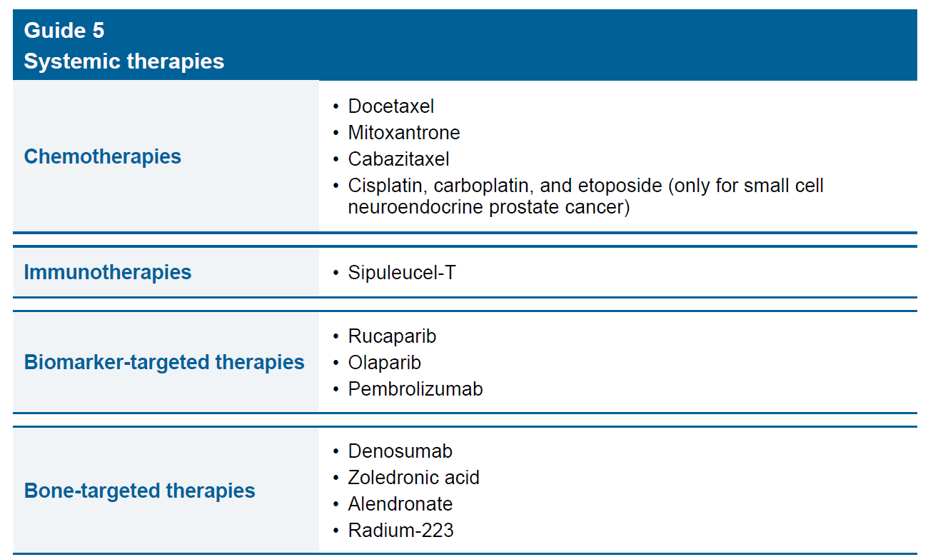


Slide 34
Metastatic Prostate Cancer
Initial therapy
Castration + Androgen blockade =
LHRH + Abiraterone or Enza/Apa/Dauro
For high volume metastases & heavily symptomatic patients
ADT + Docetaxel

Slide 35
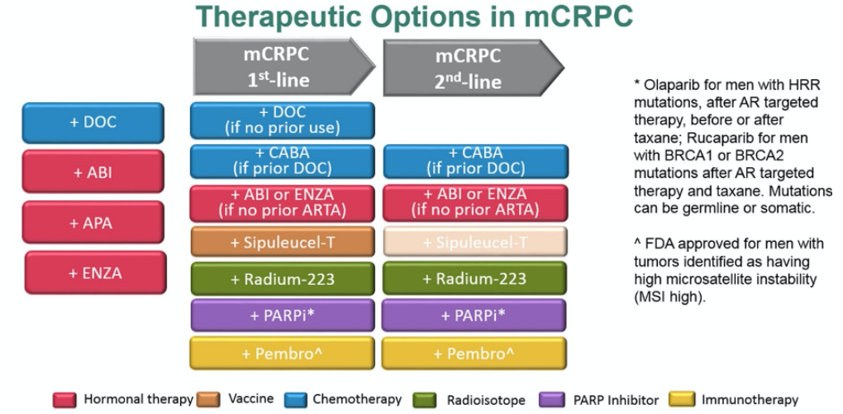

Slide 36
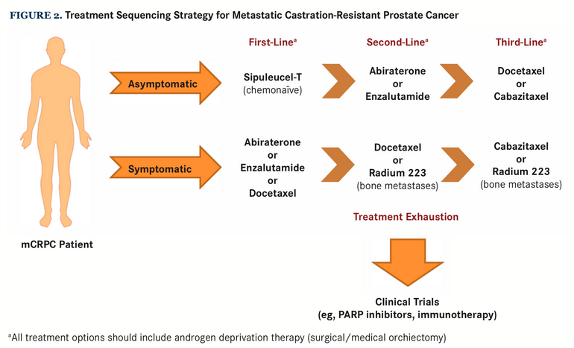

Slide 37
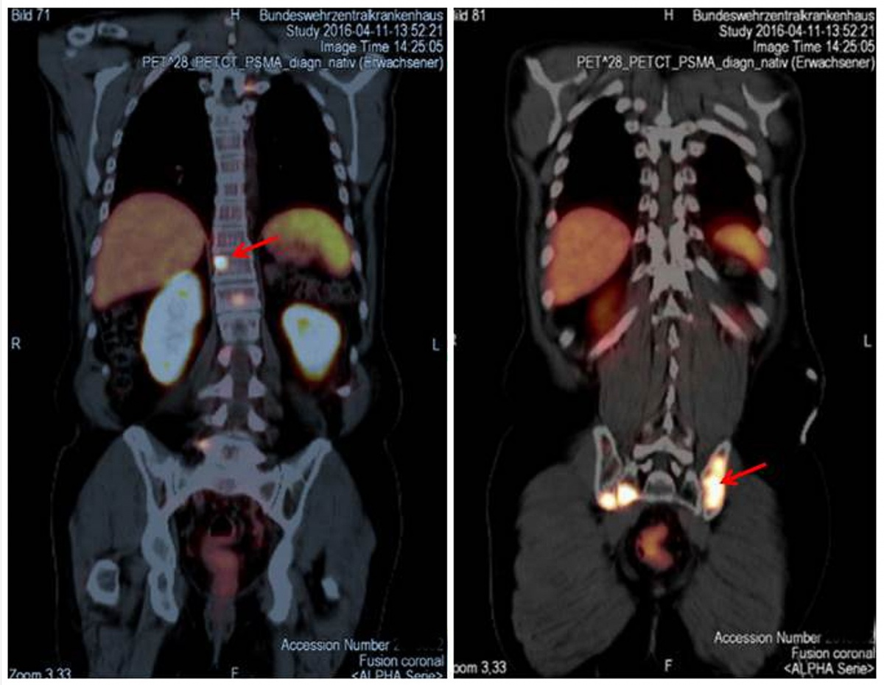
PSMA PET Scans
Uitlity
Staging prior to initial treatment
Disease localization for rising PSA
Therapy (Theranostics)

Slide 38
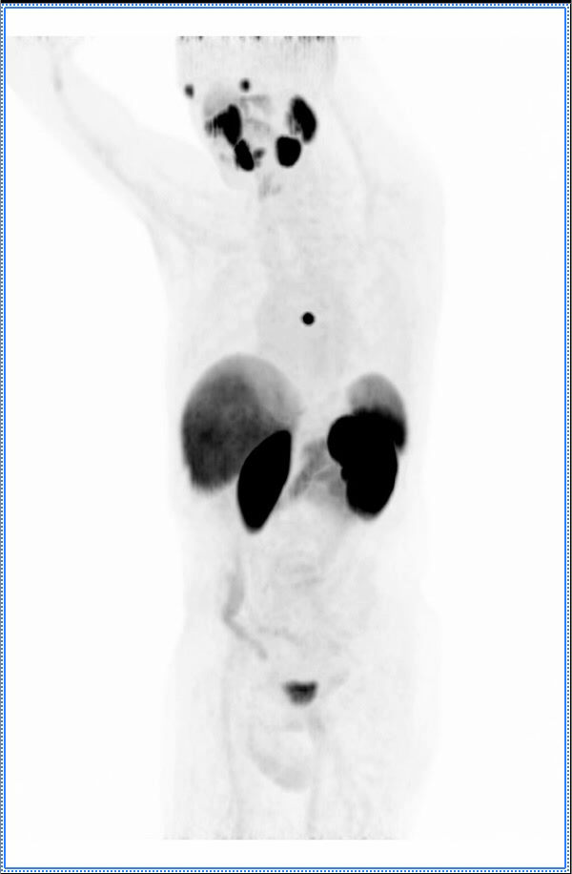
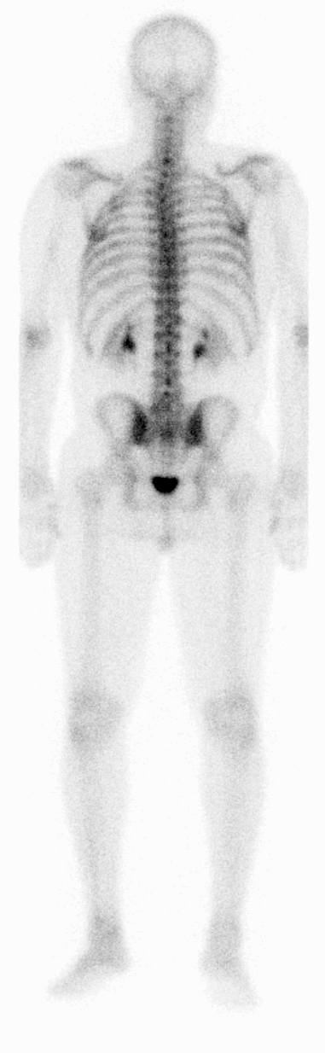
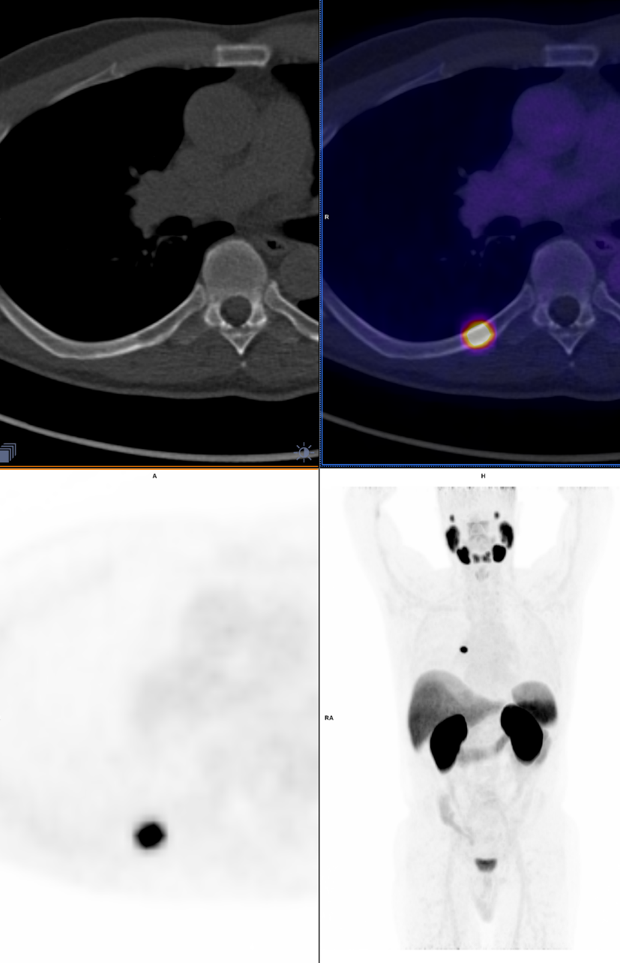
Bone scan 12/4/2020
Rh-PSMA7.3 PET/CT 12/11/2020

Slide 39
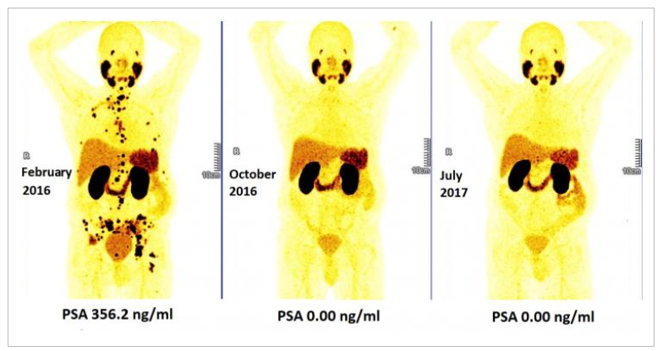

Slide 40

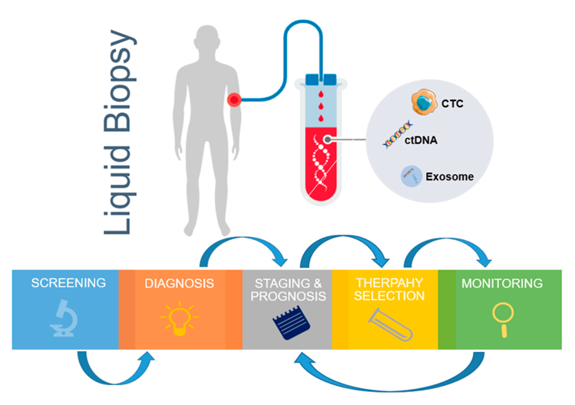
The Precision Medicine Era
Then
Now
Germline genetic testing
Tumor sequencing
Liquid Biopsy

Slide 41
