Slide 1
Sequencing Treatment for Metastatic Castration-Resistant Prostate Cancer
Daniel George, MD
Professor of Medicine and Surgery
Duke University School of Medicine
MAT-US-2009748 7/2020

Slide 2
Prostate Cancer Disease States
Clinical Metastases: Sensitive to ADT
Clinically Localized Disease
Rising PSA
Metastatic Disease Treatment
1st Line
Metastatic Disease Treatment
2nd Line
Metastatic Disease Treatment
3rd Line
Metastatic Disease Treatment
4th Line
Non- Metastatic

Slide 3




Treatment Modalities for mCRPC
Hormonal Axis
Enzalutamide
abiraterone
Apalutamide
Darolutamide
Immunotherapeutic
Sipuleucel –T
Pembrolizumab for MSI-H/dMMR Cancer (not prostate-cancer specific)
Cytotoxic
Docetaxel
Cabazitaxel
DNA Damage
Radium 223 (radiopharmaceutical)
Olaparib, rucaparib
1. American Cancer Society. Available at: http://www.cancer.org. 2. Sharifi N, et al. Clin Cancer Res. 2008;14:4691-4693. 3. Gelmann EP. J Clin Oncol. 2002;20:3001-3015. 4. Hussain M, et al. J Clin Oncol. 2006;24:3984-3990. 4. Holzbeierlein J, et al. Am J Pathol. 2004;164:217-227.

Slide 4
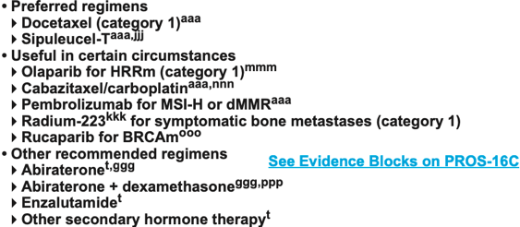
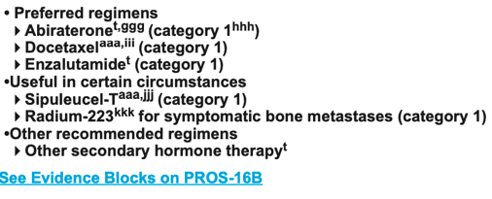
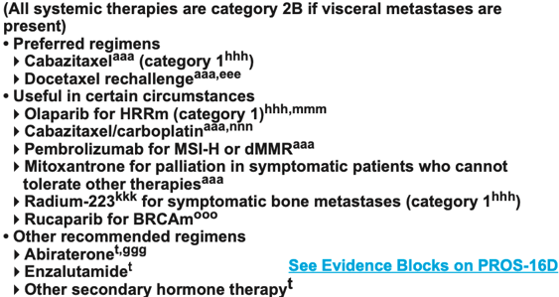
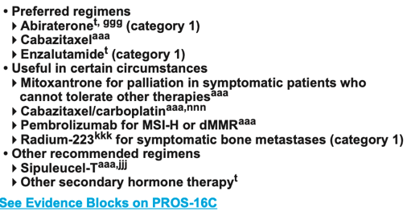
NCCN Guidelines for management of mCRPC
SYSTEMIC THERAPY FOR M1 CRPC: ADENOCARCINOMA
PRIOR NOVEL HORMONE THERAPY/NO PRIOR DOCETAXEL^{FFF}
NO PRIOR DOCETAXEL/NO PRIOR NOVEL HORMONE THERAPY^{FFF}
PRIOR DOCETAXEL AND PRIOR NOVEL HORMONE THERAPY^{FFF,III}
PRIOR DOCETAXEL/NO PRIOR NOVEL HORMONE THERAPY^{FFF}

Slide 5


Treatment Options Across the Spectrum
ABIRATERONE
ENZALUTAMIDE
DOCETAXEL
SIP_T
RADIUM
ABIRATERONE
ENZALUTAMIDE
RADIUM
DOCETAXEL
DOCETAXEL
NHT
NHT
DOCETAXEL
DOCETAXEL
DOCETAXEL
RADIUM
OLAPARIB
CABAZITAXEL
OLAPARIB
RADIUM
NHT
NHT

Slide 6
Sequencing Treatments Remains a Challenge
Selection based on:
Time between the agents
Symptomatic vs asymptomatic
Bone disease vs non bone disease
Presence or absence of visceral metastases
Presence or absence of Genomic aberrations
Oral vs IV
Distance from the center
Patient preference
PS /Fraility
Prior duration of response to ADT
Lack of level 1 evidence up until now.
Cross resistance between NHA
Cross resistance with chemotherapeutics
Many of the existing drugs/classes used in earlier lines of Rx

Slide 7
Cross Resistance to Hormonal Targeted Therapies
First Line: Abi/Enza. 60-78% 16-18 mos
REF | FIRST RX | SECOND | N | >50% PSA (%) | PFS MOS
Loriot 2013 Ann Oncol | Enza | Abi | 38 | 8 | 2.7
Noonan 2013 Ann Oncol | Enza | Abi | 30 | 4 | 3.5
Schrader 2014 Eur Urol | Abi | Enza | 35 | 28 | -
Bianchini 2014 Eur J Cancer | Abi | Enza | 39 | 12 | 2.8
Thomsen 2014 Sc J Can | Abi | Enza | 24 | 17
Petrelli 2015 Clin GU Can | Abi | Enza | 536 | 22 | 3.1
Cheng 2015 Pros Can Proc | Abi | Enza | 165 | 17 | 2.8
Azad 2015 Eur Urol | Abi | Enza | 68 | 22 | 4.6

Slide 8
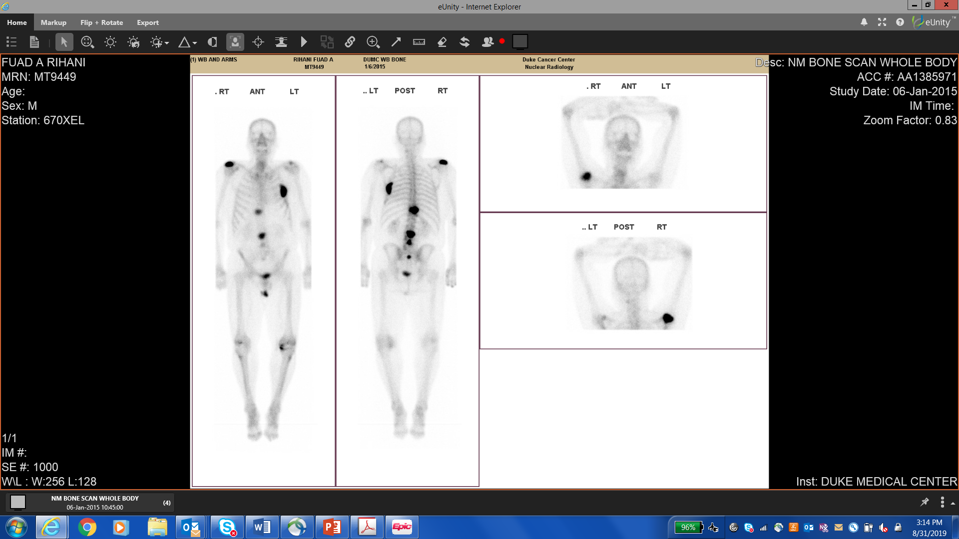
Initial Presentation
73 y/o man with hypertension presents with
urinary obstructive symptoms, right shoulder pain
PSA 37.6 ng/ml
Digital Rectal Exam (DRE) – enlarged nodular prostate (cT3)
Transrectal Biopsy (TRUS/Bx) – 8/12 cores positive Gleason 4+5
CT Abdomen/pelvis (CT A/P) – 1.5 cm para-aortic nodes,
sclerotic lesions in spine
Bone scan – osseous mets in spine, ribs, and shoulders
Foundation One profiling of tumor biopsies reveal
mutation in TP53.

Slide 9
Initial Management
Started on leuprolide, abiraterone and prednisone (based on LATITUDE)
Palliative XRT to right shoulder
Abiraterone + prednisone
Treatment Sequence

Slide 10
LATITUDE Trial
Abiraterone + prednisone in metastatic castration-sensitive prostate cancer (n=1199)
Patients
Newly diagnosed adult men with
high-risk mCNPC
Meets at least 2 of 3 high-risk criteria
Gleason score of 8 or greater
Presence of 3 or more lesions on
bone scan; and/or
Presence of measurable visceral lesion
Stratification Factors
Presence of visceral disease (yes or no)
ECOG PS (0, 1 vs 2)
ARM A
(n=597)
ADT +
abiraterone acetate
1000 mg/day and prednisone 5 mg/day
Efficacy Endpoints
Primary:
OS and rPFS
Secondary:
Time to…
  – Pain progression
  – PSA progression
  – Next symptomatic
  skeletal event
  – Chemotherapy
  – Subsequent PC therapy
Randomized 1:1
ARM B
(n=602)
ADT +
placebo (PBO)
Reference: Fizazi K, Tran N, Fein L., et al. Abiraterone acetate plus prednisone in patients with newly diagnosed high-risk metastatic castration-sensitive prostate cancer (LATITUDE): final overall survival analysis of a randomized, double-blind, phase 3 trial.
Lancet Oncol 2019; 20: 686–700

Slide 11
LATITUDE: Results
Overall Survival (OS)
ADT + PBO 343 deaths
ADT + AAP 275 deaths
ADT + PBO vs ADT + AAP
HR 0.66 (95% CI: 0.56─0.78); P < 0.0001
Secondary progression-free survival (Exploratory Endpoint)
ADT + PBO 336 events
ADT + AAP 67 events
ADT + PBO vs ADT + AAP
HR 0.58 (95% CI: 0.49─0.68); P < 0.0001
Patients treated with ADT + AAP had significantly higher OS (53.3 months) than patients who received ADT alone
( 3 6 . 5 m o n t h s ) at median follow up of 51.8 months
Patients treated with ADT + AAP (53.3 months) had significantly longer secondary progression-free survival than patients who received ADT + PBO (30.1 months)
Tolerability: Serious AEs of any grade occurred in 192 (32%) of 597 men in AA+P arm and 151 (25%) of 602 men in placebo arm. The most common grade 3/4 AEs were (AA+P vs PBO; %) hypertension 125 (21%) vs 60 (10%) and hypokalemia 70 (12%) vs 10 (2%).
AAP /AA+P = Aberaterone Acetate plus Prednisone
PBO = Placebo
::
Reference: Fizazi K, Tran N, Fein L., et al. Abiraterone acetate plus prednisone in patients with newly diagnosed high-risk metastatic castration-sensitive prostate cancer (LATITUDE): final overall survival analysis of a randomized, double-blind, phase 3 trial.
Lancet Oncol 2019; 20: 686–700

Slide 12
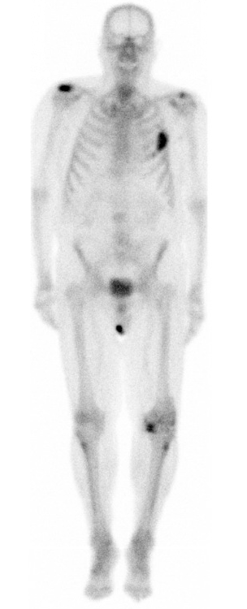

Abiraterone + Prednisone
Response to Treatment
Patient responds initially with PSA nadir of 0.25 after 3 months on therapy
Repeat CT/BS 6 months on treatment reveals decrease in nodes and stable osseous mets
Disease Progression
6 months on therapy PSA begins rising
9 months on therapy patient noted to have new osseous mets, back pain and PSA of 6.38 ng/ml
Patient progresses to metastatic castration-resistant prostate cancer (mCRPC)

Slide 13
Subsequent Management
ADT continued and patient is started on docetaxel 75 mg/m² Q3 weeks and prednisone
Abiraterone +
prednisone
DOCETAXEL +
prednisone
Treatment Sequence

Slide 14
Docetaxel + Prednisone
Response to Treatment
PSA nadir after 6 cycles, stable bone scan
Experienced adverse events
Treatment discontinued after 8 cycles due to progressive fatigue and fluid retention
Prednisone tapered off
Patient’s disease progresses …

Slide 15
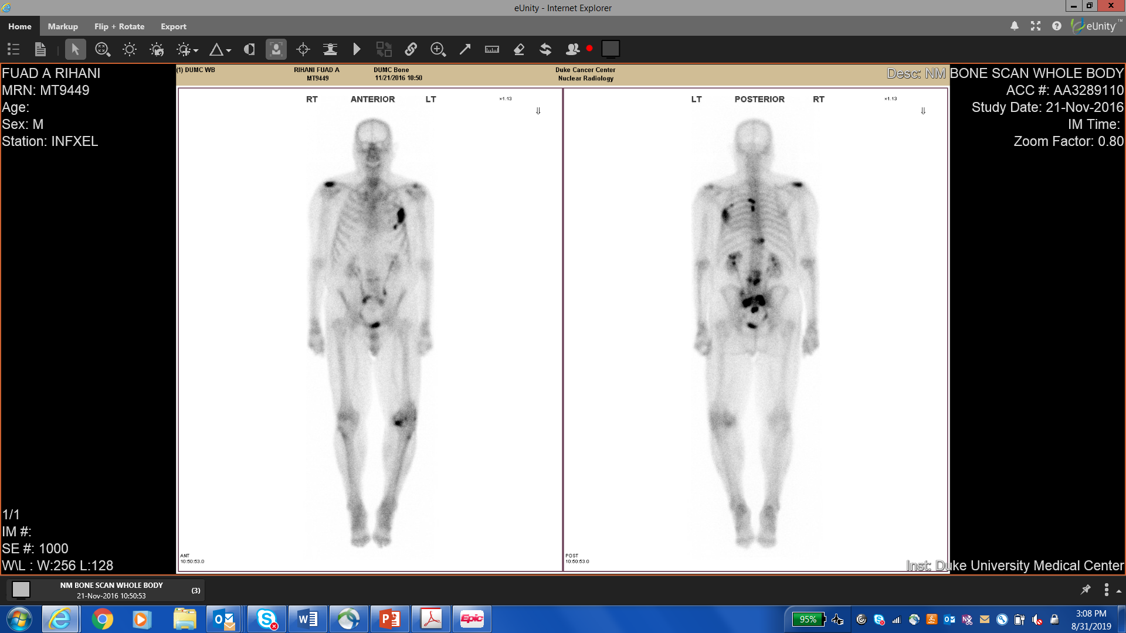
Docetaxel + Prednisone
Disease Progression
3 months off docetaxel PSA is up to 5.77 ng/ml,
new pain in his upper spine; bone scan confirms
new thoracic metastases
Palliative XRT to his thoracic spine with pain response as well as weight loss, decreased appetite, GERD
4 months off docetaxel weight loss continues with
left pleural effusion and pleural metastases on CT;
PSA rises to 10.24 ng/ml
Guardant 360 (ctDNA) reveals AKT1 E17K and TP53 R248 W mutations

Slide 16
Subsequent Management
Patient started on JEVTANA (cabazitaxel) 25 mg/m² Q3 weeks and prednisone with granulocyte colony-stimulating factor (G-CSF)
Abiraterone +
prednisone
DOCETAXEL +
prednisone
CABAZITAXEL + PREDNISONE
Treatment Sequence

Slide 17
CARD Trial
A comparative, prospective phase 4 trial of JEVTANA (cabazitaxel) vs abiraterone or enzalutamide in patients with mCRPC
(n=255)
Patients with mCRPC‡ who had previously received docetaxel (at least 3 cycles before or after an AR-targeted agent)
and had disease progression within
12 months on an AR-targeted agent
Stratification:
ECOG PS:
Time to disease progression (≤6 months vs >6 to
12 months)
Timing of previous
AR-targeted agent (before vs after docetaxel)
JEVTANA 25 mg/m²
q3w + oral prednisone
10 mg daily + G-CSF
(n=129)
Randomized 1:1
Oral abiraterone 1000 mg
once daily + oral prednisone
5 mg twice daily OR oral enzalutamide 160 mg once daily
(n=126)
DOCE
ARTA
OR
ARTA
DOCE
AR-targeted agent=abiraterone or enzalutamide. Median follow-up was 9.2 months from randomization until the end of the study.
ARTA=AR-targeted agent; CT=computed tomography; DOCE=docetaxel; MRI=magnetic resonance imaging; PCWG2=Prostate Cancer Clinical Trials Working Group 2..
‡Patients had histologically confirmed prostate cancer and castrate levels of serum testosterone (<0.5 ng/mL).
Please see additional Important Safety Information throughout and Full Prescribing Information,
including Boxed WARNING, available at this presentation.

Slide 18
CARD Trial
Randomized, open-label, multicenter study (n=255)
The trial enrolled patients with mCRPC who had previously received docetaxel and had disease progression within 12 months on an AR-targeted agent
Patients were stratified according to ECOG PS, time to disease progression (≤6 months vs >6 to 12 months), and timing of previous AR-targeted agent (before vs after docetaxel)
Patients were randomized (1:1) to:
– JEVTANA (cabazitaxel) 25 mg/m² q3w + oral prednisone 10 mg daily + G-CSF OR
– Oral abiraterone 1000 mg once daily + oral prednisone 5 mg twice daily or oral enzalutamide 160 mg once daily*
The CARD trial was an open-label trial with no blinded central review of the standard imaging. Conducted at 62 sites in 13 European countries
The 25 mg/m² dose of JEVTANA was used in the CARD trial, which was conducted in Europe. The recommended starting dose of JEVTANA is 25 mg/m² in the European label
This trial was sponsored by Sanofi
Endpoints
Primary endpoint: Imaging-based progression-free survival (rPFS)
rPFS is defined as the time from randomization to the occurrence of one of the following events: radiological tumor progression using RECIST 1.1 (except for lymph nodes: if lymph node metastasis is the only evidence of metastasis at baseline, it must be ≥20 mm in diameter when measured by spiral CT or MRI [as defined by PCWG2]), progression of bone lesions according to PCWG2 criteria, or death.
Secondary endpoints included overall survival, tumor response, and safety
*Abiraterone was given to patients who had previously received enzalutamide before trial entry and enzalutamide was given to patients who had previously received abiraterone.

Slide 19
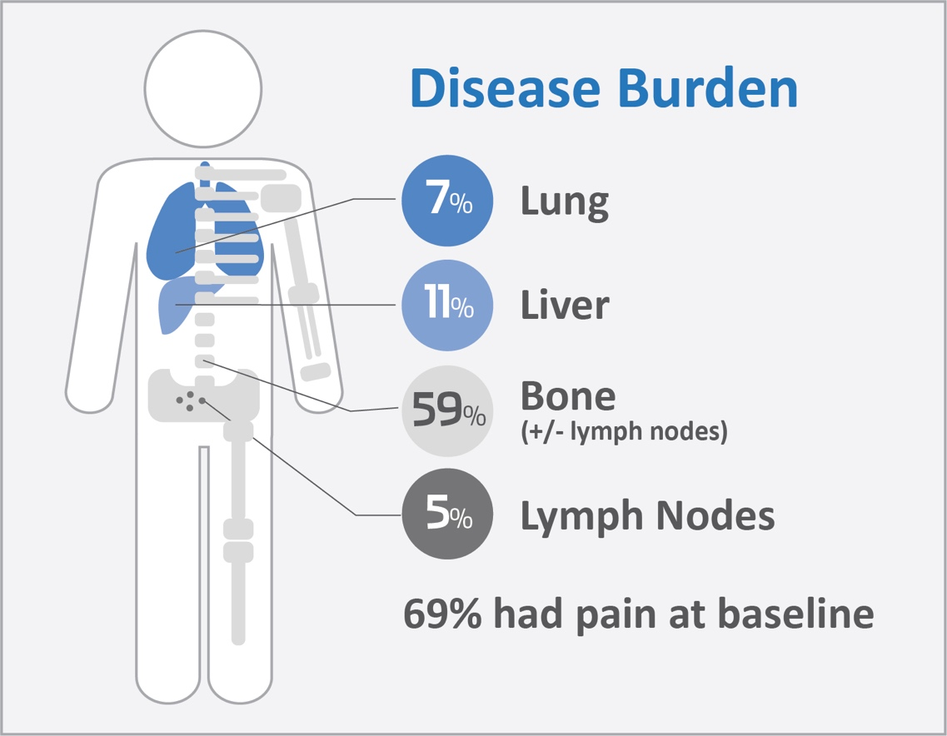
CARD Trial: Patient Characteristics
Median age (range): ~70 years (45-88);
31% were ≥75 years
ECOG PS: 0-1: 95% and 2: 5%
Speed of progression: All patients had disease progression within 12 months on abiraterone or enzalutamide either before or after docetaxel
(at least 3 cycles)

Slide 20
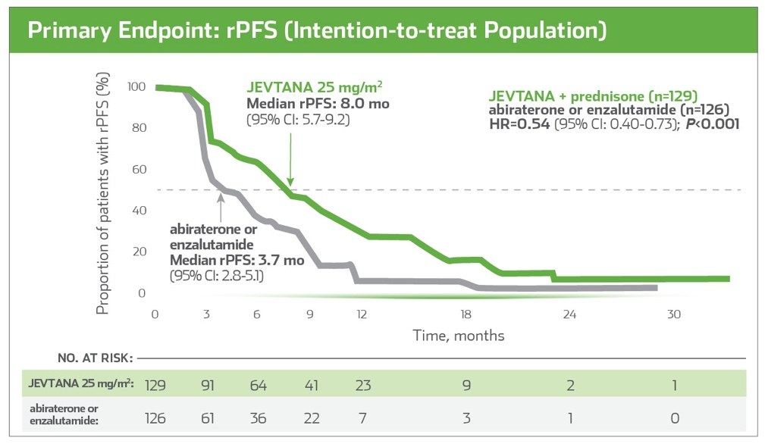
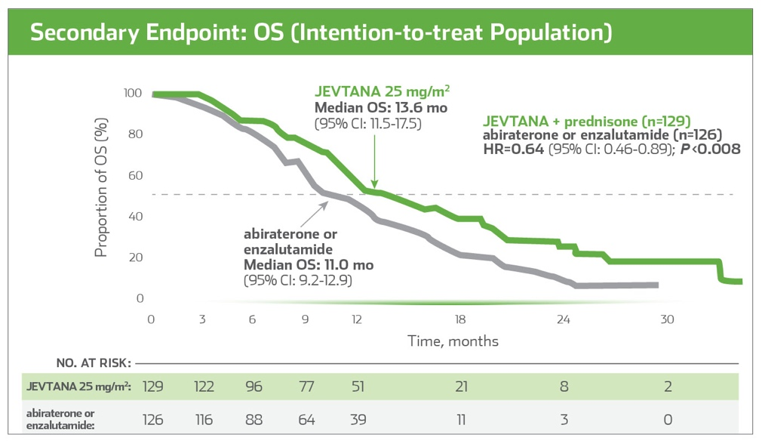
CARD Trial: JEVTANA (cabazitaxel)
46% relative reduction in risk of radiographic progression or death
36% relative reduction in risk of death
All efficacy analyses were performed on the intention-to-treat population, at the cut-off date for 196 rPFS events
After progression, the choice of subsequent anticancer treatment was at the discretion of the investigator. Of 126 patients randomized to an AR-targeted agent, 42 (33.3%) received JEVTANA after progression. Of 129 patients randomized to JEVTANA, 30 (23.3%) received abiraterone or enzalutamide after progression
At the cutoff date, 153 deaths were noted, with 70 deaths (54.3%) occurring in the JEVTANA 25 mg/m² group and 83 (65.9%) in the abiraterone or enzalutamide group
Reference: de Wit R, de Bono J, Sternberg CN, et al; for the CARD Investigators. Cabazitaxel versus abiraterone or enzalutamide in metastatic prostate cancer. N Engl J Med. 2019. doi: 10.1056/NEJMoa1911206. [Epub ahead of print].

Slide 21
CARD Trial: Safety
AE of Any Grade Reported in ≥10% and/or Grade ≥3 Reported in ≥3% of Patients in Either Treatment Arm
(Safety Population), No. (%)
 | JEVTANA 25 mg/m² + prednisone (n=126) |  | abiraterone or enzalutamide (n=124)
Adverse event | All grades | Grade ≥3 | All grades | Grade ≥3
Asthenia/fatigue | 67 (53.2) | 5 (4.0) | 45 (36.3) | 3 (2.4)
Diarrhea | 50 (39.7) | 4 (3.2) | 8 (6.5) | 0
Infection | 40 (31.7) | 10 (7.9) | 25 (20.2) | 9 (7.3)
Musculoskeletal pain/discomfort* | 34 (27.0) | 2 (1.6) | 49 (39.5) | 7 (5.6)
Nausea/vomiting | 33 (26.2) | 0 | 29 (23.4) | 2 (1.6)
Peripheral neuropathy | 25 (19.8) | 4 (3.2) | 4 (3.2) | 0
Constipation | 19 (15.1) | 0 | 13 (10.5) | 0
Hematuria | 19 (15.1) | 1 (0.8) | 7 (5.6) | 2 (1.6)
Decreased appetite | 17 (13.5) | 1 (0.8) | 19 (15.3) | 3 (2.4)
Dysgeusia | 14 (11.1) | 0 | 5 (4.0) | 0
Renal disorder† | 8 (6.3) | 4 (3.2) | 14 (11.3) | 10 (8.1)
Cardiac disorder | 8 (6.3) | 1 (0.8) | 10 (8.1) | 6 (4.8)
Arthralgia | 8 (6.3) | 0 | 16 (12.9) | 1 (0.8)
Spinal cord or nerve root disorder‡ | 6 (4.8) | 3 (2.4) | 9 (7.3) | 5 (4.0)
Psychiatric disorder§ | 5 (4.0) | 0 | 15 (12.1) | 0
Febrile neutropenia | 4 (3.2) | 4 (3.2) | 0 | 0
* Musculoskeletal pain or discomfort included back pain, flank pain, musculoskeletal discomfort and pain, neck pain, or pain in extremities.
† Renal disorder included, acute kidney injury, renal failure and impairment, hydronephrosis, or pyelocaliectasis.
‡ Spinal cord or nerve-root disorder included sciatica, radiculopathy, or spinal cord compression.
§ Psychiatric disorder included anxiety, depression, confusion, disorientation, or sleep disorder.
Reference: de Wit R, de Bono J, Sternberg CN, et al; for the CARD Investigators. Cabazitaxel versus abiraterone or enzalutamide in metastatic prostate cancer. N Engl J Med. 2019. doi: 10.1056/NEJMoa1911206. [Epub ahead of print].

Slide 22
CARD Trial: Safety (cont’d)
Deaths (intention-to-treat Population), No, (%)
Deaths, n (%) | CBZ (n=129) | ARTA (n=126)
Deaths during the on-study period | 70 (54.3) | 83 (65.9)
AE leading to death (fatal outcome)** | 7 (5.6) | 14 (11.3)
G-CSF was mandated every cycle per trial protocol. Per the full Prescribing Information, primary prophylaxis with G-CSF is recommended in patients with high-risk clinical features
Grade ≥3 Occurred at Similar Rates for Both Treatment Groups
AEs (Safety Population), n (%)
n (%) | CBZ (n=129) | ARTA (n=126)
Any AE | 124 (98.4) | 117 (94.4)
Grade ≥ 3 AE | 71 (56.3) | 65 (52.4)
Serious AE | 49 (38.9) | 48 (38.7)
AE leading to permanent treatment discontinuation | 25 (19.8) | 11 (8.9)
AE leading to death (fatal outcome)** | 7 (5.6) | 14 (11.3)
* Musculoskeletal pain or discomfort included back pain, flank pain, musculoskeletal discomfort and pain, neck pain, or pain in extremities.
† Renal disorder included, acute kidney injury, renal failure and impairment, hydronephrosis, or pyelocaliectasis.
‡ Spinal cord or nerve-root disorder included sciatica, radiculopathy, or spinal cord compression.
§ Psychiatric disorder included anxiety, depression, confusion, disorientation, or sleep disorder.
** Adverse events leading to death were assessed during the period from randomization to 30 days after the last treatment administration.
Reference: de Wit R, de Bono J, Sternberg CN, et al; for the CARD Investigators. Cabazitaxel versus abiraterone or enzalutamide in metastatic prostate cancer. N Engl J Med. 2019. doi: 10.1056/NEJMoa1911206. [Epub ahead of print].

Slide 23
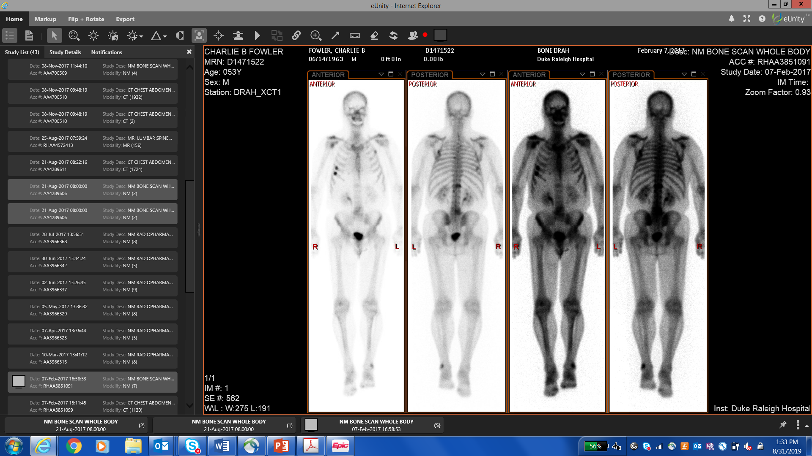
Initial Presentation
59 y/o old man found to have elevated PSA of
23.4 ng/ml on routine screening
DRE – enlarged hard prostate
Transrectal Biopsy – 6/12 cores positive (all on left) Gleason 4+4
CT A/P; Bone scan – no evidence of metastases
Initial Treatment
  Robotic-Assisted Laparoscopic Prostatectomy and Lymph Node
  Dissection (RALP +LND) revealing pT3b N0 Mx Gleason 4+5
3 Month post surgery follow up
PSA: 132.3 ng/ml
CT: Evidence of retroperitoneal adenopathy 2.4 x 1.9 cm
Bone scan: Negative for metastasis

Slide 24
Subsequent Management
Leuprolide and bicalutamide treatment initiated
12 months after initiating therapy, PSA 0.83 ng/ml (nadir)
3 months later patient progresses to mCRPC
  PSA 3.14 ng/ml
  CT A/P increased RP nodes
  Bone Scan reveals new osseous mets
Tumor profiling reveals TP53 mutation, TMPRSS2-ERG translocation
Patient progresses to metastatic castration-resistant prostate cancer

Slide 25
PREVAIL Trial
Enzalutamide in men with chemotherapy-naïve metastatic castration-resistant prostate cancer
Patient Population
1717 men with metastatic prostate cancer
progressing despite ADT
Asymptomatic/mildly symptomatic
Chemotherapy naïve
Steroids allowed, but not required
Prior antiandrogens allowed, but not required
Patients with visceral disease
(liver and/or lung) allowed
Enzalutamide
160 mg/day
(n=872)
(ADT was
maintained)
Coprimary
Endpoints
rPFS
OS
Randomized 1:1
Placebo*
(n=845)
(ADT was
maintained)
Reference: Beer TM, Armstrong AJ, Rathkopf DE, et al. Enzalutamide in metastatic prostate cancer before chemotherapy. EUROPEAN UROLOGY 7 1 ( 2 0 1 7 ) 1 5 1 – 1 5 4

Slide 26
PREVAIL Trial: Study Results
 | Enzalutamide (n=872) | Placebo (n=845)
Median rPFS (95% CI), mo | 20.0 (18.9–22.1) | 5.4 (4.1–5.6)
HR (95% CI); p value | 0.32 (0.28 – 0.36); p <0.0001
Median OS (95% CI), mo | 36 (34-38) | 31 (29-34)
HR (95% CI); p value | 0.83 (0.75 – 0.93); p =0.0008
Grade 3 or higher adverse events were reported for 46% of patients in the enzalutamide arm and 37% of patients in the placebo arm. Adverse events that led to treatment discontinuation were comparable between the enzalutamide and placebo arms (6% each). Adverse events that led to death occurred in 5% of patients in the enzalutamide arm and 4% of patients in the placebo arm.
References: Beer TM, Armstrong AJ, Rathkopf DE, et al. Enzalutamide in metastatic prostate cancer before chemotherapy. EUROPEAN UROLOGY 7 1 ( 2 0 1 7 ) 1 5 1 – 1 5 4
Armstrong AJ, et al. Five-year Survival Prediction and Safety Outcomes with Enzalutamide in Men with Chemotherapy-naïve Metastatic Castration-resistant Prostate Cancer from the PREVAIL Trial. Eur Urol (2020) https://doi.org/10.1016/j.eururo.2020.04.061

Slide 27
Enzalutamide
Response to Treatment
PSA initially declines to 1.51 ng/ml (nadir) at month 3
After 6 months, PSA up to 11.59 ng/ml
CT A/P shows increased retroperitoneal adenopathy
Disease Progression
Bone scan indicates progression with appearance of increased osseous metastases
Patient’s disease progresses …

Slide 28
Subsequent Management
Initiated on docetaxel 75 mg/m² Q3 weeks with prednisone 10 mg daily
ENZALUTAMIDe
DOCETAXEL +
prednisone
mCRPC Treatment Sequence

Slide 29
Docetaxel + Prednisone
Response to Treatment
Tolerated docetaxel with adverse events including fatigue and taste changes
PSA nadir after 4 cycles
Disease Progression
Experienced biochemical progression with PSA rise after 17 cycles (1 year)
CT A/P showed stable disease
Bone scan showed stable disease
Treatment was discontinued after 1 year.

Slide 30
After Discontinuance of Docetaxel + Prednisone
Patient continued on ADT only after docetaxel discontinuance
3 months later PSA 16.8 ng/ml
6 months later PSA 70.87 ng/ml
Restaging CT showed increased mediastinal and retroperitoneal adenopathy
Restaging bone scan showed progressive metastases
Guardant 360 (ctDNA) profiling reveals TP53 P190R; TP53 Y126C mutations
Patient’s disease progressed …

Slide 31
Subsequent Management
Patient initiated on JEVTANA (cabazitaxel) 20 mg/m² Q3 weeks with prednisone
ENZALUTAMIDe
DOCETAXEL +
prednisone
CABAZITAXEL +
PREDNISONE
mCRPC Treatment Sequence

Slide 32
Cabazitaxel + Prednisone
Response to Treatment
Continued therapy with some adverse events including:
  fatigue
  thrombocytopenia , platelet count 110,000
PSA nadir at 50.73 ng/ml after 4 cycles
CT and bone scan stable
Completes 10 cycles of treatment then patient chose a “chemo break”
  PSA 86.12 ng/ml
  At time of last assessment, CT and bone scan showed stable disease

Slide 33
Questions

