Slide 1
NASPCC Webinar Series Presents:
Exosome Testing and Liquid Biopsies – Risk Assessment for High-Grade Prostate Cancer: Home or Office Testing
Judd Moul, MD, FACS
Duke Cancer Institute
Duke University
Durham, NC

Slide 2


Greetings from Duke Cancer Institute and the Duke Prostate Center-Durham, North Carolina

Slide 3
Agenda
Overview of the PSA controversy
A brief mention of exosome science/Liquid Biopsy
Validation of the Exo Dx test
Clinical utility study of Exo Dx test
Real-world analysis-Duke
My clinical practice experience
Notes:
“Value-based care is, objectively, high-quality health care that consistently delivers the best outcomes both clinically and experientially, for the lowest possible and practical total all-in cost of care.”

Slide 4
PSA SCREENING AND USPSTF 2012, 2018
SUB-OPTIMAL SPECIFICITY (ESPECIALLY IN THE 2-10 RANGE)
PSA NOT PROSTATE CANCER SPECIFIC (BPH, PROSTATITIS,CANCER)
USPSTF RECOMMENDATIONS
  OVERDIAGNOSIS AND OVER-TREATMENT
  GRADE D RECOMMENDATION (PLCO, ERSPC) 2012
  GRADE C RECOMMENDATION (55-69 YEARS) 2018
Notes:
PSA not very specific biomarker for prostate cancer
USPSTF recommendations for PSA screening (Grade D in 2012, Grade C in 2018)
Emerging role for biomarkers to reduce over-diagnosis etc.

Slide 5
ABNORMAL PSA LEVEL?
10.0
4.0
3.0
2.0
1.5
“GRAY/GREY ZONE 2 – 10.0
“DANGER ZONE” 1.5 – 4.0
PSA “GOOD BUT NOT PERFECT”
Notes:
No general agreement on what is an abnormal PSA level
PSA level for referral to urologist?
PSA level for recommendation of prostate biopsy?
Many cancers occur in PSA “grey” and “danger” zones

Slide 6
INCREASE PSA SPECIFICITY?
AGE SPECIFIC PSA
RACE-ETHNICITY ADJUSTED PSA
PSA VELOCITY + DENSITY
% Free PSA
BIOMARKERS: BLOOD/URINE
RISK CALCULATORS (PCPT, ERSPC)
MRI IMAGING
Notes:
Many ways to attempt to improve PSA specificity for risk-adapted PSA screening.
Biomarkers and MRI emerging as preferred enhancements for PSA screening.

Slide 7
BIOMARKERS
BLOOD - PSA, fPSA, PHI, 4KScore, Iso-PSA
URINE – EXO Dx Prostate, PCA3, SELECT MDx
BLOOD AND URINE - MiPS (PSA/TMPRSS2-ERG/PCA3
TISSUE –Oncotype GPS, Prolaris, Decipher, ConfirmMDx
? RADIOMICS – mp-MRI
Notes:
Paucity of “head to head” biomarker trials.
PHI and 4K only head to head study to date
Validation studies – different age groups, different PSA levels, initial vs. prior negative biopsies
MRI emerging as a biomarker of clinically significant disease

Slide 8
PCA BIOMARKERS – “Wild West”
Tissue
BIOCHEMICAL
GENOMIC
EPIGENETIC
RADIOMICS
Blood
Urine
mp/bp-MRI
Notes:
The “WILD WEST” of Biomarkers (according to M. Cooperberg MD).
Pre-biopsy biomarkers – blood, urine, MRI.
Post biopsy/Post RP biomarkers – tissue molecular tests (genomic, epigenetic).

Slide 9
BIOMARKER CHALLENGES IN PCa
A follow-on test after a basic screening PSA to stratify risk of clinically significant cancer on biopsy
Test to reduce unnecessary negative biopsies and enhance detection of aggressive cancer (Gleason 7 plus)
Test that improves biological stratification of newly diagnosed PCa - active surveillance vs interventional therapy (surgery/RT)
Notes:
What is the role of biomarkers in diagnosis of prostate cancer?
Need to move away from histology (Gleason, GG scores) toward more precision assessment of biology and aggressiveness (genomic, molecular etc.)

Slide 10
Issues with prostate biopsy
Many prostate biopsies are benign or low-grade (GG1) and perhaps “Unnecessary”
Biopsy complications* : pain (8%) and fever (6%), troublesome hematospermia (27%), hospitalization (2%), prostatitis (2%), rising post-antibiotic prophylaxis infection rates (1.5-4.2%)
1 in 20 men regret having a biopsy
89% of patients had a side effect and 14% were worse than expected
Poor compliance with physician recommendations for a biopsy/no show for biopsy
* McKiernan J et al. JAMA Oncol. 2016 Jul 1;2(7):882-9
* Evans et al., Open Forum Infect Dis. 2017; doi: 10.1093/ofid/ofw265
* Womble PR et al. J Urol 2014; doi.org/10.1016/j.juro.2013.12.026
*Crompton S. Cancerworld Spring 2019:18-24
&Coyle et al. BMC Urol 2017;17:11
Notes:
Macro level points to the nationwide incidence.

Slide 11
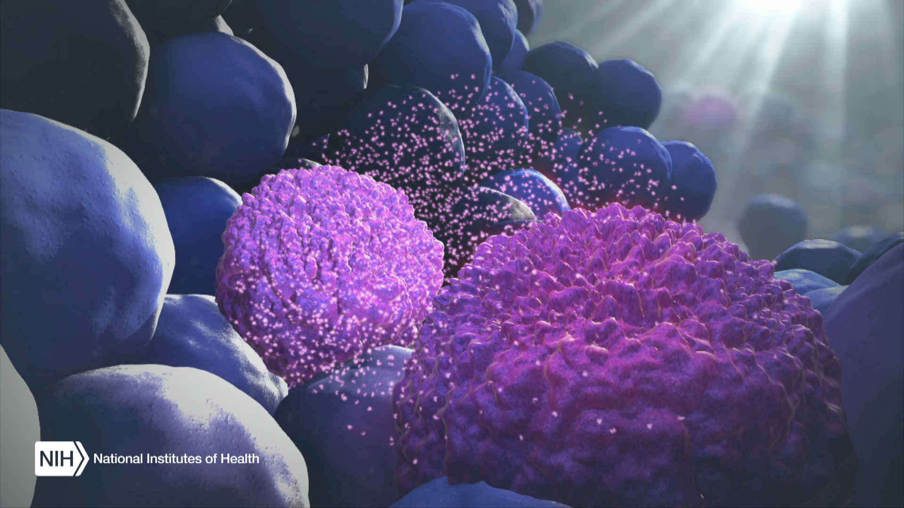
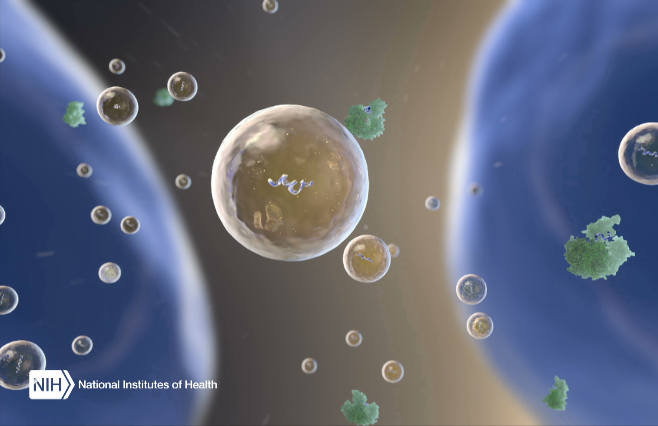
Exosomes are released by normal and cancerous cells
Exosomes are released by all living cells into biofluids
Contain RNA, DNA, protein: excellent for diagnostic needs
Measures “real time” patient biology
Play a role in health and disease
Can deliver molecules not normally secreted from cells

Slide 12
The Exodx prostate test (epi)
ExoDx Prostate is a non-DRE, urine-based liquid biopsy test analyzing three RNA biomarkers (PCA3, ERG, SPDEF) biomarkers linked to high-grade prostate cancer (>GG2) in men 50 and older with PSA of 2-10 ng/mL being considered for prostate tissue biopsy
  ExoDx assessment does not require clinical features to provide a result
  Validated as more accurate than clinical assessment tools
  Sensitivity of 92% and NPV of 91.3%
Risk of GG2 or Higher
1.0
15.6
100
EPI Below Cut-point:
DECREASED likelihood of high-grade prostate cancer (Gleason score < 7)
EPI Above Cut-point:
INCREASED likelihood of high-grade
prostate cancer (Gleason score ≥ 7)
Possible Next Steps: Continued Monitoring
Possible Next Steps: Biopsy

Slide 13
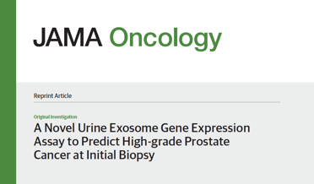
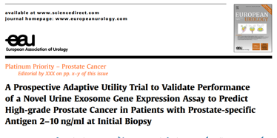
ExosomeDx validation
The ExoDx Prostate test was validated to discriminate between high grade (≥ GS7) and low grade (GS6) cancer and benign disease
Clinical validation studies include two intended use patient populations* representing more than 1,000 patients from over 24 urology clinics in the United States
Validation study results published in JAMA Oncology in July 2016 and in European Urology in August 2018; demonstrated 27% reduction in prostate biopsies
The ExoDx Test was associated with improved identification of patients with higher grade PCA among men with elevated PSA levels (2-10ng/mL)
*Men age ≥50 years, PSA 2-10ng/mL, presenting for initial biopsy
Notes:
Two prospective clinical validation studies conducted and published.

Slide 14
ExoDx Accuracy: AUC for HGPCa (GS >7) Risk Assessment
ExoDx outperformed PSA and clinical risk calculators for high grade prostate cancer
ExoDx is independent of clinical factors already considered in risk calculators and clinical evaluation
Notes:
Slide data from JAMA validation.
ExoDx accuracy is measured by area under the curve.
Point of this slide: ExoDx is significantly more accurate than any individual clinical feature or combination of features (calculators).

Slide 15
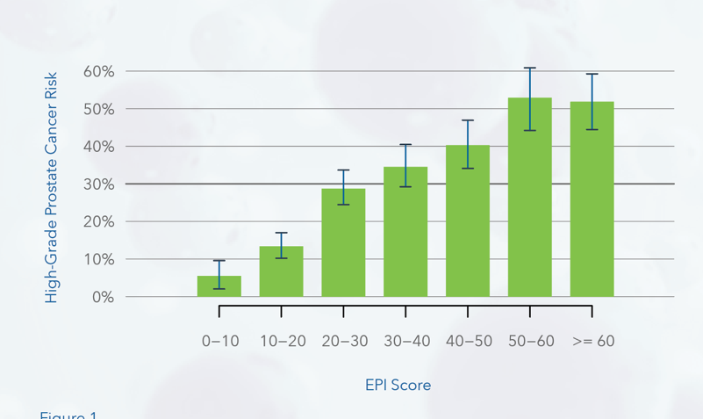

Exodx prostate Correlates with Incidence of HGPCa
Pooled analysis with >1000 patients in intended use population from JAMA Oncology, and European Urology validation studies
Notes:
Key slide point: ExoDx score can roughly be thought of as a percentage risk of HGPCa up to a maximum of ExoDx scores 50-60.

Slide 16
CareFirst BCBS study
Study Goal: Assess ExoDx Prostate impact on shared physician/patient decision making for biopsy decisions
Study Design: Multi-center clinical utility study (NCT03235687) in partnership with CareFirst BlueCross/ BlueShield of Maryland
Inclusion Criteria: men >50 with PSA 2-10ng/mL scheduled for initial prostate biopsy
Key Point: First ever-prospective, randomized prostate cancer biomarker utility study with a blinded control arm
*Prostate Cancer and Prostatic Diseases (Nature publication)

Slide 17
Study Flow
Patients were enrolled and urine collected based on standard clinical criteria
All subjects had an EPI test but were randomized into an EPI or control arm
Only the EPI arm received the results. No one was notified in advance about results
EPI arm subjects: the urologist received the test results for review with the patient during the final evaluation prior to biopsy
Control arm subjects: the urologist received a notification of No EPI Result and continued biopsy discussion per standard of care
1
2
5
3
4
Notes:
Key slide point: ExoDx accuracy (AUC) in the Carefirst clinical utility study is very similar to the accuracy displayed in both validation studies.

Slide 18
Demographics
Notes:
Key slide point: ExoDx accuracy (AUC) in the Carefirst clinical utility study is very similar to the accuracy displayed in both validation studies.

Slide 19
Decision tree and outcome for the EPI arm
458 subjects received EPI test results
93 were low risk (<15.6) and…
63% recommended to defer their biopsy (Bx) with a ….
92% compliance rate
The remaining 37% of EPI low risk subjects were recommended to have a Bx
But, 44% ultimately decided to defer biopsy.
Overall, 69 subjects, representing 74% of all EPI low risk subjects ended up deferring biopsy
1
2
5
3
6
4
7

Slide 20
Biopsy decision as a function of EPI risk score
The Bx decision rate is plotted vs. the EPI score
Urologists used the 15.6 cut-off (arrow) as a rationale to support biopsy deferral
  Only 26% of EPI low risk (<15.6) subjects proceeded with a biopsy compared to 39% in the control arm (green circle)
Above the 15.6 cut-off, due to increased compliance, the # of biopsies increased (red circle)
EPI >30 indicates an increased risk of finding HGPCA relative to SOC factors in the control arm).
Control Arm
Notes:
The # of biopsiKey slide point: ExoDx accuracy (AUC) in the Carefirst clinical utility study is very similar to the accuracy displayed in both validation studies.

Slide 21
CareFirst BCBS Results Part 1
No other biomarker has published findings with a current, real-time control arm.
This the first ever prospective, randomized prostate cancer biomarker utility study with a blinded control arm (NCT03235687).
A key learning:
  There is a misperception about the reality of Bx reduction.
  Pure Bx reduction is not possible (if the biomarker is correlated to HGPCA) because the prevalence of HGPC is higher than the actual biopsy rate.
  Bx reduction below the Bx rate results in more HGPCA
  But better care is the result: biopsies provided to the right patient at the right time

Slide 22
CareFirst BCBS Results Part 2
This study confirms that ExoDx Prostate can select the right patients at the right time for biopsy resulting in:
Below the ExoDx cut point there was a strong biopsy deferral and strong (92%) patient compliance: 23% of patients deferred their biopsy due to EPI
Above the ExoDx cut point, 30% more HGPC found as a result of increased compliance (72%) to biopsy, resulting in:
  Improved quality of patient care
  Cost savings (avoiding Bxs as appropriate and finding more HPCA earlier in the more relevant patients
    In 2.5 year follow up data, demonstrated reduction in repeat biopsies performed below the ExoDx cut-points

Slide 23
Clinical Experience with ExoDx™ Prostate Test
Notes:
Jason how would you like to hand it off to Dr. Moul?

Slide 24
Duke exodx prostate results-initial experience
N=125
ExoDx low risk: 25% (31)
ExoDx higher risk: 75% (94)
15.6 Threshold
Risk of GG2 or Higher

Slide 25
Shared decision making

Slide 26
Keeping Things Simple During COVID-EPI Score
EPI validated cut-point 15.6
Low Risk: EPI <20 “Watch and wait-follow up in 6-24 months”
Intermediate Risk: EPI 20-40 “It depends-acceptable for short term postponement”
High Risk: EPI >40 “Proceed to biopsy”
An EPI score enables the physician-patient shared decision
Removes subjectivity & improves objectivity
Patients less likely to walk away altogether

Slide 27
The Exodx Prostate test
The test score ranges from 0 to 100 and is separate from standard of care factors to help assess a man’s risk for high grade prostate cancer
Sensitivity of 92% and NPV of 91.3%
Cut-point: 15.6
EPI Result Below Cut-point:
DECREASED likelihood of high-grade prostate cancer (Gleason score < 7)
EPI Result Above Cut-point:
INCREASED likelihood of high-grade
prostate cancer (Gleason score ≥ 7)
0.0
100
Possible Next Steps: Continued Monitoring
Possible Next Steps: Biopsy
Notes:
The ExoDx score can range from 0 to 100: this is a continuum of risk.
The higher the score, the higher the probability of HGPCa (GG>2).
The cut point for defining ExoDx low risk cases is 15.6: below this threshold, there is a high likelihood that the patients does not have (GG>2).

Slide 28
Options below the cut-point of 15.6
Monitoring options
  Refer back to Primary Care Physician
  Managed with Urologist PRN
  Reassurance/Ease anxiety of patient
Also must consider: EPI Score with other clinical factors: Age, Family Hx, prostate size/BPH; Hx of prior negative Bx, patient concern; prior PSA Hx, other marker data to improve
Notes:
Dr Moul experience - Below the cut-point also saves my patients from unnecessary spend, hospitalization, and days off work

Slide 29
Case study #1
EDXA0011982-54 yo 4/5/19
EPI score 3.2
PSA 3.15; baseline 1.8-tested since 2015; no FH; No prior Bx; LUTS; prior finasteride;
40cc BPH on Digital Rectal Exam
PLAN: Reassurance
Refer back to PCP
Follow up with Urology PRN
PCP initiated tamsulosin for BPH in Jan 2020
Cut-point: 15.6
EPI Result Below Cut-point:
DECREASED likelihood of high-grade prostate cancer (Gleason score < 7)
EPI Result Above Cut-point:
INCREASED likelihood of high-grade
prostate cancer (Gleason score ≥ 7)
0.0
100
Possible Next Steps: Continued Monitoring
Possible Next Steps: Biopsy
Notes:
Add the clinical course of action

Slide 30
Case study #2
EDXA0011992-64 yo 4/5/19
EPI Score 8.95
PSA 8.02
No FH; prior biopsy negative
Mild LUTS
40cc BPH on DRE
PLAN: Reassurance
Initiate medical Rx for BPH
Follow up-Urology 2/7/20:
PSA: 6.59 (see graphic)
Cut-point: 15.6
EPI Result Below Cut-point:
DECREASED likelihood of high-grade prostate cancer (Gleason score < 7)
EPI Result Above Cut-point:
INCREASED likelihood of high-grade
prostate cancer (Gleason score ≥ 7)
0.0
100
Possible Next Steps: Continued Monitoring
Possible Next Steps: Biopsy

Slide 31
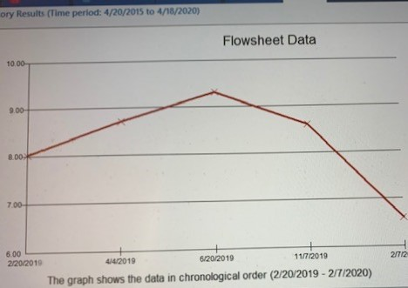

Slide 32
Management above cut-point
SECTION 1

Slide 33
Options above the cut-point of 15.6
The actual level is important e.g. “borderline” (<20); Intermediate (20-40); High (>40) (Especially during COVID)
Clinical factors to consider: Age, health, Fam Hx, Prostate Size/BPH, other markers e.g. PHI, PSA velocity, prior prostate biopsy Hx.
Patients who have abnormal EPI in addition to other factors are more compliant—lessens the “no show” rate for procedure visit
EPI Result Below Cut-point:
DECREASED likelihood of high-grade prostate cancer (Gleason score < 7)
EPI Result Above Cut-point:
INCREASED likelihood of high-grade
prostate cancer (Gleason score ≥ 7)
Notes:
Dr Moul experience with compliance to biopsy

Slide 34
Prostate Disease/Cancer and COVID Pandemic
Notes:
Dr. Moul: My experience using EPI and proceeding to biopsy is…..
Finding HGPC?
Any experience regarding spread to organs?
I have found the higher the score there is more prevalence of HGPC….
(Value) Better health for the right patient: Using EPI provides the right patient with the right standard of care

Slide 35
Triage plan during covid-19
Currently, our Duke timelines for care are:
Priority 3 : See/do now
Priority 2: Delay 6-12 weeks
Priority 1 : Delay 3-6 months

Slide 36
Case study 3
EDXA0016000-64 yo -10/2/19
EPI Score 21.39
PSA 4.71 (baseline 2.5;screening since 2015)
PHI=79.8 (High Risk)
FH: maternal grandfather died of prostate cancer
TRUS Bx 10/14/19
Dx: Gleason 4+5=9 and 4+4=8 prostate cancer in 12/12 cores
Neg CT, BS
PLAN: ADT+IMRT started 12/3/19
Cut-point: 15.6
EPI Result Below Cut-point:
DECREASED likelihood of high-grade prostate cancer (Gleason score < 7)
EPI Result Above Cut-point:
INCREASED likelihood of high-grade
prostate cancer (Gleason score ≥ 7)
0.0
100
Possible Next Steps: Continued Monitoring
Possible Next Steps: Biopsy

Slide 37
Case study 4
EDXA0011995-63 yo -4/10/19
EPI Score 89.3
PSA 4.43 (Baseline 2.5 screening since 2014)
MRI: PIRADS=5; pros volume=50cc
MRI Fusion + 12 core Bx 10/1/19:
Gleason 3+3=6 in Fusion cores; 12 systematic cores=negative
Elected initial AS
Follow up: PSA=7.01 3/16/20
Plan: Repeat MRI/repeat Bx
Cut-point: 15.6
EPI Result Below Cut-point:
DECREASED likelihood of high-grade prostate cancer (Gleason score < 7)
EPI Result Above Cut-point:
INCREASED likelihood of high-grade
prostate cancer (Gleason score ≥ 7)
0.0
100
Possible Next Steps: Continued Monitoring
Possible Next Steps: Biopsy

Slide 38
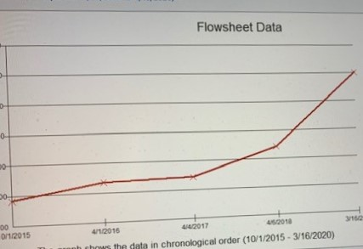

Slide 39
Telehealth solution
Most Elevated PSA consults are currently being conducted as telehealth visits (Video preferred but phone as well)
Very high-risk patients (PSA >20 ) are being encouraged to have in person visit for DRE, counseling and prostate biopsy teaching-EPI not generally indicated.
Low risk patients (PSA less than 10) and intermediate risk patients (PSA 10-20) are being asked to have a telehealth visit
Patients may be asked to come in for nurse-only visit to obtain EXO Dx (can schedule this at quiet times to adhere to extreme social distancing)
Patient At Home ExoDx Collection Kit should now further improve our ability for patient management

Slide 40
Duke University EXODx Prostate Initial Experience
Data on 250 + men Dx “elevated” PSA referrals from PCP – currently being analyzed
Pre-biopsy risk stratification
Urine collection easy in clinic; no clinical info needed on requisition form
Results available in <1 week-sent to patient via Duke MY CHART with standardized education
Independent data point for risk of high grade cancer used in shared decision-making biopsy discussion
Current initial data will form basis for a larger planned collaboration between Duke Cancer Institute Urologists and Duke Primary Care Network
Direct to patient home testing trial now underway with several other centers.
Notes:
Retrospective review of Duke experience with use of EPI.
Ongoing analysis – hopefully will lead to abstract submission for upcoming urology/urologic oncology meeting.
No prostate massage or attentive DRE needed.
Specimen should not be collected soon after routine DRE.

Slide 41
ExoDx Prostate –Future Plans at Duke
EPI score an independent, genomic risk stratification test for aggressive prostate cancer-complete preliminary assessment
Planned collaboration between Duke Cancer Institute (DCI) and Duke Primary Care Network:
  Current generation of PCP’s do not know how to use PSA properly
  Current PCP’s no longer perform DRE (unable to assess prostate size)
  Deploy Exo Dx (after proper training) to Duke Primary Care practices
  Particular emphasis on men with LUTS/BPH & African American men
  Can we streamline and make urology visit more efficient to optimize more scarce urology resources.
  RCT under development
Notes:
Detailed statistical analysis underway for abstract submission.
These are my initial takeaways and clinical impressions.
Above to be confirmed once full analysis completed

Slide 42
Thank you-honor to be here!
Judd.moul@duke.edu
Twitter: @Juddmoul

Slide 43
Questions?
Judd.moul@duke.edu
Twitter: @JuddMoul

