Slide 1


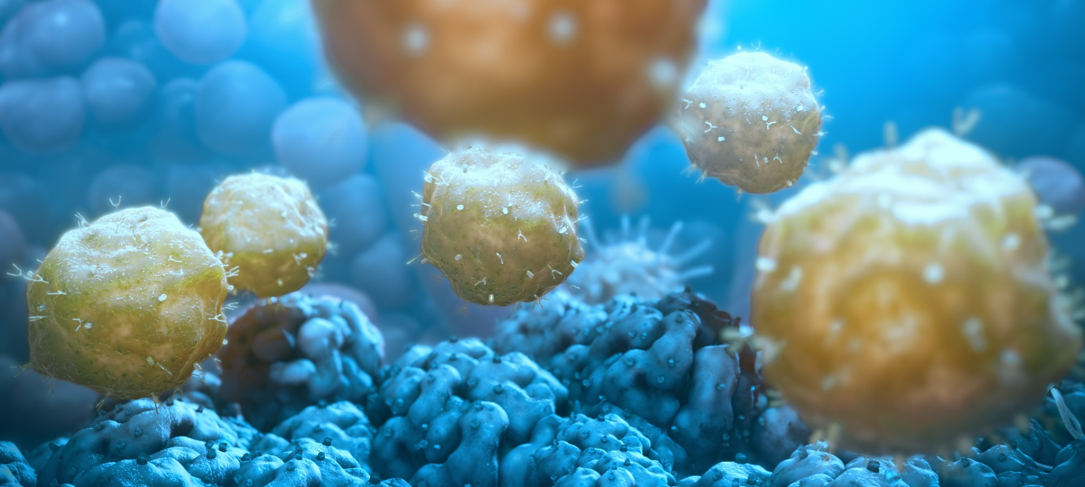
Advancing Immunotherapies for the Treatment of Prostate Cancer
Title:
Presenters: Date:
Saul Priceman, Ph.D.
Assistant Professor
Hematology & Hematopoietic Cell Transplantation Associate Director, Translational Sciences, TCTRL Beckman Research Institute
City of Hope

Slide 2



Pillars of Cancer Therapy
Smyth, Immunol Cell Biol 2017.

Slide 3

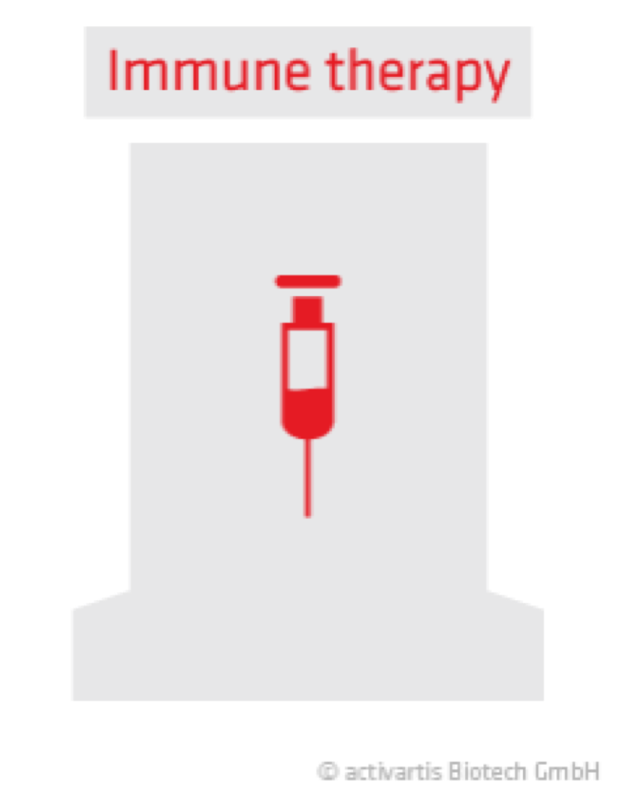
Pillars of Cancer Therapy
Smyth, Immunol Cell Biol 2017.

Slide 4
Outline
Background: Immunotherapy Strategies and CAR T Cell Therapy
Developing CAR T Cell Strategies to Target Solid Tumors
Overcoming the Barriers to Effective Immunotherapy against Solid Tumors
Where do we go from here??

Slide 5
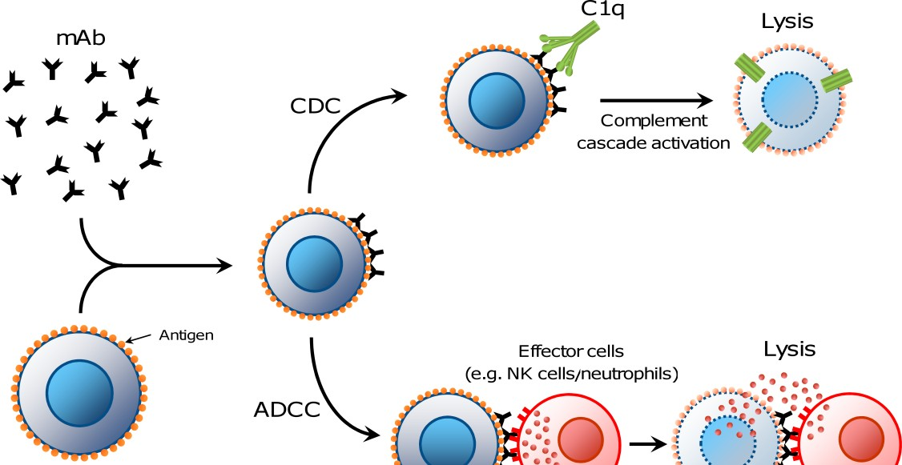
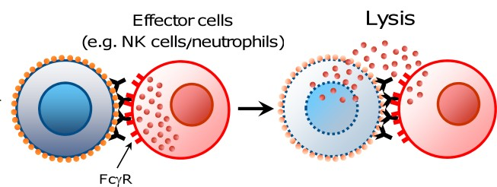
Cancer Immunotherapy
Antibody Immunotherapy
Antibody Dependent Cellular Cytotoxicity (ADCC)
*Rituximab (NHL) (Beck et al., 1999)
Tumor Cell
Tumor Cells
Adapted from Weiner LM et al.; Antibody-based immunotherapy of cancer. Cell, 2012

Slide 6
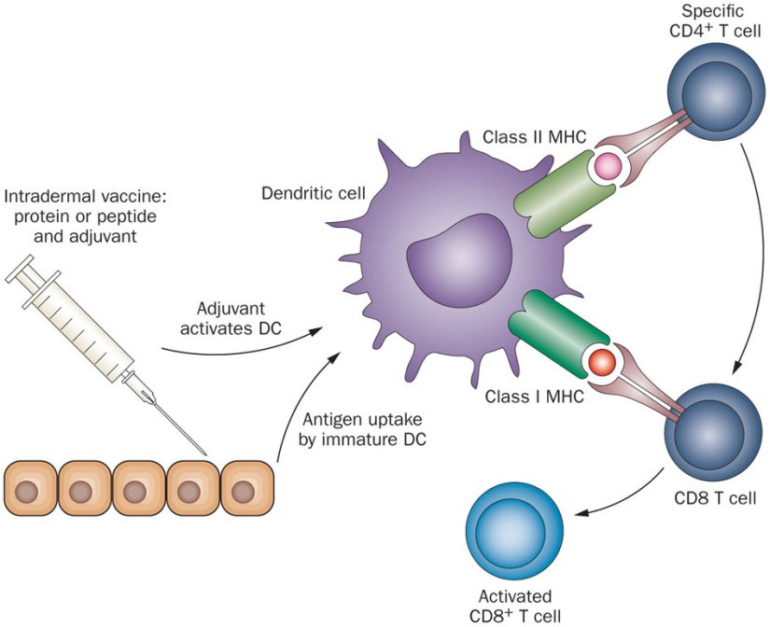
Cancer Immunotherapy
Antibody Immunotherapy
Antibody Dependent Cellular Cytotoxicity (ADCC)
*Rituximab (NHL) (Beck et al., 1999)
Cancer Vaccines
Elicit anti-tumor
T-cell responses by
inducing tumor antigen expression on DCs
*Provenge
(Hahn et al., 2012)
Adapted from Hahn NM et al.; Human Vaccines & Immunotherapeutics., 2012

Slide 7
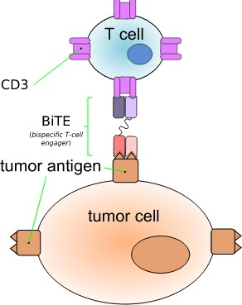
Cancer Immunotherapy
Antibody Immunotherapy
Antibody Dependent Cellular Cytotoxicity (ADCC)
*Rituximab (NHL) (Beck et al., 1999)
Cancer Vaccines
Elicit anti-tumor
T-cell responses by
inducing tumor antigen expression on DCs
*Provenge
(Hahn et al., 2012)
Bi-Specific T cell engagers
Anti-CD3/CD19 Bi-specific
Blinatumomab (ALL) (Robinson HR. et al., 2018)
Anti-CD3/PSMA BiTE (Prostate
Cancer)

Slide 8

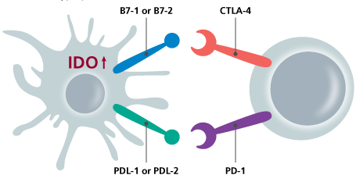
Cancer Immunotherapy
Antibody Immunotherapy
Antibody Dependent Cellular Cytotoxicity (ADCC)
*Rituximab (NHL) (Beck et al, 1999)
Bi-Specific T cell engagers
Anti-CD3/CD19 Bi-specific Blinatumomab (ALL) (Robinson HR. et al., 2018)
Activation
Cancer Vaccines
Elicit anti-tumor
T-cell responses by
inducing tumor antigen expression on DCs
*Provenge
(Hahn et al, 2012)
Checkpoint Blockade
Tumor Death
Tumor
Anti-PD1 / Anti-CTLA-4 mAbs
*Nivolumab/Ipilimumab
Metastatic melanoma (Ascierto et al., 2012)
T cell
Adapted from Weiner LM et al.; Antibody-based immunotherapy of cancer. Cell, 2012

Slide 9
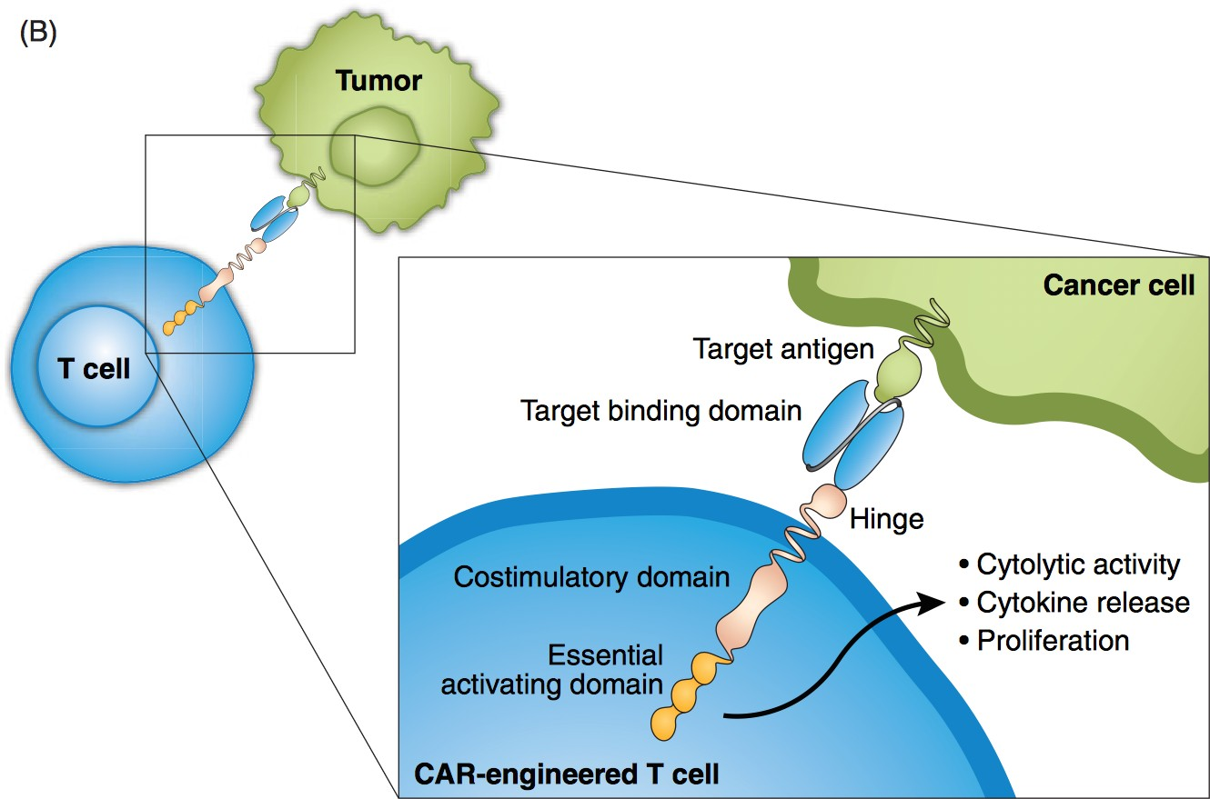
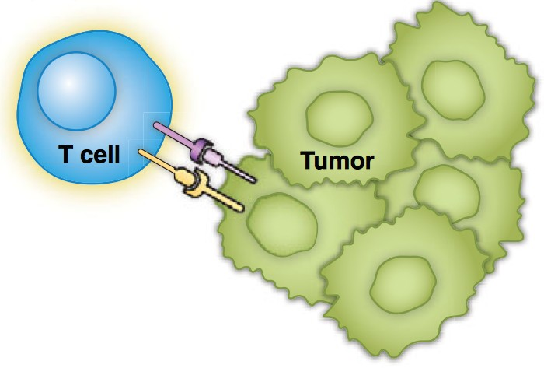




























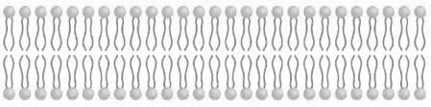


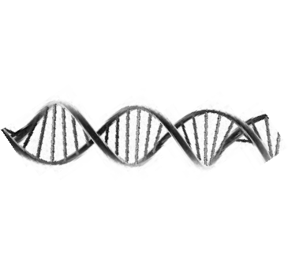





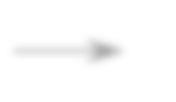














Chimeric Antigen Receptor (CAR) T Cells
Conventional TCR:MHC
Chimeric antigen receptor
Escape mechanisms in the majority of cancers
MHC down-regulation / defective antigen presentation of TAAs
Immunosuppressive tumor-infiltrating immune cells
1st generation
2nd generation
3rd generation
4th generation
Adapted from Roberts et al, Leuk & Lymphoma 2017.

Slide 10
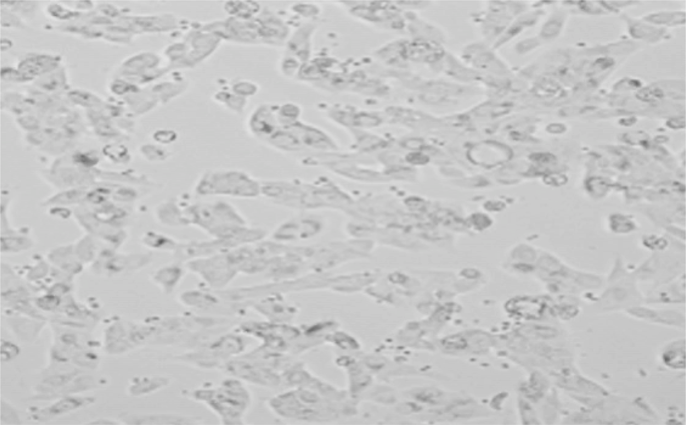
We “engineer” your immune system to fight cancer
IMMUNE CELL
CANCER CELL

Slide 11
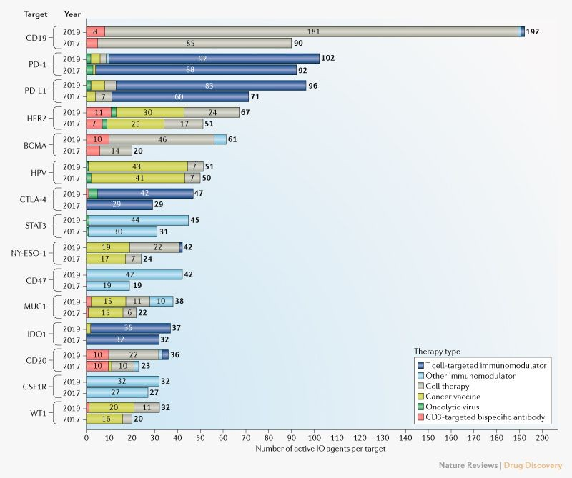
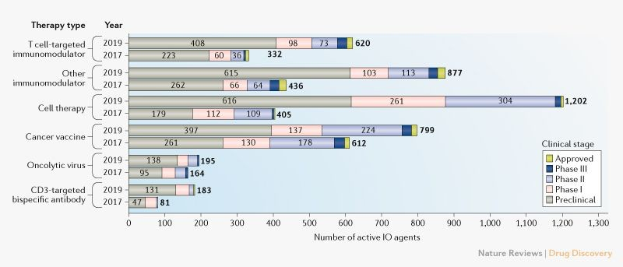
Today’s Landscape of Immunotherapy
Yu, et al. Nat Rev Drug Disc 2019

Slide 12
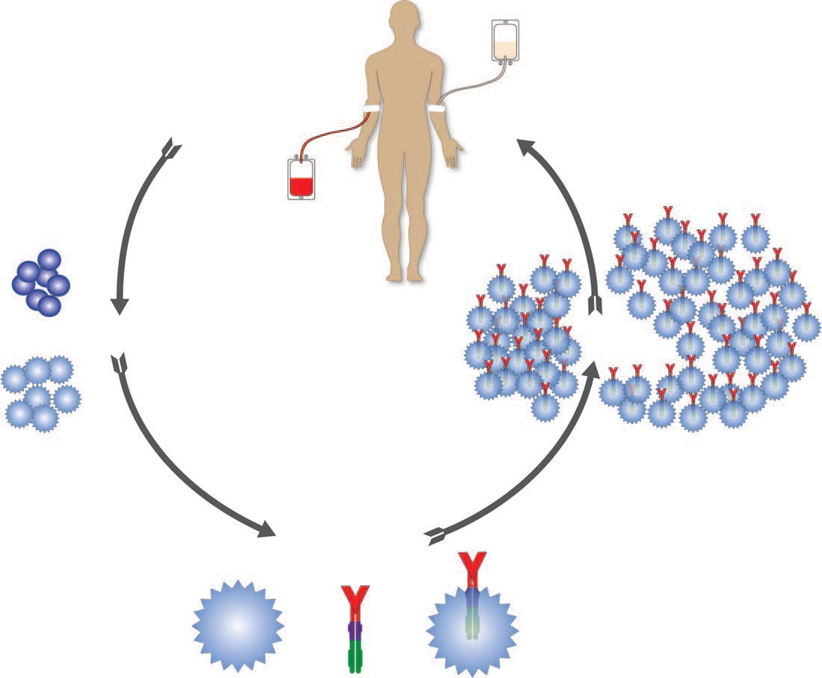
Adoptive Therapy using CAR-Engineered T Cells
Key variables in T-cell isolation
Unselected PBMC
Enriched memory subsets
Defined CD4/CD8 ratios
Key variables in adoptive transfer
Preconditoning regimens
Route of administration
T-cell dosage
Frequency of infusion
2016-2020
COH CAR TRIALS: 200+ PATIENTS
Anticipated Total Patients
₇₀ Treated Patients
t 60
s
n
ie t 50
Pa 40
f
o r 30 e
_{m} 20
b
_{Nu} 10
0
3 L L _{M M} B _{M M M} a c
^{L L} M _{M} C B B B PC ^{n}
A /i vC
_{NH 9} ^{A} ₁ GB G G B ^{R} _{O} Pa
3 ₃ M C
1 1 ^{L R2 m} 7 C
⁹ ¹ ² CS ^{1 B} R2 ^{X 2 A}
_{CD} ^{CD} _{CD} ^{IL G} HE CT HE ^{A}
1 C A PS
3 G
IL _{PS} T
1. Leukapheresis and T-cell enrichment
5. Infuse CAR T cells
+ Stimulation = 2. Activate cells
4. Expand CAR T cells
Key variables in T-cell activaction
Anti-CD3 (OKT3)
CD3/CD28 costimulation
Artificial antigen-presenting cells
Key variables in T-cell expansion
- Cytokines, e.g. IL–2, –7, –15, –21
Immune modulators, e.g. Wnt, AKT
Ex-vivo culture and fold expansion
3. Engineer CAR T cells
Key variables in CAR design
Antigen-binding domain
Extracellular linker/spacer
Intracellular signaling domain Engineering strategies
Viral delivery, e.g. lentivirus, retrovirus
Nonviral delivery, e.g. electroporation
Priceman, et al. Curr Opin Oncol 2015

Slide 13
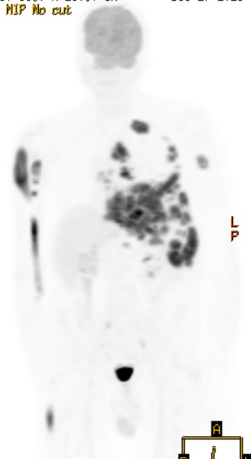
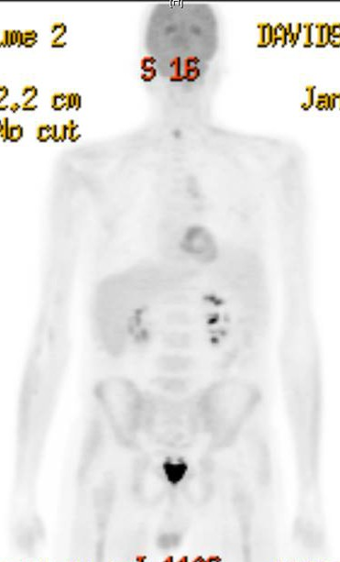

CD19-CAR T cells for Relapsed B-Cell Lymphoma and Leukemia
Case Report:
61 yr; male
Relapsed high-grade B cell lymphoma
Lymphodepletion: Flu/Cy
CD19-28z CAR T cells (200M; Tn/mem)
Grade 2 CRS (1x toci); no neurotoxicity
Pre-treatment
Post CAR T cells: 28 days
Clinical Trial | Disease | Cell Population | Cell Dose (CAR+) | Treated Patients | Response Rate
NCT | NHL | Tn/mem | 200M | 6 | Pending
02051257 | w/ auto-transplant
 | (MRD; low/neg
 | antigen)
NCT | CD19+ B cell | Tn/mem | 200M | 5 | 1 of 1 CR (4 Pending)
02153580 | Neoplasms
 | (Active disease) |  | 600M | 2 | Pending
NCT 02146924 | B-ALL (Active disease) | Tcm | 200 M | 3 | 30% CR (1 of 3)
 |  | Tn/mem | 200 M | 13 | 100% CR (13 of 13)

Slide 14
Clinical development of CAR T cells
100
95
90
85
80
10
8
6
4
2
0
Ongoing trials Non-active trials
Number of clinical trials
BCMA
CD123
CD138
CD16V
CD19
CD20
CD22
CD30
CD33
CD70
Ig k
IL-1RAP
Lewis-Y
ROR1
CD19/ CD20
CD19/ CD22
NKG2D ligands
Antigens of hematological malignancies
12
Ongoing trials Non-active trials
Number of clinical trials
10
8
6
4
2
0
CAIX
CD133
CEA
c-MET
EGFR
EGFRvIII
EpCam
EphA2
FAP
FR-a
GD2
GPC3
IL-13Ra2
L1-CAM
MUC1
PD-L1
PSCA
PSMA
ROR1
VEGFR-2
ErbB2/Her2
Mesothelin
Antigens of solid tumors
Hartmann, et al. EMBO Mol Med, 2017

Slide 15
Clinical development of CAR T cells
100
95 Ongoing trials
90
_{trials 85} Non-active trials
80
clinical ⁸
10
of 6
Number ²
4
0
_{CD1}9/ _{CD1}9/ IL-1RAP Lewis-Y ^{ligands}
_{BCMA CD123 CD138 CD16V} CD19 CD20 CD22 CD20 CD22 CD30 CD33 CD70 ^{Igk} ROR1
Antigens of hematological malignancies _{NKG2D}
12
Ongoing trials
_{trials} 10 Non-active trials
clinical ⁸
6
of
4
Number ²
0
^{CAIX}_{CD133} ^{CEA}_{c-MET} EGFR_{EGFRvIIIEpCam EphA2ErbB2/Her2} ^{FAP FR-a GD2} GPC3_{IL-13Ra2L1-CAMMesothelin} MUC1 PD-L1 PSCAPSMA ROR1_{VEGFR-2}
Antigens of solid tumors
CD19 is an ideal target for CAR T cell therapy
2017: Landmark FDA Approvals DLBCL (Kite/Gilead)
Pediatric B-ALL + DLBCL (Novartis)
Moving Beyond Blood Cancers
Do CAR T cells offer similar promise for treatment of solid cancers?
Hartmann, et al. EMBO Mol Med, 2017

Slide 16
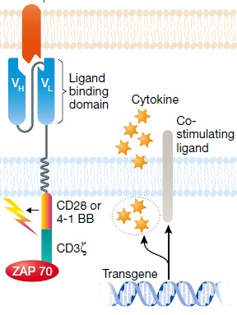
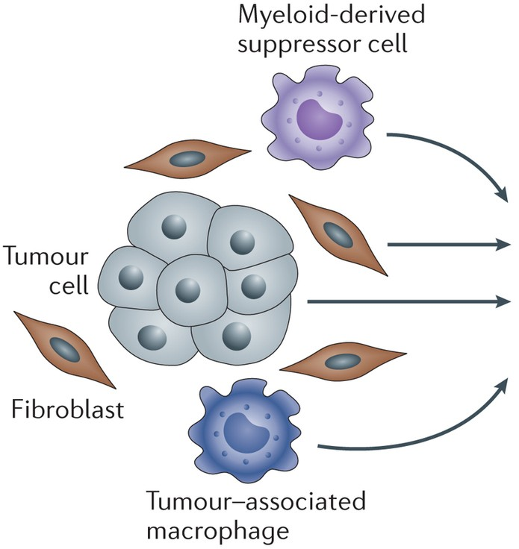

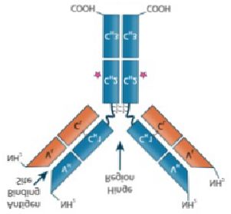

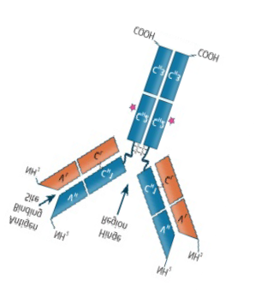

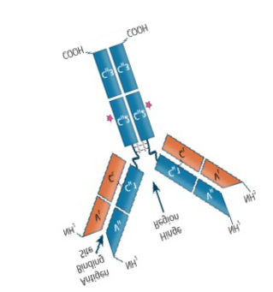

Barriers to CAR T Cell Therapies for Solid Cancers
Antigen Heterogeneity:
– New CAR T cells against
novel tumor antigens required to address heterogeneity
(Restifo, Hinrichs, Nat. Biotech 2013)
Extracellular
Matrix
mphocytes R ^{CAR CAR}
CA
cells/T reg)
CAR T Cell Persistence:
– Modified CAR T cell designs can increase durability
(Zheng et al., Oncotarget 2018)
Ly (T
Solid Tumor Microenvironment:
– Cellular/extracellular factors suppress CAR T cell activity and persistence (Kakarla et al., Cancer J. 2014)
Adapted from Mahoney et al., 2015, Nature Reviews

Slide 17




T Cell Therapy at COH
Brain
Glioma
Brain Metastasis
Solid Tumors
Prostate
Breast
Pancreatic
Hematological
Leukemia – AML, ALL
Lymphoma
Multiple Myeloma
- Ovarian
- Liver

Slide 18
T Cell Therapy at COH
Brain
Glioma
Brain Metastasis
Solid Tumors
Prostate
Breast
Pancreatic
Hematological
Leukemia – AML, ALL
Lymphoma
Multiple Myeloma
- Ovarian
- Liver

Slide 19

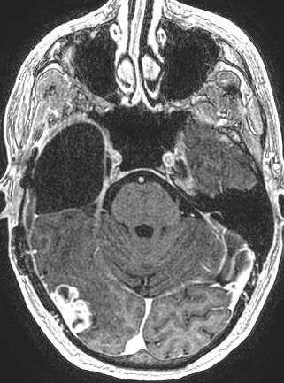
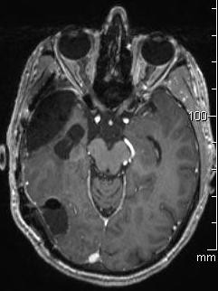
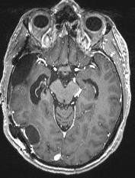
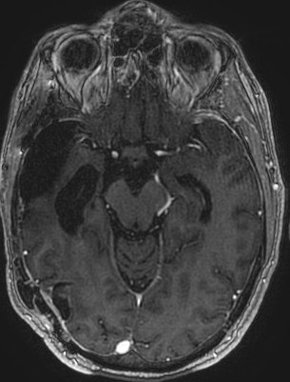

Regression of Recurrent Multifocal GBM Following IL13BBζ CAR T cell Therapy
50 yr; male
Recurrent GBM
Prior therapy: surgery, radiation, temozolamide,
Novacure device
GBM IL13Rα2+
Multifocal disease, highly proliferative
3 lesions resected
Treated with 11 infusions of IL13Rα2-CAR T cells
Pre-Op
Day -6
Pre-CAR T
Day -5
Post-CAR T
Day 21; cycles 1-3
Post-CAR T
Day 45; cycles 3-6
Brown et al, NEJM 2016

Slide 20
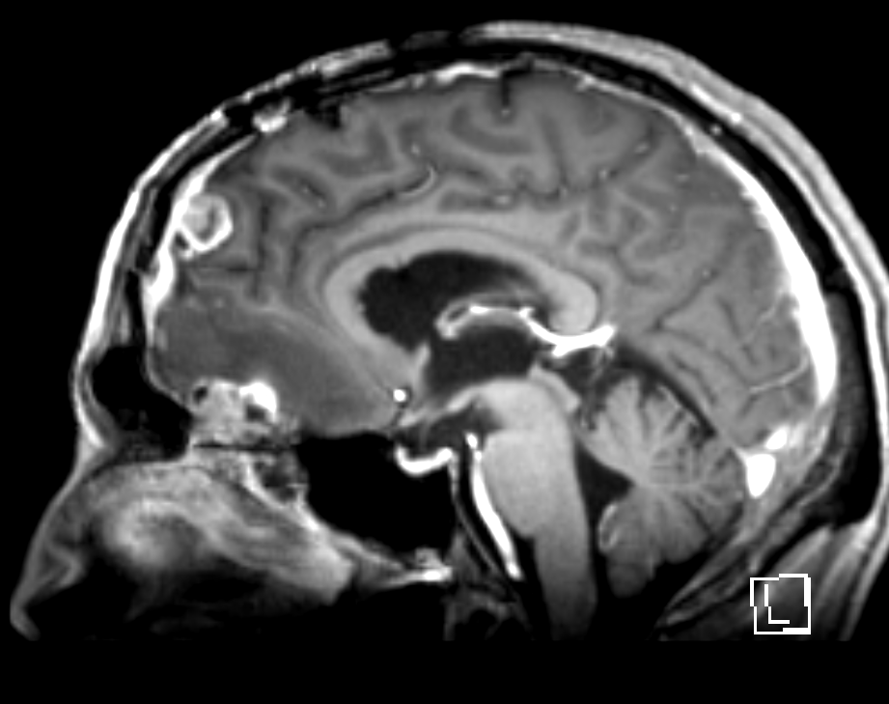

Regression of Recurrent Multifocal GBM Following IL13BBζ CAR T cell Therapy
A
Pre-CAR T (C7-C11)
MRI+Gd
L6
L7
FDG-PET
Brown et al, NEJM 2016

Slide 21
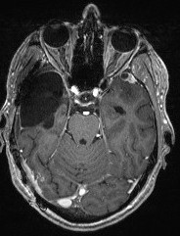
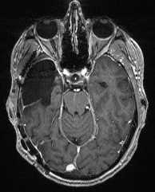
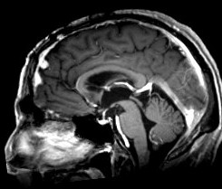

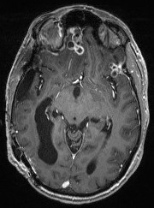
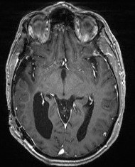
Regression of Recurrent Multifocal GBM Following IL13BBζ CAR T cell Therapy
A
B
Pre-CAR T (C7-C11)
MRI+Gd
L6
Pre-CAR T (C7-C11)
MRI+Gd
Post-CAR T (C7-C11)
MRI+Gd
Post-CAR T (C7-C11)
L6
L4
L4
L7
L7
FDG-PET
FDG-PET
L7
L7
L5
L5
Brown et al, NEJM 2016

Slide 22
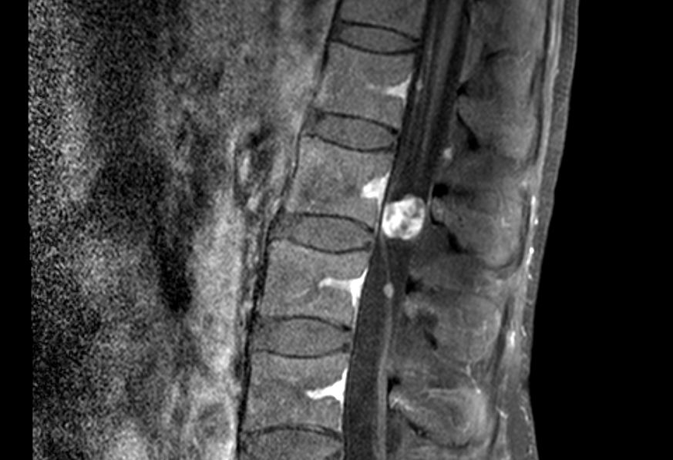
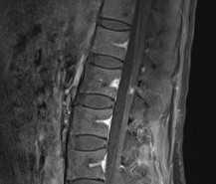

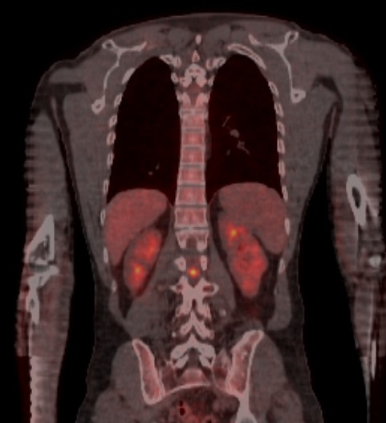
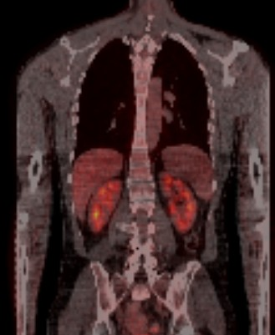
Regression of Recurrent Multifocal GBM Following IL13BBζ CAR T cell Therapy
Pre-CAR T (C7-11)
MRI+Gd
Post-CAR T (C7-C11)
MRI+Gd
Cycles 1-6 (ICT) Cycles 7-11 (ICV)
M a x L e s io n A re a ( m m ² )
4 0 0
L e s io n 4
L e s io n 5 L e s io n 6 L e s io n 7
L e s io n S p in e
3 0 0
2 0 0
FDG-PET
FDG-PET
1 0 0
0
8 0 1 0 0 1 2 0 1 4 0 1 6 0 1 8 0 2 0 0
D a y s p o s ts e n ro l lm e n t
6 0
IL13Rα2-CAR T cell infusion
Brown et al, NEJM 2016

Slide 23

The ne w engl and jour nal of medicine
Brief Report
Regression of Glioblastoma after Chimeric Antigen Receptor T-Cell Therapy
Christine E. Brown, Ph.D., Darya Alizadeh, Ph.D., Renate Starr, M.S., Lihong Weng, M.D., Jamie R. Wagner, B.A., Araceli Naranjo, B.A.,
Julie R. Ostberg, Ph.D., M. Suzette Blanchard, Ph.D., Julie Kilpatrick, M.S.N., Jennifer Simpson, B.A., Anita Kurien, M.B.S., Saul J. Priceman, Ph.D.,
Xiuli Wang, M.D., Ph.D., Todd L. Harshbarger, M.D., Massimo D’Apuzzo, M.D., Julie A. Ressler, M.D., Michael C. Jensen, M.D., Michael E. Barish, Ph.D., Mike Chen, M.D., Ph.D., Jana Portnow, M.D., Stephen J. Forman, M.D.,
and Behnam Badie, M.D.
A
MRI;
Rickham device implanted
Intraventricular CAR T-Cell Doses
6
6
6
6
6
6
6
6
6
6
2×10
10×10
10×10
MRI; PET
10×10
10×10
MRI; MRI;
PET PET
10×10
10×10
10×10
10×10
10×10
PET
MRI
MRI
MRI; CT; PET
Day: 0 108 109 112 | 119 | 126 | 133 | 141 | 148 | 156 190 | 192 213 | 233 234 254 255 276 284–298
Cycle: 7 | 8 | 9 |  | 10 | 11 |  | 12 13 | 14 15 16
Brown et al, NEJM 2016

Slide 24
T Cell Therapy at COH
Brain
Glioma
Brain Metastasis
Priceman et al. Clin Cancer Res 2018
Solid Tumors
Prostate
Breast
Pancreatic
Ovarian
Liver
Hematological
Leukemia – AML, ALL
Lymphoma
Multiple Myeloma

Slide 25































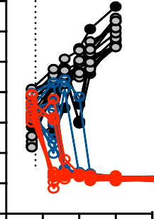
Intraventricular Delivery of HER2-BB𝜁 CAR T Cells for the Treatment of Breast Cancer Brain Metastases
a
b
Day:
7
tx
12
16
20
24
30
51
i.c. T cell delivery
i.c.v. T cell delivery
Mock i.c.
Mock i.c.v.
BBM1
LV
HER2-
BBζ i.c.
HER2-
BBζ i.c.v.
10⁵
10⁶
c
d
e
₁₀11
₁₀10
10⁹
10⁸
tx
₁₀11
₁₀10
10⁹
10⁸
10
10⁶
10⁵
tx
tx
100
Tumor only Mock i.v.
HER2-BBζ i.v. HER2-BBζ i.c.v.
Mock i.c. Mock i.c.v. HER2-BBζ i.c.
HER2-BBζ i.c.v.
Tumor Only
Mock i.v. HER2-BBζ i.v.
HER2-BBζ i.c.
Flux (photons/sec)
Mock i.c.
Mock i.c.v.
HER2(EQ)BBζ i.c. HER2(EQ)BBζ i.c.v.
Flux (photons/sec)
Percent survival
v.
10
7
7
50
10⁶
10⁵
10⁴
0 10 20 30 40 50 100 150
Days post tumor injection
10⁴
0
50 100
Days post tumor injection
0
0
50 100
Days post tumor injection
150
150
-ICV therapy provides potent antitumor activity against brain metastases and is superior to IV delivery (at 10-fold lower dose)
Priceman, et al. Clin Cancer Res 2018

Slide 26
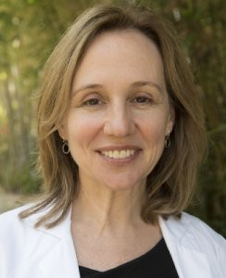
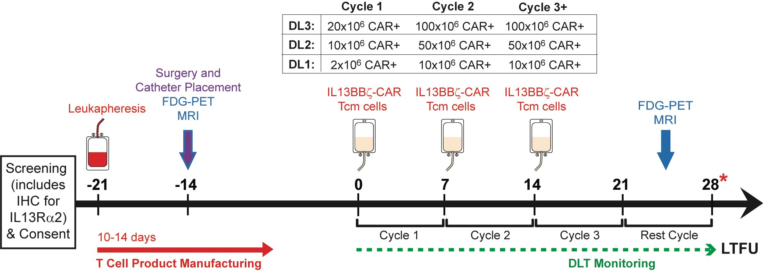
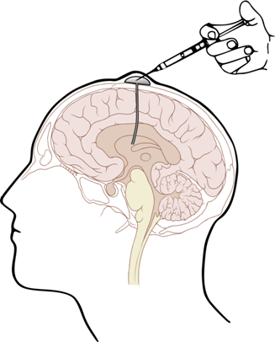

Phase I Clinical Trial to Evaluate HER2-BB𝜁 CAR T Cells in Breast-to-Brain Metastasis
HER2+ Brain/Leptomeningeal Metastases
(Clinical PI: Jana Portnow, MD, Research PI: Saul Priceman, PhD) – enrolling
HER2BB𝜁
HER2BB𝜁
HER2BB𝜁
Continue therapy if no disease progression observed
HER2
DLT monitoring
HER2-CAR in BBM phase 1 trial
Meringoff Foundation Norris Foundation Horowitz/Marsh funds

Slide 27
T Cell Therapy at COH
Brain
Glioma
Brain Metastasis
Solid Tumors
Prostate
Breast
Pancreatic
Hematological
Leukemia – AML, ALL
Lymphoma
Multiple Myeloma
Ovarian
Liver
Murad et al.
Front Immunol 2018

Slide 28
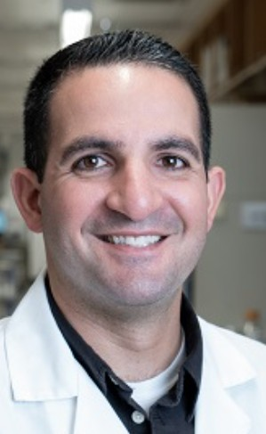


































Regional delivery of TAG72-CAR T cells delay the growth of human peritoneal ovarian tumors in xenograft models
a
b
₁₀11
₁₀10
10⁹
10⁸
tx
tx
Days: 13
tx
17 21 24 28 34 43 66
₁₀11
₁₀10 TAG72-BBζ i.p.
10⁹
10⁸
Mock i.p.
i.p. OVCAR3 tumor
i.v.
T cell
Mock i.v.
i.p.
T cell
(photons/sec)
Mock i.p.
10⁷
0 25 50 75
TAG72-BBζ i.p.
10⁷
0 25 50 75
TAG72-BBζ i.v.
₁₀11
₁₀10
10⁹
10⁸
10⁷
tx
₁₀11
₁₀10
10⁹
10⁸
10⁷
tx
Flux
10⁶
10⁸
Mock i.v.
TAG72-BBζ i.v.
0 25 50 75 0 25 50 75
Days post tumor injection
-Intraperitoneal delivery of TAG72-CAR T cells demonstrate potent anti-tumor activity with improved survival of mice bearing peritoneal ovarian tumors, but not intravenous delivery
-Tumor recurrences observed in all mice following therapy
Murad, et al. Front Immunol 2018

Slide 29
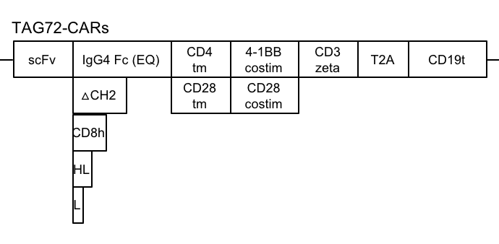
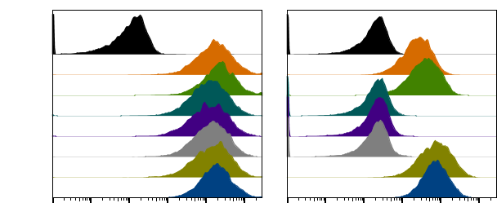
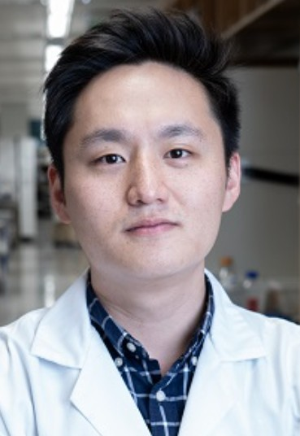
Optimization of CAR Impacts CAR T Cell Potency and Persistence
a
b
% of Max
CD19t
Protein L
Mock
TAG72-dCH2(CD4tm)BBζ
TAG72-EQ(CD4tm)BBζ TAG72-CD8h(CD8tm)BBζ
TAG72-HL(CD4tm)BBζ TAG72-L(CD4tm)BBζ TAG72-dCH2(CD28tm)28ζ TAG72-dCH2(CD28tm)BBζ
10
8
6
4
2
0
0
300

Slide 30
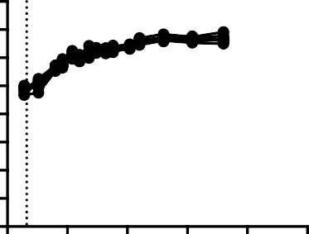
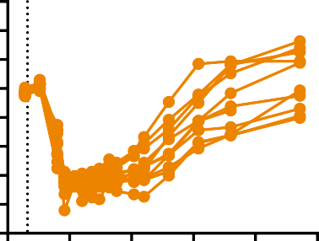


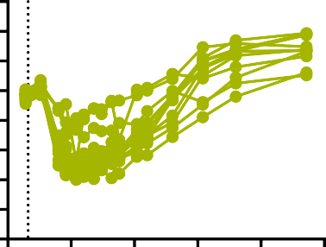
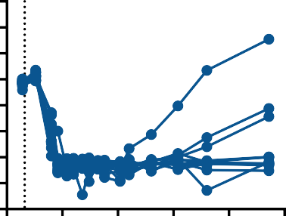
Optimization of CAR Impacts CAR T Cell Potency and Persistence
Mock
4/BBz
Mock
tx
TAG72(CD4tm)BBζ
₁₀12
₁₀11
₁₀10
10⁹
10⁸
10⁷
10⁶
10⁵
10⁴
tx
₁₀12
₁₀11
₁₀10
10⁹
10⁸
10⁷
10⁶
10⁵
10⁴
Flux (photons/sec)
Flux (photons/sec)
i.p. OVCAR3 tumor
i.v.
T cell
CR: 0/10
0 25 50 75 100 125
Day post tumor injection
CR: 0/10
0 25 50 75 100 125
Day post tumor injection
i.p.
T cell
tx
TAG72(CD28tm)28ζ
tx
TAG72(CD28tm)BBζ
₁₀12
₁₀11
₁₀10
10⁹
10⁸
10⁷
10⁶
10⁵
10⁴
₁₀12
₁₀11
₁₀10
10⁹
10⁸
10⁷
10⁶
10⁵
10⁴
Flux (photons/sec)
Flux (photons/sec)
-4-1BB co-stimulation with CD28tm provided greatest CAR T cell potency in vivo
CR: 7/10
CR: 0/10
0 25 50 75 100 125
0 25 50 75 100 125
Day post tumor injection
Day post tumor injection
Lee et al., unpublished

Slide 31
Phase 1 Clinical Trial to Evaluate Intraperitoneal Delivery of TAG72-CAR T Cells for Ovarian Cancer
cGMP production of TAG72(28tm)BB𝛇 CAR lentivirus, initiated December 2019
IND submission anticipated Q4 2020
Phase 1 trial anticipated Q1 2021 (PI: Dr. Mihaela Cristea, MD)

Slide 32
T Cell Therapy at COH
Brain
Glioma
Brain Metastasis
Hematological
Leukemia – AML, ALL
Lymphoma
Multiple Myeloma
Solid Tumors
- Prostate
- Breast
Priceman et al. Oncoimmunology 2018
Pancreatic
Ovarian
Liver

Slide 33









































PSCA-41BBζ CAR T Cells Show Increased Control of Disseminated Disease
a
Survival
D13
D20 D23 D27 D34 D36 D43 D50 D62 D76
Tumor only
0/8
0%
NSG
PSCA-CAR human CD3+ T cells
Mock
0/9
0%
LAPC-9
(intratibial)
PSCA-
28𝜁
3/11
27%
PSCA-
BB𝜁
10/11
91%
tx
-4-1BB co-stimulation demonstrates durable anti-tumor activity in patient- derived PSCA+ PCa bone metastasis xenograft model, compared with CD28 co-stimulation
b
c
NS
4000
p < 0.05
1.2
1.0
0.8
0.6
0.4
0.2
0.0 D24 D76
% hCD45⁺CAR⁺ T cells
p < 0.05
Mock PSCA-28𝜁 PSCA-BB𝜁
PSA (pg/mL)
3000
2000
1000
0
D76
Priceman, et al. OncoImmunology 2018

Slide 34
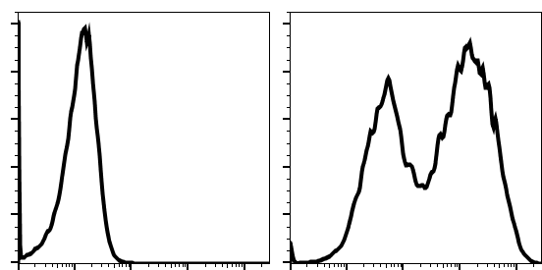





Syngeneic Immunocompetent Cancer Mouse Model “Safety and Efficacy”
a
mPSCA-BBζ
5’
 | 1G8 scFv | mCD8h | mCD8 tm | m4-1BB costim | mCD3 zeta | T2A | mCD19t
3’
- Generation of fully-murine CAR
construct in retrovirus
b
Mock
PSCA-mCAR
Mock
PSCA-mCAR
<1%
60%
64%
57%
- Effective transduction and ex vivo
expansion of murine splenic T cells
% of Max
CD8
28%
35%
CD19t
CD4
hPSCA-KI
Prostate (Epcam⁻)
Prostate (Epcam⁺)
- C57BL/6 mice with hPSCA knock-in to mouse promoter
Bladder
Stomach
2nd only _{WT}B6
hPSCA-KI^{het}
- Normal tissue expression of hPSCA allows for safety and efficacy studies in immunocompetent mice
2nd only
RM9^{WT} _{RM9}hPSCA
% of Max
PSCA (1G8)
Murad et al. unpublished

Slide 35








Requirement of Lymphodepleting Preconditioning for CAR T Cell Efficacy
a c
Mock
PSCA-mCAR
Mock + CPA
PSCA-mCAR + CPA
hPSCA-KI
100
Percent Survival
75
+ T cells (i.v.)
+_ CPA (i.p.)
50
25
p < 0.005
RM9-hPSCA
(s.c.)
0
0 10 20 30 40 50
Days post tumor injection
b
2500
2000
1500
1000
500
0
Mock
PSCA-mCAR
Mock + CPA
PSCA-mCAR + CPA
Tumor volume (mm³)
2500
2000
1500
1000
500
0
2500
2000
1500
1000
500
0
CR = 0/6
CR = 0/7
CR = 0/7
CR = 3/7
0 10 20 30 40 0 10 20 30 40 0 10 20 30 40 0 10 20 30 40
Days post tumor injection
-Safe and effective CPA-preconditioning and PSCA-CAR T cell-mediated anti-tumor responses
Murad et al. unpublished

Slide 36



















Requirement of Lymphodepleting Preconditioning for CAR T Cell Efficacy
a
Mock PSCA-mCAR Mock + CPA PSCA-mCAR + CPA
Tumor
Normal tissue
Normal tissue
Tumor
Normal tissue
Tumor
Normal tissue
Tumor
CD3
e
f
b D1 D2 D3 D4 D5 D6 c
Mock
PSCA-mCAR
Mock + CPA
PSCA-mCAR + CPA
d
Bulk Tumor RNAseq
PSCA-mCAR
X
14
12
10
8
6
4
2
0
Flux (photons/sec)
10⁹
Fold change
10⁸
PSCA-mCAR + CPA
10⁷
10⁶
1 2 3 4
Days post-T cell injection
Day 3
Mock
PSCA-mCAR
Mock + CPA PSCA-mCAR + CPA
-Tumor infiltration of T cells and PSCA-CAR T cell antitumor activity requires CPA pre-conditioning
-CPA converts to immunologically “warm” tumors with increased CD11c+ DCs and reduced CD206+ M2 macrophages
Murad et al. unpublished

Slide 37



Phase I Clinical Trials to Evaluate PSCA-BB𝜁 CAR T Cells in Solid Tumors
PSCA+ metastatic castration resistant prostate cancer
(Clinical PI: Tanya Dorff, MD, Research PI: Saul Priceman, PhD) – enrolling
PSCA+ metastatic pancreatic cancer – TBD
CT
CT
Table 1. CAR+ Cell Dose Schedule
Dose -1 | Starting Dose 0a | Dose 0b | Dose 1 | Dose 2
50M | 100M | 100M +precond. | 300M +precond. | 600M + precond.
PSCA-CAR in mCRPC phase 1 trial

Slide 38
















Immunologically “Hot” vs. “Cold” Tumors
“Cold”
TGFb
PD-1/PD-L1 CTLA-4 VEGF
IDO
TAMs
G/M-MDSCs
Tregs STAT3
“Hot”
Prostate Cancer / Pancreatic Cancer
IFNg TNFa IL-2 IL-12
CXCL9/10
CD8 T cells Th1
NK cells DCs
Melanoma
Anti-tumor immunity
Tumor mutational burden Stromal/Fibrosis contribution T cell accumulation
High suppressive myeloid/T cells

Slide 39












































KPC Metastatic Pancreatic Tumors are T Cell “Excluded”
Day:
5
11
18
T Cells
Macrophages
Murad et al. unpublished

Slide 40

Oncolytic Virotherapy
Oncolytic viruses selectively infect and replicate in tumors, promoting immunogenic cell death (ICD)
ICD can induce tumor-associated antigen release, recruitment of APCs, and elicit adaptive antitumor immunity
T-VEC – FDA approved HSV-I expressing GM-CSF for metastatic melanoma
Enhanced antitumor immunity by introduction of genes (apoptosis-inducing, chemokines, cytokines)

Slide 41

Oncolytic Viruses Deliver CAR Targets to “Targetless” Solid Tumors
with Yuman Fong MD, Stephen Forman MD, Anthony Park MS
Park et al. BioRxIV 2019

Slide 42































Oncolytic Viruses Deliver CAR Targets to “Targetless” Solid Tumors
a
J2R
Vaccinia Oncolytic Virus
CF33-(SE)hCD19t
^{P}SE
Vaccinia Virus CD19
DAPI
hCD19t
b
MOI 0.025
MOI 1
MOI 0
CD19t
c
0 hrs
24 hrs
48 hrs
72 hrs
d
0 hrs
24 hrs
48 hrs
72 hrs
OV alone
OV alone
OV + Mock
OV + Mock
OV + CAR
OV + CAR
MDA-MB-468
U251T
Park et al. BioRxIV 2019

Slide 43







OV19t Drive CD19-CAR T cell Anti-Tumor Responses in Solid Tumors
Tumor injection
OV19t
CAR T cells
D0
D36
D46
Monitor tumor growth
a
No treatment
Mock alone
CAR alone
b
600
Tumor Volume (mm³)
600
OV T cells
400
400
200
200
p < 0.05
Tumor Volume (mm³)
0
0
30 40 50 60 70 80 0
30 40 50 60 70 80 0
30 40 50 60 70 80
0
0 30 40 50 60 70 80
Days post tumor injection
OV19t alone
OV19t + Mock
OV19t + CAR
No treatment Mock alone CAR alone
OV19t alone OV19t + Mock OV19t + CAR
600
400
200
0
0
30 40 50 60 70 80 0
30 40 50 60 70 80 0
Days post tumor injection
30 40 50 60 70 80
-Combination of OV carrying CD19t and CD19-CAR T cells promotes tumor regression in xenograft model of TNBC
Park et al. BioRxIV 2019

Slide 44
OV19t Drive Safe and Effective CD19-CAR T cell Anti-Tumor Responses in Syngeneic Mouse Models of Solid Tumors
a
mCD19-BBζ
5’
 | scFv | hinge | tm | 4-1BB costim | CD3 zeta | T2A | EGFRt
3’
% Tumor Killing
100
80
60
40
20
0
100
80
60
40
20
0
100
80
60
40
20
0
OV alone OV + Mock OV + CAR
CD19t (%)
Vaccinia (%)
0.001
0.01
0.1
1
10
0.001
0.01
0.1
1
10
0.001
0.01
0.1
1
10
Multiplicity of Infection
-Combination of OV carrying CD19t and CD19-CAR T cells promotes tumor regression in syngeneic mouse models of cancer
Park et al. BioRxIV 2019

Slide 45




OV19t Drive Safe and Effective CD19-CAR T cell Anti-Tumor Responses in Syngeneic Mouse Models of Solid Tumors
Tumor injection
mOV19t
CAR T cells
D0
D7 + D9
D11
Monitor tumor growth
a
Mock
CAR
b
Tumor Volume (mm³)
1024
512
256
128
64
32
16
8
Tumor Volume (mm³)
1024
512
256
128
64
32
16
8
100
Mock
CAR
OV + Mock OV + CAR
Survival (%)
75
CR = 0/9
50
p < 0.05
CR = 0/9
25
0 20 40 60 80 100 120
Days post tumor injection
0 20 40 60 80 100 120
Days post tumor injection
0
0 20 40 60 80 100 120
Days post tumor injection
Mock + OV
CAR + OV
Tumor Volume (mm³)
1024
512
256
128
64
32
16
8
Tumor Volume (mm³)
1024
512
256
128
64
32
16
8
CR = 5/9
CR = 2/9
0 20 40 60 80 100 120
Days post tumor injection
0 20 40 60 80 100 120
Days post tumor injection
-Combination of OV carrying CD19t and CD19-CAR T cells promotes tumor regression in syngeneic mouse models of cancer
Park et al. BioRxIV 2019

Slide 46

























OV19t promotes endogenous and CAR T cell tumor infiltration
a
Mock
CAR
OVm19t + Mock
OVm19t + CAR
b
p = 0.0003
1000
800
600 p = 0.01
400
200
0
p = 0.08
Mock CAR
OVm19t + Mock OVm19t + CAR
CD3
CD8⁺ (cells/field)
CD8
c
d
e
f
Cd19
Il6 Ly6c1 Nos2 Cd274
Il1b Csf1r Tnf
Itgam Ccl5
Ly6g Cd4 Cd3g Cd8a Cd3e Cd3d Itgal Ly6c Gzmb Itgax
Flux (photons/sec x 10⁶)
3
p = 0.0013
1500
OVm19t
Tumor Volume (mm³)
-2 -1 0 1 2
2
1000
CAR
1
p = 0.11
500
0
0
CAR
0 10 20 30 40
OVm19t
+ CAR
OVm19t
Days post tumor rechallenge
Mock
CAR
OVm19t + CAR
OVm19t+CAR
Treatment naive Previously cured
OVm19t+Mock
-Combination of OV carrying CD19t and CD19-CAR T cells promotes
endogenous cytotoxic T cells and CAR T cells, and memory T cell responses
Park et al. BioRxIV 2019

Slide 47
Where do we go from here?
Learnings from Phase 1 trials
Improve persistence/survival of CAR T cell in solid tumors
Combination therapies
Engineering CAR T cells for improved potency
Radiation + CAR T cells
Oncolytic viruses + CAR T cells
Translate effective treatments for cancer!

Slide 48






Acknowledgements
Priceman Lab
Current members
John Murad, PhD Anthony Park, MS (GSR) Yuki Yamaguchi, PhD Lauren Adkins, MS Jackson Gibson, BS Rudra Bhowmick, PhD Eric Lee, BS
Jason Yang, BS
Lupita Lopez, BS (GSR) Cari Young, BS (GSR) Kevin Ou, BS
Cody Cullen, BS
Catalina Martinez, BS (Proj Mgr)
Collaborators
COH: Jana Portnow, MD, Tanya Dorff, MD, Mihaela Cristea, MD, John Burnett, PhD, Marcin Kortylewski, PhD, Monty Pal, MD, Vincent Chung, MD, Hua Yu, PhD, Laleh Melstrom, MD, Ed Manuel, PhD, Mark LaBarge, PhD, Paul Yazaki, PhD, Jack Shively, PhD, Anna Wu, PhD, Russell Rockne, PhD, Ammar Chaudhry, MD PhD, Lorna Rodriguez, MD PhD
UCLA: Owen Witte, MD, Robert Reiter, MD
USC: Peter Kuhn, PhD FHCC: John Lee, MD Caltech: Lior Pachter, PhD
Emory/GIT: Hadyn Kissick, PhD, Gabriel Kwong, PhD
Not shown: Cari Young, Jason Yang, Kevin Ou, Cody Cullen, Catalina Martinez
TCTRL
Stephen Forman, MD (Director) Christine Brown, PhD (Deputy Director) Xiuli Wang, MD PhD
Stephen Lin, PhD (Mfg Dir) Araceli Naranjo, BS (Mfg Mgr) Jamie Wagner, BS (Reg Mgr) Wen-Chung Chang, MS (Cloning) Brenda Aguilar, MS (Animal Mgr)
Elizabeth Budde, MD
Sandra Thomas, PhD (Dev Dir) Vanessa Jonsson, PhD (Comp Bio) Renate Starr, MS (Lab Mgr)
Julie Ostberg, PhD Kirsten Rood, PhD
Larry Stern, PhD (now USF) All of the TCTRL
Past members
Ethan Gerdts (UCSD Med)
Dileshni Tilakawardane, MS (TCTReg) Brook Jeang, MS (UCI PhD grad)
Kelly Kennewick, BS (UCLA PhD grad) Anna Kozlowska, PhD (Poseida)
Achini Bandara, PhD
Industry Partners
Mustang Bio, Inc
Funding Sources
Meringoff Foundation Norris Foundation Horowitz/Marsh funds

