Slide 1

PARP inhibitor Combination Treatments for Advanced Prostate Cancer
Neeraj Agarwal, MD, FASCO
Professor of Medicine
Senior Director for Clinical Translation, Huntsman Cancer Institute (HCI)
HCI Presidential Endowed Chair of Cancer Research
Director, Center of Investigational Therapeutics
Director, Genitourinary Oncology Program
Huntsman Cancer Institute, University of Utah (NCI-CCC)

Slide 2
Conflict of Interest
(career wide/past or present)
Consultancy to Astellas, Astra Zeneca, Argos, Aveo, Bayer Oncology, Bristol Myers Squibb, Calithera, Clovis, Eisai, Eli Lilly, EMD Serono, Exelixis, Foundation Medicine, Genentech, Janssen, Merck, MEI Pharma, Nektar, Novartis, Pfizer, Pharmacyclics, Seattle Genetics
Research funding to my institution on my behalf: Active Biotech, Astra Zeneca, Bavarian Nordic, Bayer Oncology, BN Immunotherapeutics, Bristol Myers Squibb, Calithera, Celldex, Clovis, Eisai, Eli Lilly, EMD Serono, Exelixis, Genentech, Glaxo Smith Kline, Immunomedics, Janssen, Medivation, Merck, Nektar, New link Genetics, Novartis, Pfizer, Prometheus, Rexahn, Roche, Sanofi, Seattle Genetics, Takeda, Tracon

Slide 3
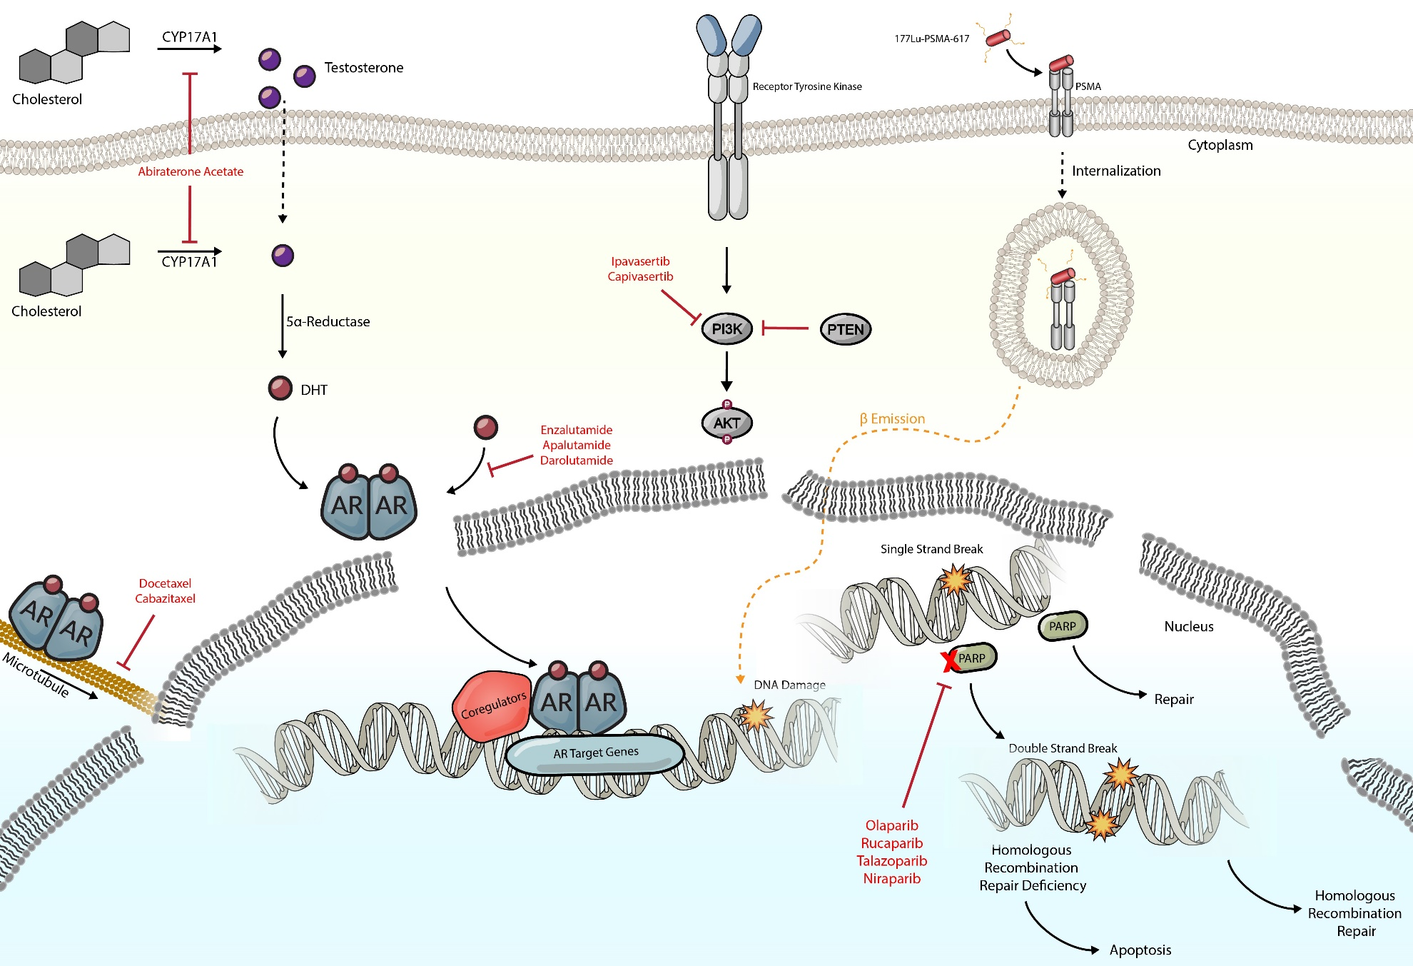
Therapeutic targets of systemic therapies for advanced prostate cancer

Slide 4
PARP Inhibitors: Mechanism of Action
PARP
DNA
Repaired
BER
Cell Survival
HRR
PARP
i
PARP
HRD
NHEJ ↑
Accumulation
of DSBs
SSB
+
i
+
i
PARP
i
PARP
Cell Death
PARP
Trapping
Replication Fork
Instability
Abbreviations: PARP = poly(ADP-ribose) polymerase; SSB = single strand break; DSB = double strand break; i = PARP inhibitor; BER = base excision repair;
HRR = homologous recombination repair; HRD = homologous recombination deficiency; NHEJ = non-homologous end joining.
Notes:
Before I delve into the trials using PARP inhibitors, let me briefly review its mechanism of action. This figure describes the pathways leading to PARP activation and how PARP inhibitors may lead to cell death. <<CLICK>> PARP is recruited to sites of single-strand DNA damage which leads to activation of the base excision repair pathway <<CLICK>> and ultimately cell survival. <<CLICK>> In the presence of PARP inhibitors an alternate mechanism for DNA repair, homologous recombination repair (BRCA1/2 pathway) is activated which also leads to cell survival. <<CLICK>> In the case of mutations in genes belonging to homologous recombination repair (BRCAness or homologous recombination deficiency), the presence of PARP inhibitors leads to cell death due to accumulation of double-strand breaks and upregulation of the non-homologous end joining pathway, a process known as synthetic lethality. <<CLICK>> Alternatively, certain PARP inhibitors (e.g. Talazoparib) trap PARP at the site of damage preventing DNA replication and leading to replication fork instability and cell death regardless of DNA homologous recombination repair defect.

Slide 5
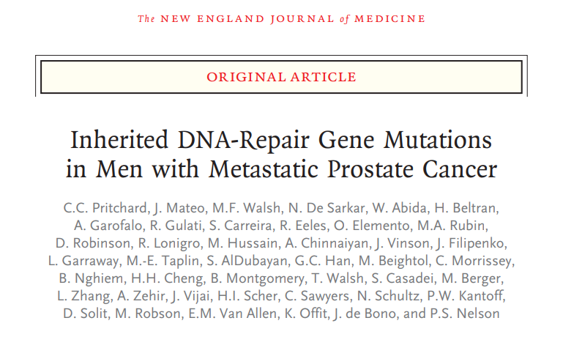
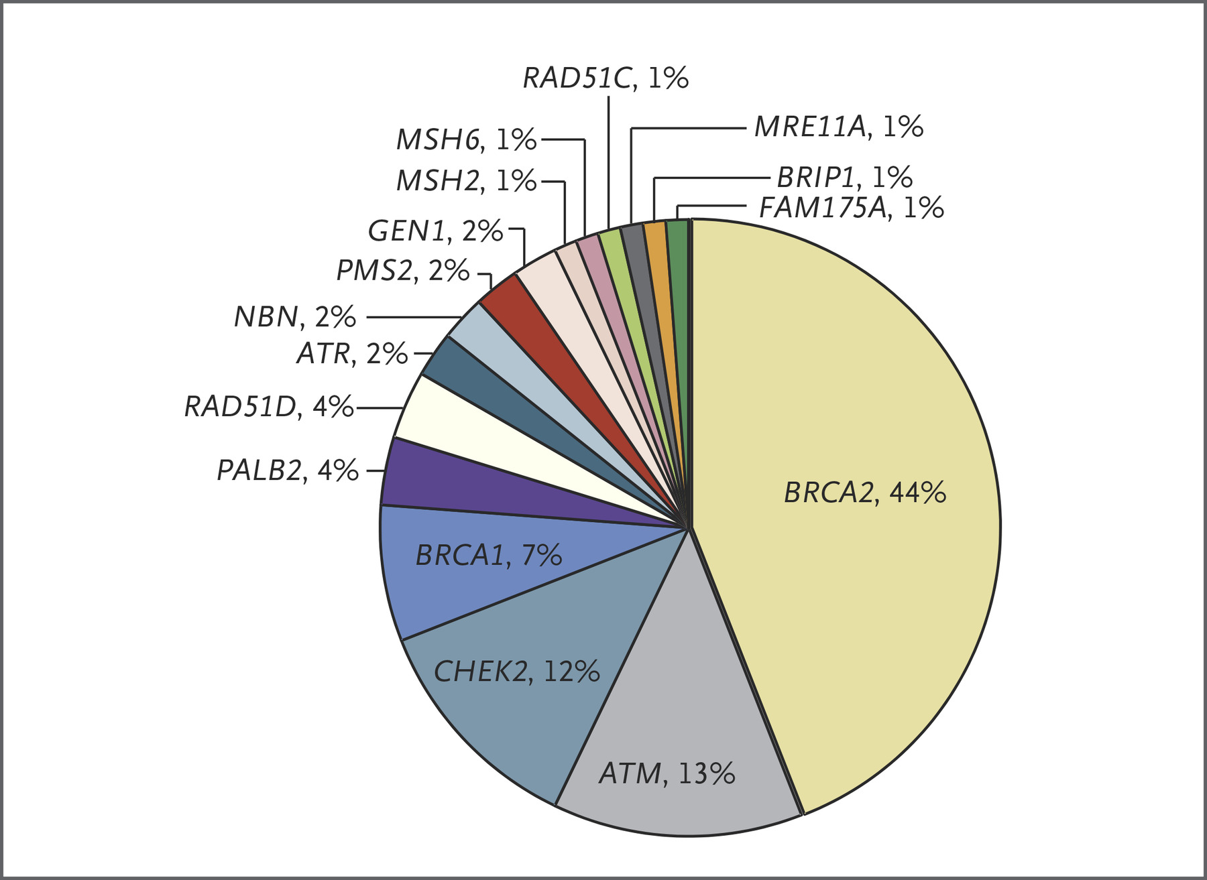
Germline HRR mutations in metastatic prostate cancer
Pritchard et al. NEJM 2016

Slide 6
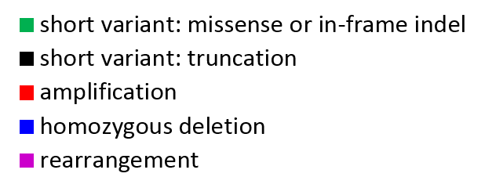

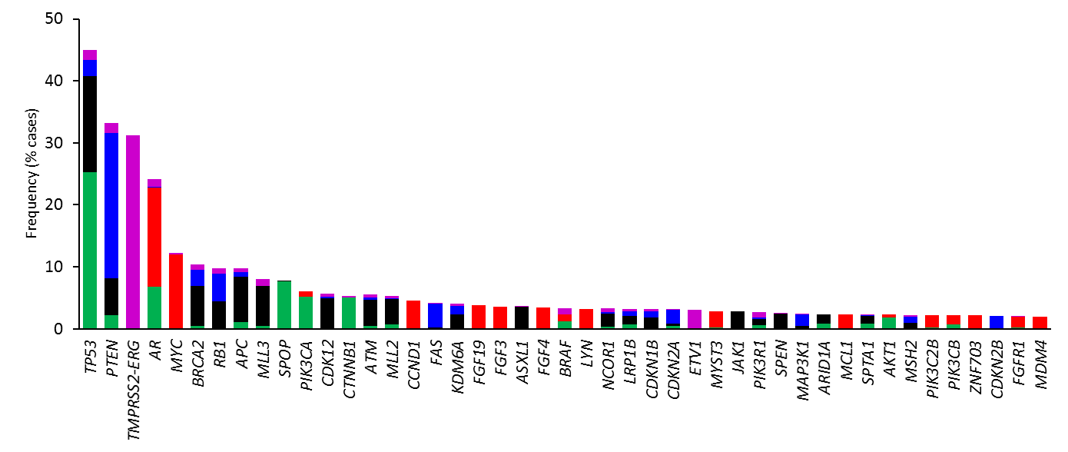
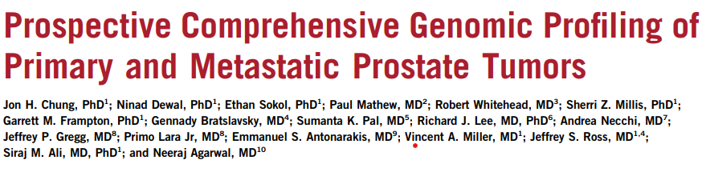
Genomic Landscape in Advanced Prostate Cancer (Tissue DNA)
n=3476 (Primary site: 1660; Metastatic site: 1816)
Chung JH, …, Agarwal N. JCO Precision Oncology 2019 (Online)
Notes:
The histogram above shows the frequency and type of GAs with the most frequent ones in <CLICK> TP53, PTEN, AR, MYC, and BRCA2. Many of the alterations detected are targetable with drugs already available in the clinic.

Slide 7
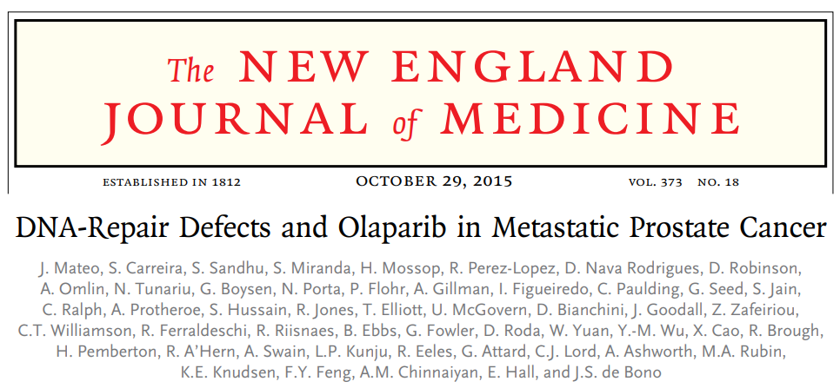
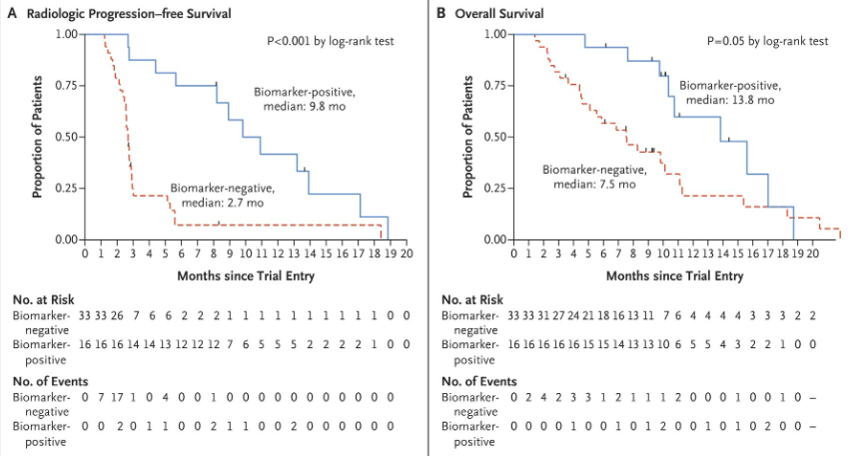
TOPARP-A (Olaparib): Phase 2 trial (mCRPC)
Mateo J. et al. NEJM 2015

Slide 8
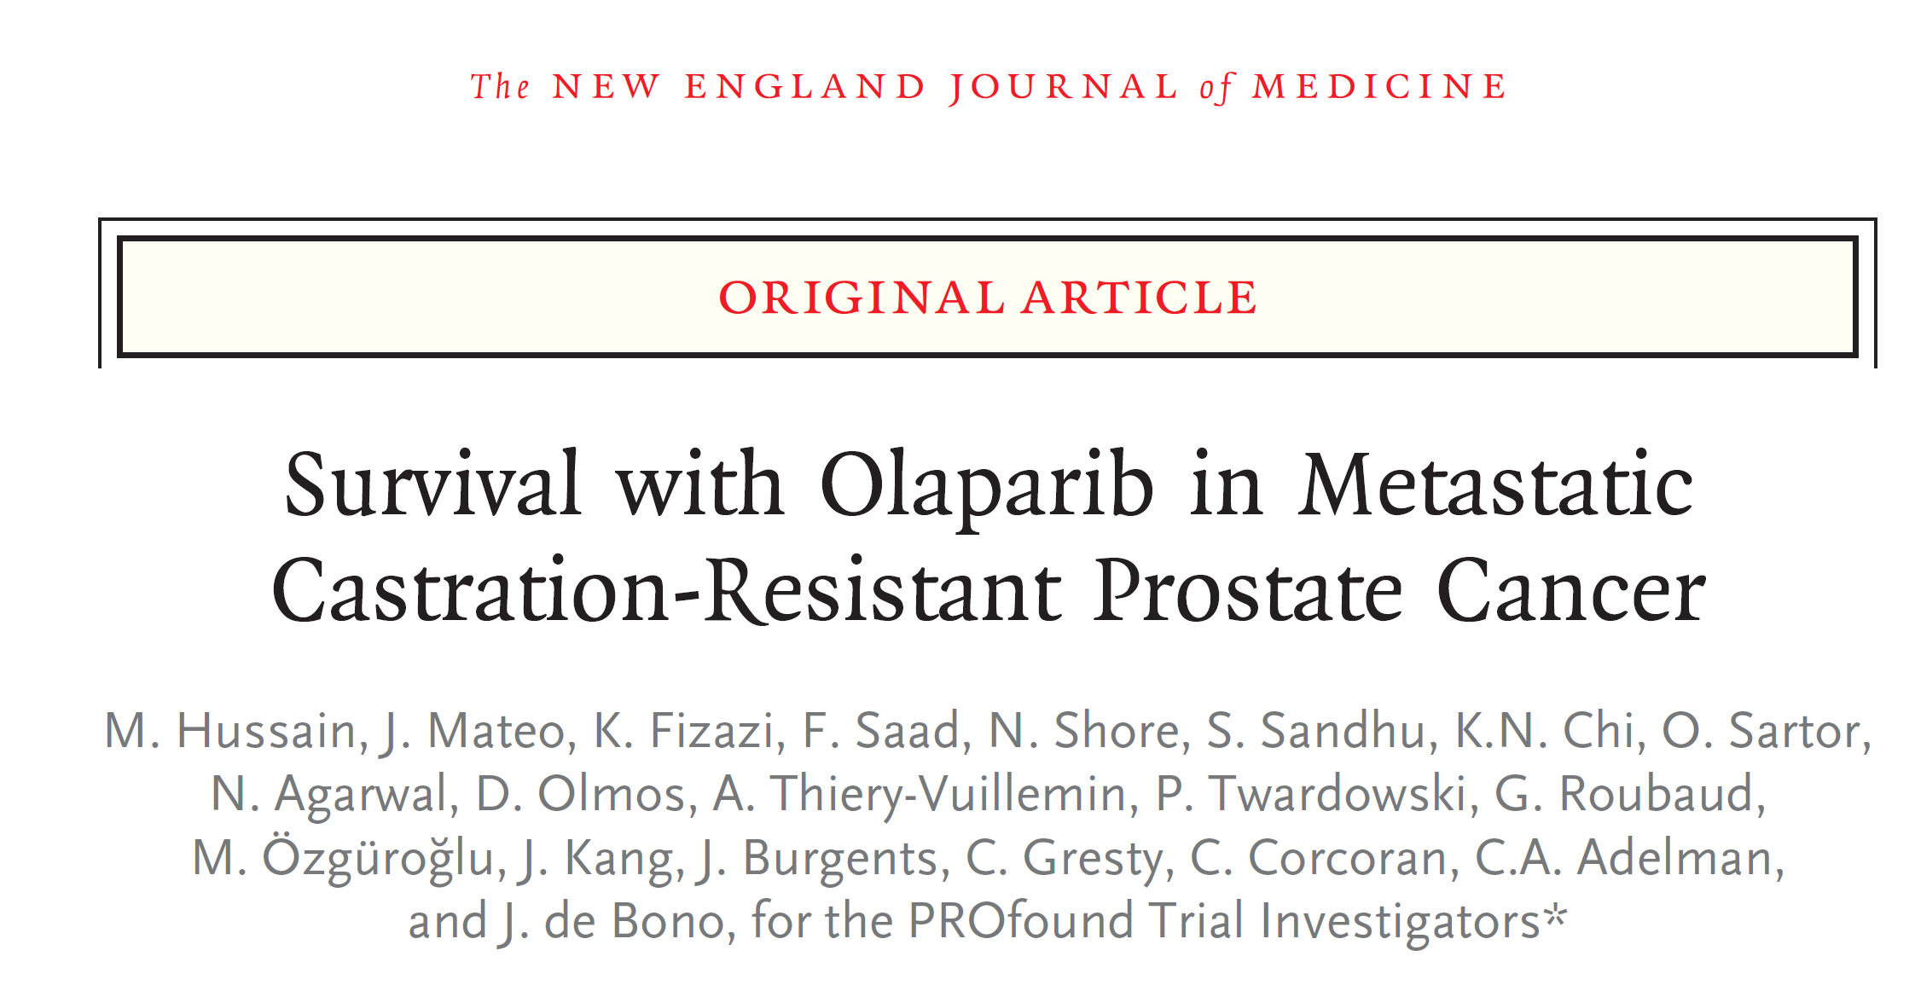
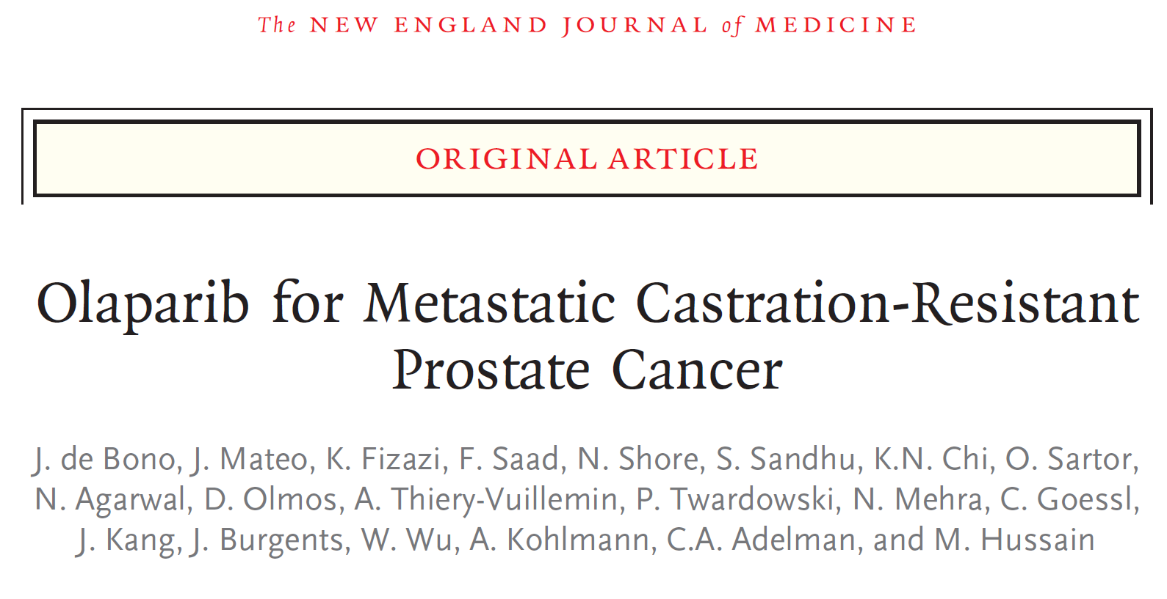
Profound (Olaparib): Phase 3 trial (mCRPC with HRR gene alteration)
2020 Apr 28. DOI: 10.1056/NEJMoa1911440
2020 Sep 20. doi: 10.1056/NEJMoa202248
Notes:
Profound was the first positive randomized phase 3 trial in metastatic prostate cancer where patients were selected based on a biomarker.

Slide 9

PROFOUND Trial: Phase 3 Trial Design
Olaparib 300 mg bid
n = 162
Primary endpoint:
rPFS by BICR in Cohort A
(alpha=0.05)
Key eligibility criteria
mCRPC
Disease progression on prior NHA, eg enzalutamide and/ or abiraterone treatment
Alterations in ≥1 of any qualifying gene with a direct or indirect role in HRR*
Cohort A:
BRCA1, BRCA2 or ATM
N=245
Physician's choice of enza or abi†
n = 83
Confirmed ORR by BICR in Cohort A
(alpha=0.05)
2:1 randomization
Open-label
Upon BICR progression, Physician's choice patients were eligible for crossover to olaparib
rPFS by BICR in Cohorts A+B
(alpha=0.05)
Olaparib 300 mg bid
n = 94
Time to pain progression
in Cohort A
(alpha=0.05)
Cohort B:
Other HRR alterations
N=142
Stratification Factors
Previous taxane
Measurable disease
Physician's choice of enza or abi†
n = 48
OS in Cohort A → Interim
(alpha=0.01)
OS in Cohort A → Final
(alpha=0.047)
Statistical assumption for primary endpoint: Target hazard ratio = 0.53 (assumed 9.5 vs 5 months), 95% power, 2-sided 5% alpha (60% maturity, 143 events)
*BRCA1, BRCA2, ATM, BARD1, BRIP1, CDK12, CHEK1, CHEK2, FANC, PALB2, PPP2R2A, RAD51B, RAD51C, RAD51D RAD54L; †Physician choice of either enzalutamide (160 mg qd) or abiraterone (1000 mg qd plus prednisone [5 mg bid]); BICR, blinded independent central review; bid, twice daily; ORR, objective response rate; OS, overall survival; rPFS, radiographic progression free survival.
1. de Bono J et al. N Engl J Med 2020;382:2091–102

Slide 10
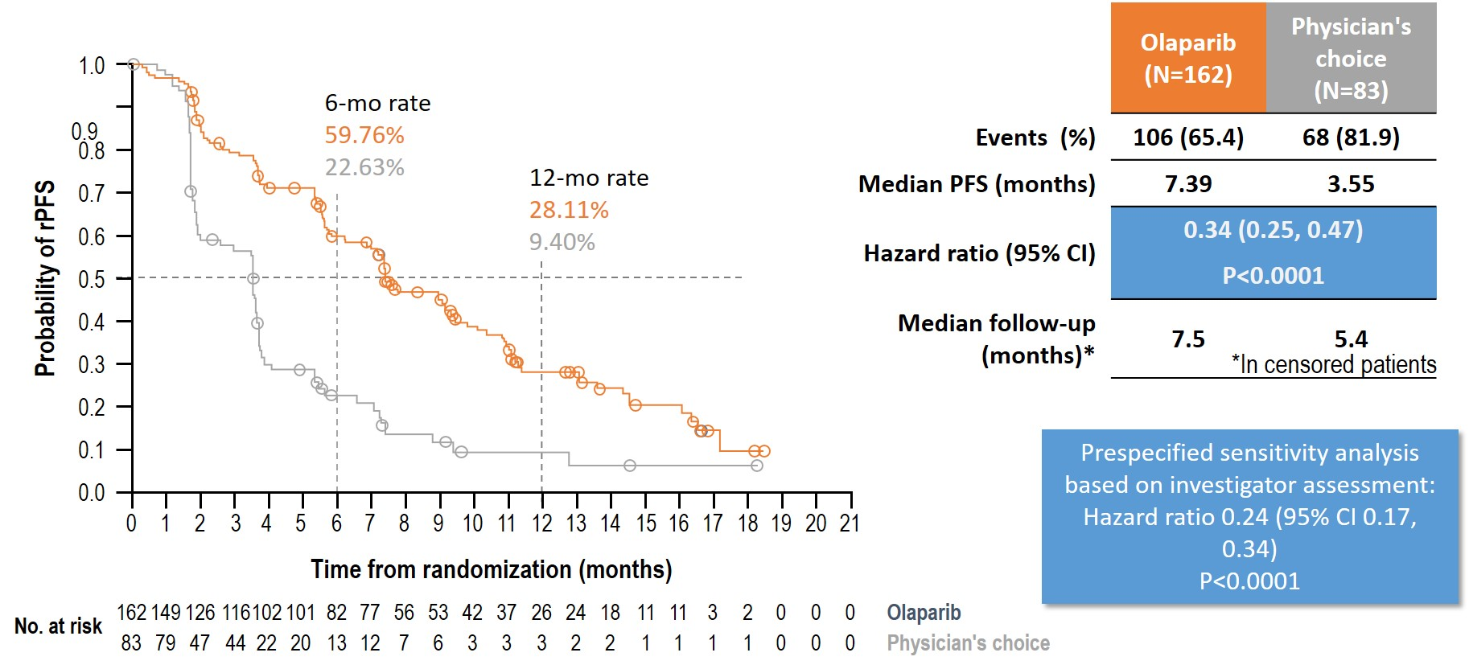
Primary endpoint: rPFS by BICR in patients with alterations in
BRCA1, BRCA2, or ATM (Cohort A)
1. de Bono J et al. N Engl J Med 2020;382:2091–102

Slide 11
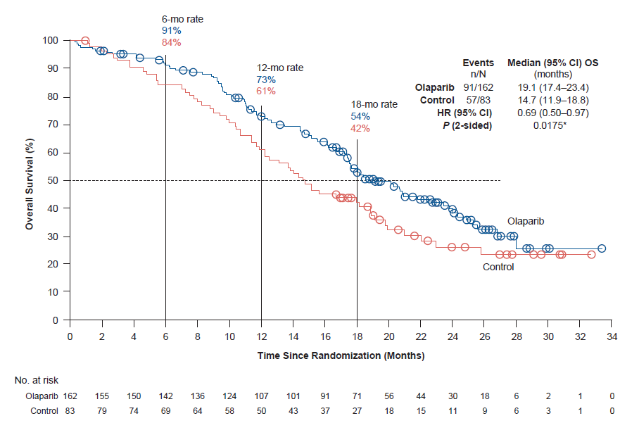
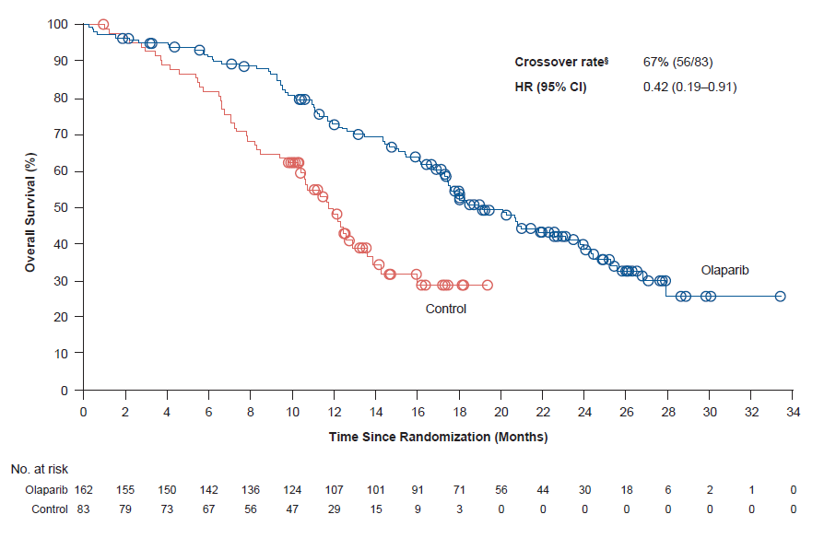
Final OS in Cohort A (BRCA1, BRCA2 and/or ATM mCRPC)
Cohort A
 | Olaparib (N=162) | Control (N=83)
Events (%) | 91 (56) | 57 (68)
Median OS | 19.1 months | 14.7 months
HR (95% CI) | 0.69
 | (0.50‒0.97); P=0.0175
Cohort A with adjustment for crossover*
Crossover rate | 67% (56/83)
HR (95% CI) | 0.42
 | (0.19‒0.91)
Median follow-up duration for censored patients was 21.9 months for the olaparib arm and 21.0 months for the control arm
*Re-censored; conducted using RPSFTM to demonstrate the impact on OS of crossover of patients from the control arm to receive olaparib as a first subsequent anticancer therapy
RPSFTM, rank-preserving structural failure time model
1. de Bono J et al. N Engl J Med 2020;382:2091–102

Slide 12
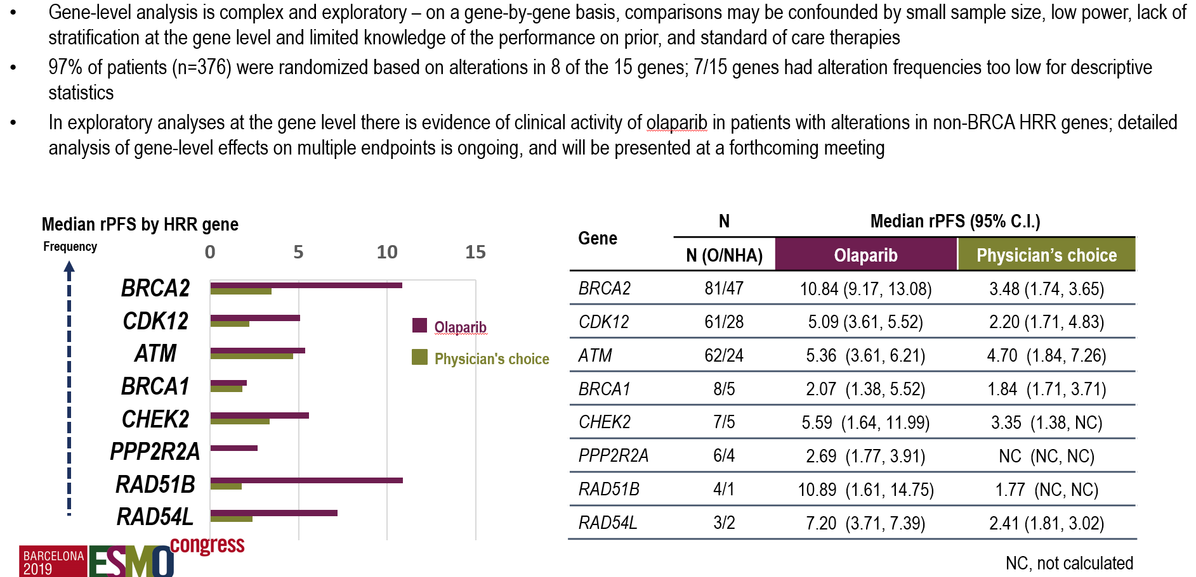
Exploratory Gene-by-Gene Analysis (rPFS)
1. de Bono J et al. N Engl J Med 2020;382:2091–102

Slide 13
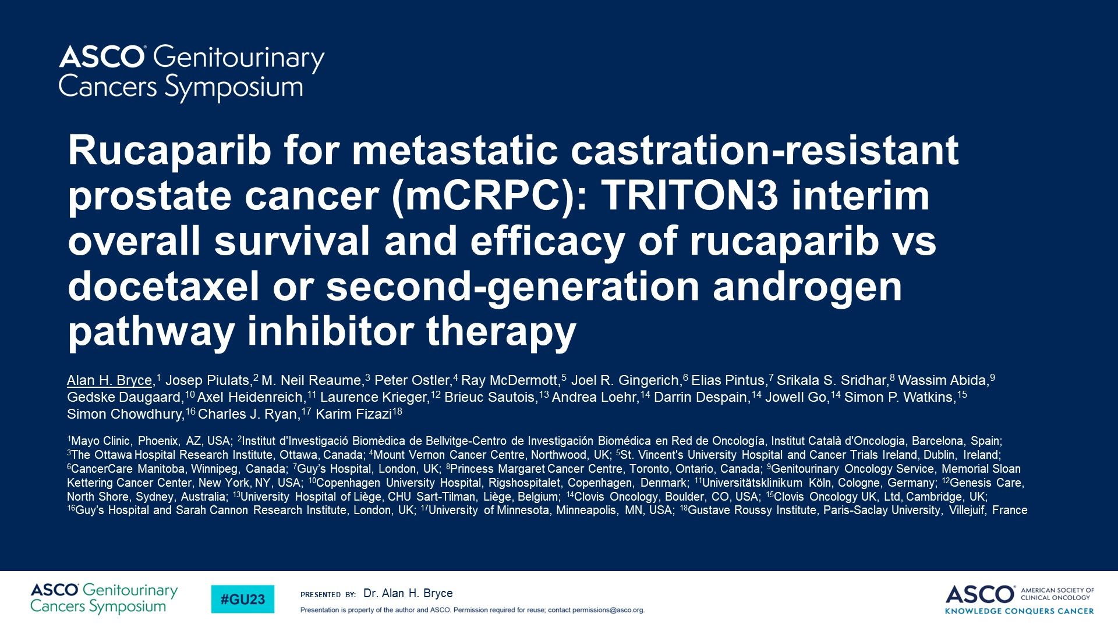
Rucaparib for metastatic castration-resistant prostate cancer (mCRPC): TRITON3 interim overall survival and efficacy of rucaparib vs docetaxel or second-generation androgen pathway inhibitor therapy

Slide 14
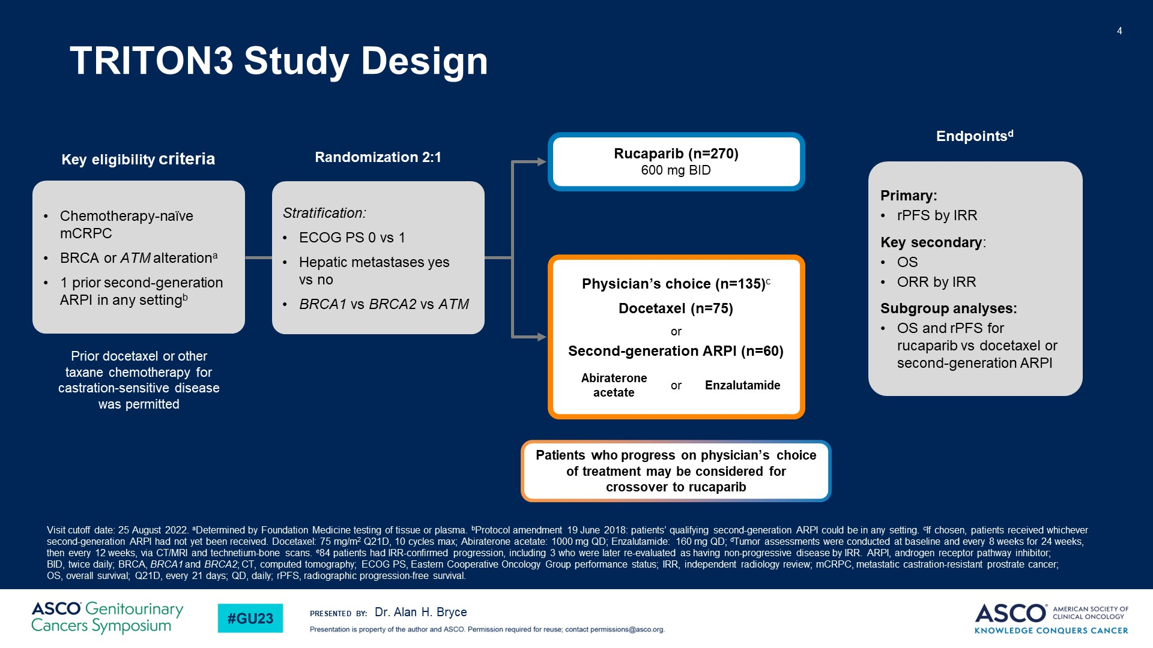
TRITON3 Study Design

Slide 15
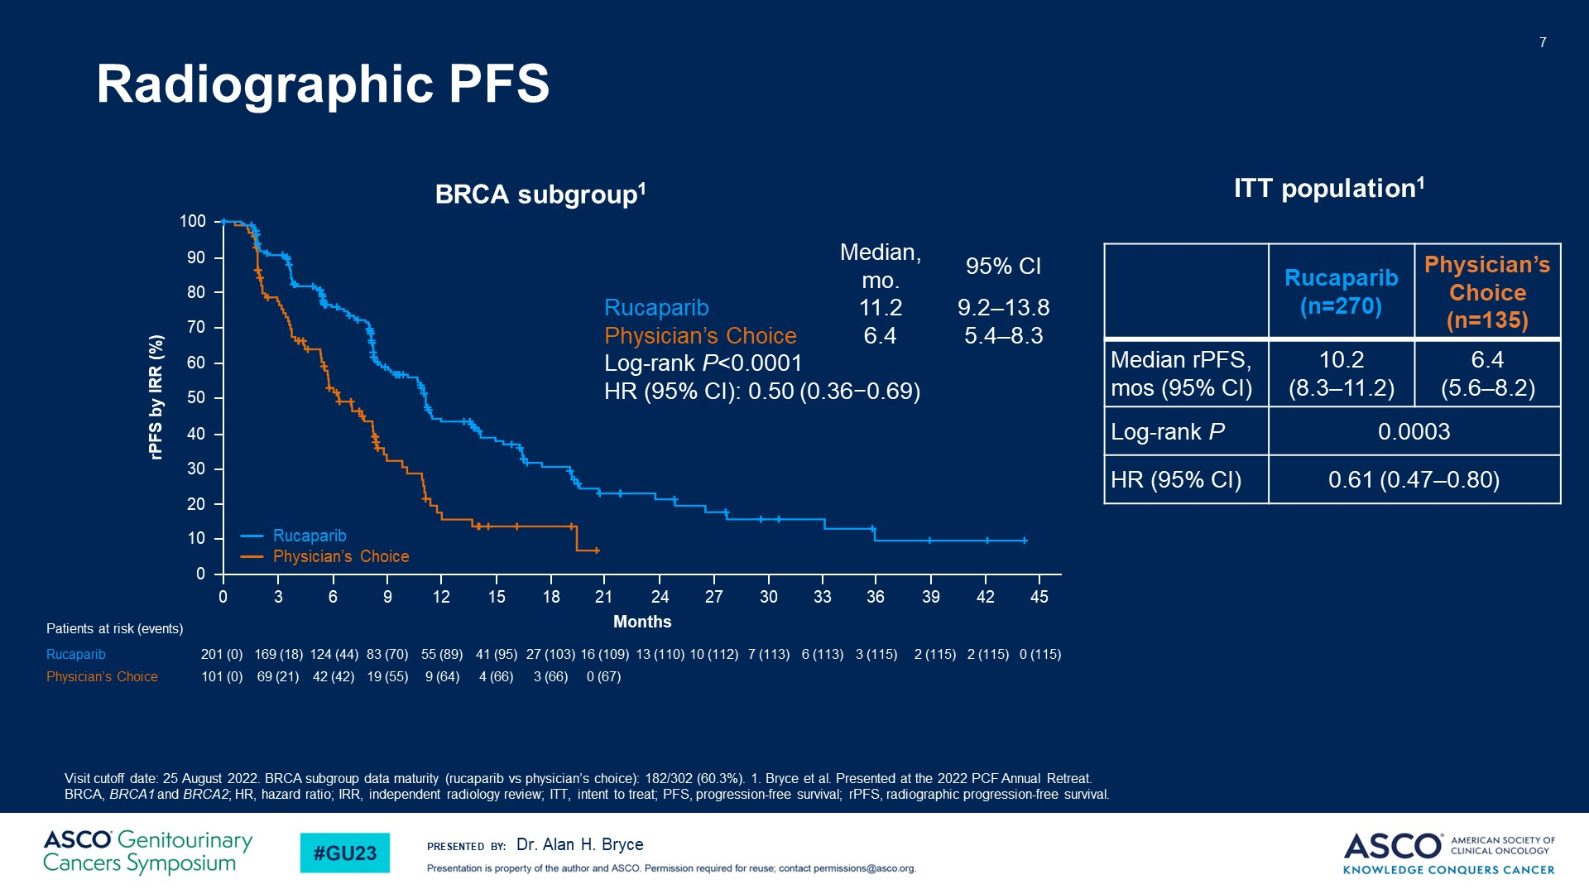
Radiographic PFS

Slide 16
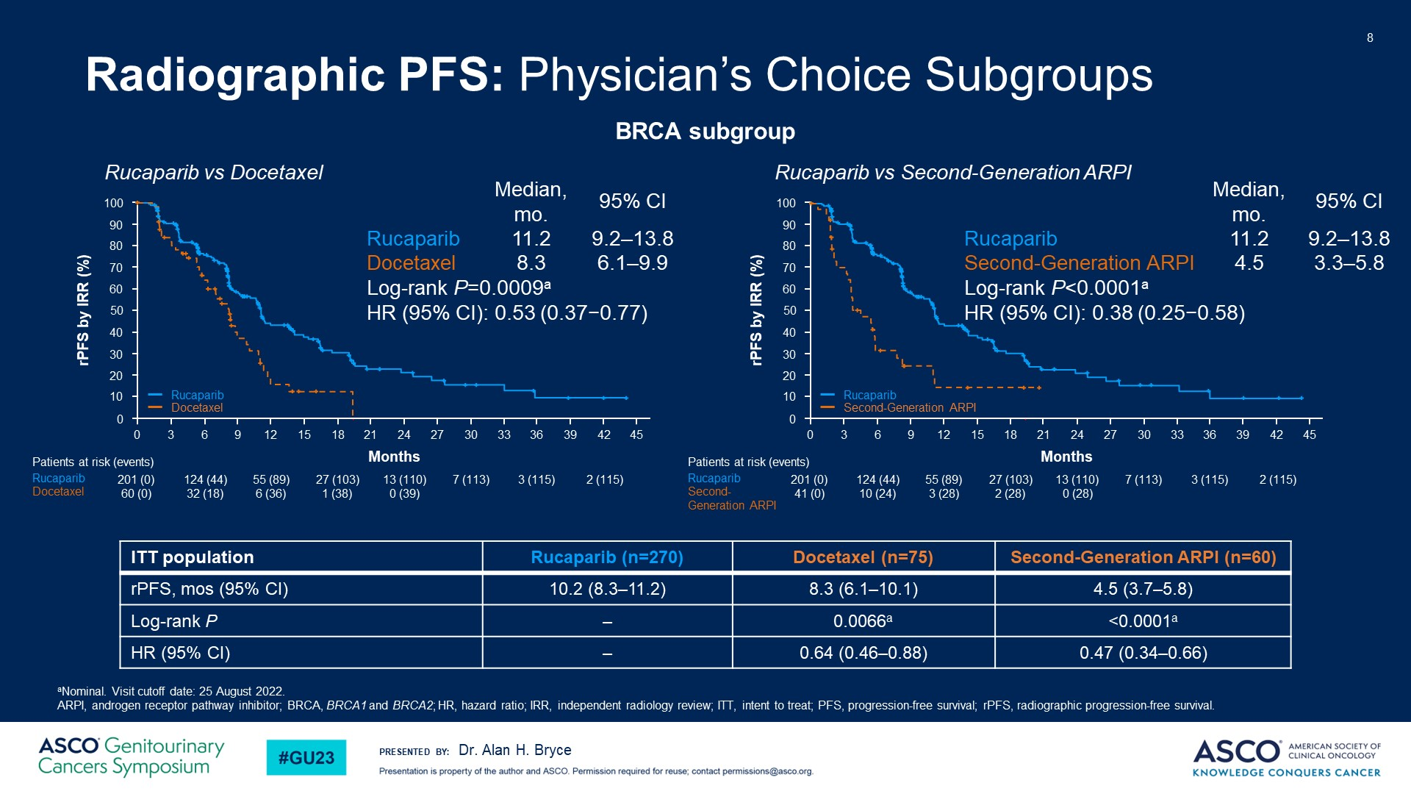
Radiographic PFS: Physician’s Choice Subgroups

Slide 17
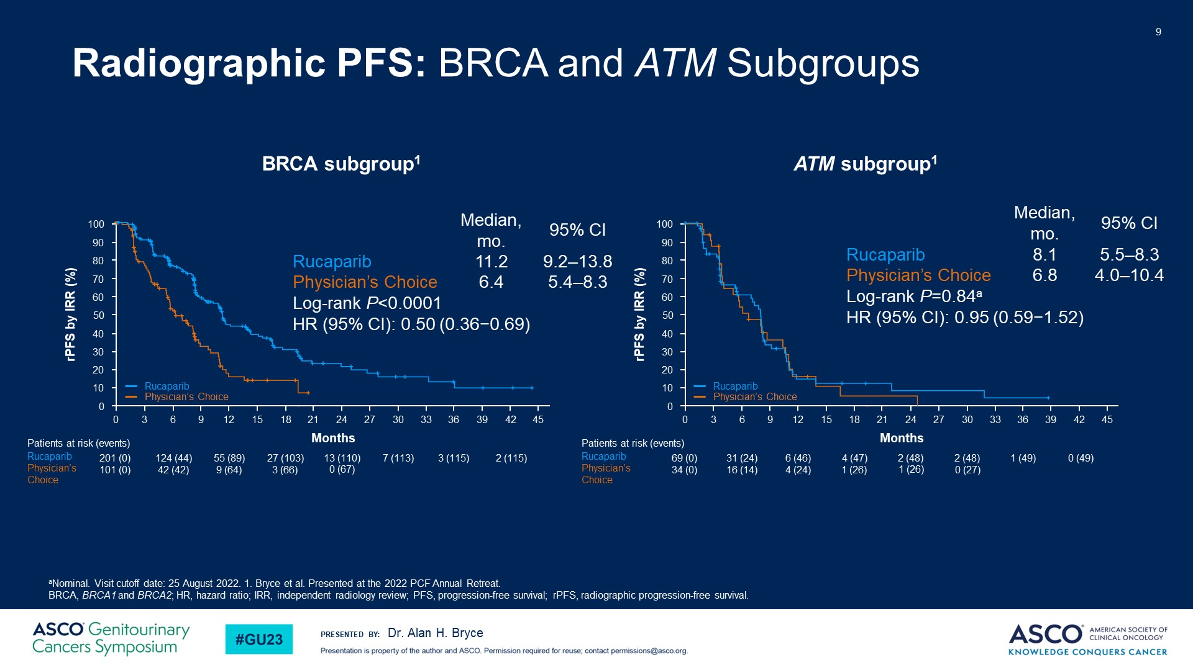
Radiographic PFS: BRCA and ATM Subgroups

Slide 18
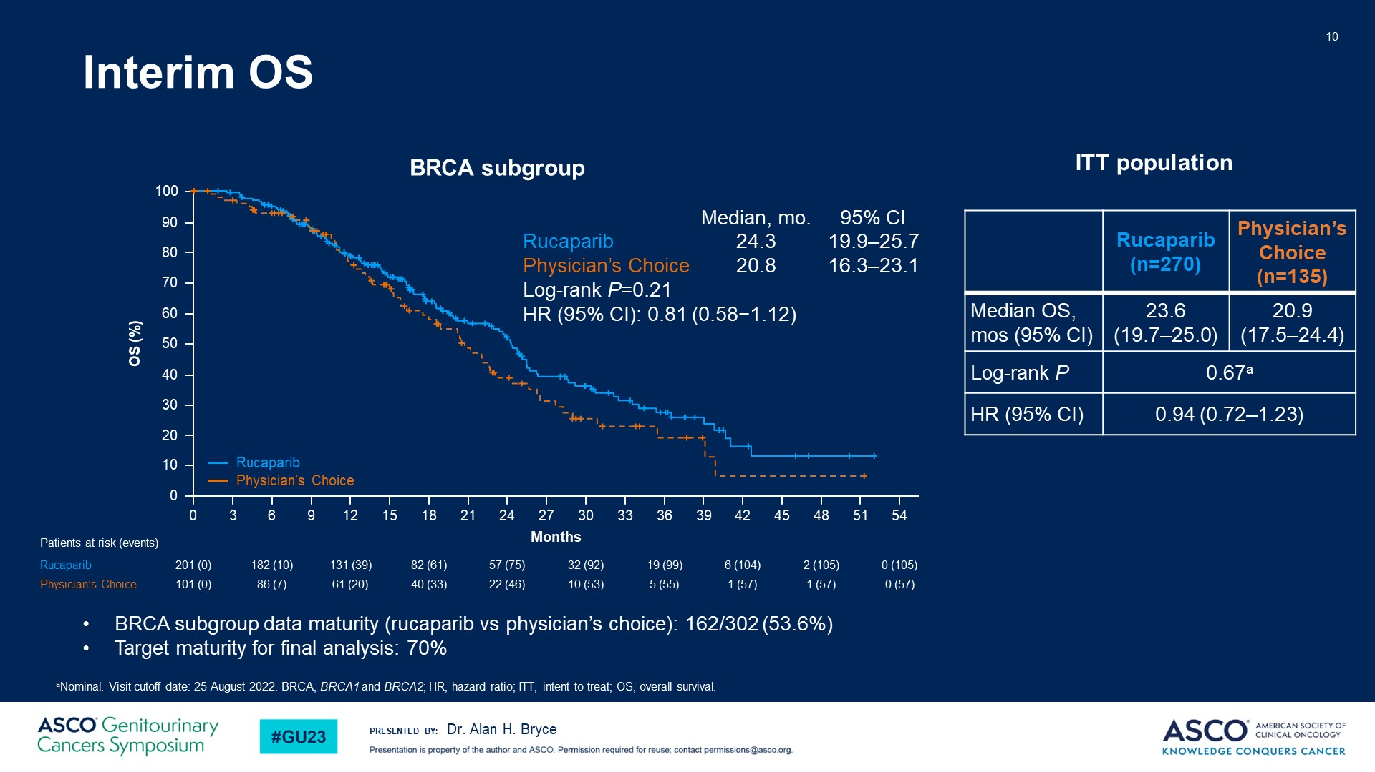
Interim OS

Slide 19
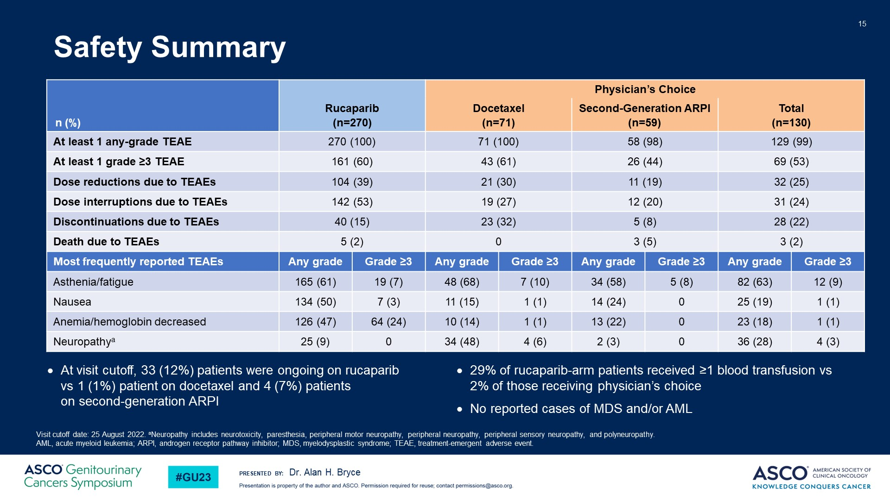
Safety Summary

Slide 20
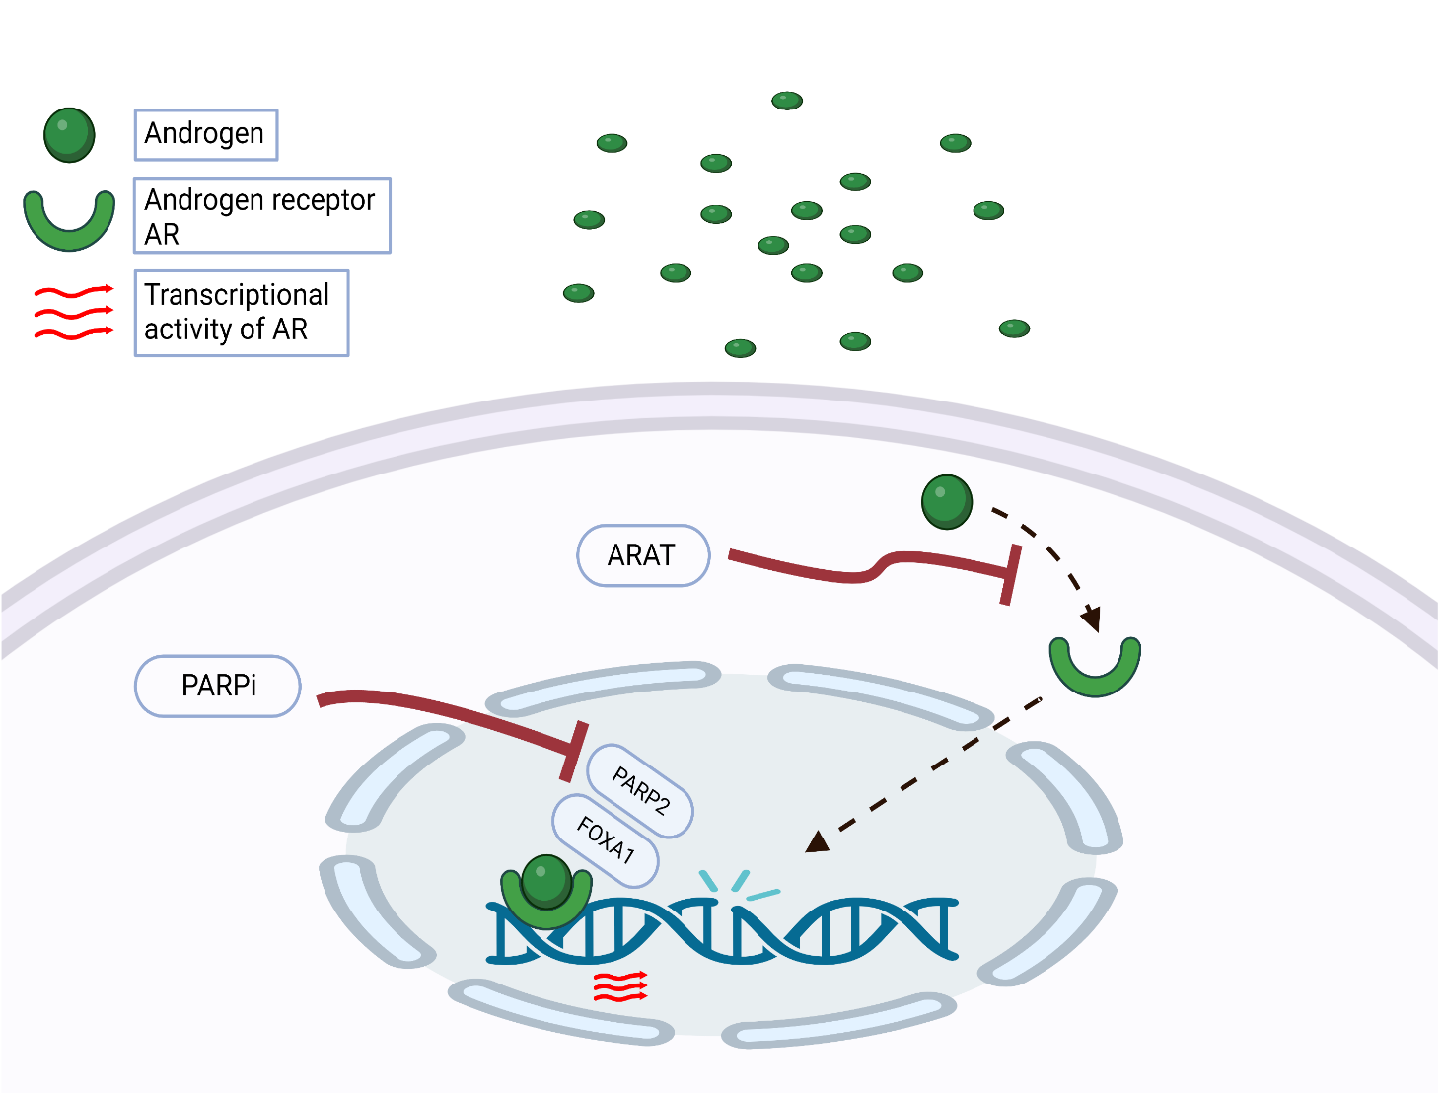
The rationale for combining PARPi with NHT
NHTs induce a phenotype resembling HRR deficiency
Suppressed AR function causes an upregulation of PARP
NHTs prime tumor cells
for PARP inhibition
PARP augments AR activity
PARP inhibitors may attenuate resistance to NHTs
PARP inhibitors extend the benefits of NHTs
Adapted from Bin Gui et al., PNAS 2019 June,
DOI https://doi.org/10.1073/pnas.1908547116
Notes:
AR inhibition upregulate PARP (as a matter of defence) and PARP augments AR activity (trying to negate the action of AR inhibitor).
beyond DNA damage repair function, PARP-2, but not PARP-1, is a critical component in AR transcriptional machinery through interacting with the pioneer factor FOXA1 and facilitating AR recruitment to genome-wide prostate-specific enhancer regions

Slide 21
Phase II Study: Abiraterone ± Olaparib in mCRPC
Randomized, double-blind, placebo-controlled phase II trial
Patients with mCRPC
  Pretreated with docetaxel
  ≤2 prior lines of chemotherapy
  No previous second-generation antihormonal agents
  Plasma (mandatory)/whole-blood (optional)/archival tissue (optional) tested for HRR mutations*
(N = 142)
Olaparib 300 mg BID +
Abiraterone 1000 mg QD + Prednisone 5 mg Q2D
(n = 71)
Until PD
Placebo +
Abiraterone 1000 mg QD + Prednisone 5 mg Q2D
(n = 71)
*Tumor/whole-blood tested first; if no data, then plasma.
Primary endpoint: radiologic PFS
Biomarker data obtained for 136 patients (96%), 21 (15%) of whom were
HRR mutation positive
  HRR mutations included BRCA2, ATM, CHEK1, CHEK2, PALB2, BRIP1, CDK12
Clarke. Lancet Oncol. 2018;19:975. NCT01972217.

Slide 22
Abiraterone ± Olaparib in mCRPC: rPFS
ITT Population
HRR Mutation Positive
 | n | Median rPFS, Mo
O + A | 11 | 17.8
P + A | 10 | 6.5
100
 | n | Median rPFS, Mo
O + A | 71 | 13.8
P + A | 71 | 8.2
100
80
80
60
60
rPFS (%)
rPFS (%)
40
40
20
20
HR: 0.65 (P = .034)
HR: 0.74 (P = .58)
0
0
0
3
6
9
12
15
18
21
24
27
30
0
3
6
9
12
15
18
21
24
27
30
HRR WT
 | n | Median rPFS, Mo
O + A | 15 | 15.0
P + A | 20 | 9.7
HRR Partially Characterized*
100
 | n | Median rPFS, Mo
O + A | 45 | 13.1
P + A | 41 | 6.4
100
80
80
60
60
rPFS (%)
rPFS (%)
40
40
20
20
HR: 0.52 (P = .115)
HR: 0.67 (P = .13)
0
0
0
3
6
9
12
15
18
21
24
27
30
0
3
6
9
12
15
18
21
24
27
30
Mo Since Randomization
Mo Since Randomization
Clarke. Lancet Oncol. 2018;19:975.
*Includes those HRR WT by plasma/germline but not verifiable by tumor; HRR WT by plasma or germline only; or no valid test result by tumor, plasma, or germline.

Slide 23


Phase 3 trial of PARPi + AR pathway inhibitor in 1st line mCRPC setting
PROpel: Abiraterone + Olaparib ¹
Published
MAGNITUDE: Abiraterone + Niraparib ²
Presented
TALAPRO-2: Enzalutamide + Talazoparib
Presented
CASPAR: Enzalutamide + Rucaparib Enrolling
1- Clarke NW et al., NEJM Evidence. 2022 Aug 23;1(9):EVIDoa2200043.
2- Chi KN et al., JCO. 2022 Feb 20;40(6_suppl):12–12. Kim Chi, (2022 Genitourinary cancers symposium (ASCO GU). Abstract #12)

Slide 24
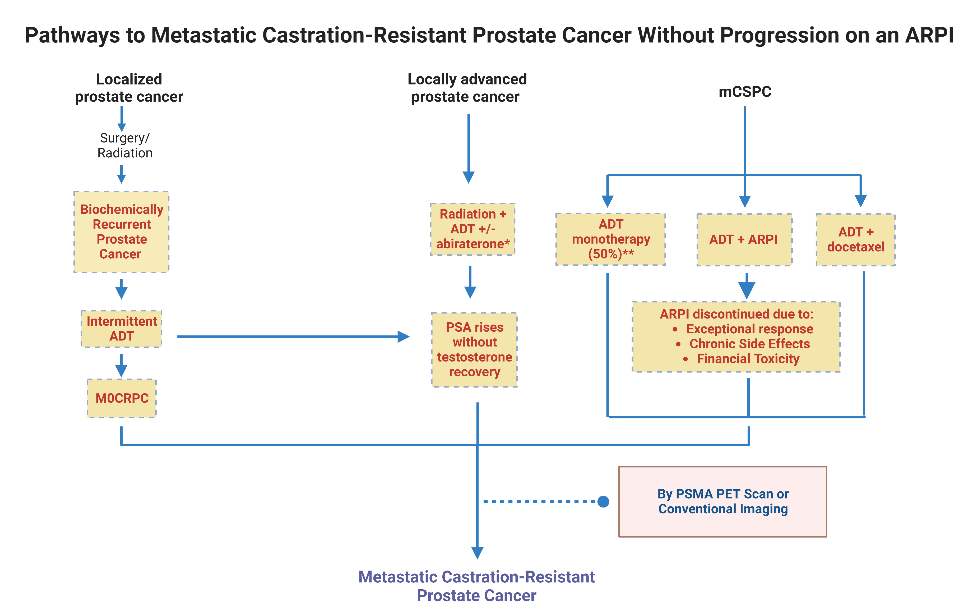
Pathways to Metastatic Castration-Resistant Prostate Cancer Without Progression on an NHT
*Limited Duration of 2 years **Swami U…Agarwal N., Cancers 2021
Abbreviations: ADT: androgen deprivation therapy; ARPI: androgen receptor pathway inhibitor; mCSPC: metastatic castration-sensitive prostate cancer; M0CRPC: non-metastatic castration-resistant prostate cancer; PSMA: prostate specific membrane antigen.

Slide 25
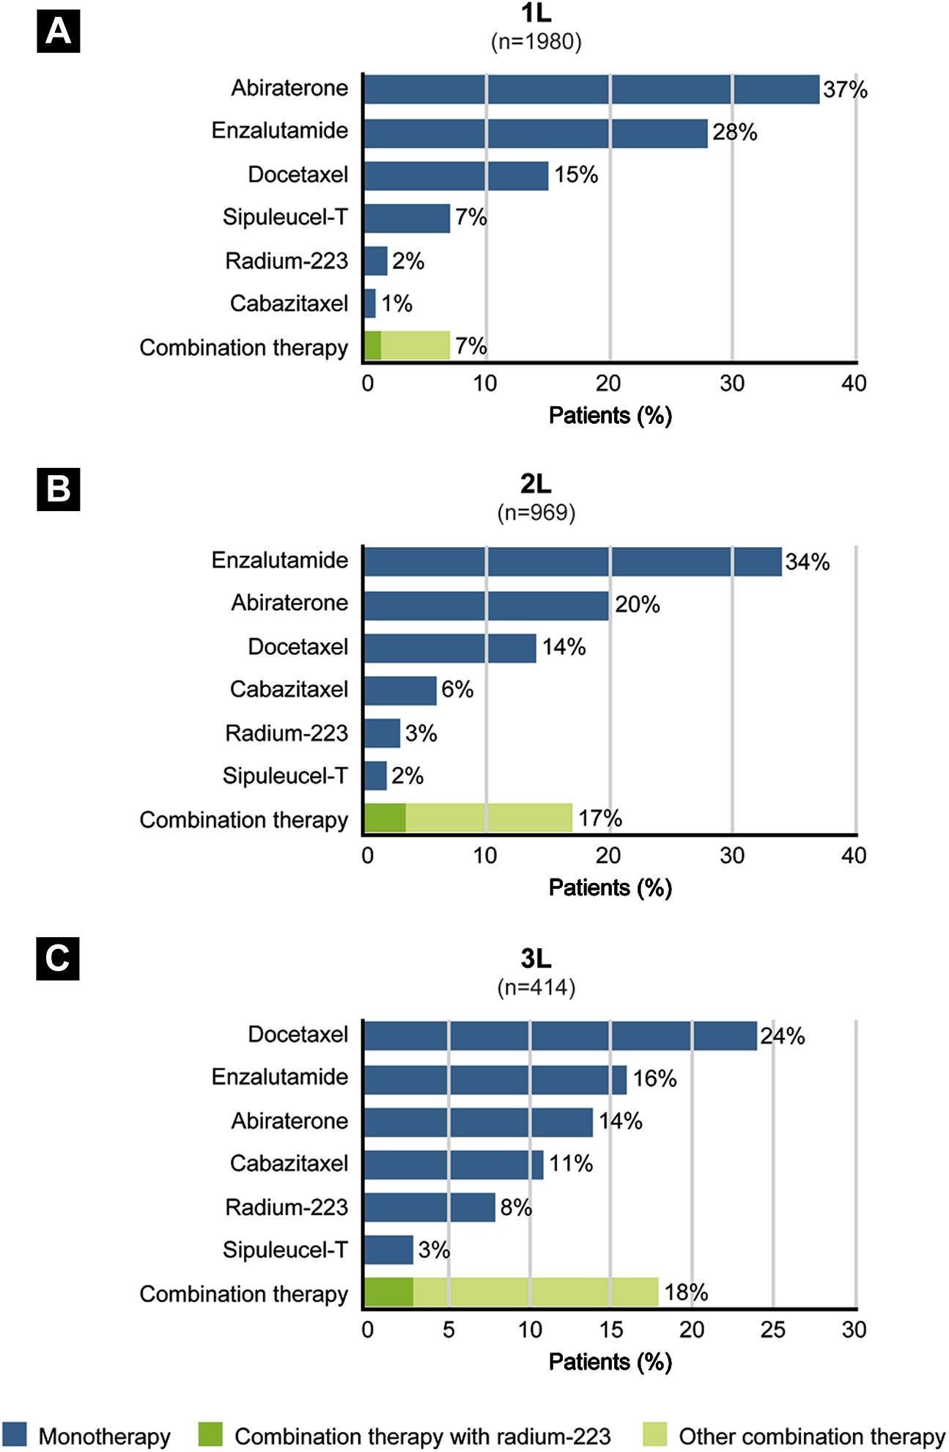
High attrition rate of our patients from first to subsequent lines of therapies in mCRPC
Abbreviations: 1L ¼ ﬁrst line; 2L ¼ second line; 3L ¼ third line.
ªIn cases in which patients were treated with combination therapy, the duration of therapy was deﬁned as the period between the ﬁrst and last administration of any agent(s) in the combination.
George DJ, Clinical Genitourinary Cancer, 2020
25
Notes:
The second-generation androgen receptor axis-targeted therapies, abiraterone/prednisone and enzalutamide, were the most common treatments administered to patients with mCRPC, accounting for 65% of first-line therapies and 54% of second-line therapies. Docetaxel was the most common third-line therapy (received by 24% of patients), with enzalutamide and abiraterone/prednisone being used for 16% and 14% of patients, respectively. Cabazitaxel represented 1%, 6%, and 11%, respectively, of first-, second-, and third-line therapies. Sipuleucel-T accounted for 7%, 2%, and 3% of treatment choices in the first-, second-, and third-line settings, respectively. Combination therapy was administered to 7%, 17%, and 18% of patients in the first-, second- and third-line settings, respectively. A wide range of combination regimens were reported. Abiraterone-containing regimens were the most common combinations in the first line (4% of patients) and second line (10%); whereas enzalutamide-containing regimens were the most common combinations in the third line (10%). Overall, 60% of patients received one or more BHAs (denosumab, 43%; zolendronic acid, 21%).

Slide 26
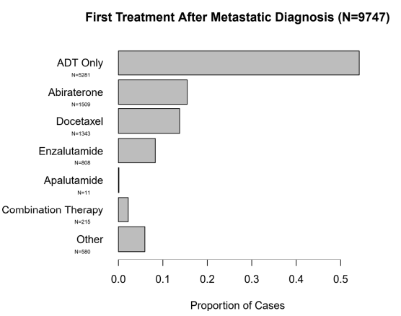
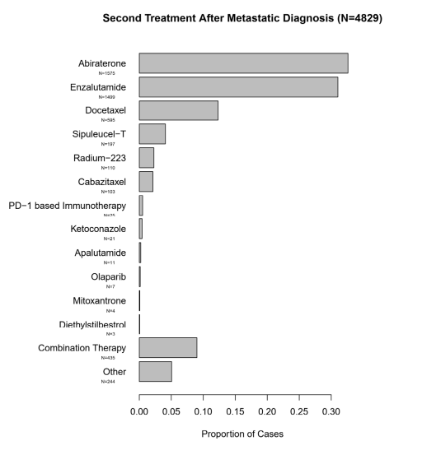

First, second, and third treatment after metastatic diagnosis
Swami U, …, Agarwal N. Cancers 2021

Slide 27
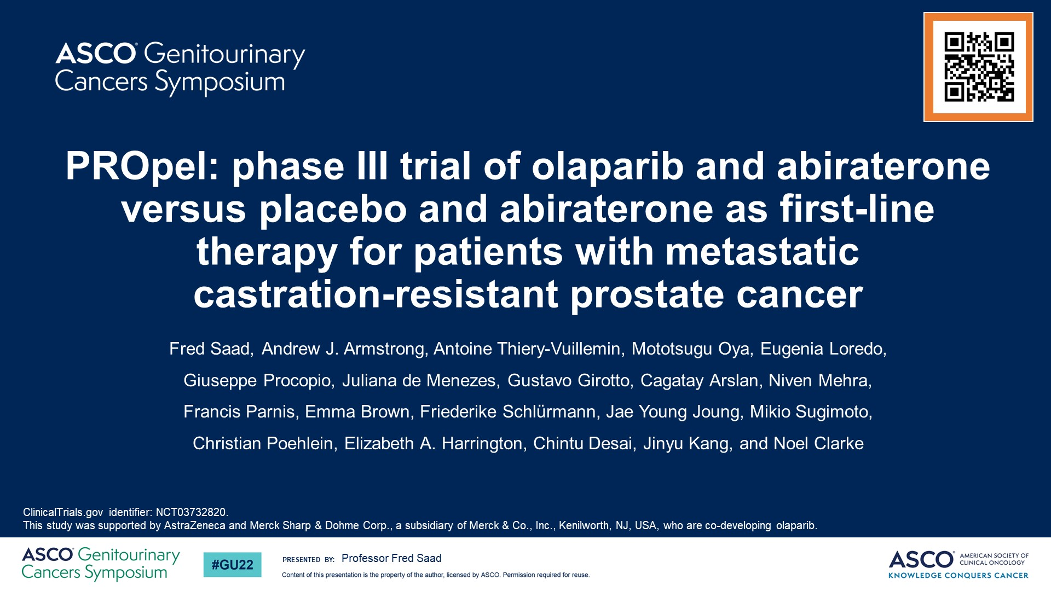
PROpel: phase III trial of olaparib and abiraterone versus placebo and abiraterone as first-line therapy for patients with metastatic <br />castration-resistant prostate cancer

Slide 28
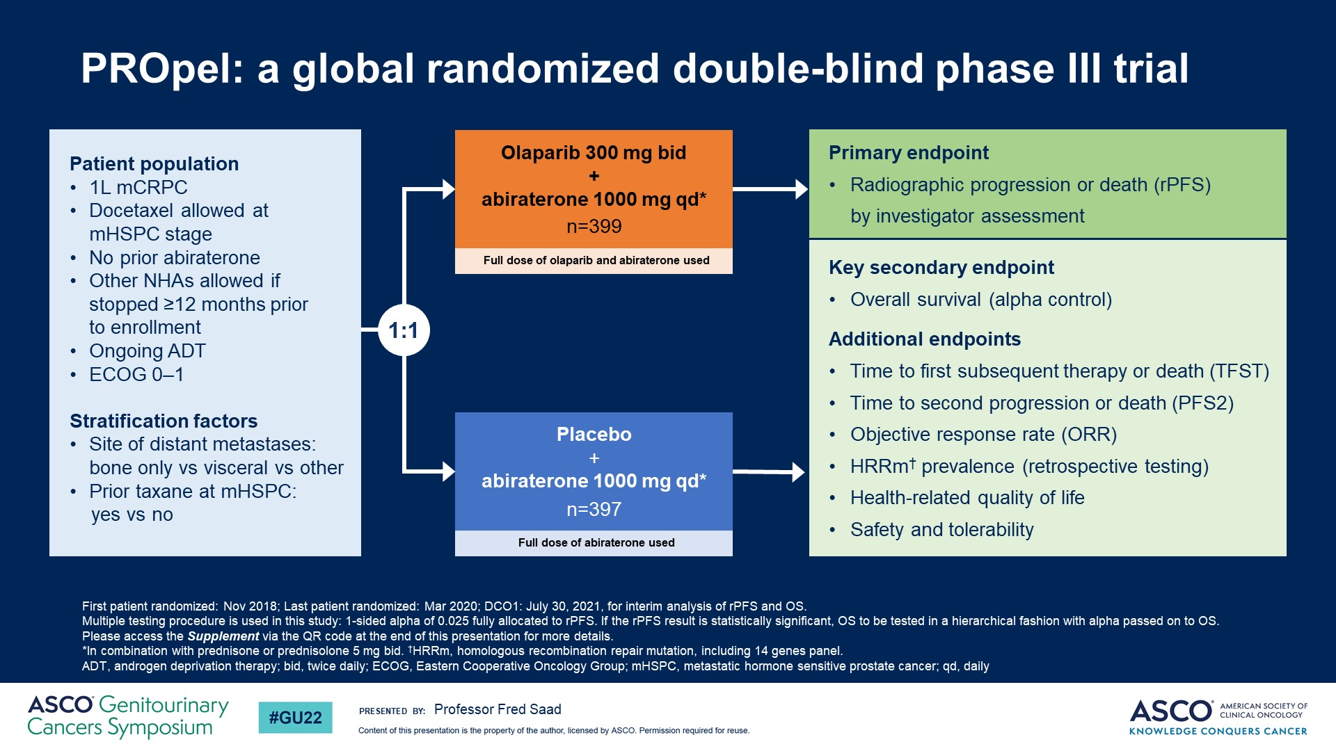
Slide 5
Notes:
PROpel is a randomized phase III trial evaluating the efficacy and safety of olaparib + abiraterone versus placebo + abiraterone in the first-line metastatic castration-resistant prostate cancer (mCRPC) setting. Docetaxel therapy was allowed if given in the metastatic castration-sensitive prostate cancer setting. Enrollment in this study was independent of defects in the homologous recombination repair pathway. The primary endpoint was investigator-assessed radiographic Progression-Free Survival (rPFS) with multiple secondary endpoints, including overall survival (OS) and safety. A total of 796 patients were randomized to olaparib + abiraterone (n=399) or placebo + abiraterone (n=397). Baseline characteristics were well-balanced between treatment arms including HRR mutation status.

Slide 29
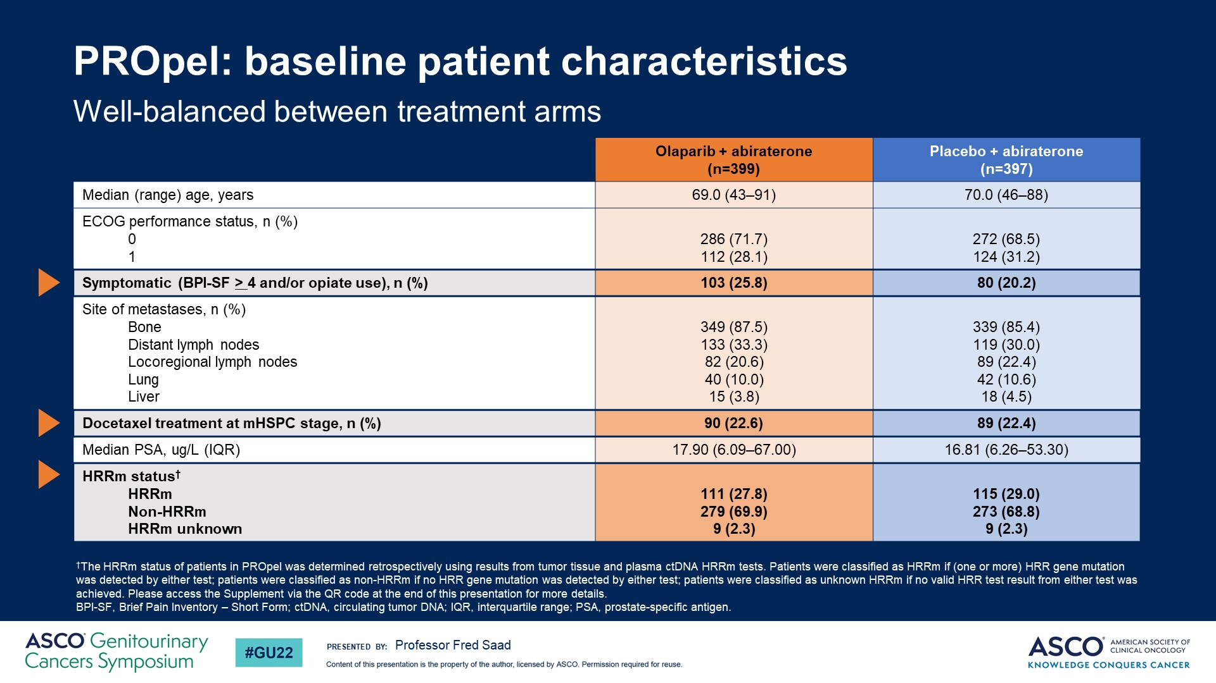
PROpel: baseline patient characteristics

Slide 30
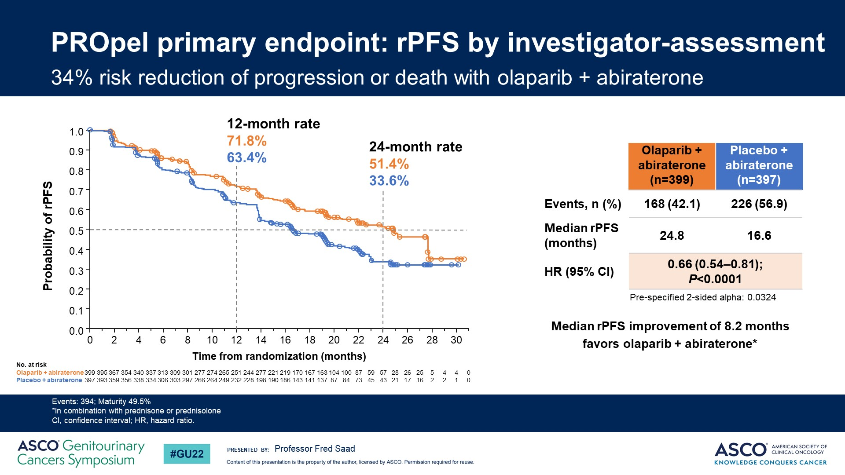
PROpel primary endpoint: rPFS by investigator-assessment
Notes:
At the pre-planned interim analysis, results show the trial met its primary endpoint with a significant improvement in rPFS for all patients receiving olaparib + abiraterone versus placebo + abiraterone regardless of the presence of homologous recombination repair gene mutations. Median rPFS was 24.8 vs 16.6 months for patients receiving olaparib + abiraterone versus placebo + abiraterone respectively, and a hazard ratio of 0.66, 95% confidence interval 0.54–0.81 and a P value <0.0001, which translates into a 34% reduction in the risk of progression or death.

Slide 31
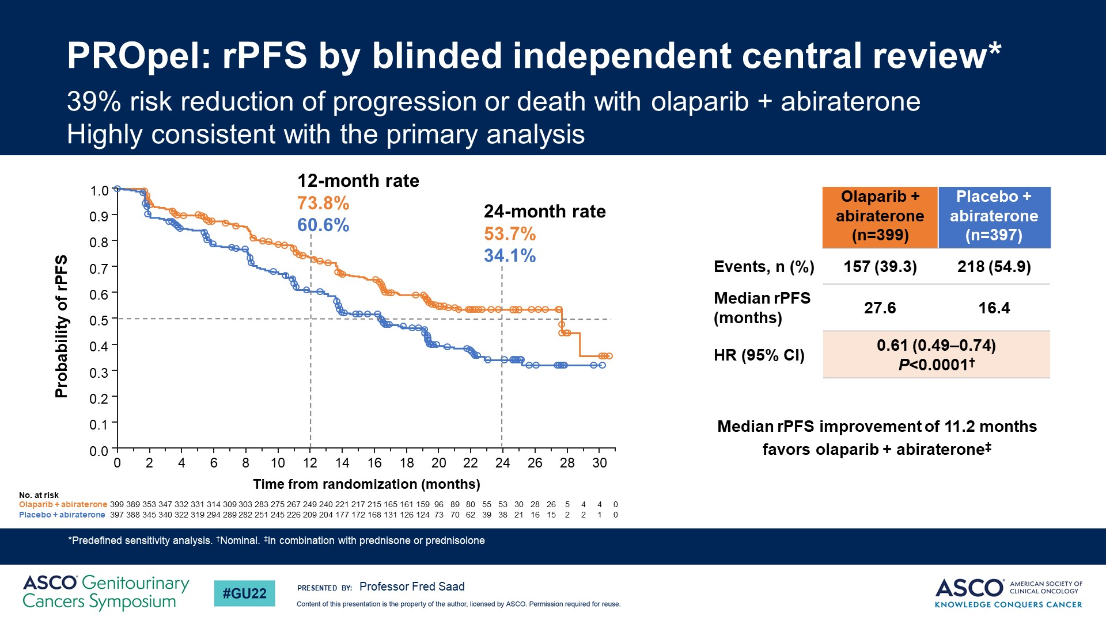
PROpel: rPFS by blinded independent central review*

Slide 32
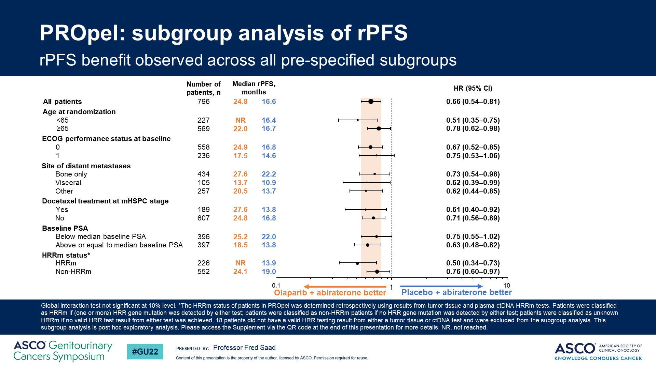
PROpel: subgroup analysis of rPFS

Slide 33
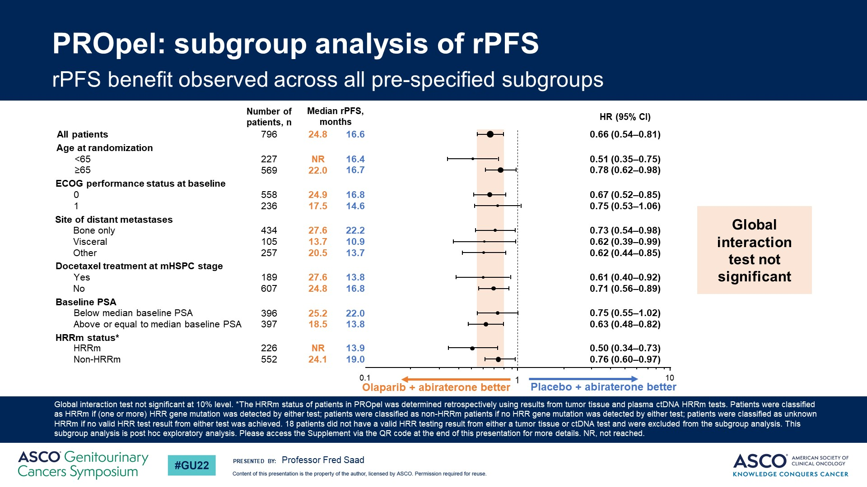
PROpel: subgroup analysis of rPFS
Notes:
It is interesting that even patients deemed negative for homologous recombination repair gene mutations showed significant improvement in rPFS when treated with olaparib + abiraterone versus placebo + abiraterone. It is important to note that, based on what was mentioned in the abstract, homologous recombination repair gene mutations were evaluated by cfDNA testing. This is notable for a reason. The levels of ctDNA present in the cfDNA can affect sensitivity for detection of homologous recombination repair gene mutations, especially in the case of copy number gene loss. In the first-line mCRPC setting this fraction may be especially low. If this is true, it is possible that some of the HRR positive patients were falsely determined to be HRR negative by the ctDNA testing, and included among the HRR negative patients. Based on the current results, there is no doubt that the combination of olaparib + abiraterone was effective in improving survival outcomes in the patient population studied in this trial. The survival benefit was more pronounced in the patients that were homologous recombination repair mutation positive versus not, but benefit was observed in both groups.

Slide 34
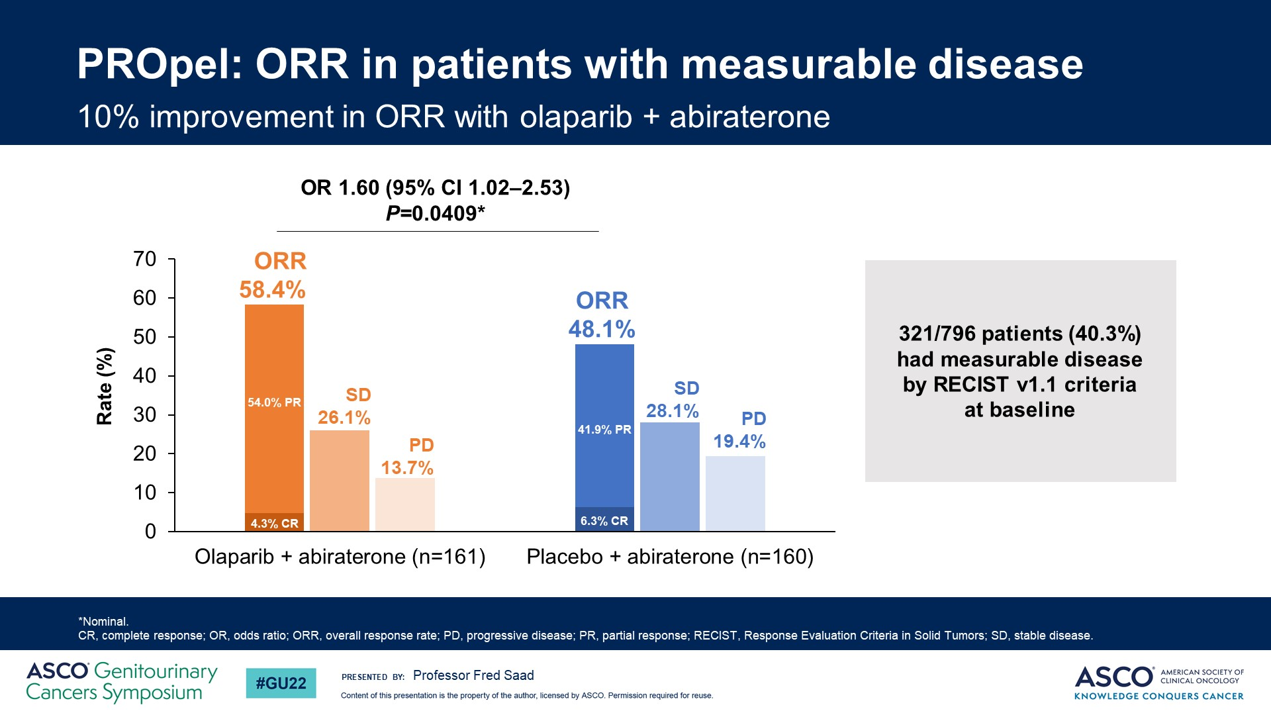
PROpel: ORR in patients with measurable disease

Slide 35
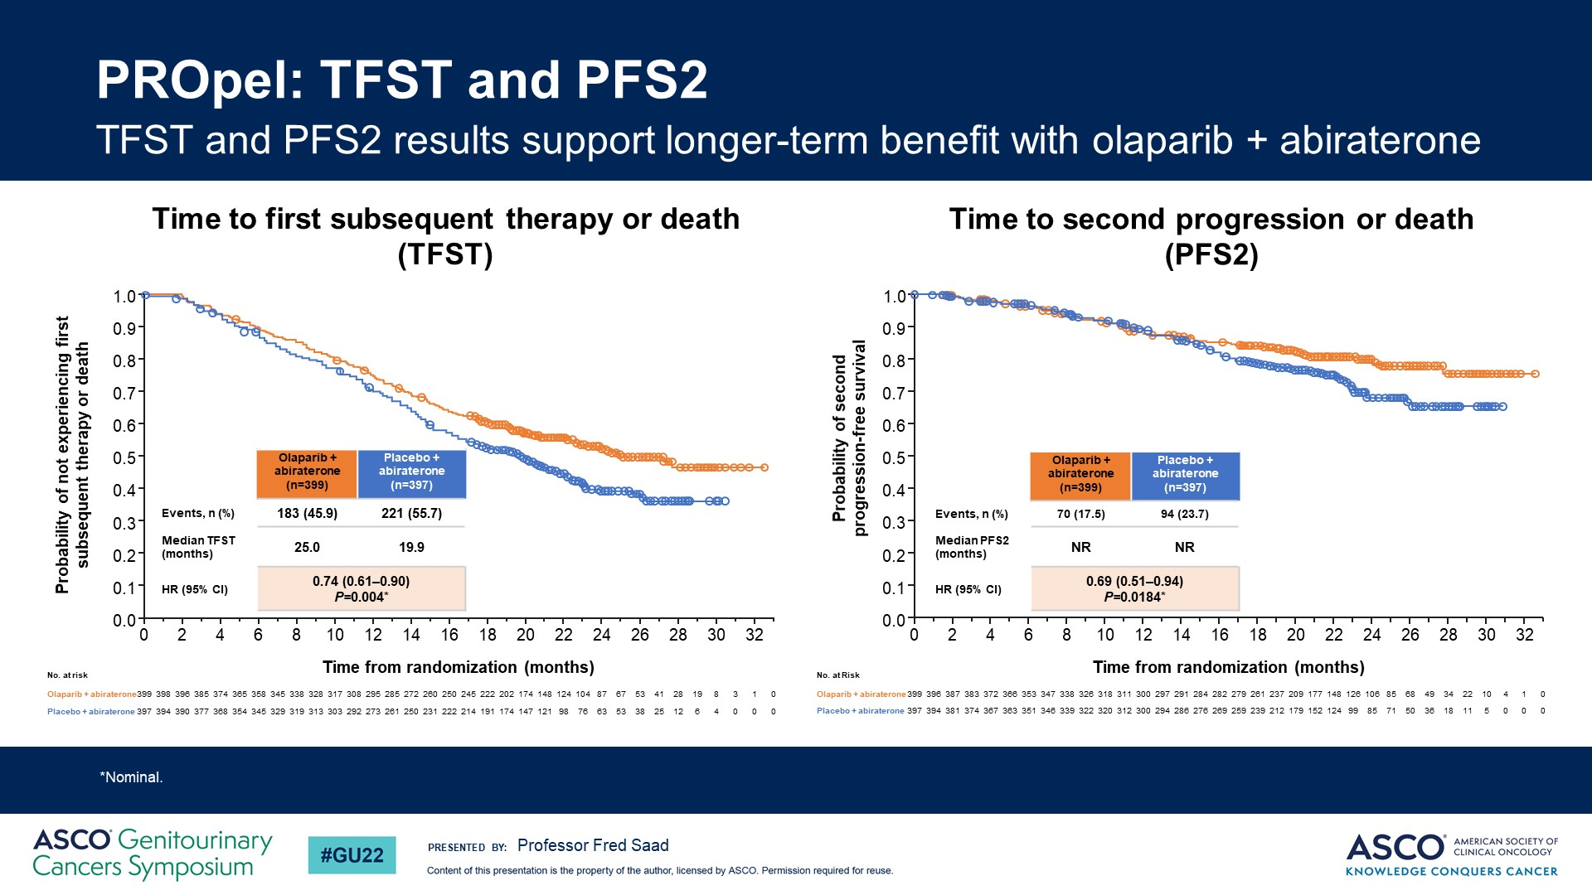
PROpel: TFST and PFS2

Slide 36
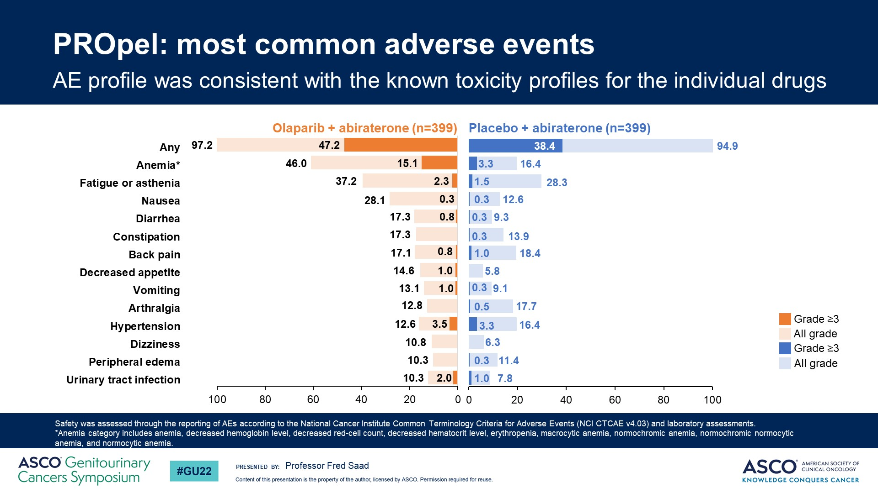
PROpel: most common adverse events
Notes:
Regarding the adverse events, they were what would be expected from the combination of a PARP inhibitor such as olaparib and abiraterone. We saw a higher frequency of all grade events of anemia, fatigue and nausea in the combination arm, while anemia was the only grade 3-4 adverse event observed at a significantly higher frequency in the combination arm.

Slide 37
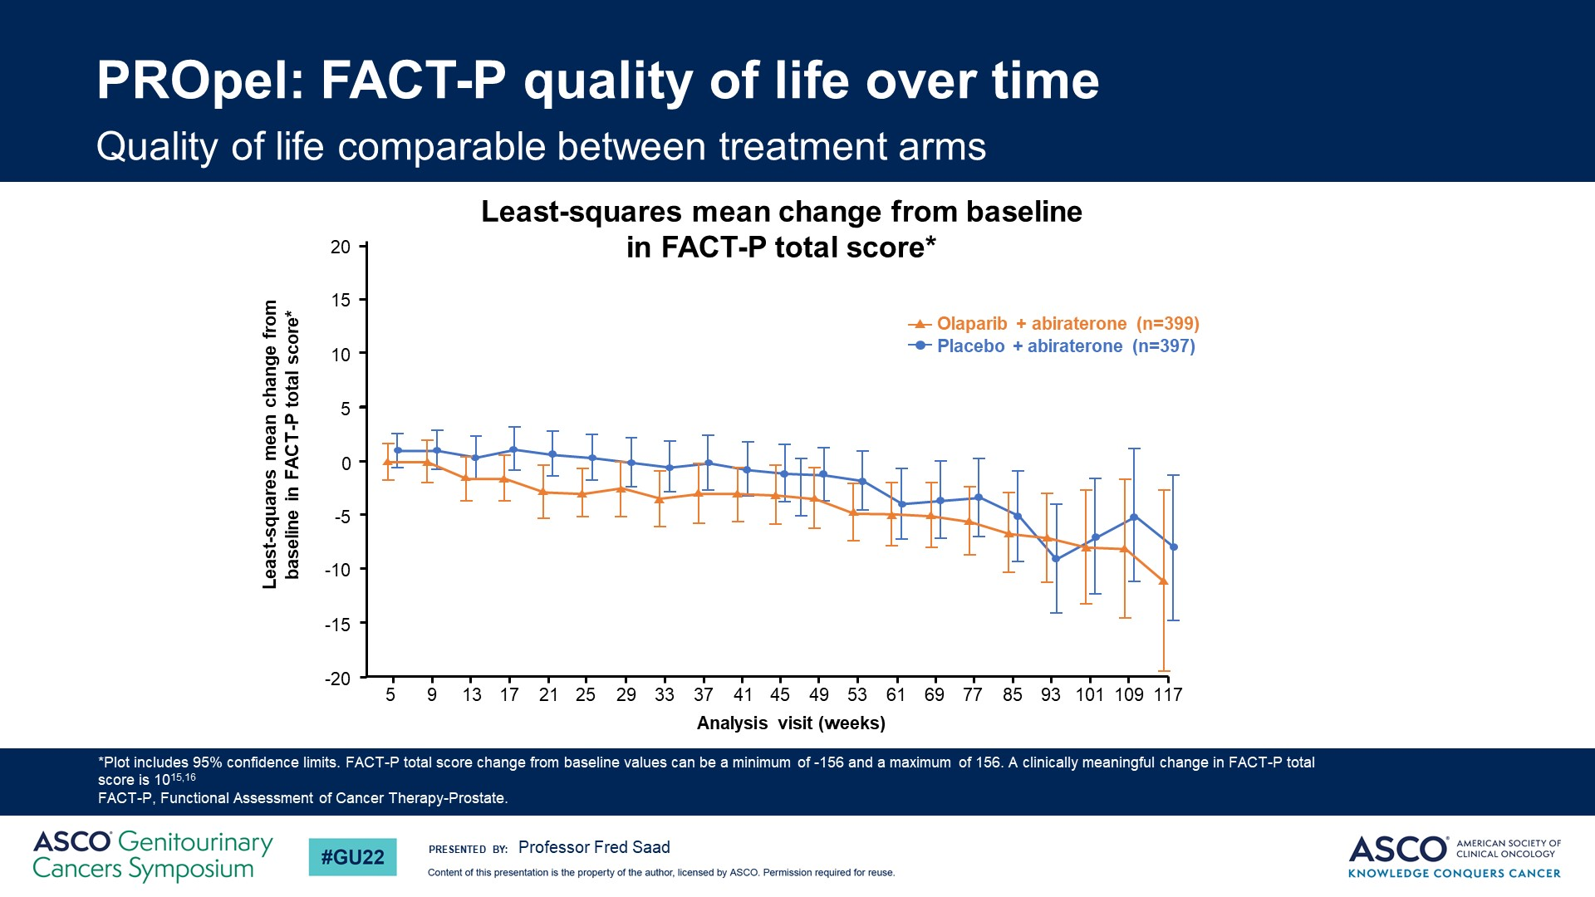
PROpel: FACT-P quality of life over time
Notes:
Health-related quality of life, as determined by the FACT-P assessment, was not affected by the combination therapy.

Slide 38
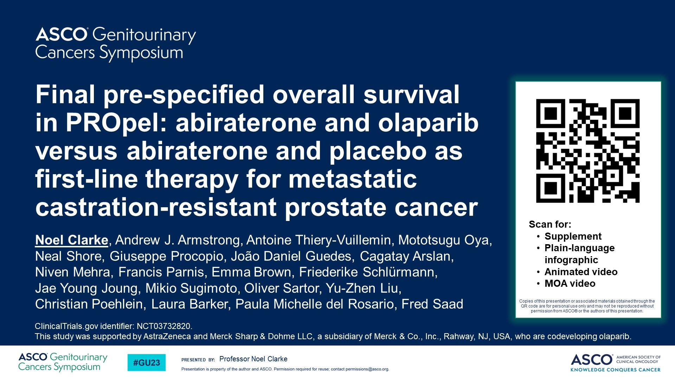
Final pre-specified overall survival in PROpel: abiraterone and olaparib versus abiraterone and placebo as first-line therapy for metastatic castration-resistant prostate cancer
Content of this presentation is the property of the author, licensed by ASCO. Permission required for reuse.

Slide 39
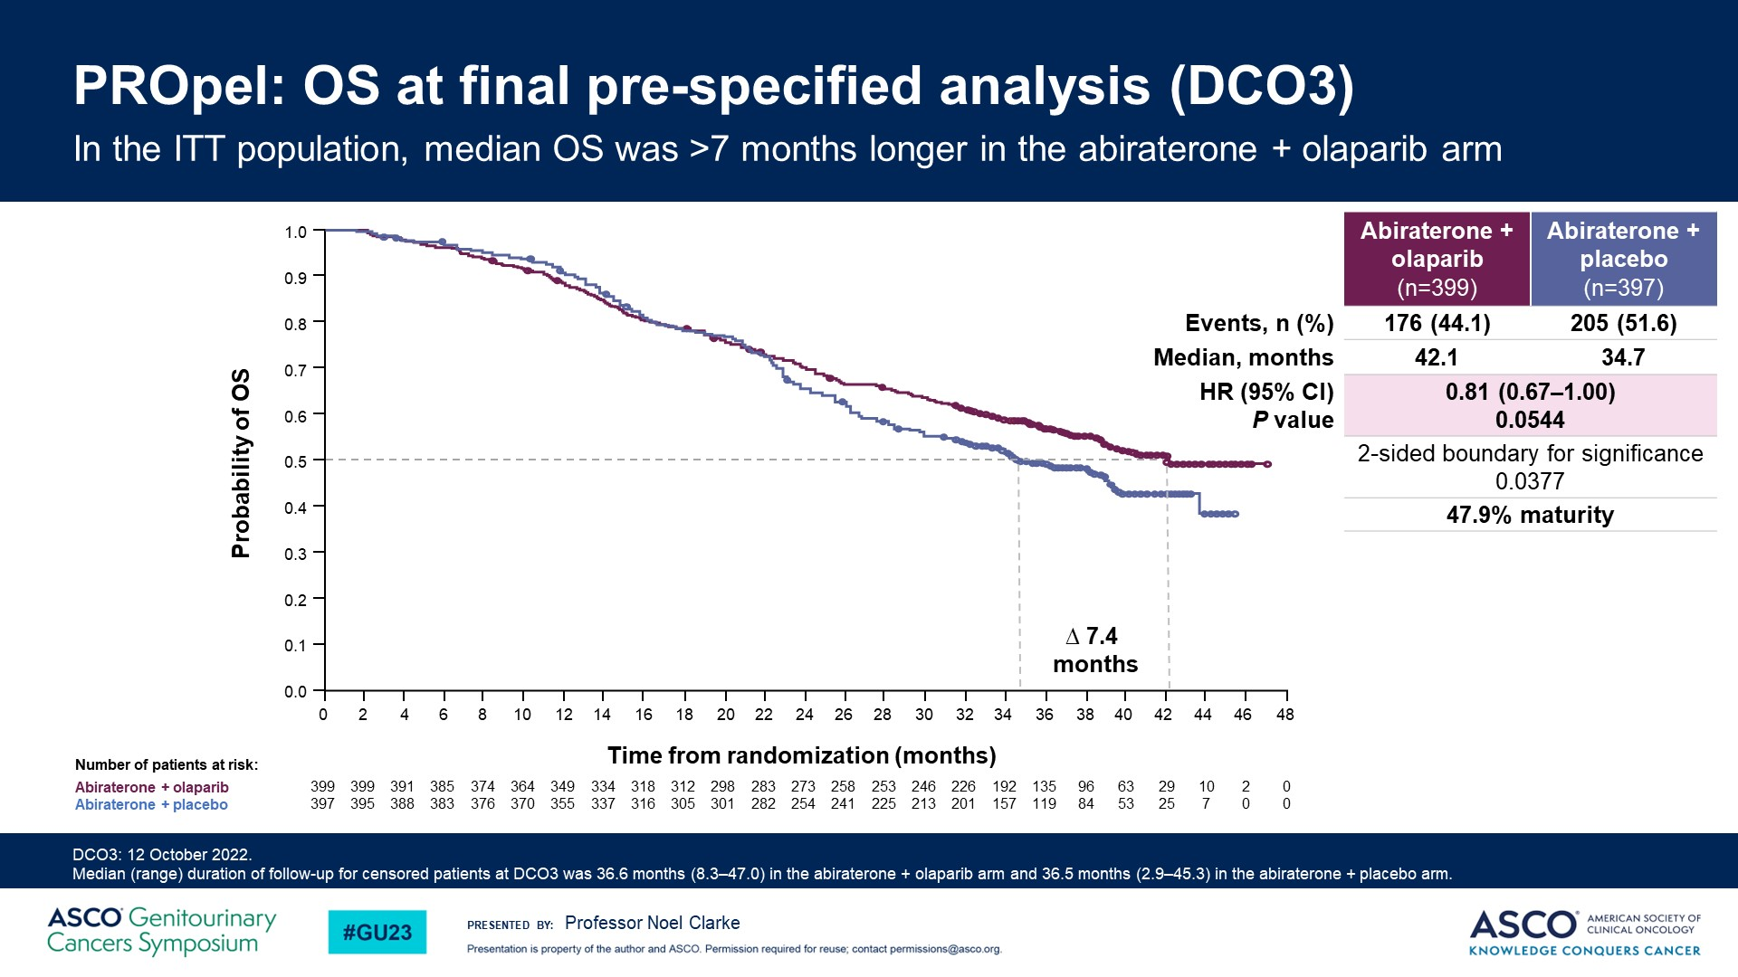
PROpel: OS at final pre-specified analysis (DCO3)
Content of this presentation is the property of the author, licensed by ASCO. Permission required for reuse.

Slide 40
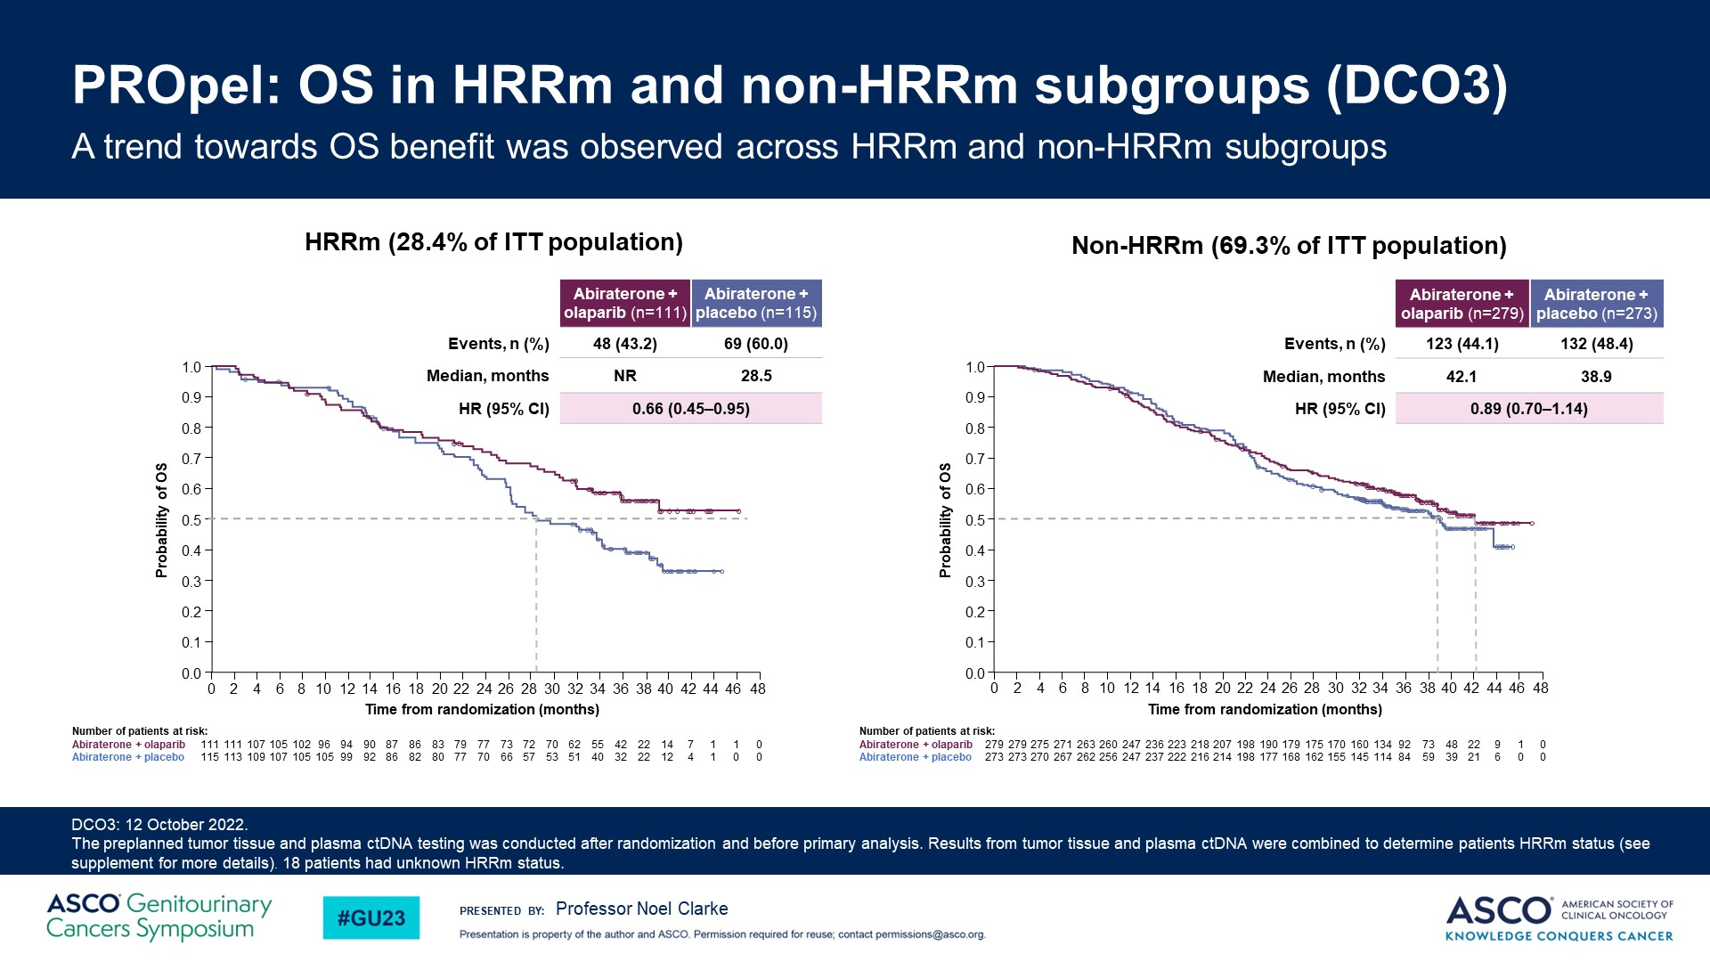
PROpel: OS in HRRm and non-HRRm subgroups (DCO3)
Content of this presentation is the property of the author, licensed by ASCO. Permission required for reuse.

Slide 41
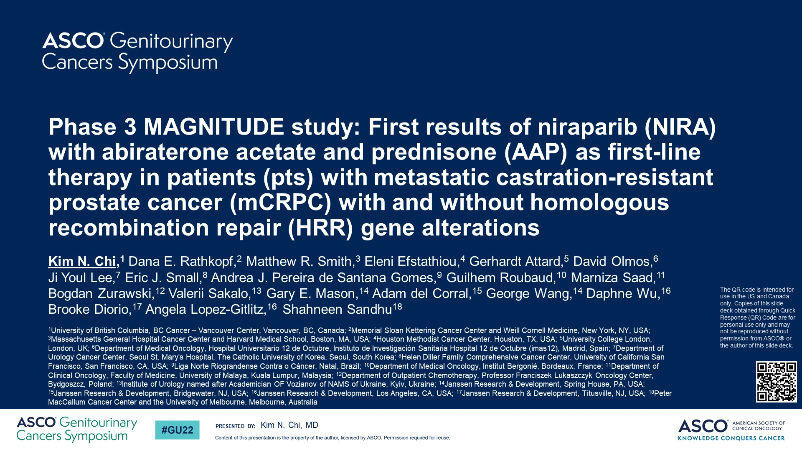
Phase 3 MAGNITUDE study: First results of niraparib (NIRA) with abiraterone acetate and prednisone (AAP) as first-line therapy in patients (pts) with metastatic castration-resistant prostate cancer (mCRPC) with and without homologous recombination repair (HRR) gene alterations

Slide 42
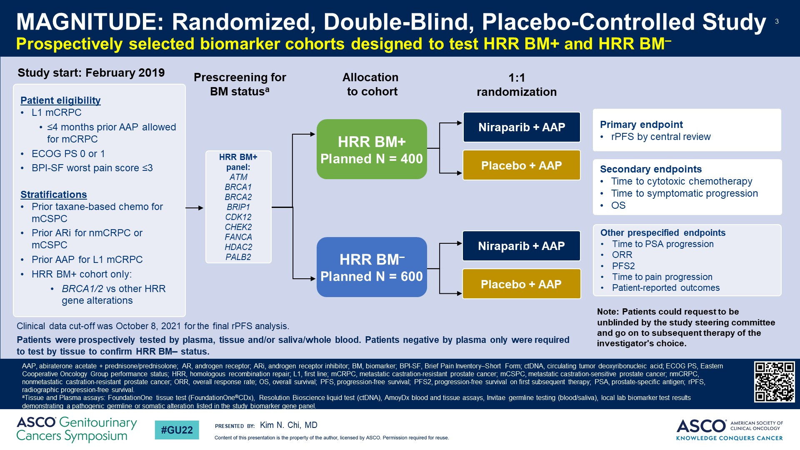
Slide 3
Notes:
MAGNITUDE is a randomized phase III trial evaluating the efficacy and safety of niraparib + abiraterone versus placebo + abiraterone in the first-line metastatic castration-resistant prostate cancer (mCRPC) setting. Prior taxane in mCSPC or NHT for (nmCRPC or mCSPC) or ≤ 4 months abiraterone in 1st line mCRPC were allowed. Prospective selection of patients with and without homologous recombination repair (HRR) pathway defects was required. The primary endpoint was radiographic Progression-Free Survival (rPFS) by central review with multiple secondary endpoints, including overall survival (OS) and safety.

Slide 43
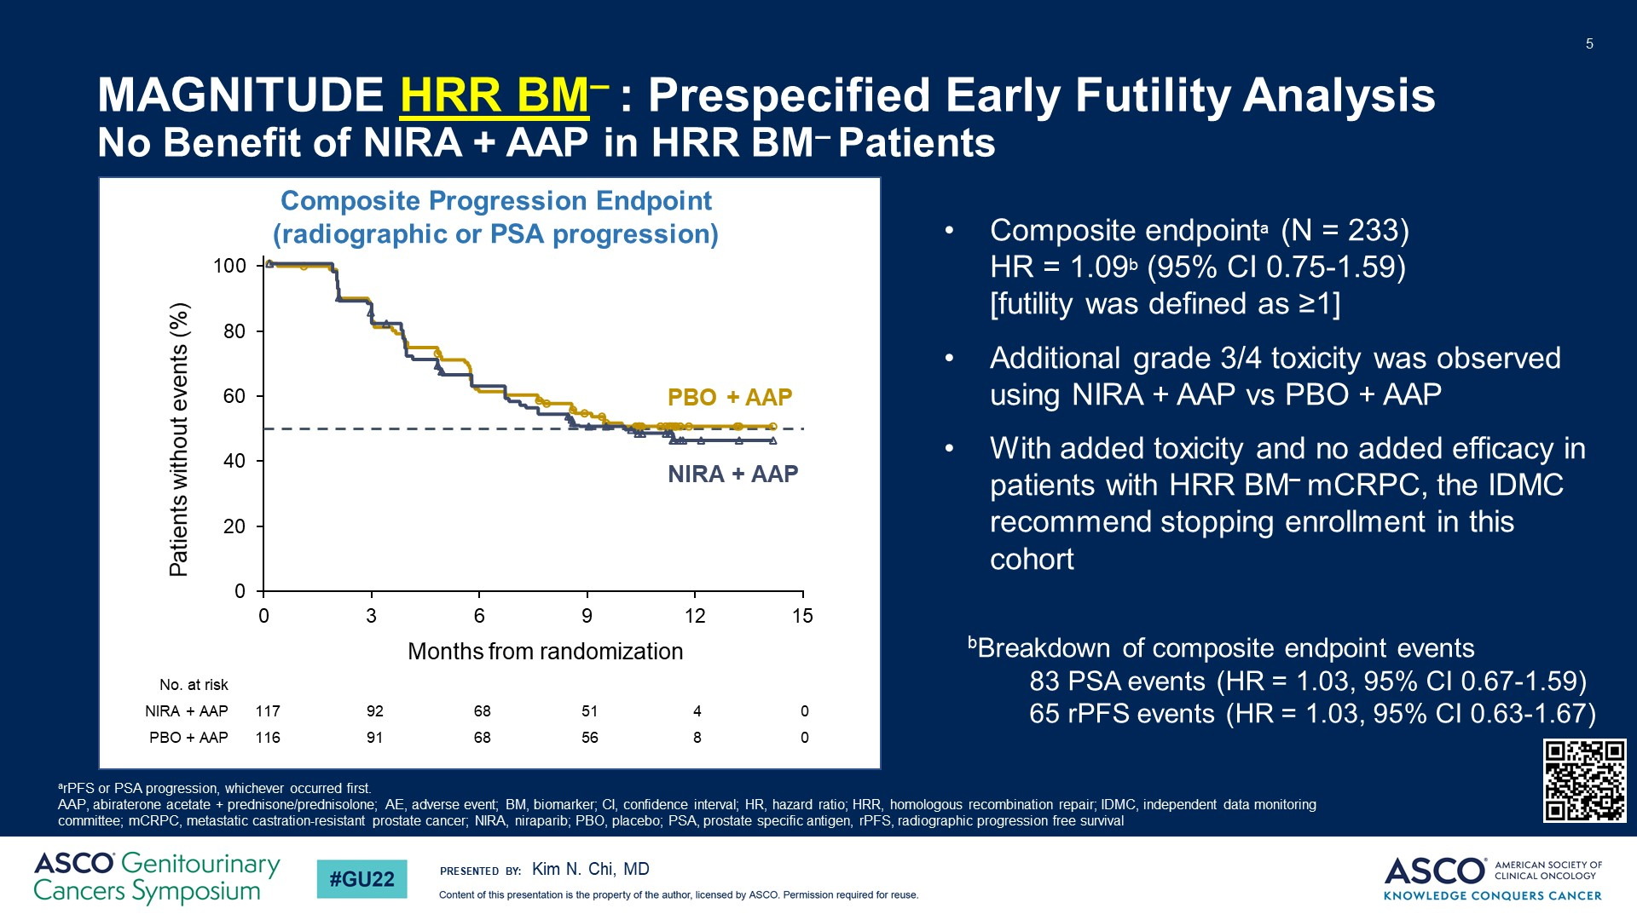
MAGNITUDE HRR BM– : Prespecified Early Futility Analysis <br />No Benefit of NIRA + AAP in HRR BM– Patients
Notes:
A pre-specified early futility analysis was planned after enrolling ~200 HRR negative (n=233) patients which were randomized to receive either niraparib + abiraterone (n=117) or placebo + abiraterone (n=116). Evaluation of futility was based on a composite PFS of PSA or radiographic progression, whichever occurred first, and a prespecified threshold of ~125 events. The pre-planned futility analysis showed no benefit in the biomarker negative cohort.

Slide 44
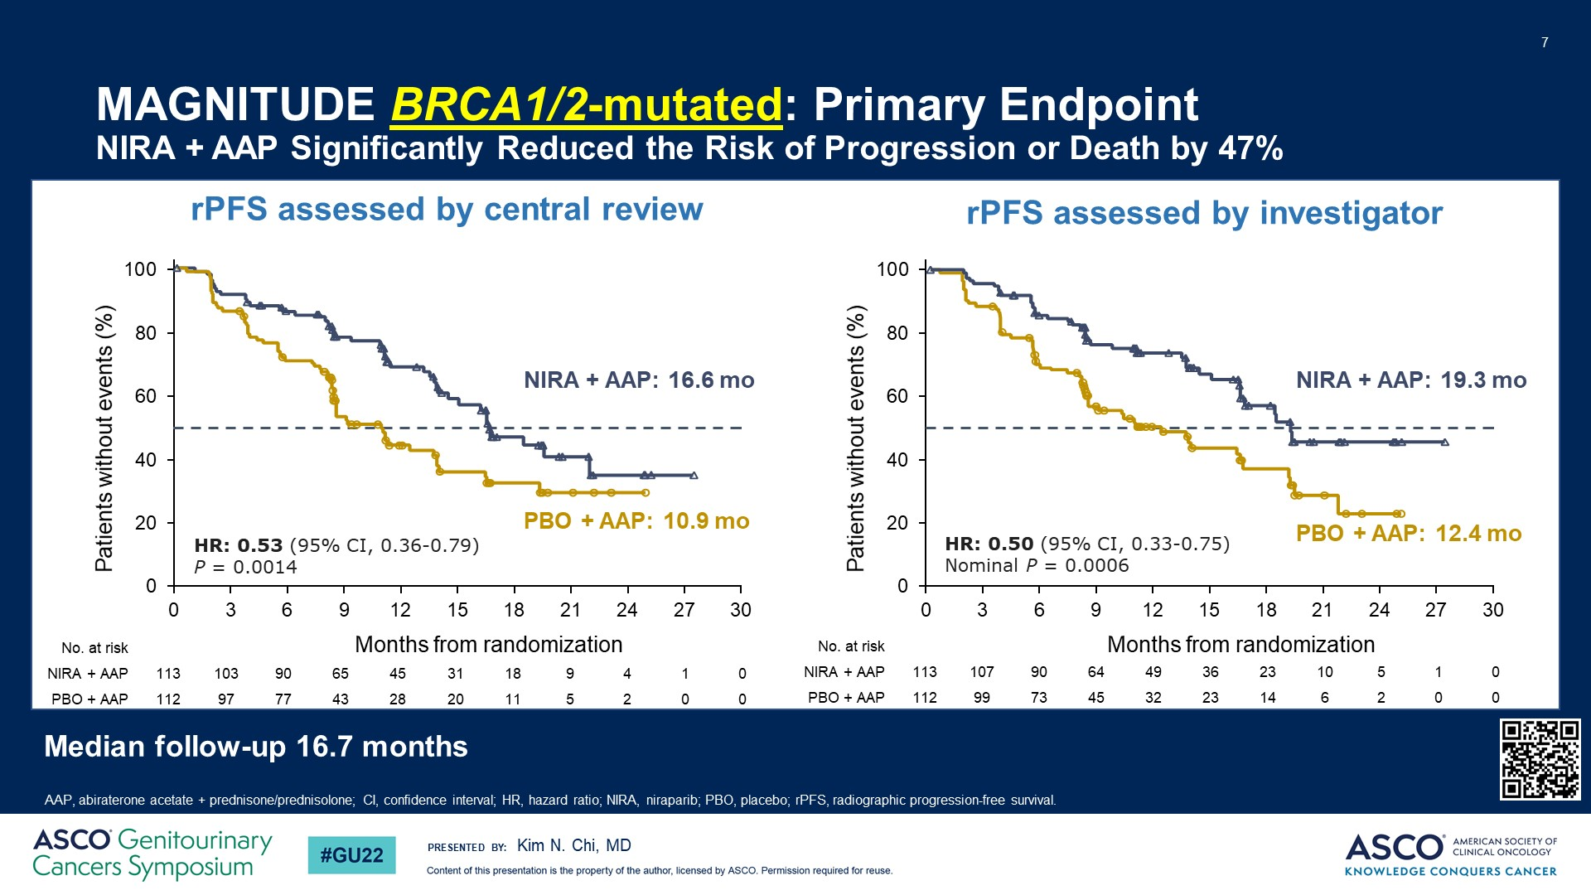
MAGNITUDE BRCA1/2-mutated: Primary Endpoint<br />NIRA + AAP Significantly Reduced the Risk of Progression or Death by 47%
Notes:
HRR Positive (n=423) patients were randomized to receive either niraparib + abiraterone (n=212) or placebo + abiraterone (n=211). At the pre-planned interim analysis, results show the trial met its primary endpoint with a significant improvement in rPFS for BRCA1/2 and all homologous recombination repair mutation positive patients receiving niraparib + abiraterone versus placebo + abiraterone. Overall survival results are still immature. It is important to note that in the HRR positive cohort of patients, approximately 50% were BRCA1/2 positive and that these patients clearly derived the most benefit from the combination with an approximate 47% reduction in the risk of progression or death. Median rPFS in the biomarker positive BRCA1/2 subgroup was 16.6 vs 10.9 months with a HR 0.53, 95% CI: 0.36 – 0.79; P=0.0014.

Slide 45
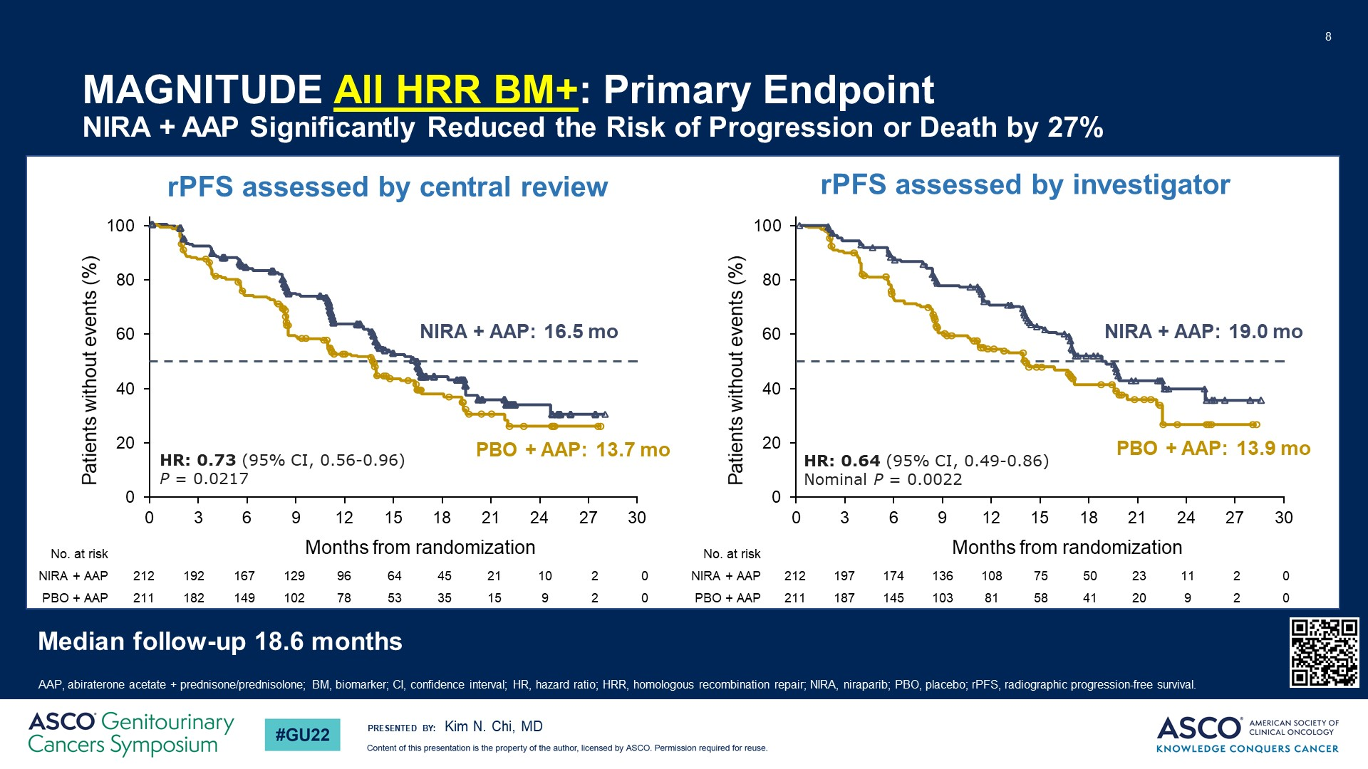
MAGNITUDE All HRR BM+: Primary Endpoint<br />NIRA + AAP Significantly Reduced the Risk of Progression or Death by 27%
Notes:
While benefit in all biomarker positive patients had a median rPFS of 16.5 versus 13.7 months with a HR of 0.73, 95% CI: 0.56 – 0.96 and P value = 0.217, which translates to a 27% reduction in the risk of progression or death.

Slide 46
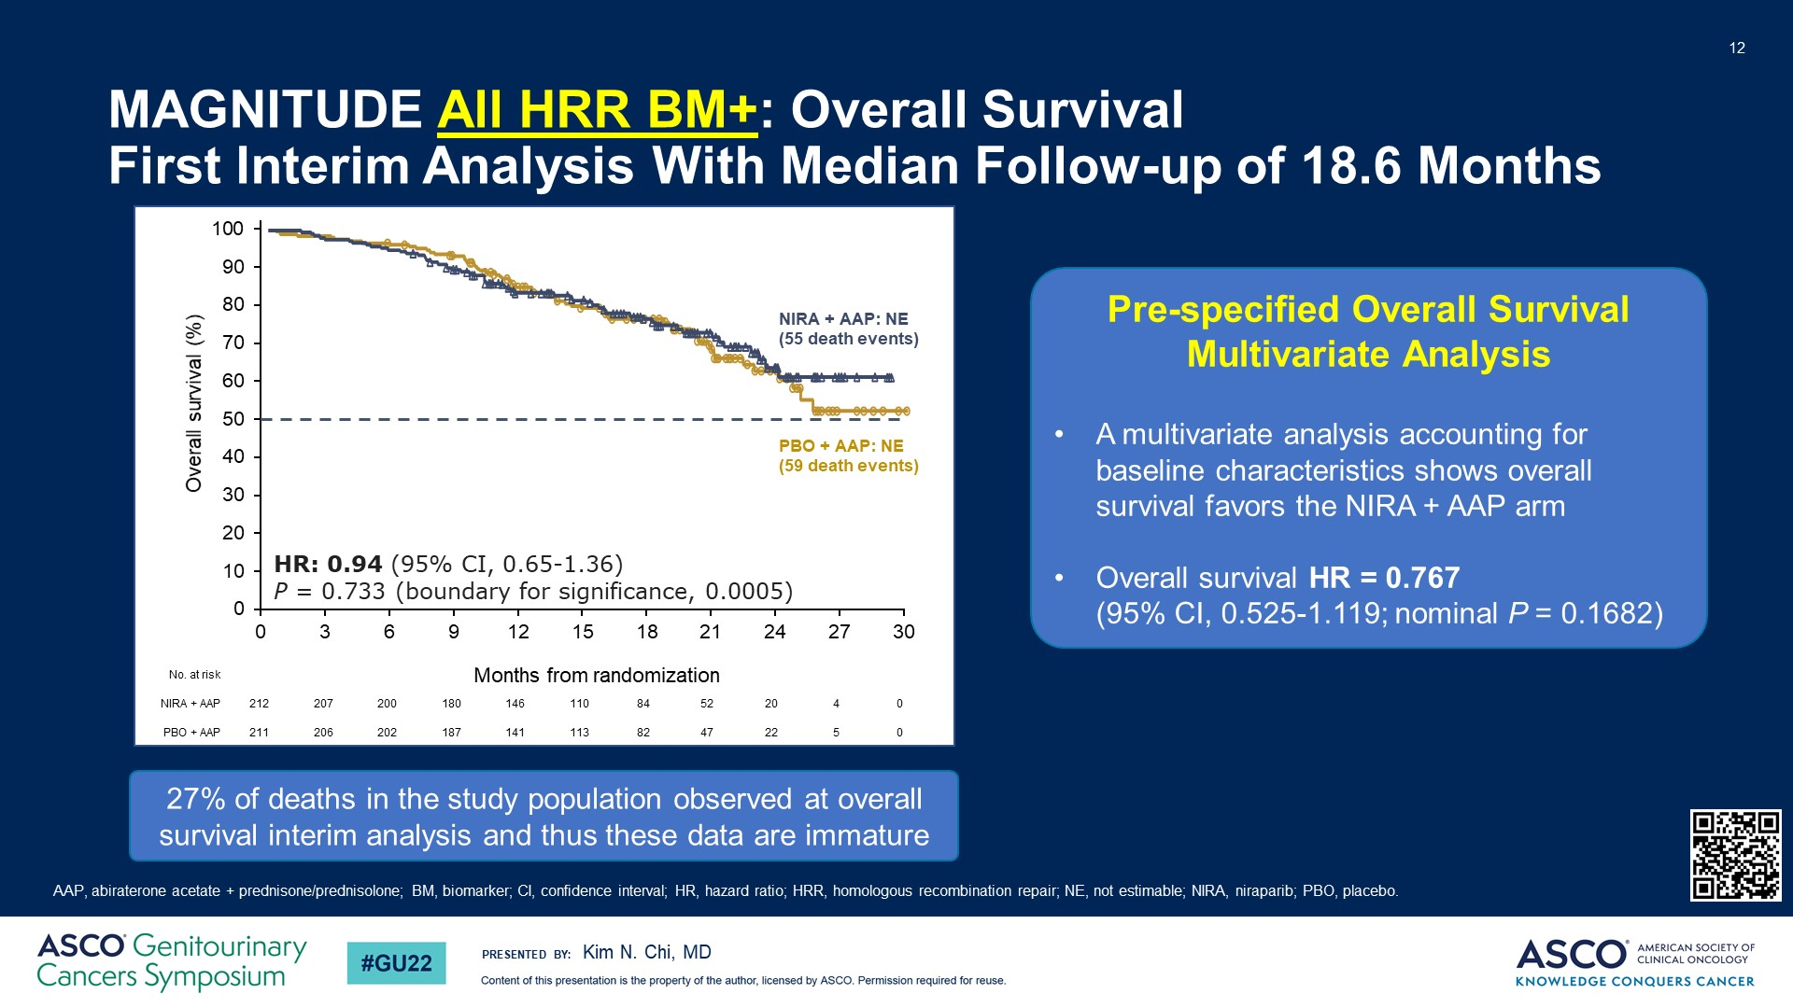
MAGNITUDE All HRR BM+: Overall Survival <br />First Interim Analysis With Median Follow-up of 18.6 Months
Notes:
Overall survival results are still immature with only 27% events in the study population reported to date.

Slide 47
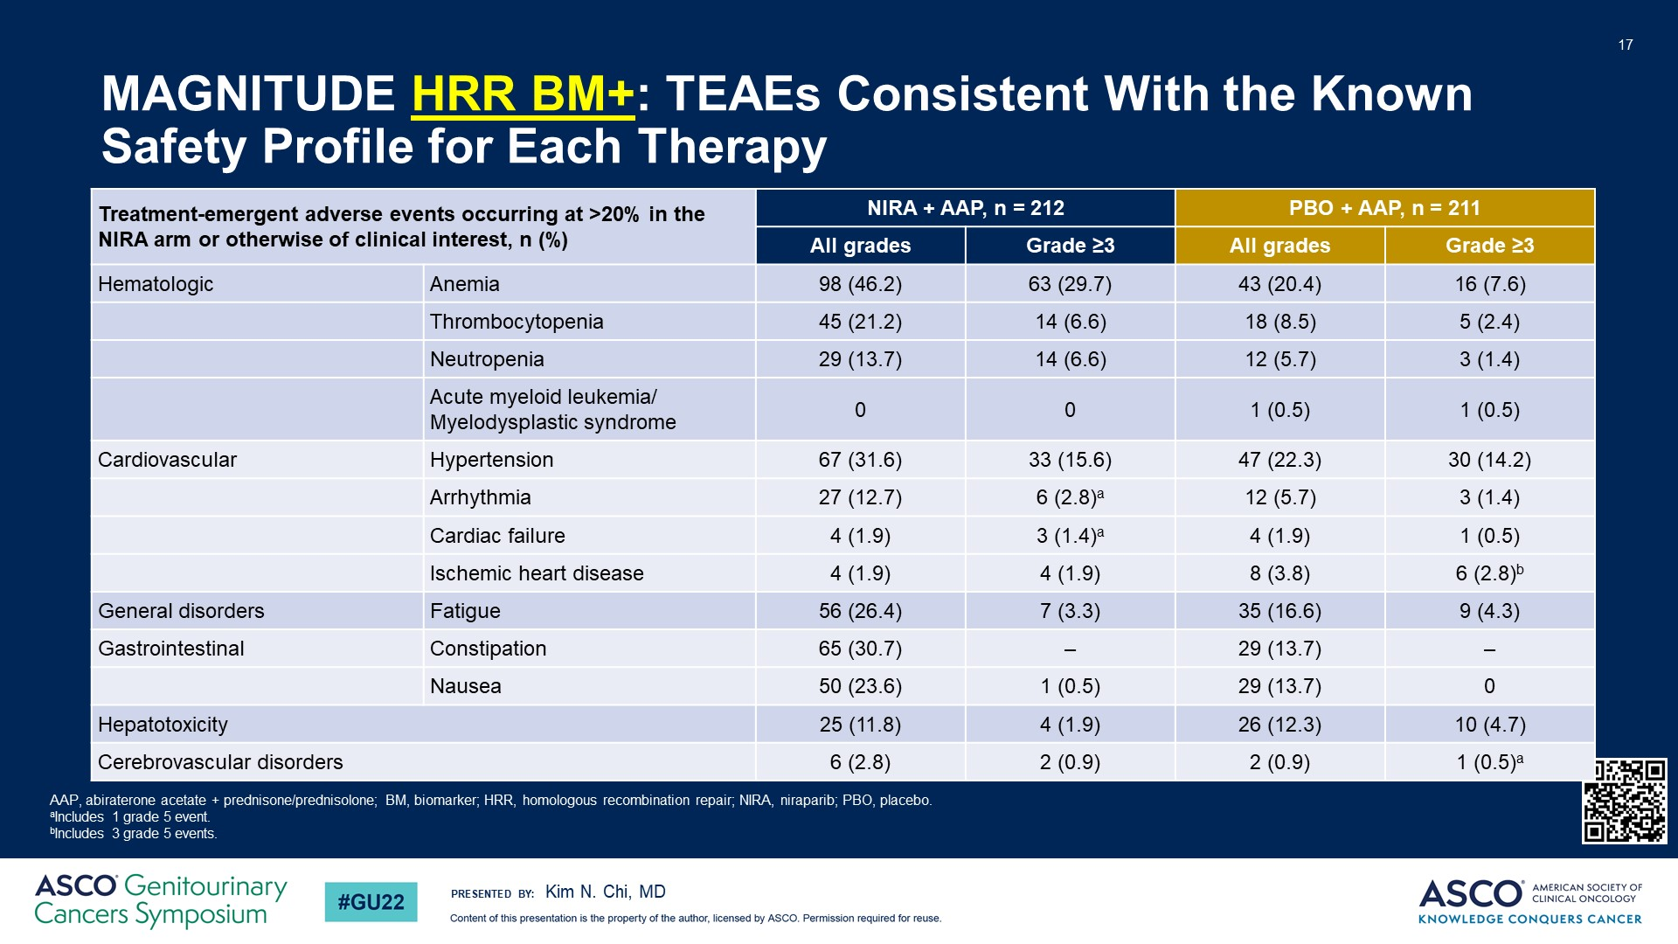
MAGNITUDE HRR BM+: TEAEs Consistent With the Known Safety Profile for Each Therapy
Notes:
Adverse event profile for the combination is consistent with previous reports for monotherapy for each therapy. More frequent all grade adverse events of anemia, thrombocytopenia, neutropenia and fatigue were observed in patients treated with the combination. Grade 3/4 adverse events of anemia, thrombocytopenia and neutropenia also were more frequently observed in the combination arm.

Slide 48
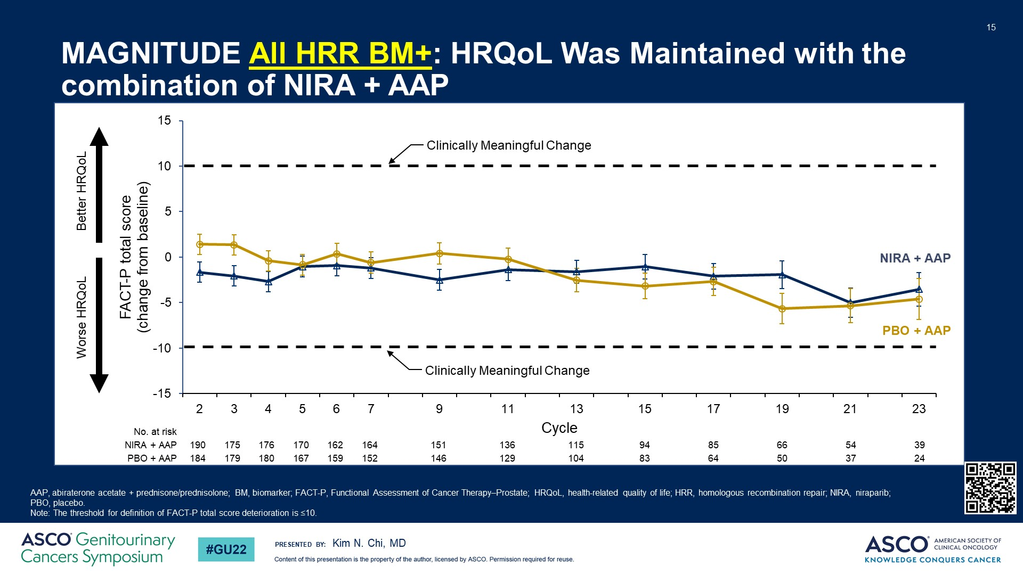
MAGNITUDE All HRR BM+: HRQoL Was Maintained with the combination of NIRA + AAP
Notes:
Health-related quality of life was not affected by the combination treatment.

Slide 49
PROpel and MAGNITUDE Revealed
Conflicting Results
PROpel (1)
MAGNITUDE (2)
olaparib + abiraterone
All-comers study
niraparib + abiraterone
2 seperate cohorts: HRR-pos. and HRR-neg.
HR 0.66
rPFS all-comers
rPFS HRR negative-NOT reported
rPFS HRR-positive
rPFS BRCA-positive
rPFS non-BRCA HRR-positive
N/A
HR 0.76
HR: Not assessed, given early termination
HR 0.5
HR 0.73
HR 0.24
HR 0.53
Not reported
HR 0.99
DATA SUPPORT ALL-COMERS APPROACH
DATA SUPPORT TARGETED APPROACH
TALAPRO-2: TIEBREAKER ?
1 Saad et al., 2022, ABSTRACT 11 ASCO-GU, NEJM Evidence, 2022.
2 Kim N. Chi et al., 2022. ABSTRACT 12 ASCO-GU, JCO, 2023

Slide 50
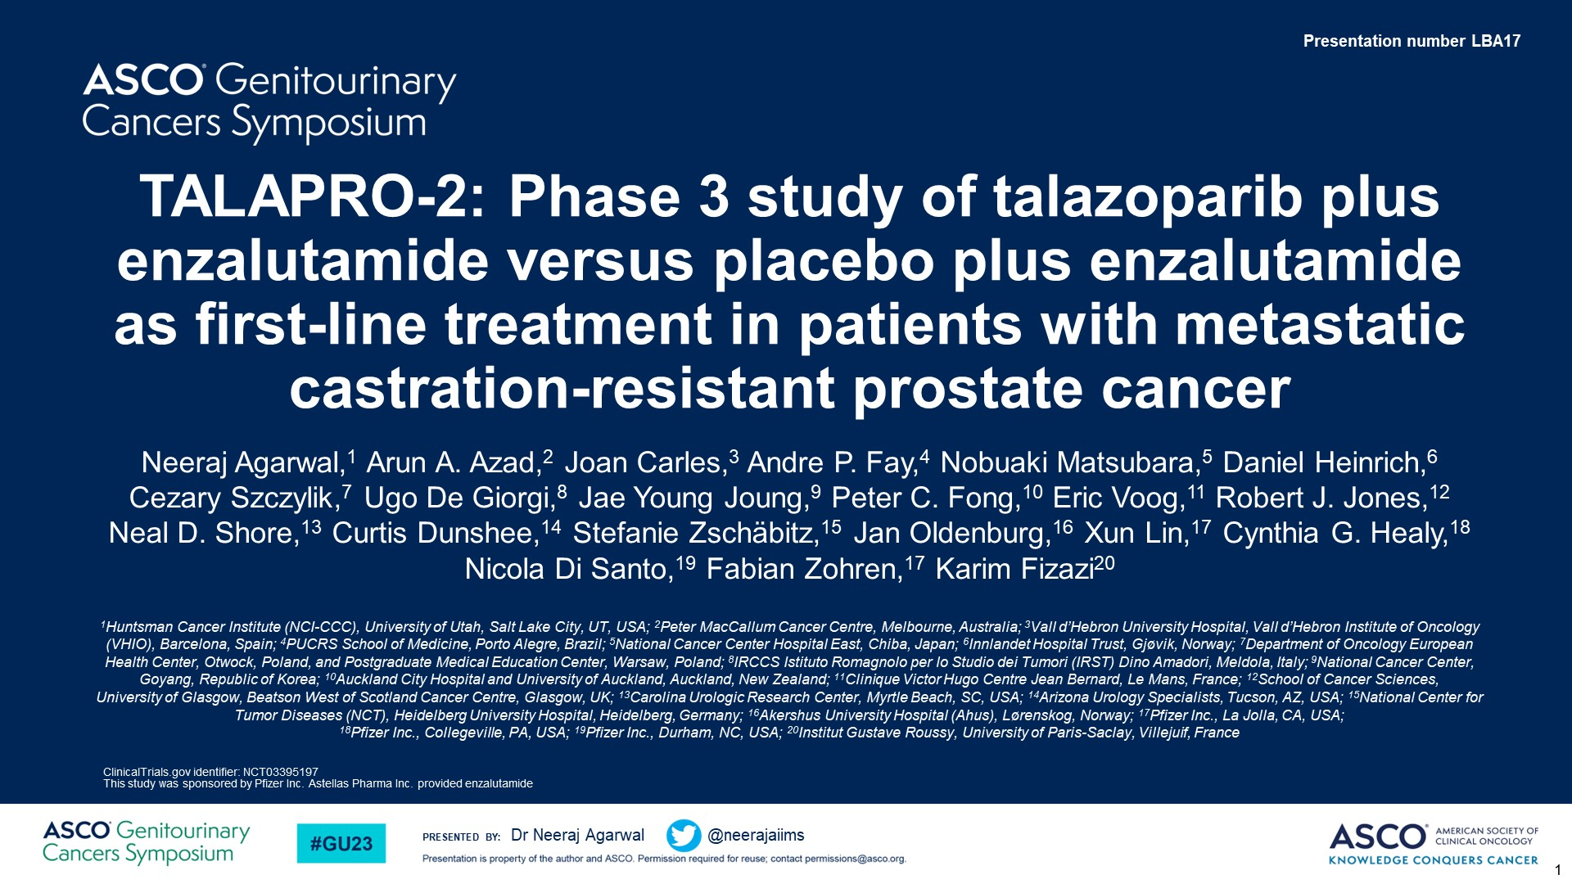
TALAPRO-2: Phase 3 study of talazoparib plus enzalutamide versus placebo plus enzalutamide as first-line treatment in patients with metastatic castration-resistant prostate cancer

Slide 51
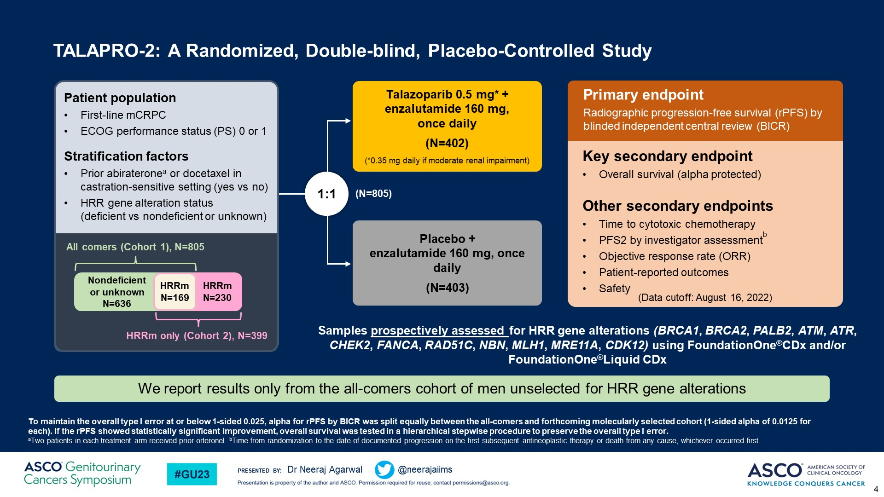
TALAPRO-2: A Randomized, Double-blind, Placebo-Controlled Study<br />

Slide 52

TALAPRO-2: Source of Tumor DNA for Assessment and Baseline HRR Gene Status<br />Biomarker status was prospectively informed by tumor tissue for 99.9% of patients

Slide 53

TALAPRO-2 Primary Endpoint: rPFS by BICR<br />Treatment with talazoparib plus enzalutamide resulted in a 37% reduced risk of progression or death

Slide 54

TALAPRO-2: Subgroup Analysis of rPFS by BICR <br />A consistent treatment effect with talazoparib plus enzalutamide was seen in prespecified subgroups

Slide 55

TALAPRO-2: rPFS by BICR in HRR-nondeficient by Prospective Tumor Tissue Testing<br />A 34% risk reduction was seen in patients without HRR gene alterations detected by prospective tumor tissue testing

Slide 56

TALAPRO-2: Overall Survival (Interim Analysis)<br />Overall survival data are immature: 31% maturity

Slide 57

TALAPRO-2: Time to PSA Progression<br />Treatment with talazoparib plus enzalutamide prolonged time to PSA progression

Slide 58

TALAPRO-2: Time to Cytotoxic Chemotherapy and PFS2<br />Benefits of talazoparib plus enzalutamide were consistently observed across other secondary endpoints

Slide 59

Slide 16

Slide 60

TALAPRO-2: Patient-Reported Global Health Status (GHS)/QoL per EORTC QLQ-C30<br />Talazoparib plus enzalutamide significantly prolonged time to definitive clinically meaningful deterioration in GHS/QoLa

Slide 61
 | PROpel* | MAGNITUDE* | TALAPRO-2**
Primary endpoint | rPFS (investigator view) | rPFS (central view) | rPFS
Prior NHA in mCSPC | Only after 12 mo of interruption (abiraterone not allowed) | Yes (except abiraterone) | Yes (abiraterone only)
Prior Docetaxel in mCSPC | Yes | Yes | Yes (if discontinued in the 28 days prior to randomization)
Stratification by HRR status | No | Yes | Yes
HRR analysis | Tissue or ctDNA /retrospective | 100% tissue/prospective | Primarily tissue (99.9%)/prospective
Patients who received NHA/Docetaxel in mHSPC in experimental arm (%) | 0.3/22.6 | 3.8/19.3**
rPFS
All commers | + (HR 0.66) | Not reported | + (HR 0.63)
HRR -ve | + (HR 0.76) | No benefit | + (HR 0.66)
HRR +ve | + (HR0.50) | + (HR 0.73 for BRCA+/0.53 for all HRR genes) | + (HR 0.46)
ORR | 58 vs 48% | 60% vs 28% (only HRR+ pts) | 61.7 vs 43.9%
HRQol | Maintained | Maintained | Prolonged time to clinically meaningful deterioration
OS | Immature | Immature | Immature
27(xx/xx)
*ASCO GU 2022 **nmCRPC and mHSPC/23.6% received prior abiraterone in mCRPC setting **ASCO GU 2023 (LBA17).

Slide 62

TALAPRO-2: Study Cohorts and Enrollment
Content of this presentation is the property of the author, licensed by ASCO. Permission required for reuse.

Slide 63

TALAPRO-2 HRR-Deficient: Baseline Demographics and Disease Characteristics
Content of this presentation is the property of the author, licensed by ASCO. Permission required for reuse.

Slide 64

TALAPRO-2 HRR-Deficient Primary Endpoint: rPFS by BICR
Content of this presentation is the property of the author, licensed by ASCO. Permission required for reuse.

Slide 65

TALAPRO-2 HRR-Deficient: rPFS by BICR by Selected Gene Subgroups
Content of this presentation is the property of the author, licensed by ASCO. Permission required for reuse.

Slide 66

TALAPRO-2 HRR-Deficient: Overall Survival (Interim Analysis)
Content of this presentation is the property of the author, licensed by ASCO. Permission required for reuse.

Slide 67

TALAPRO-2 HRR-Deficient: Time to PSA Progression
Content of this presentation is the property of the author, licensed by ASCO. Permission required for reuse.

Slide 68

TALAPRO-2 HRR-Deficient: Time to Cytotoxic Chemotherapy and PFS2
Content of this presentation is the property of the author, licensed by ASCO. Permission required for reuse.

Slide 69

TALAPRO-2 HRR-Deficient: Summary of TEAEs
Content of this presentation is the property of the author, licensed by ASCO. Permission required for reuse.

Slide 70

TALAPRO-2 HRR-Deficient: Most Common All-Cause TEAEs
Content of this presentation is the property of the author, licensed by ASCO. Permission required for reuse.

Slide 71

TALAPRO-2 HRR-Deficient: Patient-Reported Global Health Status
Content of this presentation is the property of the author, licensed by ASCO. Permission required for reuse.

Slide 72

Phase 3 trial of PARPi + NHT in 1st line mCRPC and mCSPC
PROpel: Abiraterone + Olaparib¹
mCRPC
Published
MAGNITUDE: Abiraterone + Niraparib²
Presented
TALAPRO-2: Enzalutamide + Talazoparib
Press release
October 2022
CASPAR: Enzalutamide + Rucaparib Enrolling
mCSPC
TALAPRO-3: Enzalutamde + Talazoparib Enrolling
Amplitutde: Abiraterone + Niraparib Enrolling
1- Clarke NW et al., NEJM Evidence. 2022 Aug 23;1(9):EVIDoa2200043; 2-2022 Genitourinary cancers symposium (ASCO GU). Abstract #12

Slide 73
AMPLITUDE (Niraparib) : Phase 3 Trial Design (mCSPC)
Key Eligibility
Men aged ≥ 18 years with confirmed mCSPC (adenocarcinoma)
Metastatic disease documented by greater than or equal to (>=) 1 bone lesion(s)
Positive for deleterious germline or somatic homologous recombination repair (HRR) gene mutations
Radiation with curative intent or prior treatment with PARPi is not allowed
Patients with long-term use of systemically administered corticosteroids or history of MDS or AML were excluded
R
A
N
D
O
M
I
Z
E
D
n=788
Niraparib 200 mg qd
+
Abiraterone Acetate
1000 mg qd.
+
Prednisone 5 mg qd
Efficacy end points
Primary:
rPFS per PCWG 3
Secondary:
OS
Symptomatic PFS
Time to subsequent therapy
Duration of response (DOR)
Number of Participants with Adverse Events as a Measure of Safety and Tolerability
Placebo
+
Abiraterone Acetate
1000 mg qd.
+
Prednisone 5 mg qd
www.clinicaltrials.gov: (NCT04497844)
Rathkopf et al., 2021, ABSTRACT TPS 176 ASCO-GU
Notes:
The AMPLITUDE trial, is investigating a combination of niraparib plus abiraterone versus placebo plus abiraterone. This study plans to recruit a total of 788 patients with metastatic castration-sensitive prostate cancer with a known DNA repair gene defect status. The primary endpoint is radiographic PFS.

Slide 74
TALAPRO-3 (Talazoparib) : Phase 3 Trial Design (mCSPC)
Key Eligibility
Men aged ≥ 18 years with confirmed mCSPC (adenocarcinoma)
Metastatic disease documented by greater than or equal to (>=) 1 bone or soft tissue lesion(s)
Positive for deleterious germline or somatic homologous recombination repair (HRR) gene mutations
Radiation/surgery with curative intent or prior treatment with chemotherapy or PARPi is not allowed
Patients with brain metastases or a history of MDS or AML were excluded
R
A
N
D
O
M
I
Z
E
D
n=550
Talazoparib 0.5 mg/day
(0.35 mg/day [PO]
if moderate renal
impairment)
+
open-label enzalutamide
160 mg/day (PO)
Efficacy end points
Primary:
rPFS
Secondary:
OS
ORR
PSA response
Health-related quality of life
Placebo
+
open-label enzalutamide
160 mg/day (PO)
www.clinicaltrials.gov: (NCT04821622)
1 Agarwal et al., 2022, ABSTRACT TPS 221 ASCO-GU
Notes:
The TALAPRO-3 trial, is investigating a combination of talazoparib plus enzalutamide versus placebo plus enzalutamide. This study plans to recruit a total of 550 patients with metastatic castration-sensitive prostate cancer with a known DNA repair gene defect status. The primary endpoint is radiographic PFS.

Slide 75
Select Studies in mCRPC of PARP Inhibitors in Combination With Agents Targeting Potentially Synergistic Pathways
AR Therapy
Immunotherapy
Cotargeting Other Pathways
Olaparib
Ph III PROpel
Met primary endpoint
Ph III KEYLYNK-010
Negative results
Ph II
NCT03810105
Ph I/II COMRADE*
NCT03317392
Ph I LuPARP*
NCT03874884
Ph II NCT02893917
Abiraterone
Pembrolizumab
Durvalumab
Radium-223
¹⁷⁷Lu-PSMA-617
Cediranib (VEGFRi)
Talazoparib
Ph III TALAPRO-2
Met primary endpoint
Ph II†
NCT04824937
Ph I*
NCT04846478
Ph I*
NCT04703920
Enzalutamide
Telaglenastat (GLSi)
Tazemetostat (EZH2i)
Belinostat (HDACi)
Rucaparib
Ph III CASPAR*
NCT04455750
Ph II CheckMate 9KD
NCT03338790
Ph II PLATI-PARP
NCT03442556
Phase I/II
NCT04253262
Enzalutamide
Nivolumab
Chemotherapy
Copanlisib (PI3Ki)
Niraparib
Ph III MAGNITUDE
Met primary endpoint
Ph I/II QUEST
NCT03431350
Ph I NiraRad
NCT03076203
Phase III
Abiraterone
Cetrelimab
Radium-223
Early phase
Trials active as of February 2023. *Recruiting. †Not yet recruiting.

Slide 76
Conclusions
Phase 3 trials (Magnitude and Propel) in the 1st line mCRPC showed improved rPFS in HRRm positive patients with the combination of NHT+PARPi, but conflicting results in HRRm negative patients
All PARPi, and even combinations are not created equal
Phase 3 TALAPRO-2 trial in the 1st line mCRPC: Talazoparib + enzalutamide (vs. enzalutamide) improves rPFS in patients with or without HRRm

Slide 77

Thank you!
Acknowledgements:
Nicolas Sayegh, MD
Umang Swami, MD
Beverly Chigarira, BS
Benjamin Louis Maughan, MD
Georges Gebrael, MD
Nishita Tripathi, MD
@neerajaiims
Notes:
Thank you very much for your kind attention.

