Slide 1
NASPCC Webinar Series:
Immunotherapy and PARP Inhibition
Dr. Judd Moul, Professor, Duke University Medical Center
October 5, 2020

Slide 2



Duke Prostate Center (DPC): Greetings-NASPCC

Slide 3
Cancer and the Immune System
Prostate Cancer:
-Sipuleucel-T (Provenge): 2010-present
-PARP Inhibitors: Brand New-- 2020

Slide 4
Hot Topic Immunotherapy

Slide 5
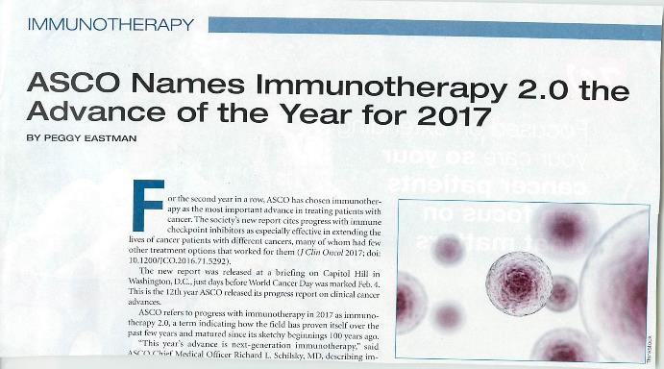
Hot Topic Immunotherapy

Slide 6
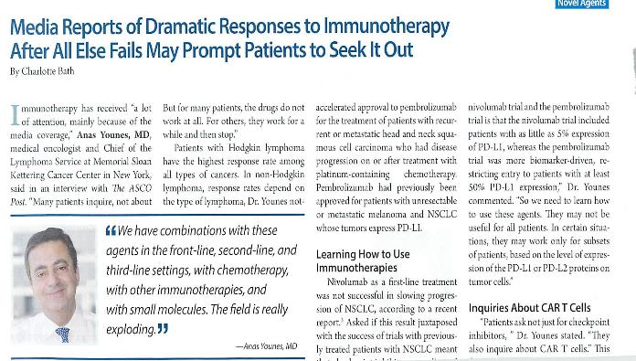
Hot Topic Immunotherapy

Slide 7
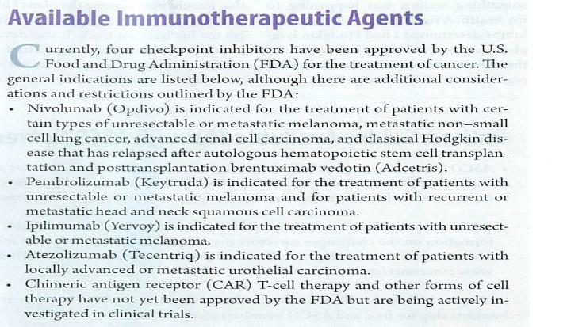
More comfortable that Immunotherapy works

Slide 8

Has a Major Role in Cancer Pathogenesis
The Immune System
Avoiding immune destruction
Evading growth suppressors
Deregulating cellular energetics
Activating invasion and metastasis
Hallmarks
of Cancer
Pathogenesis
Sustaining proliferative signaling
Enabling replicative
immortality
Resisting cell death
Inducing angiogenesis
Hanahan, D., & Weinberg, R. A. (2011). Cell, 144(5), 646-674.
Hanahan, D., & Weinberg, R. A. (2000). Cell, 100(1), 57-70.

Slide 9

and Overwhelms the Immune System
Cancer Evades
Tumors evade and overwhelm the immune system
  Enabling malignant cells to grow and spread
In a dynamic process, the immune system can either
  Block tumor growth or
  Allow tumor growth and metastasis
IMMUNE
PROTECTION
IMMUNE
EVASION
3E’s
Immune system and cancer interact in a dynamic process, known as the 3 E’s
- Elimination (immune system eradicates cancer cells)
- Equilibrium (immune system controls cancer outgrowth)
- Escape (cancer overwhelms the immune system)
Dunn, G. P., et al. (2006). Nat Rev Immunol, 6(11), 836-949.

Slide 10


Defining Castration-Resistant Prostate Cancer (CRPC)
Prostate cancer that progresses clinically, radiographically, or biochemically despite ADT and castrate levels of testosterone is castration-resistant¹
+
=
nmCRPC
No evidence
of metastasis
+
Disease progression*
while on ADT
Serum testosterone levels below 50 ng/dL
+
=
mCRPC
mCRPC
Evidence
of metastasis
*Disease progression can be radiographically, clinically or biochemically while serum testosterone is <50ng/mL
1. Referenced with permission from the NCCN Clinical Practice Guidelines in Oncology (NCCN Guidelines®) for Prostate Cancer V.X.2019. © National Comprehensive Cancer Network, Inc. 2019. All rights reserved. Accessed [March 19, 2019]. To view the most recent and complete version of the guideline, go online to NCCN.org.
10
Notes:
1. Saltus et al. Prostate Cancer Volume 2019, Article ID 4387415, 7 pages https://doi.org/10.1155/2019/4387415 In clinical practice, CRPC is defined as progression of advanced prostate cancer despite medical or surgical castration. Key defining factors include castrate level of serum testosterone plus evidence of progression, either biochemically (serial prostate-specific antigen assays) or by radiologic evaluation (bone scan or measurable soft tissue masses).
- Referenced with permission from the NCCN Clinical Practice Guidelines in Oncology (NCCN Guidelines®) for Prostate Cancer V.X.2019. © National Comprehensive Cancer Network, Inc. 2019. All rights reserved. Accessed [March 19, 2019]. To view the most recent and complete version of the guideline, go online to NCCN.org.

Slide 11

Treatment of mCRPC with sipuleucel-T
Provenge (sipuleucel-T):
  The first FDA approved autologous cellular immunotherapy available since 2010¹
  Designed to induce an immune response targeted against prostatic acid phosphatase (PAP), an antigen expressed in most prostate cancers^{1,2}
PROVENGE (sipuleucel-T) is an autologous cellular immunotherapy indicated for the treatment of asymptomatic or minimally symptomatic metastatic castrate-resistant (hormone-refractory) prostate cancer.
Indication
PROVENGE [prescribing information]. Seal Beach, CA: Dendreon Pharmaceuticals; 2017.
Kantoff PW et al. N Engl J Med. 2010;363:411-422.
11

Slide 12
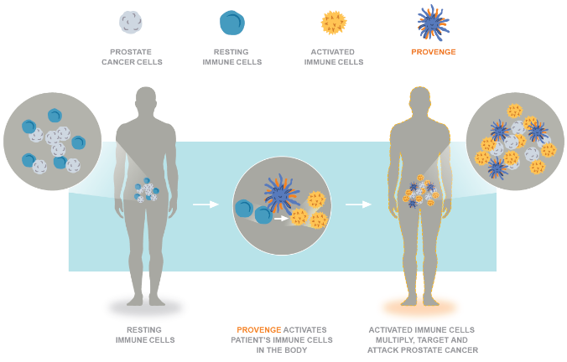
How PROVENGE® Works
PROVENGE activates your resting immune cells, which then replicate, target and attack prostate cancer cells
PROVENGE® patient brochure https://www.provenge.com/support/your-provenge-experience
Notes:
Provenge patient brochure on website
https://www.provenge.com/Portals/_default/Skins/ProvengeDTC/downloads/PRV.0025.USA.19_%20Patient%20Brochure%20iPresent.pdf

Slide 13
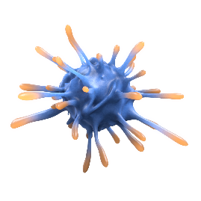
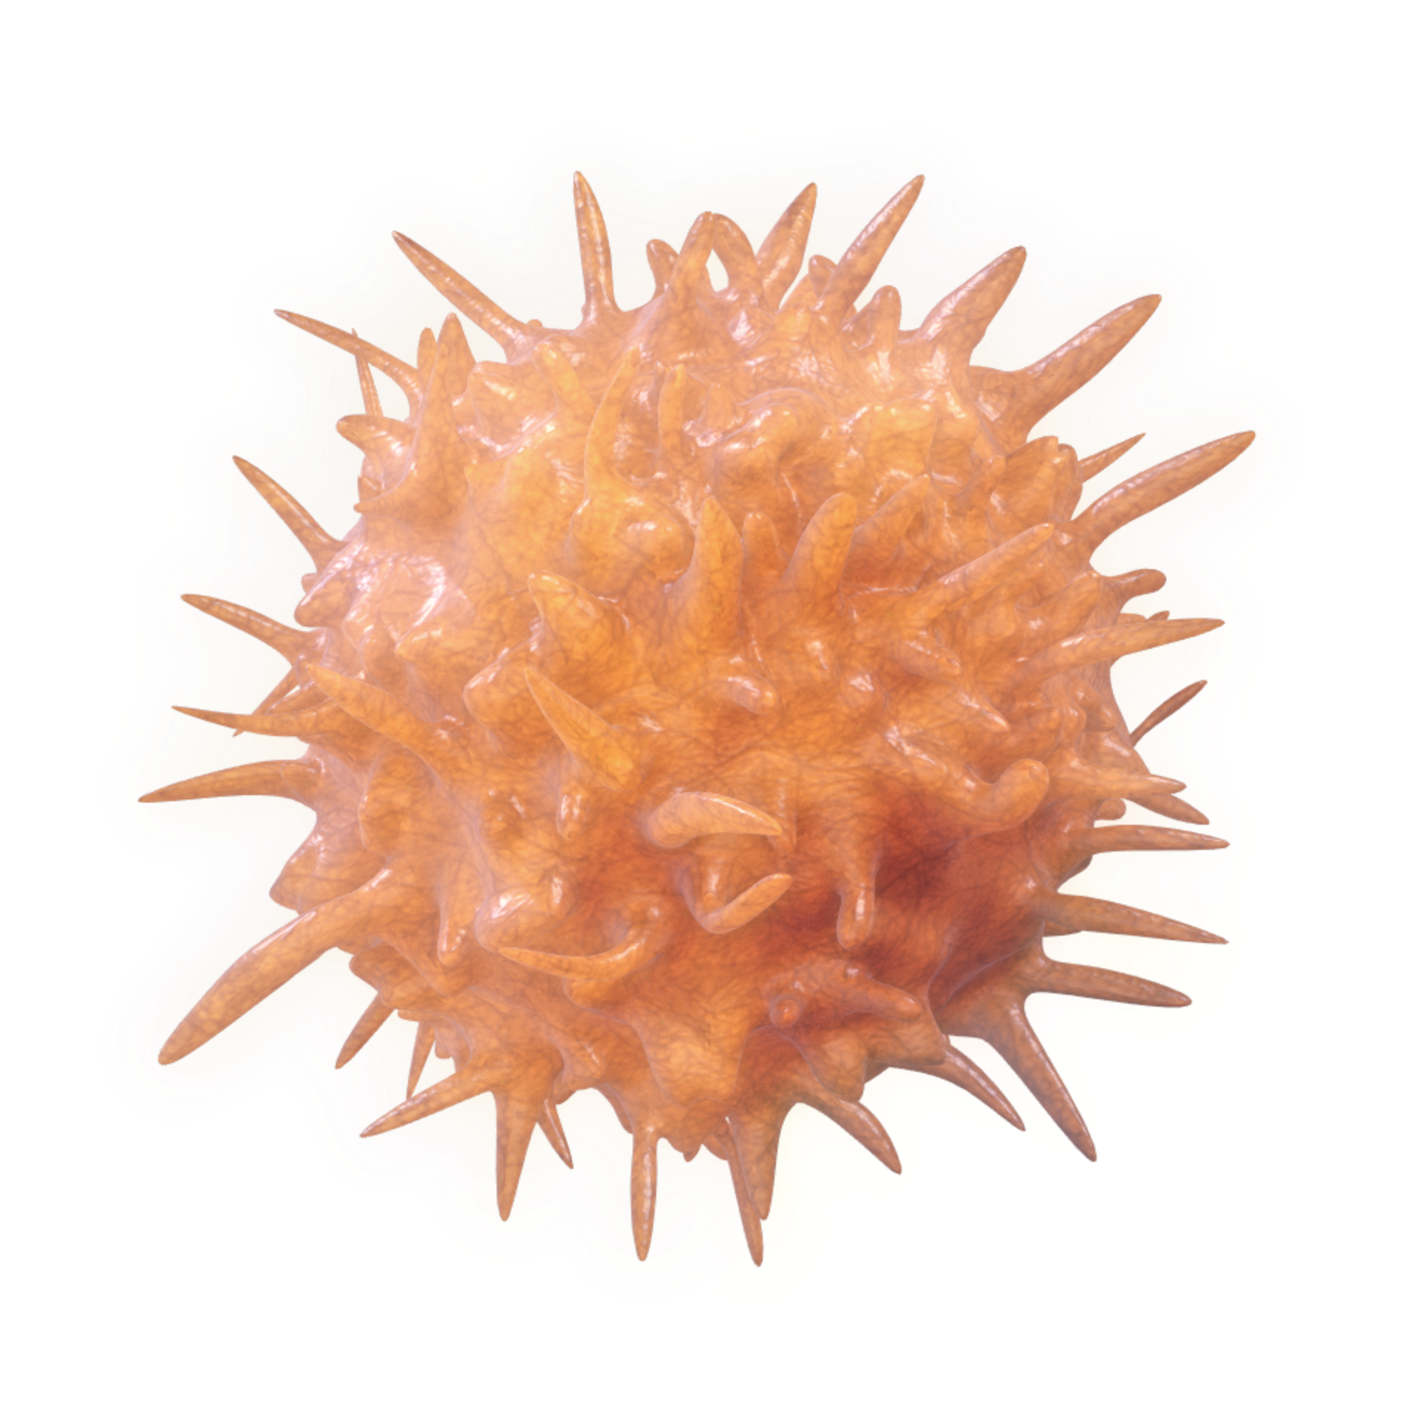
Sipuleucel-T Activates the Immune System to Target and Attack Prostate Cancer
Sipuleucel-T was the first FDA-approved personalized immunotherapy for mCRPC
NCCN Guidelines¹, RADAR II, AUA, SITC guidelines recommend early use of Sipuleucel-T in mCRPC
PROCEED registry showed that mCRPC men with a baseline PSA ≤ 5.27 ng/mL when they were treated with PROVENGE had a median overall survival of nearly 4 years
A post-hoc analysis of the IMPACT trial suggested that patients who received PROVENGE when their PSA was below 22 ng/mL had an improvement to overall survival of over 1 year
African American men in the PROCEED registry with a baseline PSA less than or equal to the median (29.48 ng/mL) had a median overall survival of over 4.5 years (54.3 months)
PROVENGE is generally well tolerated, 1.5% of patients in the pivotal clinical trial discontinued treatment
Notes:
† PROCEED was a registry to evaluate the safety of PROVENGE® (sipuleucel-T) in a real world setting whereby all patients received PROVENGE and there was no control group. The study was to quantify the risk of CVEs and survival. Patients may have received subsequent anti-cancer interventions per the local investigator’s standard of care. This sub-group analysis of the PROCEED registry was exploratory and results need careful interpretation.
Referenced with permission from the NCCN Clinical Practice Guidelines in Oncology (NCCN Guidelines®) for Guideline Prostate Cancer V.1.2020.© National Comprehensive Cancer Network, Inc. 2020. All rights reserved. Accessed April 27, 2020. To view the most recent and complete version of the guideline, go online to NCCN.org.
NCCN makes no warranties of any kind whatsoever regarding their content, use or application and disclaims any responsibility for their application or use in any way
*These subgroup analyses were not powered for statistical significance, and the population within the subgroups were not randomized. Therefore, the findings are limited by their exploratory nature.

Slide 14
Leukapheresis and Administration
Notes:
Speaker Notes:
Let’s now discuss how Sipuleucel-T can be integrated into everyday practice with straightforward administration that is completed in about 1 month
Reference:
Kantoff PW, et al. N Engl J Med. 2010;363:411-422.

Slide 15




Sipuleucel-T is Manufactured from a Patient’s Own Immune Cells and is Designed to Attack Prostate Cancer Cells
PBMC,
Including
APC
PA2024 Fusion Protein
(Programming Agent)
Density Gradient
Centrifugation
Prostatic Acid Phosphatase
(PAP)
Prostate
Cancer
Patient
Harvest Leukocytes
Granulocyte Macrophage Colony Stimulating Factor
(GM-CSF)
Intravenous Administration
PBMCs – Peripheral Blood Mononuclear Cells
APCs – Antigen Presenting Cells
Activated APCs displaying PAP peptides

Slide 16





Sipuleucel-T Is a Personalized Immunotherapy
Day 1
Collection
Immune cell collection from patient called leukapheresis
30m
The patient is observed for a minimum of 30 minutes following infusion for infusion reactions
18hr
Days 2-3
Manufacture
Cells are made into patient’s personalized dose of PROVENGE
3x
Course of treatment includes 3 infusions administered about 2 weeks apart, completed in 1 month
Day 4
Infusion
Patient premedicated 30 mins prior with oral acetaminophen and an oral antihistamine
Patient infused over 60 mins with PROVENGE
PROVENGE [prescribing information]. Seal Beach, CA: Dendreon Pharmaceuticals; 2017.

Slide 17

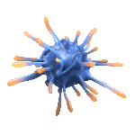




Sipuleucel-T Is Designed
to Stimulate the Patient’s Own Immune System
APC = antigen-presenting cell
PAP-GM-CSF = recombinant protein of prostatic acid phosphatase fused to granulocyte-macrophage colony-stimulating factor
Day 1
Patient cell collection
Resting APC
APC takes up PAP-GM-CSF
PAP-GM-CSF
APCs= sipuleucel-T
Creation of personalized dose of PROVENGE
Days 2-3
PAP-GM-CSF antigen combines with resting APC
PAP-GM-CSF is processed and presented on the surface of the APC
Resting T-cell
Activated T-cell
Day 4
PROVENGE infusion
Prostate cancer cell
Sipuleucel-T
activates T-cells
Activated
T-cells proliferate
…and attack
prostate cancer
PROVENGE [prescribing information]. Seal Beach, CA: Dendreon Pharmaceuticals; 2017.

Slide 18
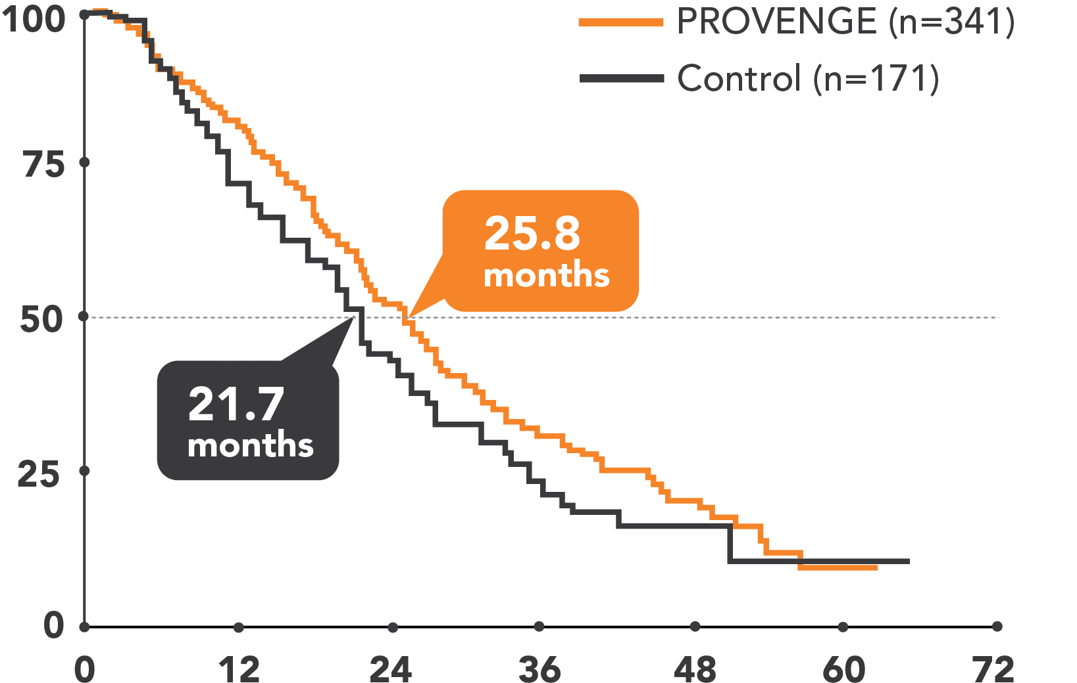
Sipuleucel-T Extends Median Survival Beyond 2 Years
Overall Survival Benefit
Sipuleucel-T (n=341)
22.5%
Risk Reduction
Survival %
HR=0.775
(95% CI: 0.614, 0.979)
P=0.032
Time From Randomization (Months)
64% of patients in the control group crossed over to receive
autologous immunotherapy made from cryopreserved cells
Kantoff PW et al. N Engl J Med. 2010;363:411-422.
No change in HR adjusting for docetaxel use/timing
Notes:
Speaker Notes:
PROVENGE extended median survival beyond 2 years: 25.8 months in the PROVENGE group and 21.7 months in the control group
Remember, 64% of patients in the control group crossed over to receive autologous immunotherapy
PROVENGE was associated with a 22.5% reduction in risk of death compared to control
Note to Speaker:
Box in bottom, right-hand corner of slide links to supplemental slide on the effect of docetaxel on overall survival
Click on box with mouse to link to slide
References
Kantoff PW, Higano CS, Shore ND, et al. Sipuleucel-T immunotherapy for castration-resistant prostate cancer. N Engl J Med. 2010;363:411-422.

Slide 19
IMPACT Trial: Baseline PSA and Survival
 | Baseline PSA (ng/mL)
 | ≤22.1 (n=128) | >22.1–50.1 (n=128) | >50.1–134.1 (n=128) | >134.1 (n=128)
Median OS (mos)
Sipuleucel-T | 41.3 | 27.1 | 20.4 | 18.4
Control | 28.3 | 20.1 | 15.0 | 15.6
Difference | 13.0 | 7.1 | 5.4 | 2.8
HR (95% CI) | 0.51 (0.31, 0.85) | 0.74 (0.47, 1.17) | 0.81 (0.52, 1.24) | 0.84 (0.55, 1.29)
Schellhammer PF, Chodak G, Whitmore JB, Sims R, Frohlich MW, Kantoff PW. Lower
baseline prostate-specific antigen is associated with a greater overall survival
benefit from sipuleucel-T in the Immunotherapy for Prostate Adenocarcinoma
Treatment (IMPACT) trial. Urology. 2013 Jun;81(6):1297-302.

Slide 20
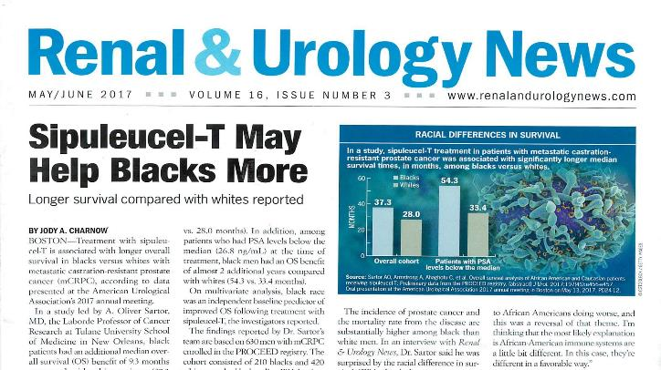
Provenge and African Americans

Slide 21
Overall Survival Analysis of African American and Caucasian Patients Receiving Sipuleucel-T: Preliminary Data From the PROCEED Registry
A. Oliver Sartor, , Andrew J. Armstrong, Chiledum A. Ahaghotu, David G. McLeod,
Matthew R. Cooperberg, David F. Penson, Philip W. Kantoff, Nicholas J. Vogelzang, Arif Hussain, Christopher Pieczonka, Nancy N. Chang, Celestia S. Higano and Judd Moul

Slide 22
The PROCEED Registry: Real-World Sipuleucel-T Use
PROCEED (NCT01306890) enrolled over 1900 real-world mCRPC patients receiving sipuleucel-T (2011-2013)
Enrolled ~12% AA patients
  Allows for prospective examination of outcomes in AA vs CAU patients
Analysis
  CAU and AA patients (2:1) matched by baseline PSA¹
  OS
  Multivariate analysis for independent factors associated with OS
AA = African American; CAU = Caucasian; mCRPC = metastatic castration-resistant prostate cancer; OS = overall survival; PSA = prostate-specific antigen.
1. Schellhammer, et al. Urology. 2013;81:1297-1302.

Slide 23
Overall Survival in CAUs and AAs by PSA Quartiles
Overall Survival by PSA Quartiles | Baseline PSA, ng/mL
 | Q1 < 7.5 | Q2 7.5-26.8 | Q3 26.81-68.49 | Q4 ≥68.5
Median OS, months
AA | 54.3 | 46.7 | 28.7 | 20.5
CAU | 37.4 | 31.9 | 22.0 | 18.3
Difference, mo | 16.9 | 14.8 | 6.7 | 2.2
HR | 0.442 | 0.602 | 0.800 | 0.913
(95% CI) | (0.260, 0.753) | (0.386, 0.939) | (0.537, 1.194) | (0.614, 1.360)
p-value | 0.003 | 0.025 | 0.275 | 0.655
AA = African American; CAU = Caucasian; CI = confidence interval; HR = hazard ratio; OS = overall survival; PSA = prostate-specific antigen.

Slide 24
Independent Baseline Predictors of OS: Multivariate Analysis*
Covariate | Hazard Ratio (95% CI) | p-value
Prior chemotherapy (yes vs no) | 1.46 (1.12, 1.90) | 0.005
Age, y (>median vs ≤median) | 1.45 (1.16, 1.80) | 0.001
Alkaline phosphatase, U/L (>median vs ≤median) | 1.64 (1.31, 2.05) | <0.001
Ethnicity (CAUs vs AAs) | 1.58 (1.23, 2.04) | <0.001
Hemoglobin, g/dL (>median vs ≤median) | 0.64 (0.51, 0.80) | <0.001
PSA, ng/mL (>median vs ≤median) | 1.62 (1.29, 2.03) | <0.001
*Variables examined in multivariate analysis: age, ethnicity, ECOG performance score, prior chemotherapy, prior radiation, weight, PSA, alkaline phosphatase, hemoglobin, liver metastases, and practice setting.
AA = African American; CAU = Caucasian; CI = confidence interval; ECOG = Eastern Cooperative Oncology Group; OS = overall survival; PSA = prostate-specific antigen.

Slide 25
Gene Mutated Prostate Cancer/PARP Inhibitors/Mismatch
NEW DRUGS:
1. Olaparib (Lynparza-AstraZeneca)
2. Rucaparib (Rubraca-Clovis Oncology)
3. Pembrolizumab (Keytruda-Merck)

Slide 26
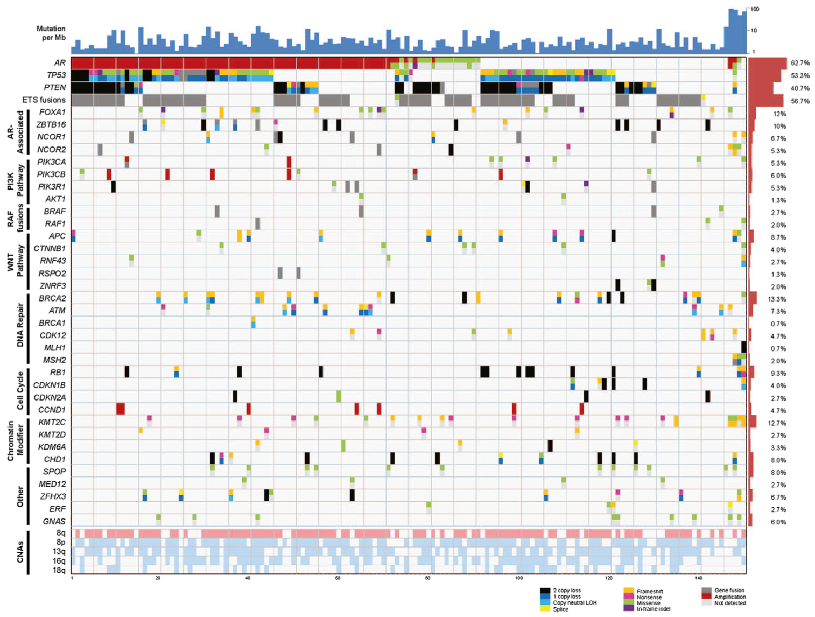
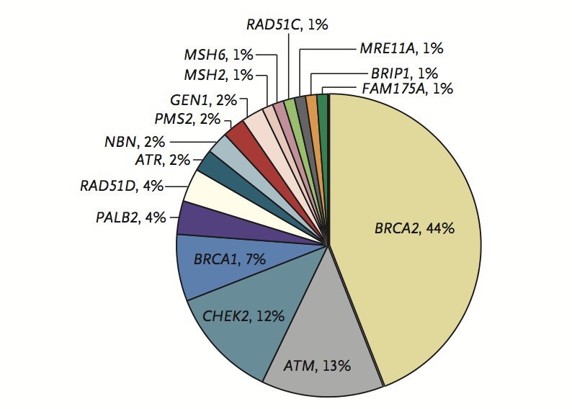
DNA Repair Alterations in Metastatic Prostate Cancer
11.8% of men with metastatic prostate cancer have a germline alteration in 16 DNA damage repair genes
Age and family history did not affect mutation frequency
23% of metastatic castration-resistant prostate cancers harbor DNA repair alterations
The frequency of DNA repair alterations increases with disease progression
Pritchard CC et al. N Engl J Med. 375:443-53.
Robinson D et al. Cell 2015; 161:1215-28.

Slide 27
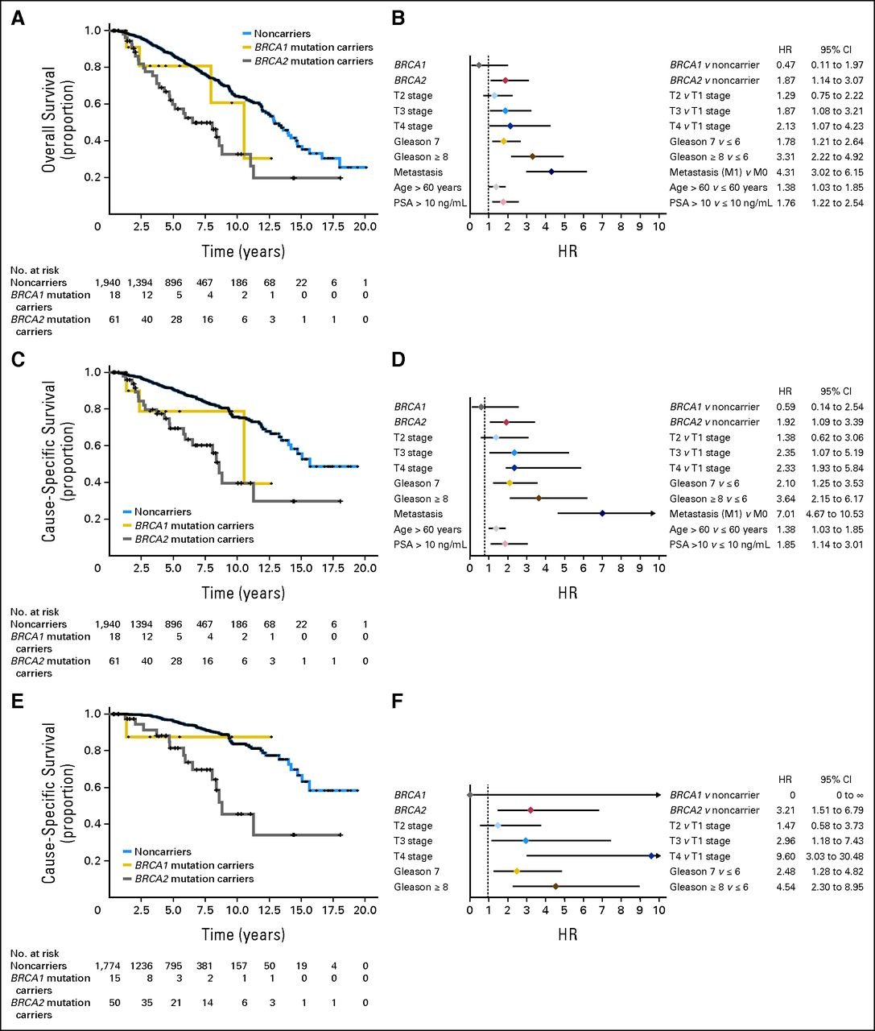
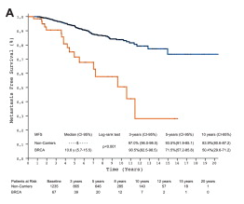
BRCA2 Mutation Carriers have a Worse Prognosis
Noncarrier
Noncarriers
Overall survival (proportion)
BRCA2
Mutation carriers
BRCA2 mutation carriers
Metastases-free survival
Time (years)
Time (years)
Castro et al. JCO 2013;31:1748-1757
Castro et al (2014) Eur Urol

Slide 28
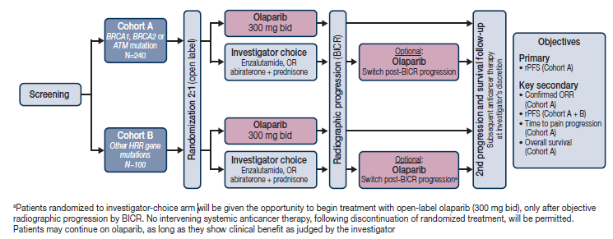
PROfound Open-label Randomized Phase 3 Trial: Olaparib vs. Enzalutamide or Abiraterone
Patient Population: Men with mCRPC and a HRR mutation who failed prior abiraterone and/or enzalutamide; prior taxane allowed, but no prior DNA-damaging chemo or PARPi
Central testing for HRR mutations using Foundation Med
ClinicalTrials.gov. NCT02987543; de Bono J, et al. Presented at ASCO 2017; abstract TPS5091.

Slide 29
PROfound rPFS
rPFS by BICR in patients with alterations in BRCA1, BRCA2, or ATM (Cohort A)
1.0
6-mo rate
59.76%
22.63%
 | Olaparib (N=162) | Physician's choice (N=83)
Events (%) | 106 (65.4) | 68 (81.9)
Median rPFS (months) | 7.39 | 3.55
Hazard ratio (95% CI) | 0.34 (0.25, 0.47)
 | P<0.0001
0.9
0.8
12-mo rate
28.11%
9.40%
0.7
0.6
Probability of rPFS
0.5
0.4
0.3
0.2
0.1
0.0
0
1
2
3
4
5
6
7
8
9
10
11
12
13
14
15
16
17
18
19
20
21
Time from randomization (months)
No. at risk
162
149
126
116
102
101
82
77
56
53
42
37
26
24
18
11
11
3
2
0
0
0
Olaparib
83
79
47
44
22
20
13
12
7
6
3
3
3
2
2
1
1
1
1
0
0
0
Physician's choice
Hussain M et al. ESMO 2019; LBA12 PR

Slide 30
PROfound Interim Overall Survival
Cohort A | Olaparib (N=162) | Physician's choice (N=83)
Median OS (months) | 18.50 | 15.11
Hazard ratio (95% CI) | 0.64 (0.43, 0.97)
 | P=0.0173†
Cohort A+B | Olaparib (N=256) | Physician's choice (N=131)
Median OS (months) | 17.51 | 14.26
Hazard ratio (95% CI) | 0.67 (0.49, 0.93)
 | P=0.0063 (nominal)
Of the physician's choice arm patients who progressed, 80.6% in Cohort A and 84.6% in Cohort B crossed over to olaparib
*38% maturity in Cohort A; 41% maturity in Cohort A+B; final analysis planned after ~146 deaths in Cohort A (60% maturity)
†Alpha spend at interim was 0.01; statistical significance not reached
6-mo rate 91.20%
84.15%
6-mo rate 92.07%
82.92%
1.0
12-mo rate
73.07%
56.94%
12-mo rate
66.06%
52.97%
0.8
18-mo rate
56.30%
42.13%
18-mo rate
49.18%
35.61%
0.6
Probability of overall survival
0.4
0.2
Key secondary endpoint
0.0
0
2
4
6
8
10
12
14
16
18
20
22
24
0
2
4
6
8
10
12
14
16
18
20
22
24
Time from randomization (months)
Time from randomization (months)
No. at risk
256
240
187
106
58
17
Olaparib
162
150
125
76
46
11
0
131
115
79
46
25
6
1
83
74
54
34
18
6
0
0
Physician’s choice
Hussain M et al. ESMO 2019; LBA12 PR

Slide 31
TRITON-2: Phase 2 Study of Rucaparib in mCRPC With HRR Aberrations — ORR¹
Characteristic | By HRR Gene With Alteration
 | BRCA1/2 (n = 57) | ATM (n = 21) | CDK12 (n = 9) | CHEK2 (n = 5) | Other (n = 13)
ORR, n (%)ª | 25 (43.9) | 2 (9.5) | 0 | 0 | 5 (38.5)
Complete response, n (%) | 3 (5.3) | 0 | 0 | 0 | 1 (7.7)^{b}
Partial response, n (%) | 22 (38.6) | 2 (9.5) | 0 | 0 | 4 (30.8)^{c}
Stable disease, n (%) | 26 (45.6) | 10 (47.6) | 5 (55.6) | 3 (60.0) | 6 (46.2)
Progressive disease, n (%) | 5 (8.8) | 8 (38.1) | 3 (33.3) | 2 (40.0) | 1 (7.7)
Not evaluable, n (%) | 1 (1.8) | 1 (4.8) | 1 (11.1) | 0 | 1 (7.7)
Confirmed PSA response rate (all evaluable patients) | 51/98 (52%) | 2/57 (3.5%) | 1/14 (7.1) | 1/7 (14.3) | 5/14 (35.7%)
43.9% confirmed objective responses were reported in 57 patients with BRCA1/2 mutation
52.0% confirmed PSA response in 98 PSA-evaluable patients with BRCA1/2 mutation

Slide 32
New PARPi FDA Approvals for Prostate Cancer
In May 2020, based on data from the PROfound study, the FDA approved olaparib for the treatment of patients with pathogenic germline or somatic HRRª gene-mutated mCRPC, who have progressed following prior treatment with enzalutamide or abiraterone^{1,b}
(ªBRCA1, BRCA2, ATM, BARD1, BRIP1, CDK12, CHEK1, CHEK2, FANCL,
PALB2, RAD51B, RAD51C, RAD51D, RAD54L)
^{b} Select patients for therapy based on two FDA-approved companion diagnostic tests: BRACAnalysis CDx and FoundationOne CDx.
1. https://www.fda.gov/drugs/drug-approvals-and-databases/fda-approves-olaparib-hrr-gene-mutated-metastatic-castration-resistant-prostate-cancer. Accessed June 2, 2020.
In May 2020, based on data from the TRITON2 study, the FDA granted accelerated approval to rucaparib for the treatment of patients with deleterious BRCA1/2 (germline and/or somatic)-associated mCRPC, who have been treated with an androgen receptor-directed therapy and a taxane-based chemotherapy²
2. https://www.fda.gov/drugs/fda-grants-accelerated-approval-rucaparib-brca-mutated-metastatic-castration-resistant-prostate. Accessed June 2, 2020.

Slide 33
FDA Approval for Pembrolizumab is Tissue/Site Agnostic for MSI high and Hypermutated Solid Tumors
In May 2017, the US FDA granted accelerated approval to pembrolizumab for adult and pediatric patients with unresectable or metastatic, microsatellite instability-high (MSI-H) or mismatch repair deficient (dMMR) solid tumors that have progressed following patient treatment and who have no satisfactory alternative treatment options¹
https://www.fda.gov/drugs/resources-information-approved-drugs/fda-grants-accelerated-approval-pembrolizumab-first-tissuesite-agnostic-indication. Accessed August 20, 2020.
In June 2020, the FDA granted accelerated approval to pembrolizumab for the treatment of adult and pediatric patients with unresectable or metastatic tumor mutational burden-high (TMB-H) [>10 mutations/megabase] solid tumors, as determined by an FDA-approved test, that have progressed following prior treatment and who have no satisfactory alternative treatment options.²
2. https://www.fda.gov/drugs/drug-approvals-and-databases/fda-approves-pembrolizumab-adults-and-children-tmb-h-solid-tumors. Accessed August 20, 2020.

Slide 34
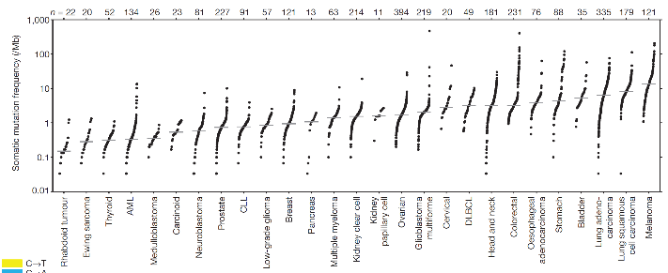
Mutational Complexity in Cancer
Somatic Mutational Frequency (/Mb)
AML
CLL
Breast
DLBCL
Thyroid
Prostate
Ovarian
Cervical
Bladder
Carcinoid
Pancreas
Colorectal
Stomach
Lung Adeno
Melanoma
Ewing Sarcoma
Neuroblastoma
Head & Neck
Rhabdoid tumor
Medulloblastoma
Kidney Clear Cell
Lung Squamous
Low-Grade glioma
Multiple Myeloma
Esophageal adeno
Kidney Papillary Cell
Glioblastoma Multiforme
Increasing evidence that the neoantigens associated with
recent mutation are the prime targets of immunotherapy
Lawrence MS et al. Nature 2013; 499:214-8.

Slide 35
Mismatch Repair Alterations with MSI in Prostate Cancer
UW Rapid Autopsy
SU2C mCRPC Biopsies
7/60 (11.7%) of advanced prostate cancers are hypermutated and all had mismatch repair gene mutations and MSI
Hypermutation defined as >300 somatic protein altering mutations in metastatic tumors
All mismatch repair alterations were in MSH2 or MSH6
2.7% harbor MMR alterations in either MLH1 or MSH2, which are consistent with MSI
Pritchard CC et al. Nat Commun. 2014; 5:4988.
Robinson D et al. Cell 2015; 161:1215-28.

Slide 36
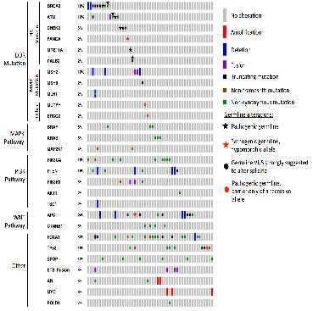
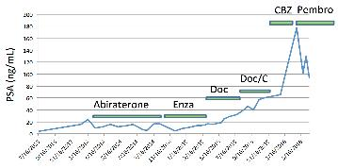

Prostate Ductal Carcinoma Enriches for MMR and DDR
Increased cases with UW, Johns Hopkins, and University of Calgary collaboration
  25/51 (49%) had at least 1 DNA Damage Repair (DDR) gene alteration
4/10 (40%) with MMR
  MLH1 (1), MSH2 (2), MSH6 (1)
Schweizer MT et al. JCO Precision Oncology 2019; Epub April 2010.
Schweizer MT et al. Oncotarget. 2016; 7:82504-10.

Slide 37
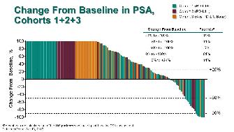
Pembrolizumab for Unselected Prostate Cancer Populations
KEYNOTE-199: Post-docetaxel single agent Pembrolizumab
KEYNOTE-365 Cohort A: Post-docetaxel Pembrolizumab + Olaparib
De Bono J et al. J Clin Oncol 36, 2018 (suppl; abstr 5007).
Yu EY et al. J Clin Oncol 38, 2020 (suppl 6; abstr 100).

Slide 38
Key Take Home Points
Sipuleucel-T (Provenge): Treatment for mCSPC: first immunotherapy for prostate cancer; extends survival; Low PSA patients and AAM may have better reponse.
DNA repair deficiency occurs in 23% of metastatic castration-resistant prostate cancer patients and 12% are germline in metastatic prostate cancer -> cascade testing implications
Olaparib and Rucaparib have regulatory approval for select mCRPC patirnts with DNA repair gene alterations
Pembrolizumab can be used for MSI high or hypermutated prostate cancer

