Slide 1

PSMA Imaging for Prostate Cancer: What is it and what is its potential?
Michael J. Morris, MD
Section Head, Prostate Cancer Memorial Sloan Kettering Cancer Center

Slide 2
Disclosures
Uncompensated advisor to AAA, Bayer, and Johnson and Johnson
Compensated advisor to ORIC and Curium
MSK receives institutional research funding for the conduct of clinical trials in which I participate from Bayer, Endocyte, Progenics, Corcept, Roche/Genentech, and Janssen
Travel to academic meetings has been supported by Endocyte and Fujifilm

Slide 3

Why do we image?
Treatment prediction (will a treatment help?)
Response assessments (is the patient responding?)
Prognostication (how long will he live?)
Assessing the targeting of new drugs (is the drug hitting its target?)
Staging (treatment planning)
Risk-assessment (prognostic)
Disease localization
Clinical Metastases: Sensitive to ADT
Clinically Localized Disease
Rising PSA
Metastatic Disease Treatment: 1st Line
Metastatic Disease Treatment: 2nd Line
Metastatic Disease Treatment: 3rd Line
Metastatic Disease Treatment: 4th Line
Non- Metastatic
Progressing despite ADT (testosterone lowering agents)
Scher, Morris, et al JCO 2016

Slide 4
Standard Imaging
Most prostate cancer metastasizes to bone, lymph nodes, and sometimes the viscera (liver and lung)
Usually, soft tissues are imaged with CT or MRI
– Cross-sectional anatomic imaging
Usually, bone disease is imaged with a bone scan
Choline and Axumin (fluciclovine) are approved molecular imaging studies, for imaging in specific circumstances (relapse
+/- negative standard studies)

Slide 5


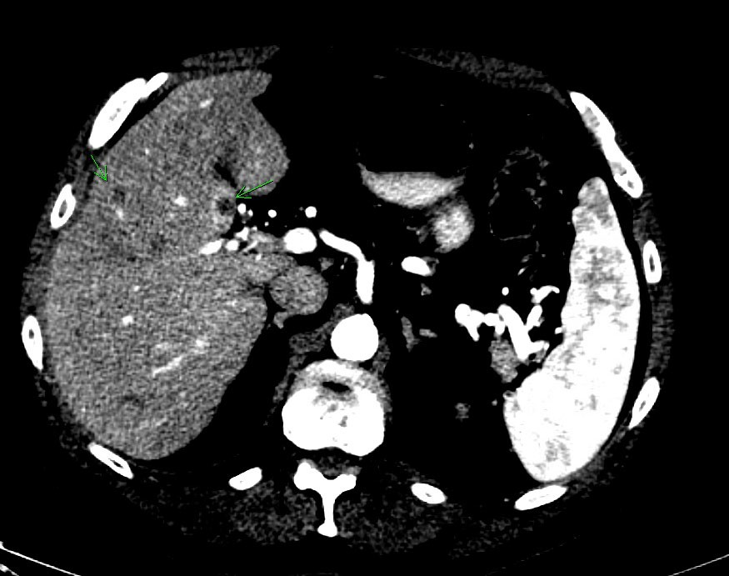
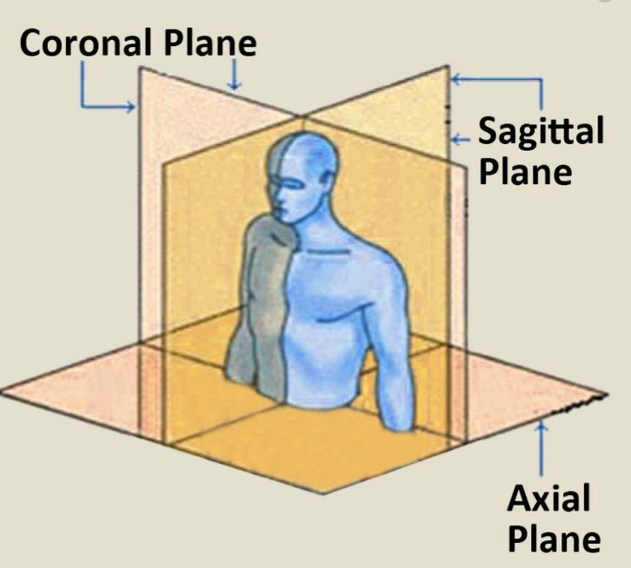


CT or MRI
Images demonstrate anatomy in cross-section – location, radiation penetrability, and size are demonstrated

Slide 6
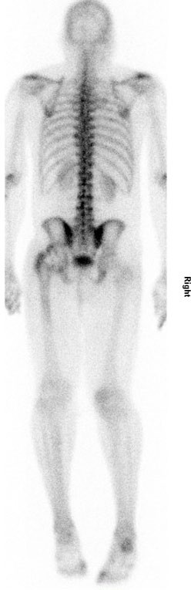
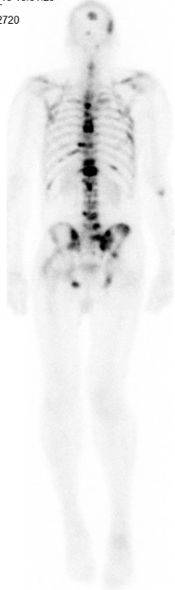
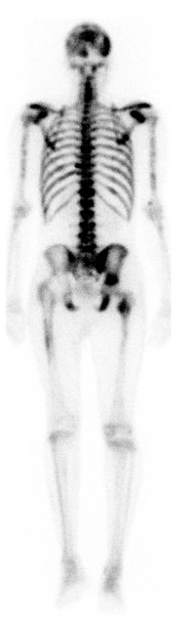


Bone scans
Bone scans do not demonstrate cancer specifically, but rather bone metabolism and injury

Slide 7
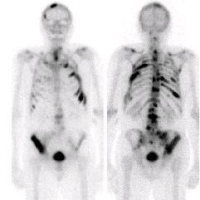
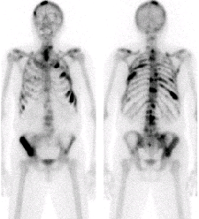
Standard Bone Scans: Poorly Reflect Anti-Tumor Effects
Failure to Reflect Response
AN
POST.
AN POST.
T.
After 3 months of treatment
T.
Baseline
PSA= 75 ng/ml
PSA=8.6 ng/ml

Slide 8
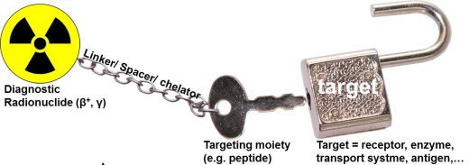
How does molecular imaging work conceptually?
Drude et al., Methods, 2017

Slide 9
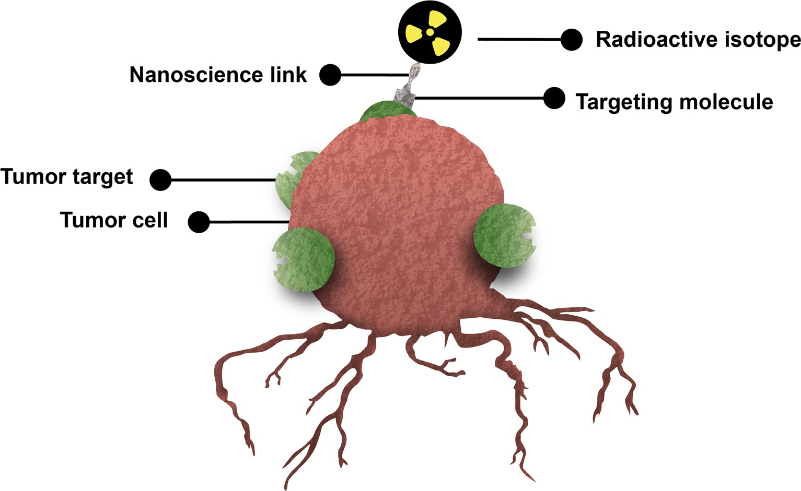
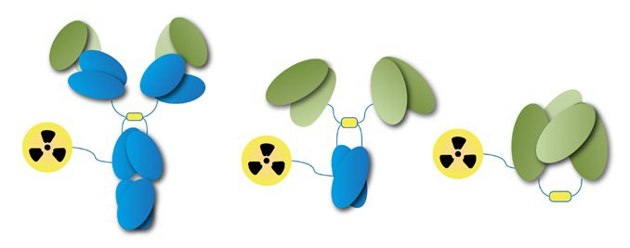
Radioligand Therapy: The elements of treatment
Ga-68 F-18

Slide 10
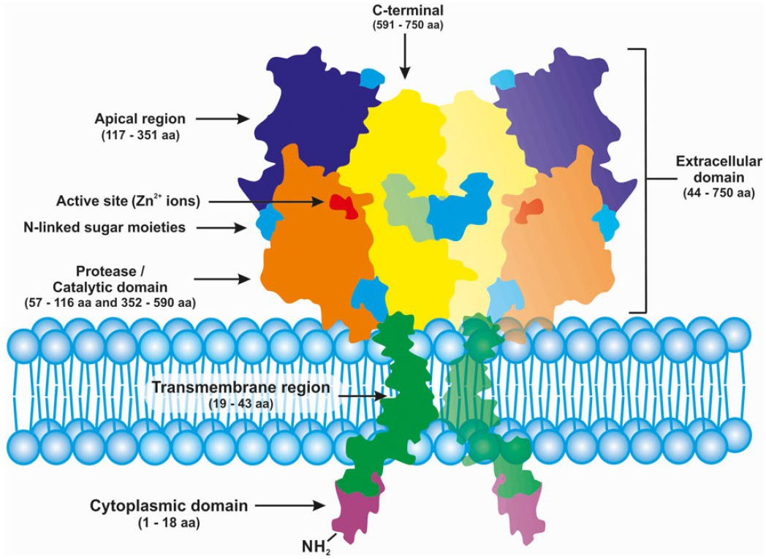
Prostate-Specific Membrane Antigen is a Multi-Domain Transmembrane Protein
PSMA is a type II transmembrane protein that is internalized after ligand binding
PSMA is expressed in the primary and at metastatic sites
PSMA expression varies by AR signaling
PSMA does have some normal organ expression
Kupffer cells
Proximal renal tubules
AR, androgen receptor; PSMA, prostate-specific membrane antigen.
1. Evans JC, et al. Br J Pharmacol. 2016;173(21):3041–3079. 2. Liu H, et al. Cancer Res.1998;58(18):4055–4060. 3. Wright GL Jr, et al. Urol Oncol. 1995;1(1):18–28. 4. Evans MJ, et al. Proc Natl Acad Sci USA. 2011;108(23):9578–9582. 5. Chang SS, et al. Cancer Res. 1999;59(13):3192–3198. 6. Israeli RS, et al. Cancer Res. 1994;54(7):1807–1811. 7. Tolkach Y, et al. Oncotarget. 2019;10(41):4149–4160.

Slide 11


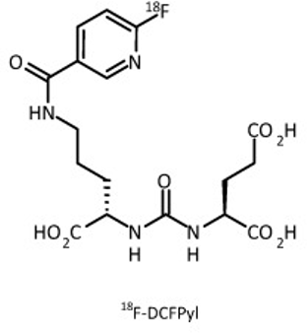


How to target PSMA: Antibodies, fragments, small molecules
V_{L}
V_{H}
^{C} H1
C_{k}
C _{H}2
Intact Ab 150 kDa
F(ab’)₂
120 kDa
C _{H}3
V
V_{L}
V_{H}
L
V_{H}
V_{L}
V
Small molecule
H
C _{H}3
scFv 28 kDa
Diabody (scFv)₂ 55 kDa
Minibody (scFv-C_{H3})₂
80 kDa
Courtesy Anna Wu, PhD
City of Hope Med Ctr, Duarte, CA

Slide 12
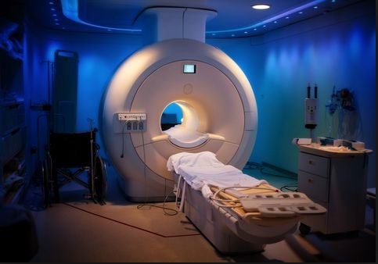
Step 1: Targeting PSMA for Imaging – PET Scanning
PET imaging demonstrate biology
A positron is a subatomic molecule
It is the size of an electron
When it hits an electron it releases energy that can be imaged (called a gamma wave)
When fused to a CT or MRI, PET imaging demonstrates anatomy and biology

Slide 13
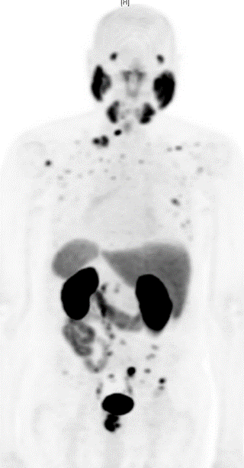
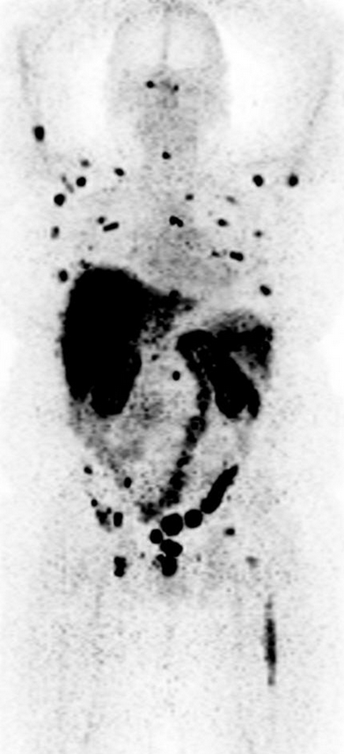









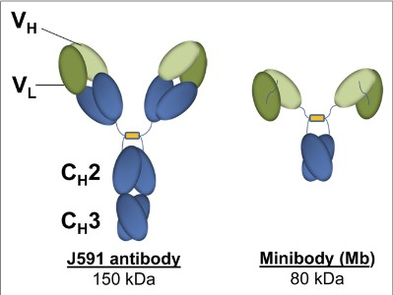

PSMA PET Scan with antibodies vs. Small Molecules: Different normal organ distribution

Slide 14

PSMA PET Imaging: Impact on staging localized disease
Clinical Metastases: Sensitive to ADT
Clinically Localized Disease
Metastatic Disease Treatment: 1st Line
Metastatic Disease Treatment: 2nd Line
Metastatic Disease Treatment: 3rd Line
Metastatic Disease Treatment: 4th Line
Rising PSA
Non- Metastatic
Scher, Morris, et al JCO 2016

Slide 15
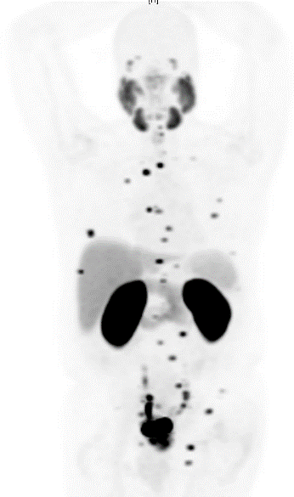
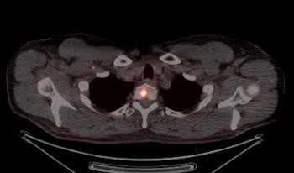
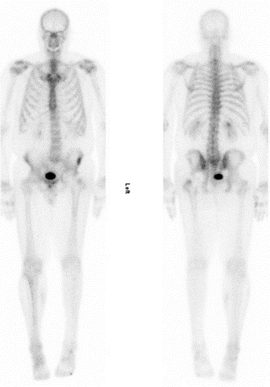
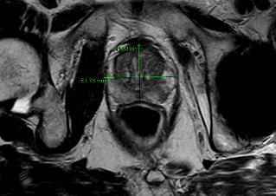
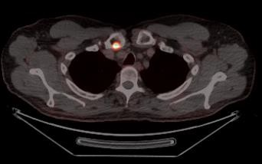
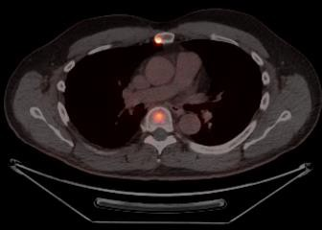
There are many uses for PSMA beyond theranostics, such as more accurate staging
63 y.o.
PSA 7
Gleason 4+5
13/16 positive cores
Much disease on his MRI of his prostate….
PSMA scan with metastatic disease
Bone scan looks good
Michael J. Morris, MD

Slide 16
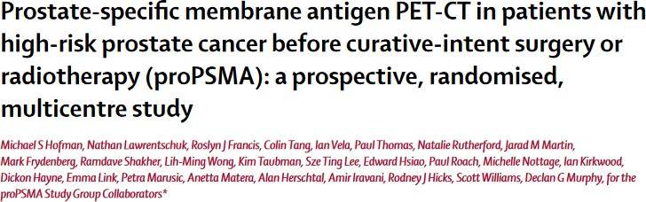
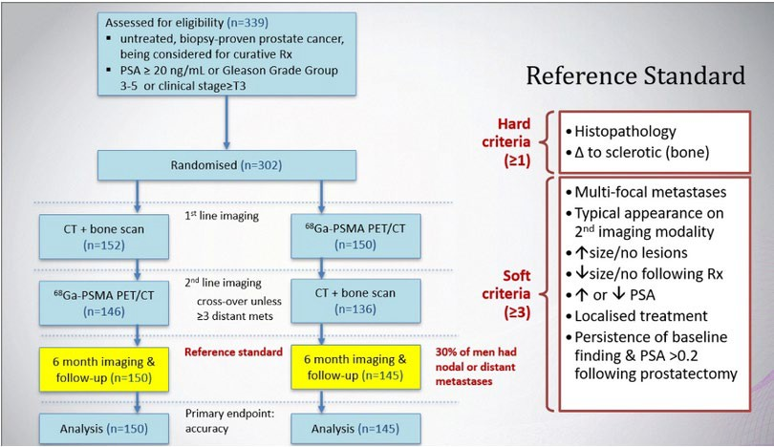
Hofman, EUA, 2020

Slide 17
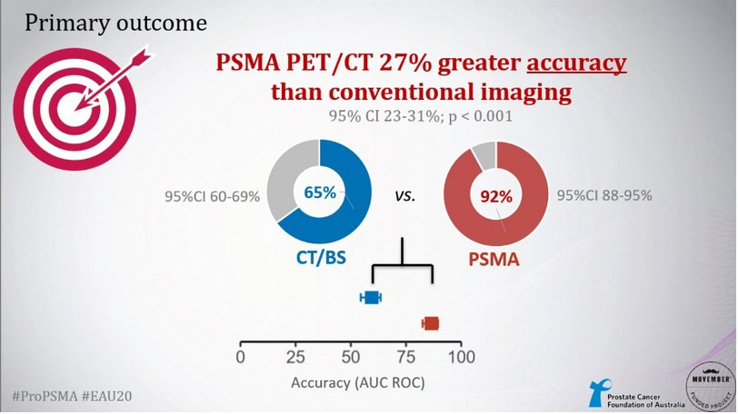

Slide 18
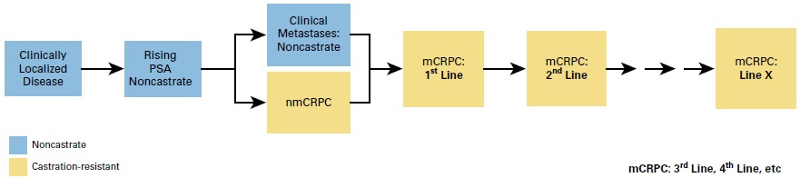
¹⁸F-DCFPyL Path to FDA Approval
OSPREY Cohort A:
Preoperative, with pathology comparator
CONDOR
(composite truth standard; pathology hard to secure)
OSPREY Cohort B: locally recurrent or metastatic disease to be biopsied (pathology comparator)
PCWG3 JCO 2016
Michael J. Morris, MD

Slide 19
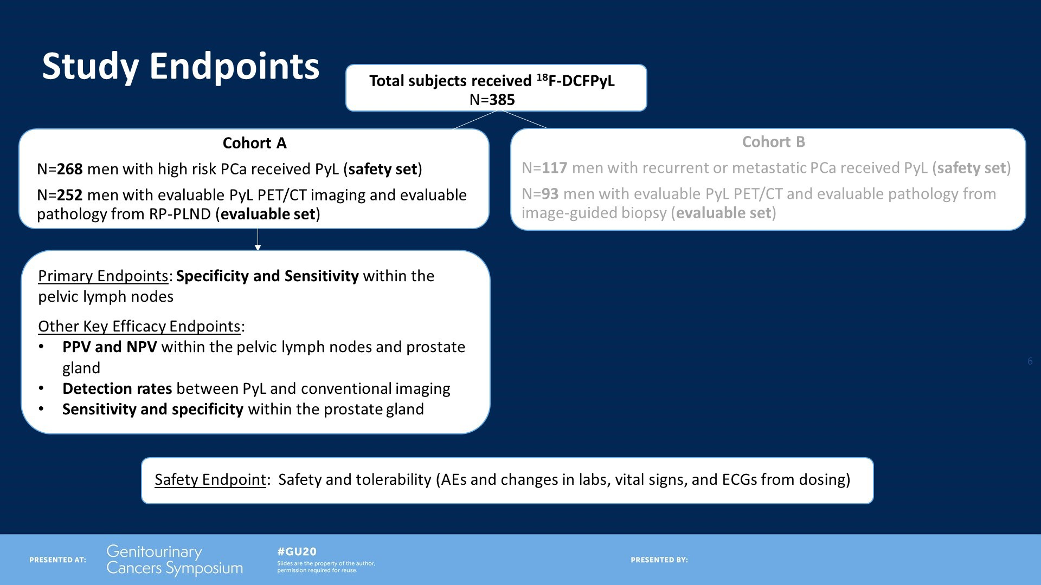
Study Endpoints
Presented By Frederic Pouliot at 2020 Genitourinary Cancers Symposium

Slide 20
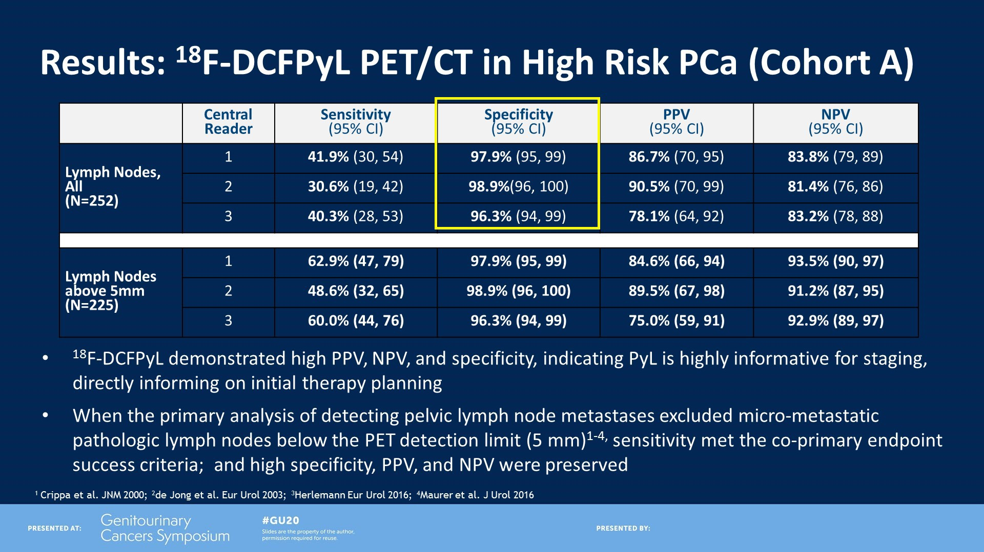
Results: 18F-DCFPyL PET/CT in High Risk PCa (Cohort A)
Presented By Frederic Pouliot at 2020 Genitourinary Cancers Symposium

Slide 21
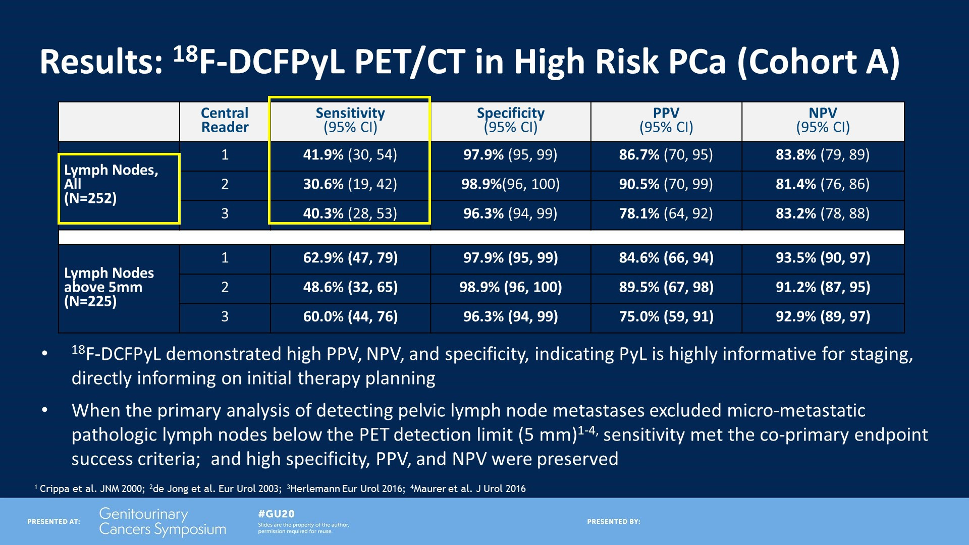
Results: 18F-DCFPyL PET/CT in High Risk PCa (Cohort A)
Presented By Frederic Pouliot at 2020 Genitourinary Cancers Symposium

Slide 22
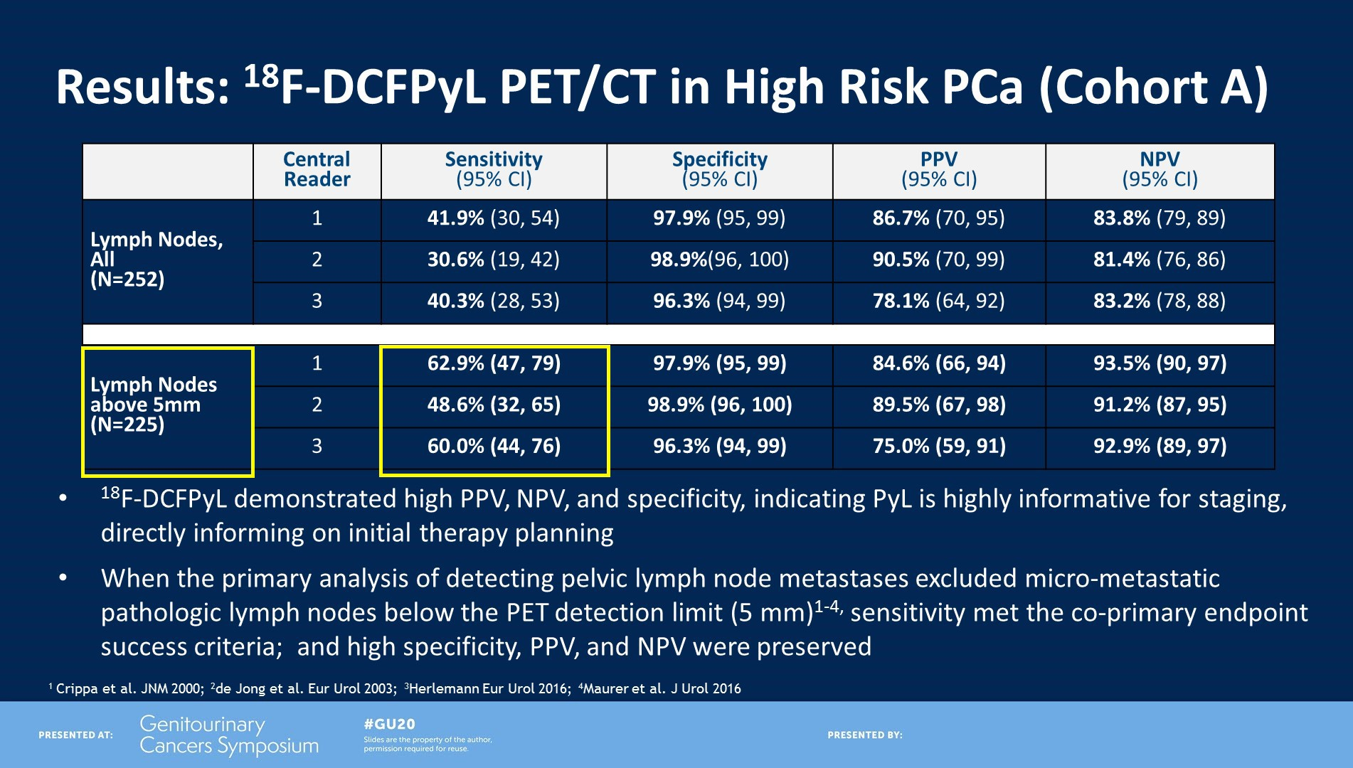
Results: 18F-DCFPyL PET/CT in High Risk PCa (Cohort A)
Presented By Frederic Pouliot at 2020 Genitourinary Cancers Symposium

Slide 23
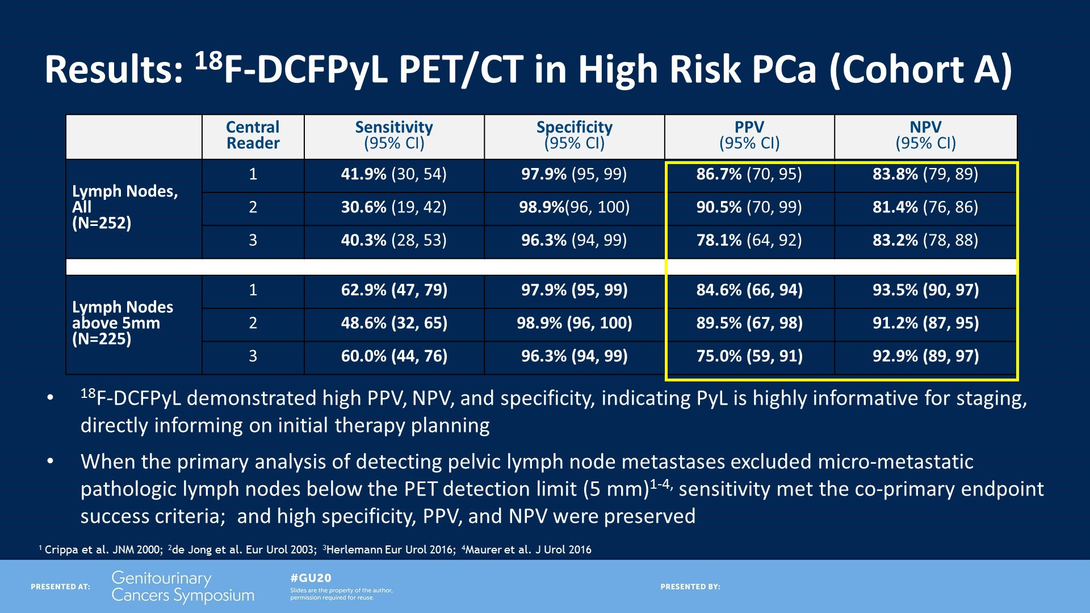
Results: 18F-DCFPyL PET/CT in High Risk PCa (Cohort A)
Presented By Frederic Pouliot at 2020 Genitourinary Cancers Symposium

Slide 24

PSMA PET Imaging: Impact on Rising PSA
Crucial decision on whether to give no therapy, local salvage treatments, or systemic therapy
Typically this decision-making occurs at very low PSA levels
Knowing where the disease is, early, is crucial
Clinical Metastases: Sensitive to ADT
Rising PSA
Metastatic Disease Treatment: 1st Line
Metastatic Disease Treatment: 2nd Line
Metastatic Disease Treatment: 3rd Line
Metastatic Disease Treatment: 4th Line
Clinically Localized Disease
Non- Metastatic
Progressing despite ADT (testosterone lowering agents)

Slide 25
Condor Study Design
Post-¹⁸F-DCFPyL-PET/CT
Intended Clin Management Questionnaire by Day 60
Pre ¹⁸F-DCFPyL-
PET/CT Intended Clin Management Questionnaire
¹⁸F-DCFPyL followed by whole-body
PET/CT scan
Day 1, t=1-2 hrs
Pts with ≥1 lesion detected
on ¹⁸F-DCFPyL-PET/CT
Biopsy/surgery & local histopathology by Day 60
Conventional imaging of anatomical correlate to
¹⁸F-DCFPyL-suspected
lesion(s) by Day 60
Post-RT PSA change by Day 90
OR
OR
Central imaging core lab
Three blinded, independent ¹⁸F-DCFPyL-PET/CT readers
Two separate truth panel readers
14 sites in the US and Canada
Michael J. Morris, MD, ASCO 2020

Slide 26
Select Baseline Characteristics, N=208
 |  | Patients Screened/Consented (N) | 217
 |  |  | 208
 | Patients dosed (N)
 | Age (years): Median (range) |  | 68 (43, 91)
 | Months from Prostate Cancer Diagnosis: Median (range) |  | 71 (3, 356)
 |  | Prior Prostate Cancer Therapies, N (%)
 |  | RP only | 103 (49.5)
 |  | RP and RT | 74 (35.6)
 |  | RT only | 31 (14.9)
 |  | At least 1 prior systemic therapy | 58 (27.9)
 |  | Total Gleason Score, N (%)
 |  | < 8 | 153 (73.6)
 |  | ≥ 8 | 55 (26.4)
PSA: Median (range) ng/mL | 0.8 (0.17, 98.45)
PSA Group (N=202), N (%)
<2.0 ng/mL | 139 (68.8)
<0.5 ng/mL | 69 (34.2)
0.5 to <1.0 ng/mL | 37 (18.3)
1.0 to <2.0 ng/mL | 33 (16.3)
≥2.0 ng/mL | 63 (31.2)
2.0 to <5.0 ng/mL | 33 (16.3)
≥5.0 ng/mL | 30 (14.9)
Michael J. Morris, MD, ASCO 2020

Slide 27
Select Baseline Characteristics, N=208
 |  | Patients Screened/Consented (N) | 217
 |  |  | 208
 | Patients dosed (N)
 | Age (years): Median (range) |  | 68 (43, 91)
 | Months from Prostate Cancer Diagnosis: Median (range) |  | 71 (3, 356)
 |  | Prior Prostate Cancer Therapies, N (%)
 |  | RP only | 103 (49.5)
 |  | RP and RT | 74 (35.6)
 |  | RT only | 31 (14.9)
 |  | At least 1 prior systemic therapy | 58 (27.9)
 |  | Total Gleason Score, N (%)
 |  | < 8 | 153 (73.6)
 |  | ≥ 8 | 55 (26.4)
PSA: Median (range) ng/mL | 0.8 (0.17, 98.45)
PSA Group (N=202), N (%)
<2.0 ng/mL | 139 (68.8)
<0.5 ng/mL | 69 (34.2)
0.5 to <1.0 ng/mL | 37 (18.3)
1.0 to <2.0 ng/mL | 33 (16.3)
≥2.0 ng/mL | 63 (31.2)
2.0 to <5.0 ng/mL | 33 (16.3)
≥5.0 ng/mL | 30 (14.9)
Michael J. Morris, MD, ASCO 2020

Slide 28
Select Baseline Characteristics, N=208
 |  | Patients Screened/Consented (N) | 217
 |  |  | 208
 | Patients dosed (N)
 | Age (years): Median (range) |  | 68 (43, 91)
 | Months from Prostate Cancer Diagnosis: Median (range) |  | 71 (3, 356)
 |  | Prior Prostate Cancer Therapies, N (%)
 |  | RP only | 103 (49.5)
 |  | RP and RT | 74 (35.6)
 |  | RT only | 31 (14.9)
 |  | At least 1 prior systemic therapy | 58 (27.9)
 |  | Total Gleason Score, N (%)
 |  | < 8 | 153 (73.6)
 |  | ≥ 8 | 55 (26.4)
PSA: Median (range) ng/mL | 0.8 (0.17, 98.45)
PSA Group (N=202), N (%)
<2.0 ng/mL | 139 (68.8)
<0.5 ng/mL | 69 (34.2)
0.5 to <1.0 ng/mL | 37 (18.3)
1.0 to <2.0 ng/mL | 33 (16.3)
≥2.0 ng/mL | 63 (31.2)
2.0 to <5.0 ng/mL | 33 (16.3)
≥5.0 ng/mL | 30 (14.9)
Michael J. Morris, MD, ASCO 2020

Slide 29
 |  | Diagnostic Performance of ¹⁸F-DCFPyL PET/CT in Biochemical Recurrence: Correct Localization Rate
 |  |  | All subjects (N=208)
 |  |  | Reader 1 | Reader 2 | Reader 3
Positive ¹⁸F-DCFPyL Scan on Subject Level (Detection Rate) |  |  | 137 (65.9%) | 124 (59.6%) | 123 (59.1%)
Unevaluable* |  |  | 33 | 24 | 24
CLR (TP/(TP+FP)) |  |  | 89/104 | 87/100 | 84/99
 |  |  | 85.6% (95% CI 78.8, 92.3) 15 8 TP FP | 87.0% (95% CI 80.4, 93.6 ) 13 87 TP FP | 84.8 (95% CI 77.8, 91.9) 15 84 TP FP
*SOT not submitted or false negative at the lesion level
•
Correct Localization Rate met the primary endpoint, as the lower limit of the 95% CI far exceeded 20% by all 3
readers
Michael J. Morris, MD, ASCO 2020

Slide 30
 |  | Diagnostic Performance of ¹⁸F-DCFPyL PET/CT in Biochemical Recurrence: Correct Localization Rate
 |  |  | All subjects (N=208)
 |  |  | Reader 1 | Reader 2 | Reader 3
Positive ¹⁸F-DCFPyL Scan on Subject Level (Detection Rate) |  |  | 137 (65.9%) | 124 (59.6%) | 123 (59.1%)
Unevaluable* |  |  | 33 | 24 | 24
CLR (TP/(TP+FP)) |  |  | 89/104 | 87/100 | 84/99
 |  |  | 85.6% (95% CI 78.8, 92.3) 15 8 TP FP | 87.0% (95% CI 80.4, 93.6 ) 13 87 TP FP | 84.8 (95% CI 77.8, 91.9) 15 84 TP FP
*SOT not submitted or false negative at the lesion level
•
Correct Localization Rate met the primary endpoint, as the lower limit of the 95% CI far exceeded 20% by all 3
readers
Michael J. Morris, MD, ASCO 2020

Slide 31
 |  | Diagnostic Performance of ¹⁸F-DCFPyL PET/CT in Biochemical Recurrence: Correct Localization Rate
 |  |  | All subjects (N=208)
 |  |  | Reader 1 | Reader 2 | Reader 3
Positive ¹⁸F-DCFPyL Scan on Subject Level (Detection Rate) |  |  | 137 (65.9%) | 124 (59.6%) | 123 (59.1%)
Unevaluable* |  |  | 33 | 24 | 24
CLR (TP/(TP+FP)) |  |  | 89/104 | 87/100 | 84/99
 |  |  | 85.6% (95% CI 78.8, 92.3) 15 8 TP FP | 87.0% (95% CI 80.4, 93.6 ) 13 87 TP FP | 84.8 (95% CI 77.8, 91.9) 15 84 TP FP
*SOT not submitted or false negative at the lesion level
•
Correct Localization Rate met the primary endpoint, as the lower limit of the 95% CI far exceeded 20% by all 3
readers
Michael J. Morris, MD, ASCO 2020

Slide 32
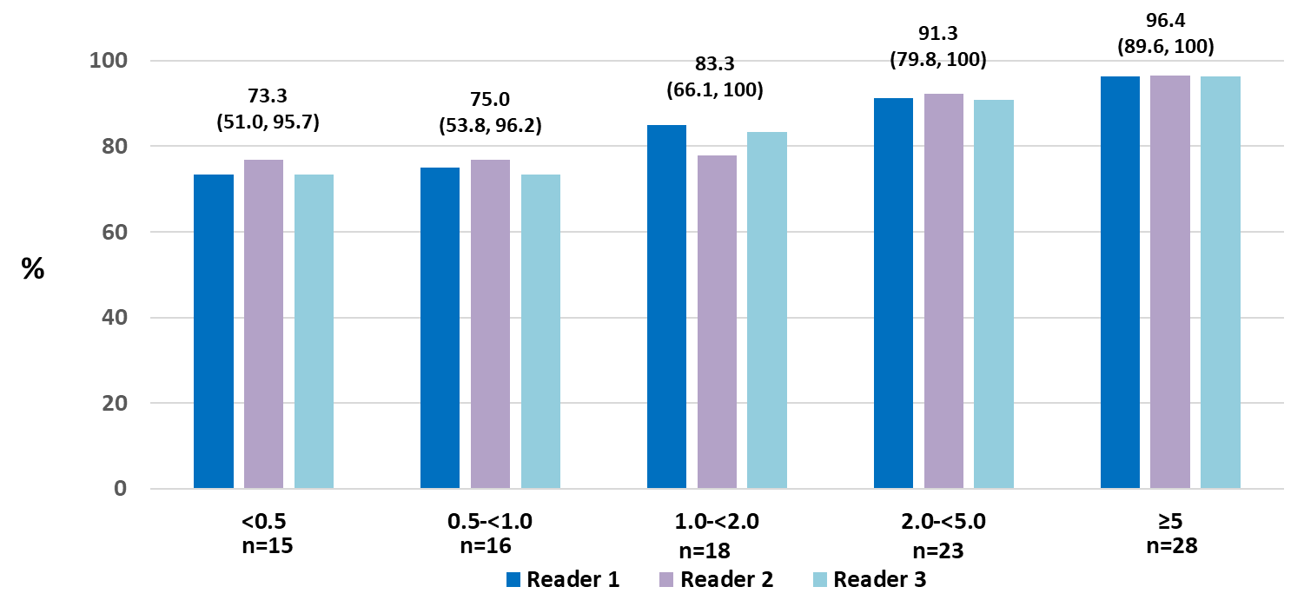
Correct Localization Rate by PSA
ng/mL
Median values for each group of three readers provided
Michael J. Morris, MD, ASCO 2020

Slide 33
Change of Management
63.9% of evaluable subjects had a change in intended management after ¹⁸F-DCFPyL-PET/CT
78.6% were attributable to positive and 21.4% to negative ¹⁸F-DCFPyL-PET/CT scans
Noncurative systemic therapy to salvage local therapy (n = 43; 21.0%)
Salvage local therapy to systemic therapy (n = 58; 28.3%)
Observation to initiating therapy (n = 49; 23.9%)
Planned treatment to observation (n = 9; 4.4%)
Michael J. Morris, MD, ASCO 2020

Slide 34
Efficacy Summary
The CONDOR study has met its primary endpoint, demonstrating excellent diagnostic performance of ¹⁸F-DCFPyL-PET/CT imaging in men with biochemically relapsed prostate cancer, even at low PSA values
¹⁸F-DFPyL-PET/CT is superior to standard imaging in men with BCR
The results yielded actionable information clinically significant information. Optimized treatment patterns need to be further defined
This trial, coupled with the OSPREY study, has now established the performance characteristics of ¹⁸F-DCFPyL-PET/CT in localized, BCR, and metastatic prostate cancer
Michael J. Morris, MD, ASCO 2020

Slide 35

PSMA PET Imaging: Impact on nmCRPC
Multiple FDA approved drugs for non-metastatic disease in men progressing through ADT
How many of these men are truly non-metastatic?
Clinical Metastases: Sensitive to ADT
Non- Metastatic
Clinically Localized Disease
Rising PSA
Metastatic Disease Treatment: 1st Line
Metastatic Disease Treatment: 2nd Line
Metastatic Disease Treatment: 3rd Line
Metastatic Disease Treatment: 4th Line
Progressing despite ADT (testosterone lowering agents)

Slide 36
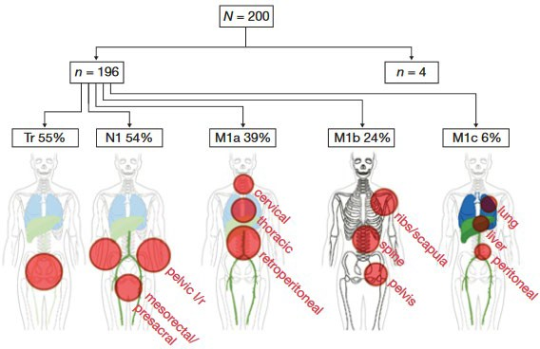
Men with high-risk non-metastatic disease despite ADT
Fendler et al, CCR, 2019

Slide 37

PSMA PET Imaging: Ability to detect metastatic disease
Multiple FDA approved drugs for non-metastatic disease in men progressing through ADT
How many of these men are truly non-metastatic?
Clinical Metastases: Sensitive to ADT
Clinically Localized Disease
Rising PSA
Metastatic Disease Treatment: 1st Line
Metastatic Disease Treatment: 2nd Line
Metastatic Disease Treatment: 3rd Line
Metastatic Disease Treatment: 4th Line
Non- Metastatic
Progressing despite ADT (testosterone lowering agents)

Slide 38
Data: Patient Disposition
385 men with PCa received ¹⁸F- DCFPyL
Cohort A: 268 men with high risk PCa received ¹⁸F-DCFPyL (safety set)
Cohort B: 117 men with recurrent or metastatic PCa received ¹⁸F-DCFPyL (safety set)
252 men underwent PET/CT imaging and have evaluable surgical pathology (evaluable set)
93 men underwent PET/CT imaging and have evaluable pathology from image-guided biopsy (evaluable set)

Slide 39
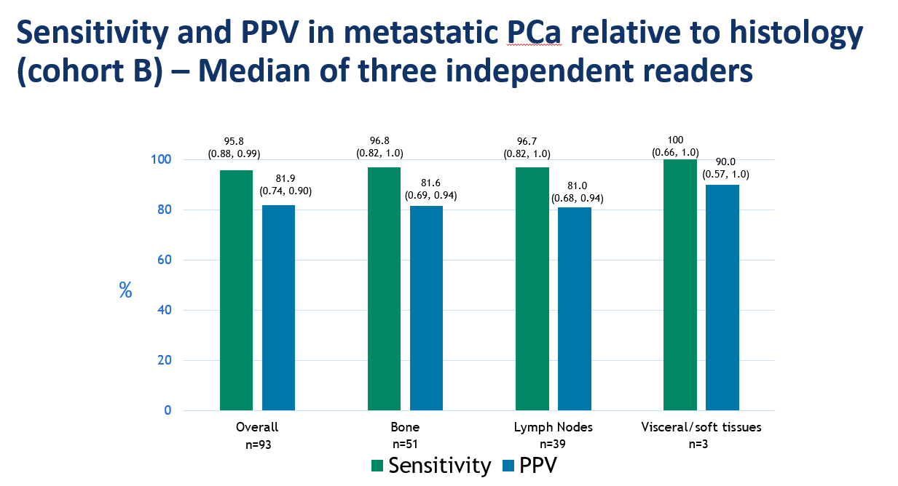
Morris, ASCO 2019

Slide 40































Fundamental changes in how we categorize patients and significantly impacts prognostic models
High Risk Localized
BCR
Metastatic
Prognostic model
Prognostic model
Should the treatment of these reclassified patients change, and if so, how?
Michael J. Morris, MD

Slide 41
When will PSMA imaging come to the US?
Imaging studies, like drugs, require evidence for FDA approval:
Evidence that the imaging agent correctly detects disease
When it is positive, it truly reflects disease
When in is negative, it truly reflects the absence of disease
Evidence that the imaging agent is reproducible
Evidence that the imaging agent is safe
Evidence that it is useful
Evidence is collected in well conducted clinical trials

Slide 42
Is that evidence in place?
The Ga-68 PSMA scan has been submitted for regulatory review
The F-18 PSMA has been submitted for regulatory review
We hope that these are favorably received
Reimbursement policies are separate from regulatory approval

Slide 43
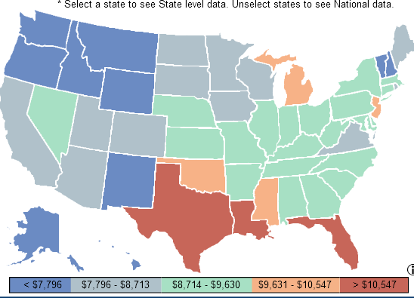
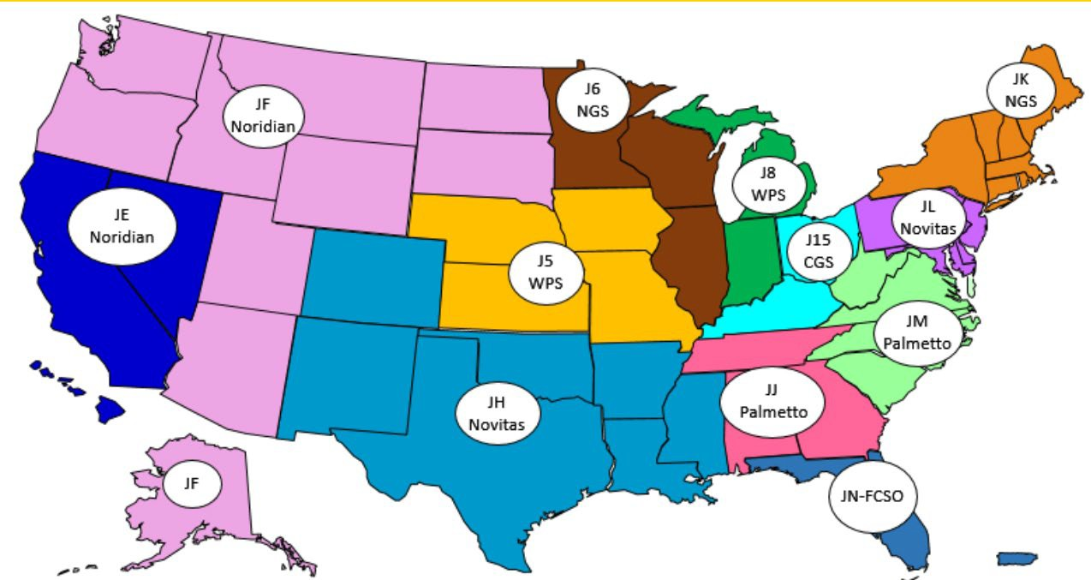
Reimbursement: Regional variability
“Local Medicare Administrative Contractors (MACs) may determine coverage within their respective jurisdictions for positron emission tomography (PET)...”
https://www.cms.gov/medicare-coverage-database/details/nca-decision- memo.aspx?NCAId=261
https://www.cms.gov/Research-Statistics-Data-and-Systems/Statistics-Trends-and- Reports/Dashboard/GeoVar-State/GeoVar_State.html
Michael J. Morris, MD

Slide 44
Conclusions
To make good decisions in prostate cancer care, you need imaging
Imaging should reflect the true status of the patient’s disease as much as possible.
PSMA imaging gives reliable information about distribution of disease, that is superior to the current standards
How we use that information has still to be determined

