Slide 1
Men’s Health
Signs, Symptoms and Treatment Options for Erectile Dysfunction and Stress Urinary Incontinence

Slide 2

Dr. William Brant, M.D., F.A.C.S., F.E.C.S.M.
Medical Degree
University of California
Internship & Residency
University of Colorado Health Sciences Center
Fellowship
Focusing on sexual medicine and surgery at University of California, San Francisco under the direction of Dr. Tom Lue.
Granger Medical Clinic
Summit Urology
24 S. 1100 E., Ste. 105
Salt Lake City, UT 84102
801-965-2767
www.menssexualhealthutah.com

Slide 3
Erectile Dysfunction
What is it? Who has it? What causes it?

Slide 4
Erectile Dysfunction (ED)
What is it?
The persistent inability to achieve or maintain an erection firm enough to have sexual intercourse
How prevalent is it?
Approximately 1 in 5 American men ≥ 20 years old experience ED in their lifetime¹
More than half of men over 40 have some degree of ED²
Affects approximately 39 million American men³

Slide 5
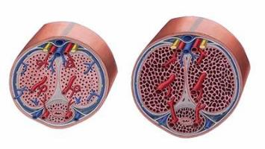
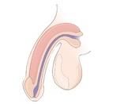
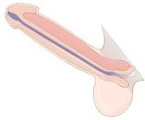
Erection Process⁴
When aroused, the nerves surrounding the penis become active
Muscles around the arteries then relax and more blood flows into the penis
The additional blood makes the penis stiff and hard, or erect
This erection tightens the veins so the blood can’t leave the penis, enabling the penis to remain erect
Flaccid
Erect

Slide 6
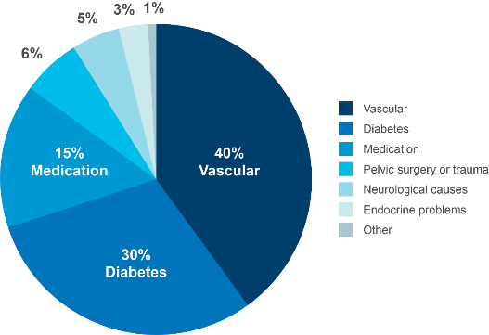
Causes and Comorbidities Associated with ED⁵
Correlates positively with overall poor health
Top three physical causes are:
Vascular
Diabetes
Medication
Can be a result of or precursor to:
Prostate cancer treatment
Diabetes
Heart disease

Slide 7
OPTIONAL SLIDE
Erectile Dysfunction and
Prostate Cancer Treatment

Slide 8
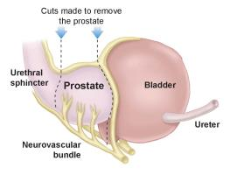
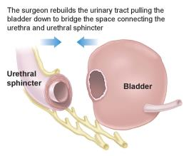
OPTIONAL SLIDE
Erectile Dysfunction as a Result of Prostate Cancer Treatment
The nerves that provide stimulation for an erection lie very close to the prostate and may be injured during prostate cancer treatmment²²
Prostate cancer treatments can affect a man’s ability to get an erection on a temporary or permanent basis²²

Slide 9
OPTIONAL SLIDE
Sexual Dysfunction After Prostate Cancer Treatment
Overall erectile dysfunction affects 25–75% of men²³
Erectile dysfunction as a result of prostate cancer surgery, robot-assisted radical prostatectomy (RARP),
10–46% of men 1 year after surgery had ED²⁴
Sexual dysfunction after radiation affects up to 50% of men²⁵

Slide 10
Erectile Restoration Treatment Options

Slide 11
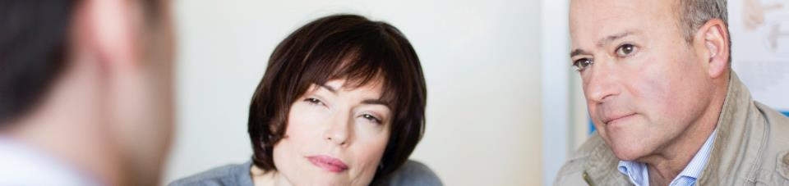
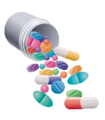
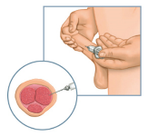
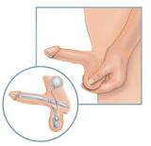
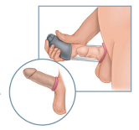
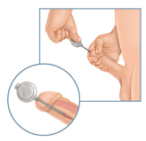
Treatment Options
Oral Medications
Injections
Penile
Implants
Vacuum
Erection
Devices
Urethral
Suppositories

Slide 12

Oral Medications (PDE-5 inhibitors)
How do they work?²⁷⁻²⁹
Increase blood flow to the penis, may improve ability to get erections and maintain them until sexual intercourse is successfully completed
Requires sexual stimulation
Usually taken within 1 hour before anticipated sexual activity
Typically works for up to 4 hours (~36 hours with Cialis™)
Not to be taken more than once a day
Some oral medications’ efficacy can be affected by food
How effective are they?
Effective in approximately 50–85% of cases²⁷⁻²⁹
Almost half of men with ED after prostate surgery give up or the pills stop working²³
Men with diabetes are 1.5 to 2 times more likely to move on to other treatments¹⁴

Slide 13
Oral Medications²⁷⁻²⁹
Most common side effects:
Headache, facial flushing, stuffy nose, upset stomach
Some cautions:
Talk to your doctor if sex is inadvisable because of cardiovascular status
With alpha-blockers: generally, you should be stable on your alpha-blocker therapy before using an oral medication
With nitrates: talk to your heart doctor, nitrates cannot be taken with PDE-5 inhibitors
Tell your doctor if you:
Have ever had any heart problems, stroke or low or high blood pressure
Have ever had liver or kidney problems

Slide 14
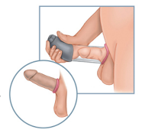
Vacuum Erection Device (VED)³⁰
How does it work?
A hollow plastic tube is placed over the penis
The pump (hand/battery-powered) is used to create a vacuum that pulls blood into the penis
Once an erection is achieved, an elastic tension ring is placed at the base of the penis to help maintain the erection
How effective is it?
Patient satisfaction rates rage from 68–80%³¹
Despite initial high success rates, in one study 86% of patients decide to move on to other sexual aids²³

Slide 15
Vacuum Erection Device (VED)
Most common side effects:^{30,34}
Blocked ejaculation
Bruising of penis
Penile discomfort
Penile numbness or coldness
Most common reason for discontinuation:^{10,35}
Erections of insufficient rigidity or duration
Difficult mechanics
Penile bruising
Lack of spontaneity

Slide 16

Urethral Suppository
How does it work?³⁹
A urethral suppository, such as MUSE™, is administered by inserting the applicator stem into the urethra after urination
Onset of erection is within 5 to 10 minutes
The suppository must be refrigerated
How effective is it?
In clinical literature, success rates are reported at 40–65%^{32,33}
40–50% of men don’t continue using this therapy after 6–8 months^{23,41}
Most common side effects:^{39,40}
Pain in the penis, urethra or testes
Urethral pain or burning
Low blood pressure
Dizziness
Most common reasons for discontinuation:⁴¹
Insufficient erections suitable for intercourse
Urethral pain and burning
Alprostadil (MUSE™)

Slide 17

Intracavernous Injection Therapy
How does it work?⁴²
Self-inject medication directly into corpora cavernosa
Onset of erection within 5 to 20 minutes
How effective is it?
Approximately 60% of patients were satisfied and continued use³⁶
Despite success rates, in a study of 254 men, only 20% continued the therapy³⁷
Most common side effects:^{37,42}
Penile pain
Penile fibrosis or scar tissue
Priapism or prolonged erection
Blood collection under the skin at injection site
Most common reasons for discontinuation:^{37,43}
Unsatisfactory erections
Pain
Dislike of injections
Alprostadil (CAVERJECT™)

Slide 18

Penile Implant
How does it work?⁴⁴
Pair of cylinders implanted in the penis, a pump placed inside the scrotum and a reservoir of saline placed in the lower abdomen
Squeezing and releasing the pump moves fluid into the cylinders, creating an erection
Deflate the device by pressing the deflate button on the pump. The penis then returns to a soft, flaccid and natural-looking state.
How effective is it?
98% of patients reported erections to be “excellent” or “satisfactory”⁴⁷
At 7 years, 94% are still in use and free of revision³⁸
Most common side effects include:⁴⁴
Post-operative genital pain
Mechanical malfunction, including auto-inflation
Infection
Entirely contained in body: no one can tell you have it

Slide 19
Benefits of Penile Implant
Designed as a permanent solution to ED
Spontaneous—have sex when the mood strikes
Erection lasts as long as you desire
Entirely contained inside the body—no one knows you have one unless you tell them
High patient and partner satisfaction^{47,51}
Typically does not interfere with ejaculation or orgasm⁵²
Implants have been in use for more than 40 years⁴⁹
Nearly 500,000 patients have been treated with a penile implant⁵⁰

Slide 20
Penile Implants are a Surgical Procedure—Possible Risks⁴⁴
There are risks involved with any surgery. Not all patients are candidates for a penile implant. Discuss all the risks and benefits of this procedure in more detail with your doctor.
Some risks of a penile implant may include:
Will make natural or spontaneous erections as well as other interventional treatment options impossible
There may be mechanical failure of the implant, which may require revision surgery
If the implant needs to be removed and replaced, the penis may become shorter, curved or scarred
Pain (typically associated with the healing process)
Men with diabetes, spinal cord injuries or open sores may have an increased risk of infection

Slide 21

Summary
ED is a common problem and may be associated with other conditions
There are a variety of treatment options
Penile implants could offer a permanent solution
Talk to your partner
Talk to your ED specialist (Prosthetic Urologist) or find one at EDCure.org
EDCure.org is sponsored by Boston Scientific Corporation.

Slide 22
Male Stress Urinary Incontinence
What is it? Who has it? What causes it?

Slide 23
Male Stress Urinary Incontinence
What is it?
Also known as bladder leakage, SUI is when the urinary sphincter muscle is damaged or weakened and it cannot squeeze and stop urine from flowing out of the body when you laugh, lift, walk, bend, push, pull and move
How prevalent is it?
Studies suggest that as many as 50% of men report leakage immediately following surgery for prostate cancer but most heal within the first few weeks to few months⁵³
Somewhere between 9% and 16% of men will have persistent SUI one year after surgery⁵⁴
Worldwide, approximately 500,000 men suffer from SUI⁵⁵

Slide 24
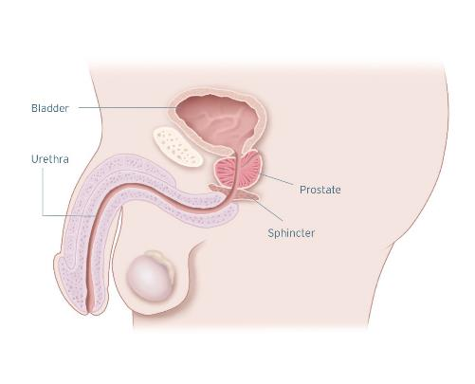
Urinary Process
The bladder stores urine
Urine exits the body via the urethra
Part of the urethra is surrounded by muscles called sphincter muscles
The sphincter muscles remain contracted in order to keep urine in the bladder
When the sphincter muscles relax, urine is able to exit the body via the urethra

Slide 25
Causes and Comorbidities Associated with SUI
Strongly correlates with prostate cancer surgery
Approximately 9–16% of men have persistent post-prostatectomy incontinence 1 year after treatment⁵⁴
Can also be a result of:^{56,57}
Neurologic disorders
Enlarged prostate surgery
Occurring in 0.5–3% of men after surgery
External beam radiation (pelvic radiation)
Occurring in 1.6% of men after treatment
Pelvic trauma

Slide 26
Male SUI and Prostate Cancer Treatment

Slide 27
SUI and Prostate Cancer Treatment Connection
181,000 men are diagnosed with prostate cancer each year in the US⁵⁹
Approximately 70,000 radical prostatectomies are performed each year⁶⁰
Radical prostatectomy is an operation to remove the prostate and some of the tissue around it²²
Approximately 9-16% of men have persistent post-prostatectomy incontinence 1 year after treatment⁵⁴

Slide 28
A Side Effect of Prostate Cancer Treatment
Incontinence is normal immediately following radical prostatectomy
Continence is often restored during the first year of recovery
But not all patients are able to regain their continence^{54,61}
There are solutions for patients who want to restore their continence and normalcy

Slide 29
Male Continence Treatment Options

Slide 30
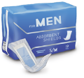

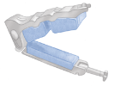
Short-term Treatment Options
Behavioral modifications
Reduced fluid intake
Planned restroom breaks
Intervention
Pelvic floor physical therapy
Kegel exercises
Biofeedback
Coping
Pads
Diapers
Catheters
Penile clamps

Slide 31
Long-term Treatment Options
Male Sling
Designed to support the urethra to better control urine⁶⁵
Studies have shown it may be most appropriate for mild to moderate SUI⁶⁴
Made of soft mesh material that is completely concealed inside the body⁶⁶
Artificial Urinary Sphincter (AUS)
Designed to replicate the function of the external sphincter muscle to control urine⁶⁷
Can treat all levels of SUI
Made from three small connected components that are completely concealed inside the body⁶⁷:
Cuff
Control Pump
Pressure Regulating Balloon

Slide 32
Benefits of a Male Sling
Minimally invasive procedure⁷⁰
Normal activities can be resumed 1 to 2 weeks after the procedure or at the discretion of your urologist⁶⁶
There is no interaction with the device, it works on its own to restore continence⁶⁸
Can help restore normalcy and renew confidence

Slide 33
Benefits of an Artificial Urinary Sphincter (AUS)
Mimics a healthy sphincter, allowing you to urinate when desired⁶⁷
Offers most men with a weakened sphincter muscle the ability to achieve continence⁷⁵
Placed entirely inside the body, it is undetectable to others

Slide 34

Take Control and Assess Your Condition
If you are bothered by your leakage, take action to restore your normalcy and renew your confidence:
Speak with a urologist
Share your daily pad usage
Keep a weekly pad journal
For more information visit
FixIncontinence.com
FixIncontinence.com is sponsored by Boston Scientific Corporation.

Slide 35
The Male Sling and Artificial Urinary Sphincter are Surgical Procedures—Possible Risks
There are risks involved with any surgery. Not all patients are candidates for a male sling or AUS. Discuss all the risks and benefits of these procedures in more detail with your doctor.
Male Sling
Possible side effects include, but are not limited to:
Device failure
Urinary retention
Post-operative pain
Irritation at the wound site
Foreign body response
Artificial Urinary Sphincter
Possible side effects include, but are not limited to:
Device malfunction or failure, which may require revision surgery
Erosion of the urethra in the cuff area
Urinary retention
Infection, pain and soreness

Slide 36
Insurance Coverage
Insurance coverage cannot be guaranteed
Medicare and most private insurance companies cover a male incontinence procedures; however, individual coverage may vary
Work with your doctor’s office and insurance provider to check coverage levels prior to receiving treatment

Slide 37
Summary
Male SUI is a known side effect of prostate cancer treatment and other conditions
There are a variety of treatment options
Coping short-term options can be expensive over time and uncomfortable
A sling or artificial urinary sphincter could offer a permanent solution for male SUI
Talk with your urologist to understand your options

