Slide 1

Disparities in Prostate Cancer Outcomes: Race, Access, and Ancestry
Andrew J Armstrong MD ScM FACP
National Alliance of State Prostate Cancer Coalitions Webinar Series
November 2020
Professor of Medicine and Surgery, Pharmacology and Cancer Biology
Director of Research, Duke Cancer Institute
Center for Prostate and Urologic Cancer
Durham NC USA

Slide 2
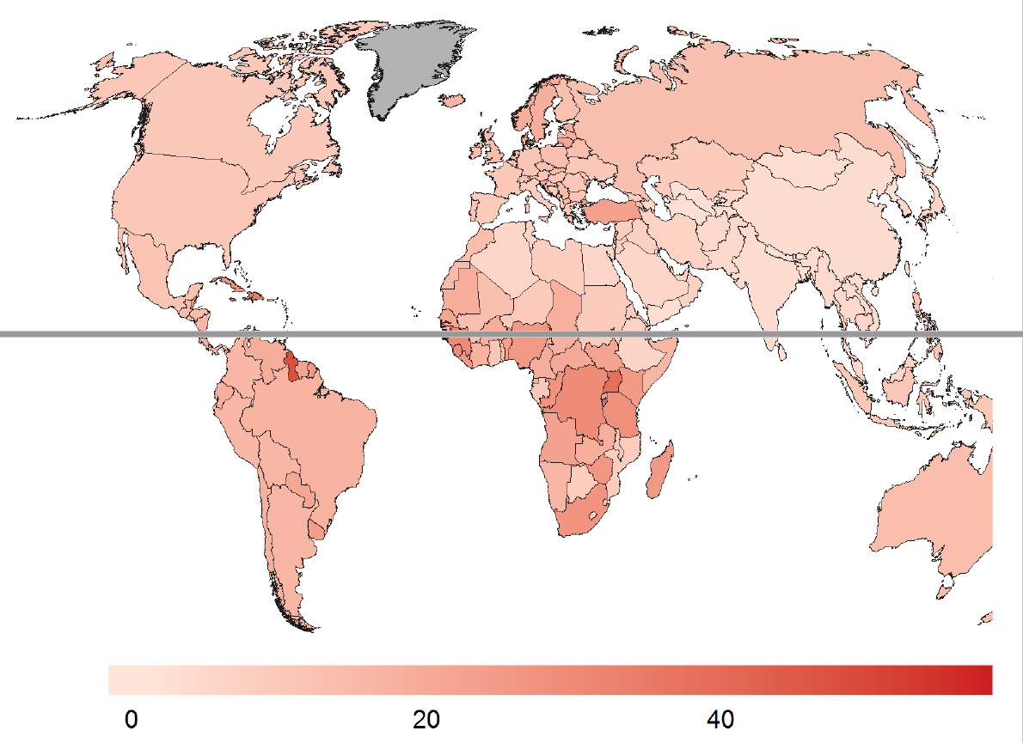
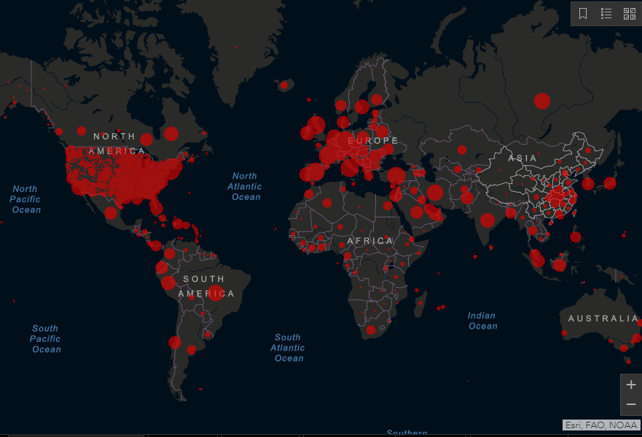
Comparison of COVID-19 and Prostate Cancer
Death rate/100,000
COVID-19 Prostate Cancer
Global Cases (as of 10/6/20) 46,000,000 1,436,000 per year
Global Deaths 1,202,000 381,000 per year
US Cases 9,213,002 174,650/year (3.6M survivors)
US Deaths 231,000 31,620/year
Contagious? YES NO
Preventable? HOPEFULLY IN MOST CASES
Racial Disparity? Yes Yes
Common Biology TMPRSS2 is the COVID-19 receptor and part of the fusion gene underlying half of prostate cancer, and is hormonally regulated

Slide 3
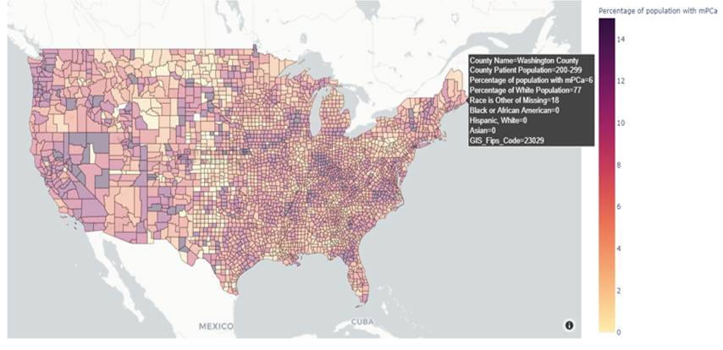
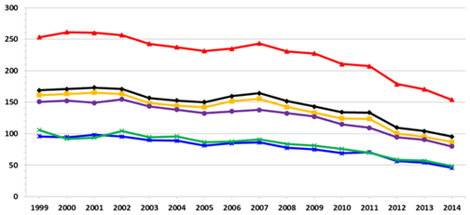
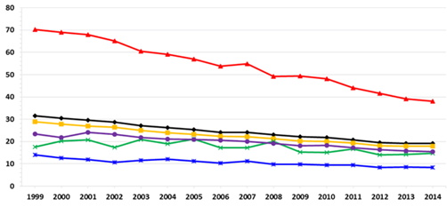
Prostate Cancer Disparities Among Racial Groups
Incidence Rates by Race and Ethnicity
US, 1999-2014
All Races
Rate per 100,000
Year of Diagnosis
White
Black
A/PI
Death Rates by Race and Ethnicity
US, 1999-2014
AI/AN
Hispanic
https://www.cdc.gov/
Year of Death

Slide 4
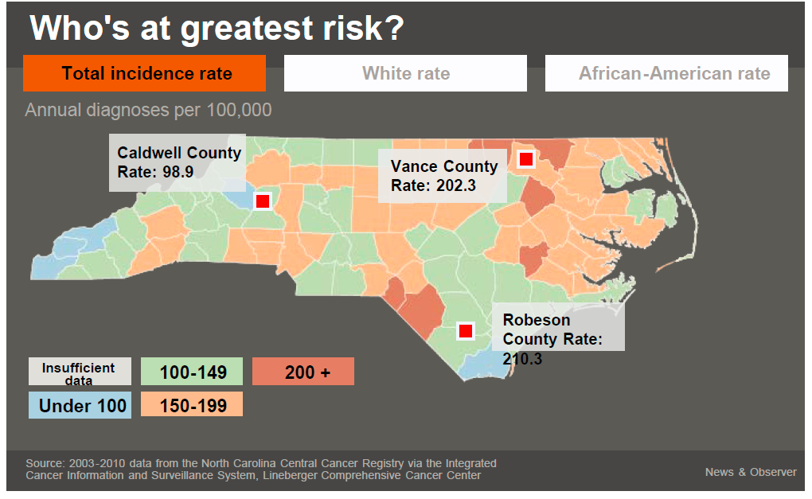
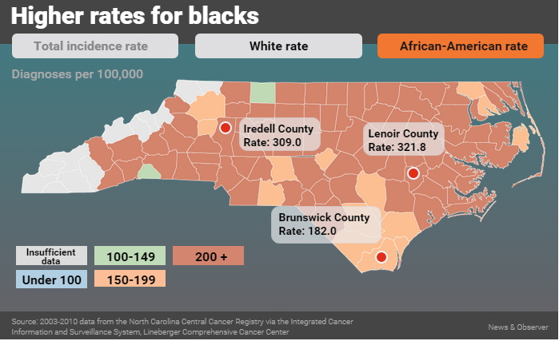
Prostate cancer affects African Americans at 1.5 greater rate than Caucasians
General population data does not reflect the risk in
disproportionately affected populations like African Americans

Slide 5
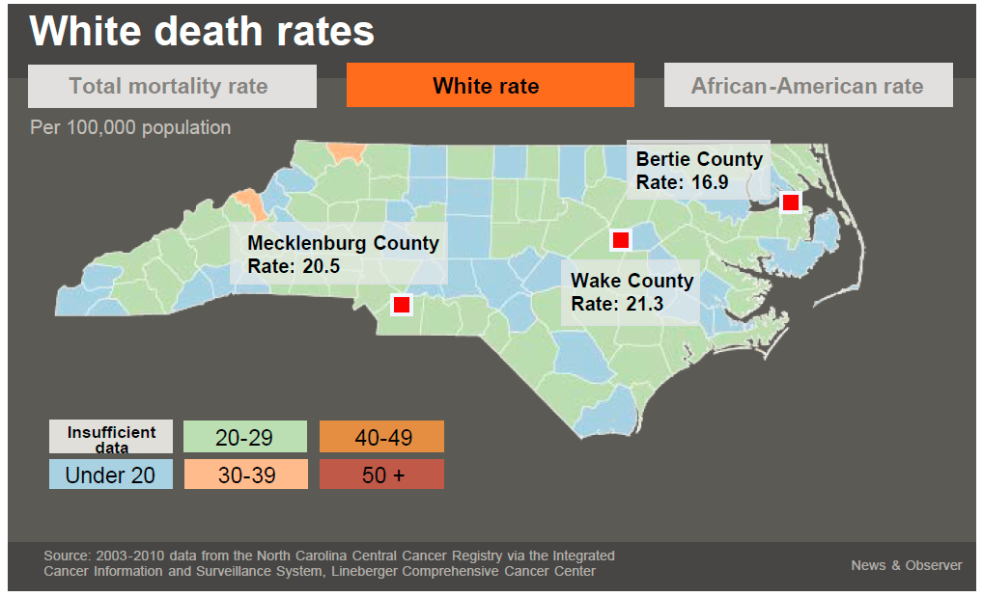
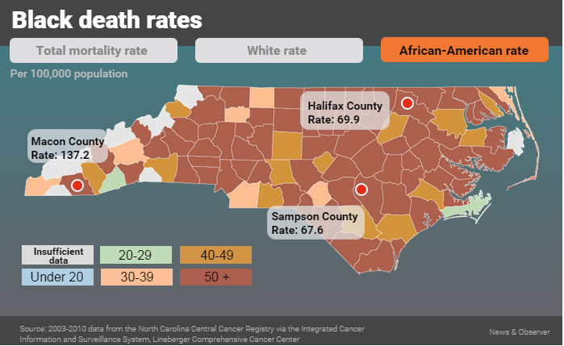
Death from prostate cancer – an even greater disparity
AAM have 2.5 greater risk of death from prostate cancer than CM

Slide 6
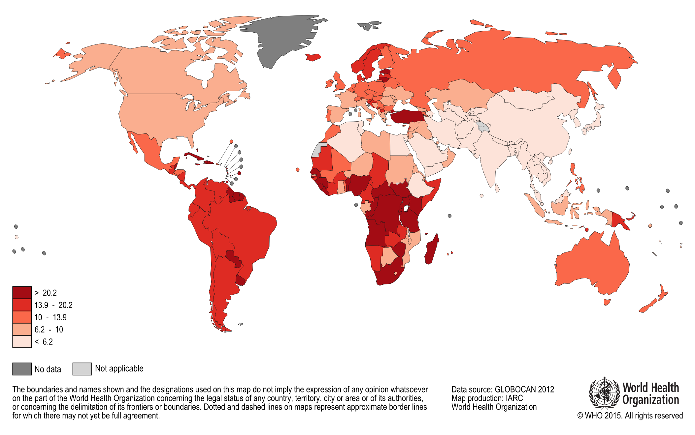
Lethal Prostate Cancer in the World

Slide 7
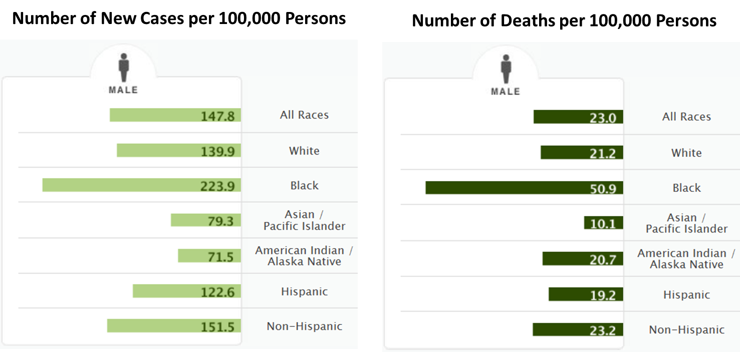
Prostate cancer (PC) health disparities among racial groups
1.6
(W or CA)
2.4
(AA)
SEER Stat Fact Sheets: Prostate. Available from: http://seer.cancer.gov/statfacts/html/prost.html
Notes:
PC remains a major public health concern – common cancer that is the second leading cause of cancer-related death in American men and because profound PC health disparities exist
The age-adjusted incidence rate for PC among AA men is 1.6-fold greater than among white men
The age-adjusted mortality rate for PC among AA men is 2.4-fold greater than among white men

Slide 8
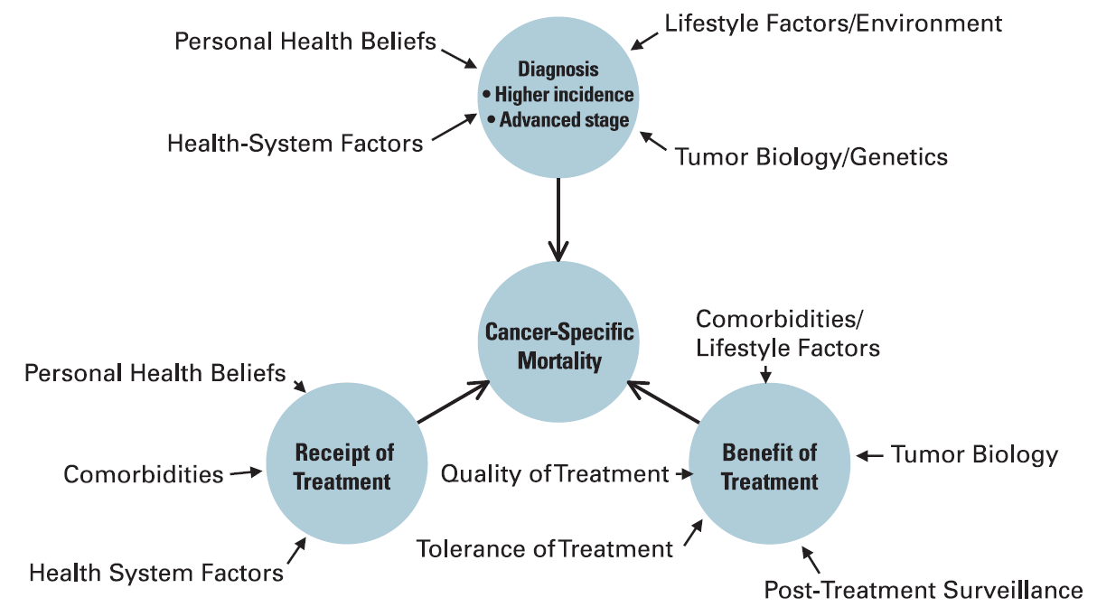
Oncology Health Disparities Model
Polite et al., J Clin Oncol, 2006, 24(14), p.2179-87

Slide 9
The Healthcare System Maze Needs a GPS for everyone, but especially vulnerable populations
Employment/
Loss Wages
Language/interpreter
Fear
Location of Facility
Problems with Scheduling
Transportation
Perceptions and Beliefs
Comorbidities
Communication with Medical Personnel
Uninsured,
Underinsured
Disability
Healthcare Barriers
Literacy
Child/Adult Care
Notes:
9
9

Slide 10
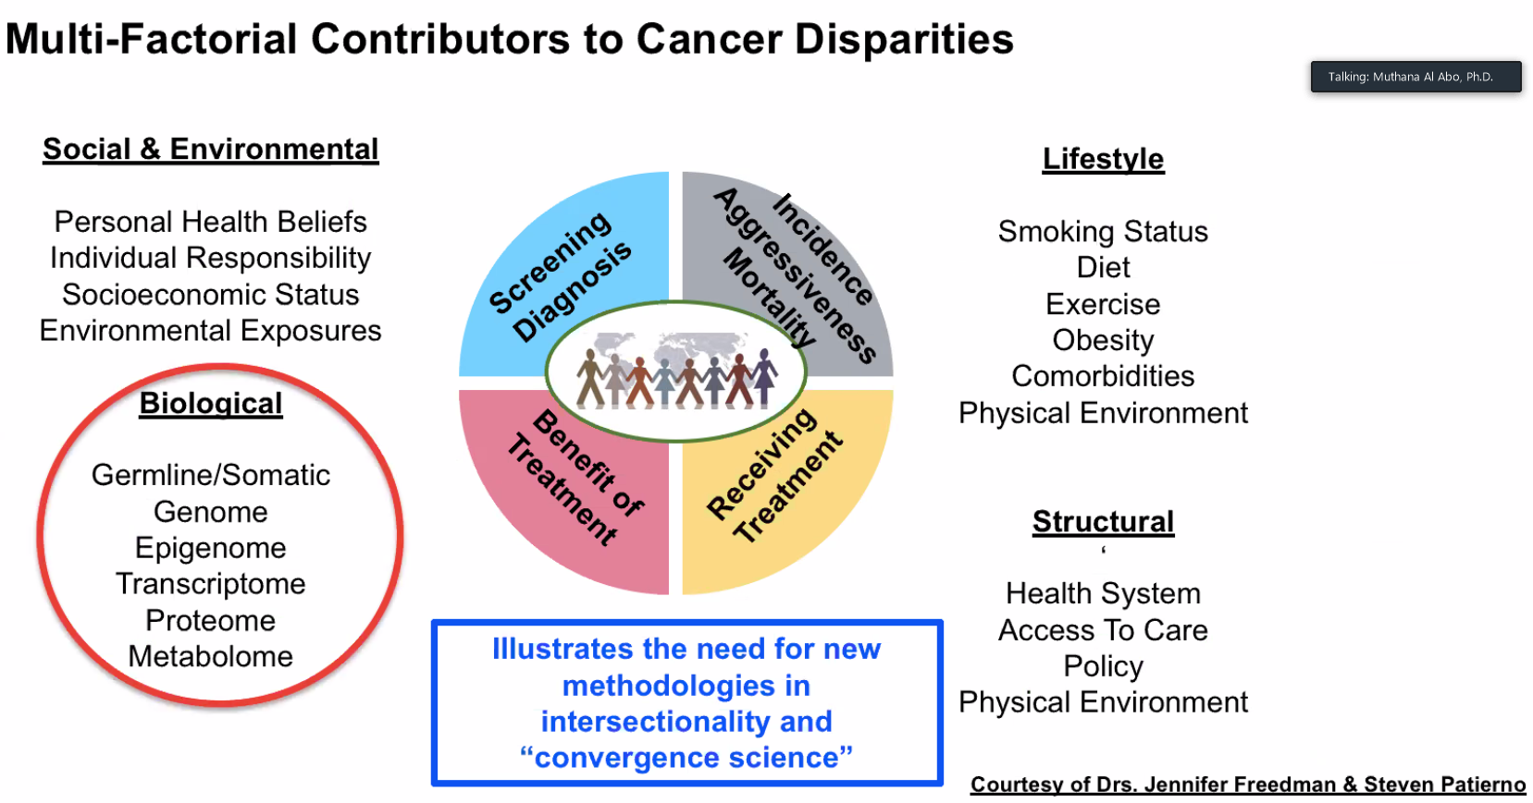

Slide 11
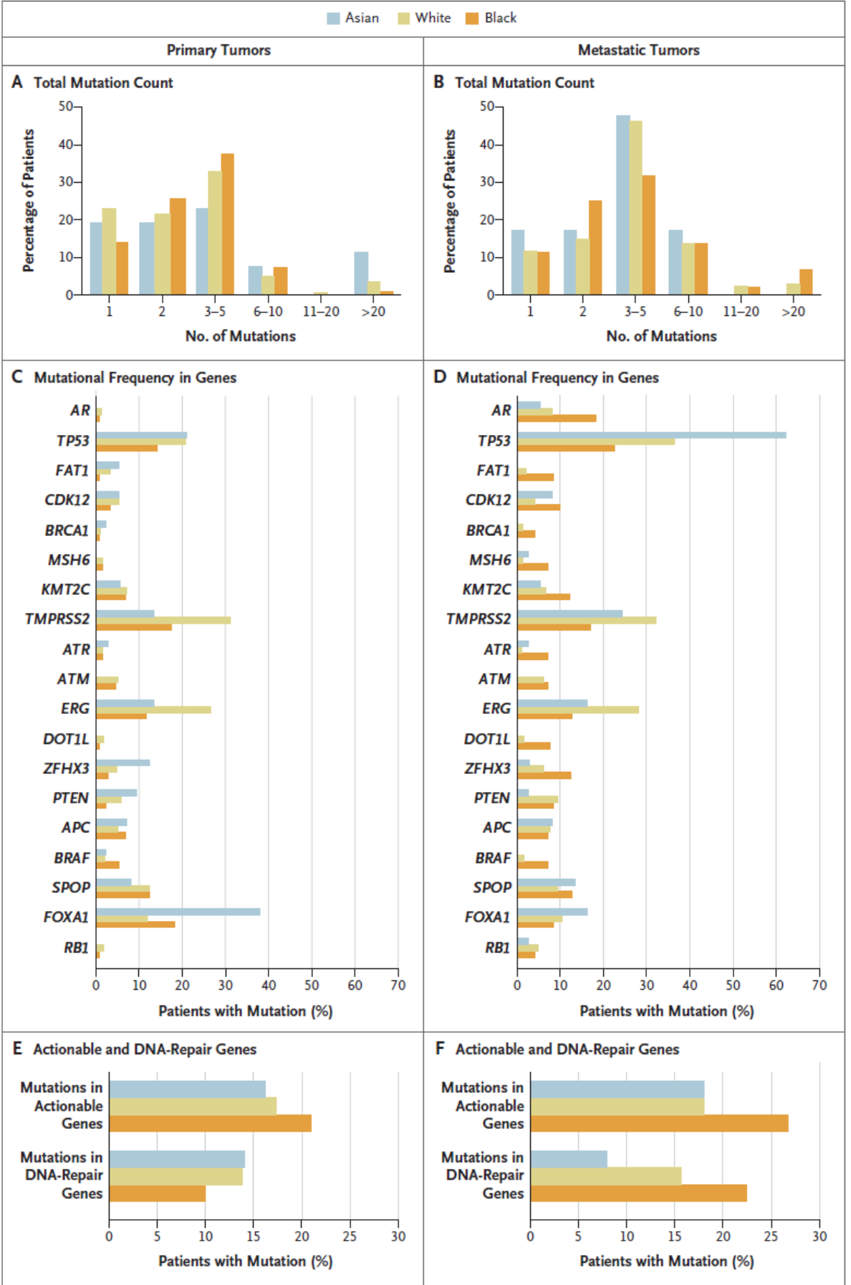
Mahal et al NEJM 2020
Differences do exist in the altered genes in prostate cancers by race that may be clinically relevant, but do not address the causes of these differences
(heredity, exposures, diet, treatments)
2393 men, including 204 Black men analyzed (8%) from Project GENIE v7.0 (AACR)

Slide 12
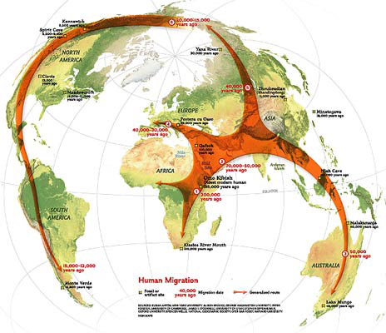
RACE IS NOT A BIOLOGICAL CONSTRUCT
RACE/ETHNICITY ARE SOCIO-CULTURAL CONSTRUCTS
But, RACIAL ANCESTRY, AS A FUNCTION OF THE HUMAN DIASPORA, AFFECTS GENETIC, PHENOTYPIC & CULTURAL DIVERSITY AND THEREFORE DISEASE RISK AND OUTCOMES

Slide 13

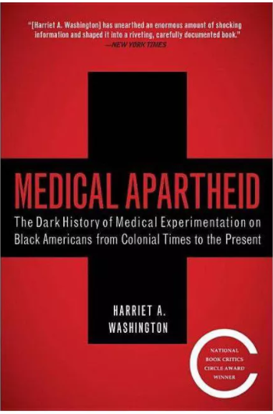
“Race is the child of racism, not the father” --Ta-Nehisi Coates Between the World and Me
Two excellent resources→

Slide 14
What is Duke doing to study Prostate Cancer?
How does prostate cancer spread (metastasis)?
GU Oncology Basic/Translational Research Program Themes
Prostate Cancer Drug Resistance and Pharmacology
Racial Disparities in Prostate Cancer Aggressiveness
Lifestyle and Therapeutics: Exercise, Diet
Androgen Signaling and Androgen Receptor Biology
Tissue and Circulating Biomarkers of Aggressive Disease
Urologic Medical Radiation Imaging Pathology Survivorship
Oncology Oncology Oncology
GU Oncology Clinical Research Groups

Slide 15
CELLS to SOCIETY: Trans-disciplinary Health Disparities Research
Social Conditions and Policies Culture, Norms, Racism, Sexism Discrimination, Public Policies, Poverty
Fundamental
Causes
Institutions
Health Care System, Families, Churches, Communities, Health Economics, Legal & Political Systems, Media, Workforce
Health Outcomes
Upstream Factors
HealthCare Delivery
Social/Physical Context
Social Capital, spatial environment, Access to Resources, Social Cohesion,
Segregation, Neighborhood Disadvantage, Neighborhood Stability
Social and Physical Context
Social Relationships
Social Networks, Social Support Social Influences, Social Engagement
Downstream Factors
HealthCare Delivery
Individual Risk Factors
Age, SES, Education, Obesity, Tobacco Use, Acculturation, Diet, Race, Environment,
Individual Demographic and Risk Factors
Biologic/Genetic Pathways Allostatic Load, Metabolic Processes, Physiological Pathways, Genomics/epigenomics, BIOMARKERS
Pharmacogenomics/Metabolomics
Biologic Responses
and Pathways
Adapted from Warnecke 2009
Notes:
15

Slide 16
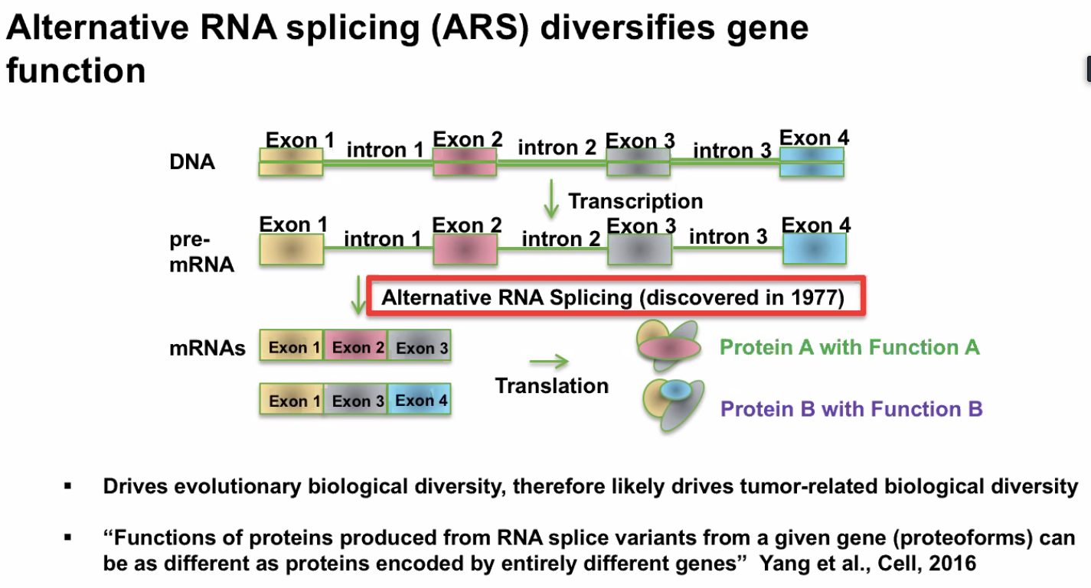
Diversity and biology: RNA Splicing

Slide 17
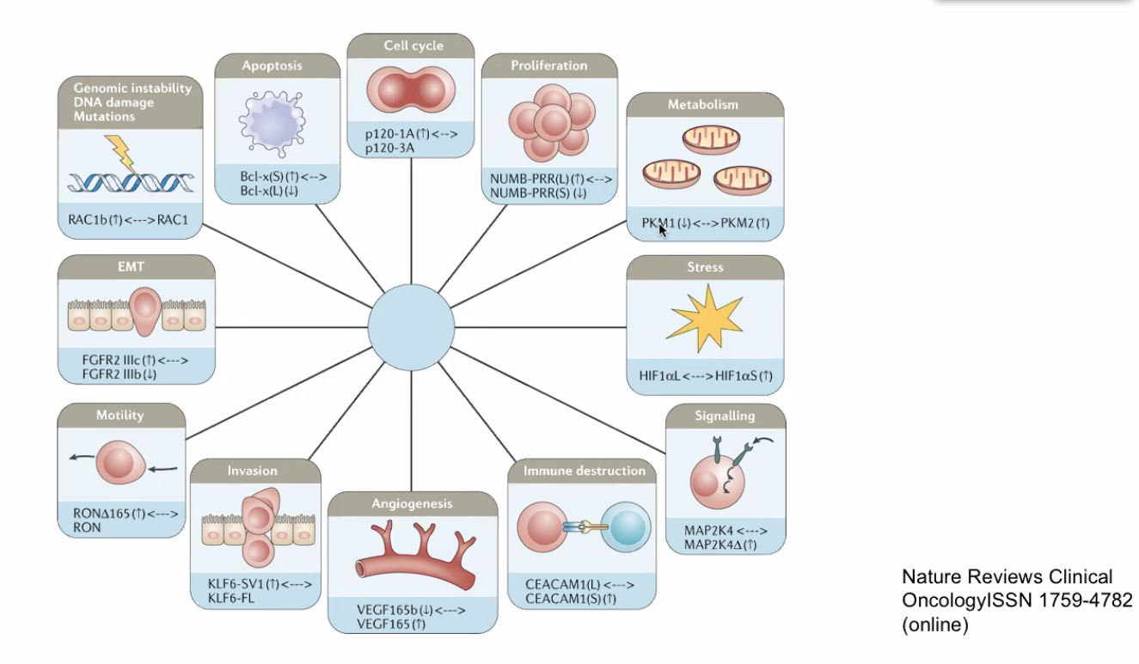
Importance of splicing to cancer biology

Slide 18
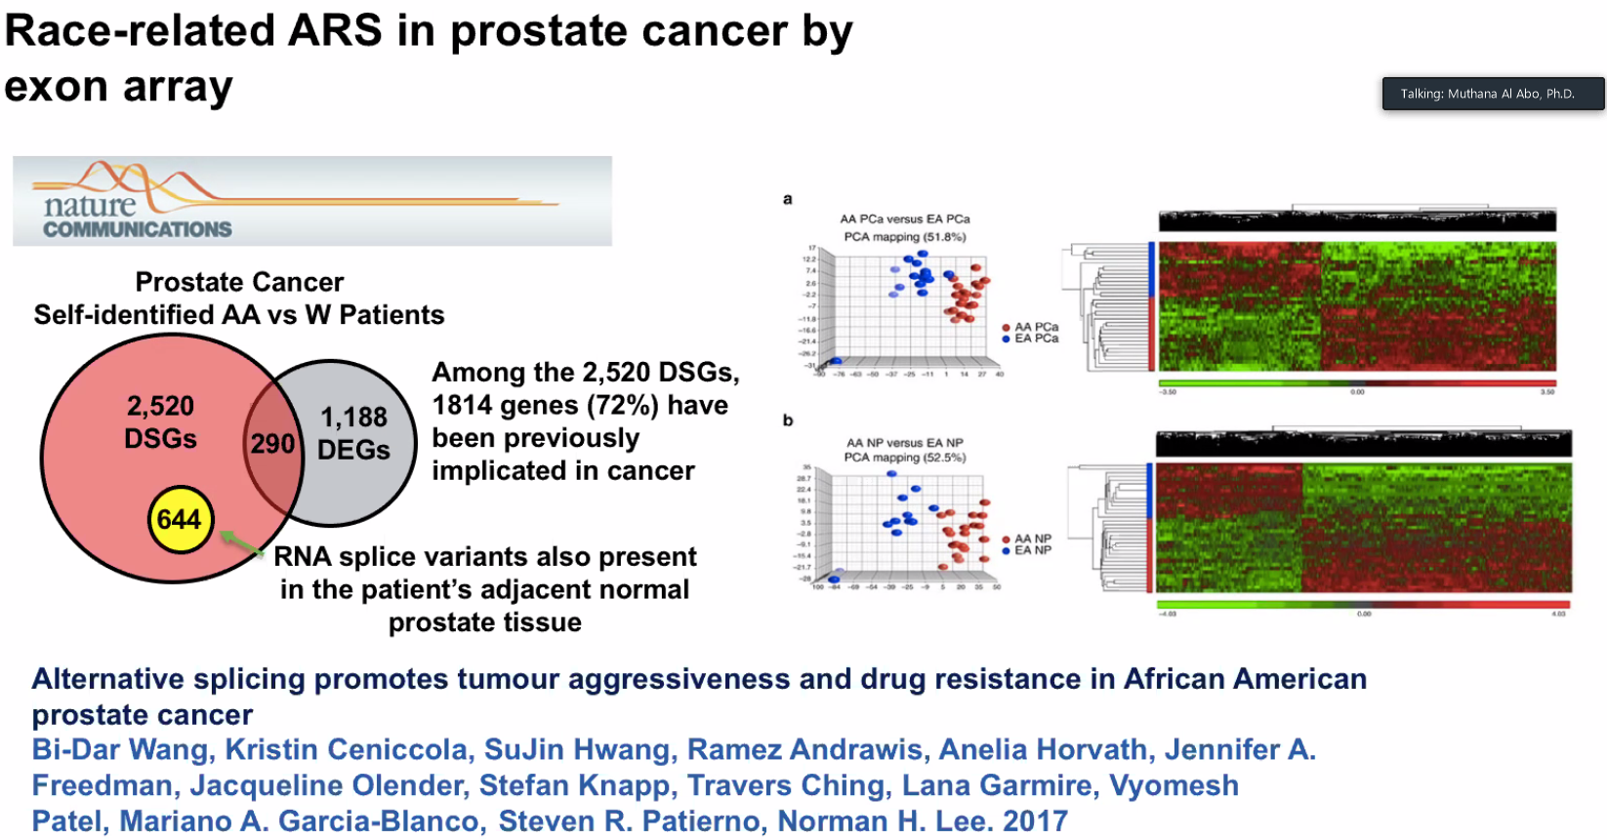

Slide 19
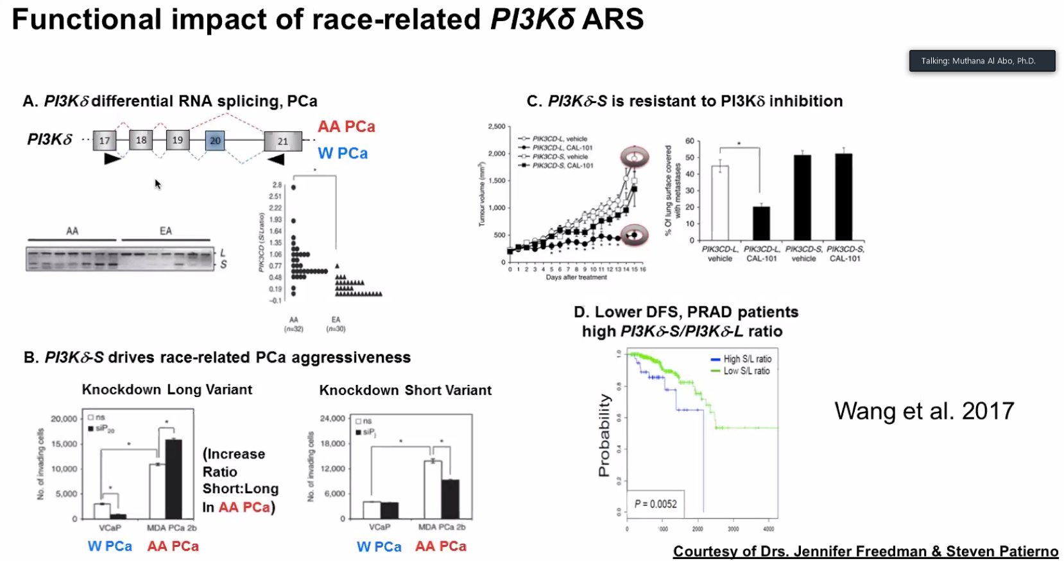

Slide 20

Patient-Centric Care
Primary Care Physician or Geriatrician
Surgical Oncologist
Radiation Oncologist
Medical Oncologist
Nursing care
Family, spiritual, spousal support
Palliative care
The patient

Slide 21
Duke Prostate Cancer Screening Algorithm
During the pre- and postimplementation
periods, 49,053 and 49,980 men, respectively, were seen across 26 clinics (20.6% African American).
The proportion of men who met screening algorithm
criteria increased from 49.3% (pre-implementation) to
68.0% (post-implementation) (p < 0.001)
Shah et al JGIM 2020

Slide 22
Results of the Screening Algorithm
Importantly, the percent of men who had a PSA did not change: 55.3% pre-implementation, 55.0% post-implementation.
The adjusted odds of meeting algorithm-based screening was 6.5-times higher in the post-implementation period than in the preimplementation period (95% confidence interval, 5.97 to 7.05).
Shah et al JGIM 2020

Slide 23
Natural History of Lethal Prostate Cancer and Treatment Options
Nonmetastatic
Metastatic
Castration Hormone Therapy
Cabazitaxel
Enzalutamide
Abiraterone
Radium-223
Docetaxel
Tumor Volume and Activity
Local
Therapy
Sipuleucel-T
Abiraterone or
Enzalutamide
Radium-223
MSI^{hi:} pembrolizumab
HRD+: platinum or PARPi
(olaparib or rucaparib)
v
M0: Apalutamide, Darolutamide or Enzalutamide
Asymptomatic
Symptomatic
NONMETASTATIC
Time

Slide 24
Disparities in Localized Disease Outcomes Population Studies vs Equal Access Centers vs. Clinical Trials
Dess et al JAMA Oncol 2019

Slide 25
Disparities in Mortality: Cancer vs. Non-Cancer
Black race was associated with an increased age-adjusted PCSM hazard (HR 1.30; 95%CI, 1.23-1.37;P < .001) within the SEER cohort.
After IPW adjustment, black race was associated with a 0.5% (95%CI, 0.2%-0.9%) increase in PCSM at 10 years after diagnosis (sHR, 1.09; 95%CI, 1.04-1.15; P < .001), no difference for high-risk men (sHR, 1.04; 95%CI, 0.97-1.12; P = .29).
No significant differences in PCSM were found in the VA IPW cohort (sHR, 0.85; 95%CI, 0.56-1.30; P = .46), and black men had a significantly lower hazard in the RCT IPWcohort (sHR, 0.81; 95%CI, 0.66-0.99; P = .04).
Black men had a significantly increased hazard of OCM in the SEER (sHR, 1.30; 95%CI, 1.27-1.34; P < .001) and RCT (sHR, 1.17; 95%CI, 1.06-1.29; P = .002) IPWcohorts.
Dess et al JAMA Oncol 2019

Slide 26
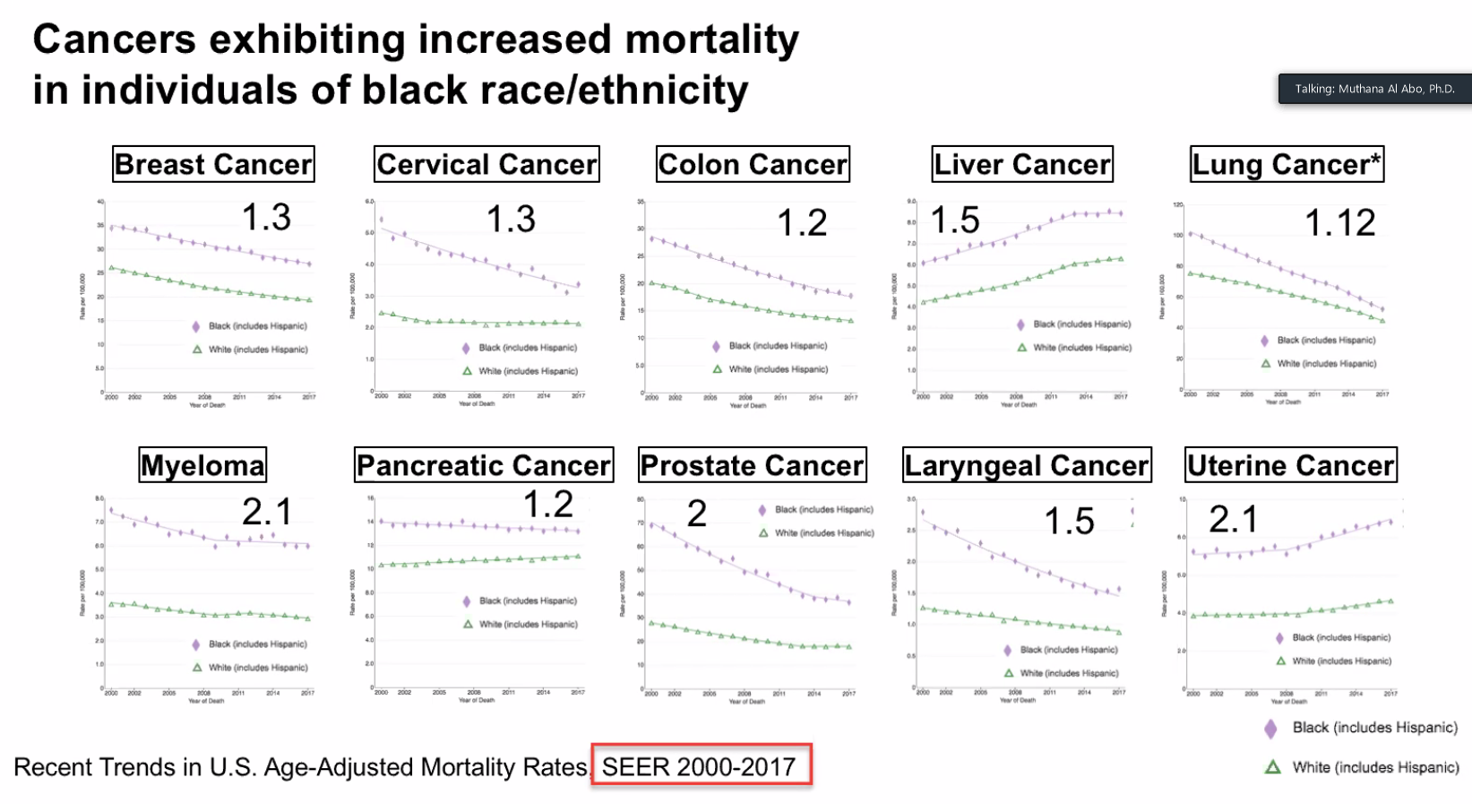

Slide 27
In other words…
Black men face a higher rate of lethal PC in the US
But, when given access to screening and clinical trials, Black men with PC do just as well if not better than matched white men
Black men face higher risks of non-cancer deaths over time, likely related to cardiovascular comorbidities
The answer is not to say there is no real disparity but rather we need to improve the structure of our society and health care system to improve access to care, screening and early detection and effective treatments in Black men

Slide 28
CRPC: Current Management Options
Maintenance of ongoing ADT
Secondary Hormonal Strategies
Anti-androgens (bicalutamide, flutamide, nilutamide, enzalutamide, apalutamide, darolutamide) and anti-androgen withdrawal
Androgen synthesis inhibitors (ketoconazole, abiraterone)
Immunotherapy (sipuleucel-T)
Chemotherapy
Docetaxel, cabazitaxel
Mitoxantrone
Radium-223
DNA Homologous Repair Deficiency: Olaparib, Rucaparib
MSI-high mCRPC: Pembrolizumab
Supportive care
Bone health agents: bisphosphonates (zoledronic acid), denosumab
Exercise, sunlight, vitamin D and calcium
Palliative radiation, palliative care

Slide 29
Disparities Research in mCRPC
Immunotherapy outcomes: sipuleucel-T
Black men live longer than similar white men with mCRPC treated with immunotherapy
Hormonal therapy with abiraterone
Black men tend to have improved outcomes
Chemotherapy
Black men tend to have slightly improved survival

Slide 30
Lack of Inclusion of Black Men in mCRPC trials
We need to do better, and a mandate to allocate enrollment in US trials to disproportionately impacted groups in prostate cancer trials should be considered

Slide 31
Disparities in Immunotherapy Outcomes by Race
AA men often present with aggressive prostate cancer¹⁻⁵
Higher incidence
Greater risk of disease progression after local therapy
Increased prostate-specific mortality
Pooled data from phase 3 mCRPC docetaxel trials indicated 1 month OS advantage for AA patients in multivariate analyses⁶
Pooled data from phase 3 sipuleucel-T trials indicated possible OS benefit in AA patients⁷⁻⁸
Hypothesis generating but very small and far from definitive
AA = African American; mCRPC = metastatic castration-resistant prostate cancer; OS = overall survival
1. Siegel, et al. CA Cancer J Clin. 2017;67:7-30. 2. Ahaghotu, et al. Clin Genitourin Cancer. 2016;14:105-116. 3. SEER Database. Accessed: March 12, 2017. 4. Aizer, et al. Cancer. 2014;120:1532-1539. 5. Di Pietro, et al. Int Neurourol J. 2016;20:S112-119. 6. Halabi, et al. J Clin Oncol. 36:suppl 18S;abstract LBA5005. 7. McLeod, et al. AUA 2012, abstract 953. 8. Quinn, et al. J Clin Oncol. 35:suppl 6S;abstract 192

Slide 32

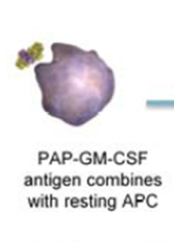
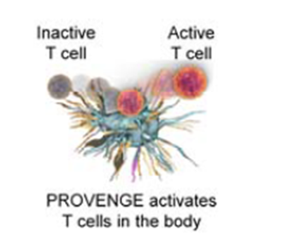
Sipuleucel-T: Patient-Specific Therapy
Day 1
Leukapheresis
Day 2-3
sipuleucel-T is manufactured
Day 3-4
Patient is infused
Apheresis Center
Dendreon
Doctor’s Office
COMPLETE COURSE OF THERAPY:
Weeks 0, 2, 4
Schellhammer et al, AUA 2009 meeting, LBA 9

Slide 33
IMPACT: Sipuleucel-T Trend Toward Greater Survival Benefit With Lower Baseline PSA
 | Baseline PSA, ng/mL
 | ≤22.1 (n=128) | >22.1-50.1 (n=128) | >50.1-134.1 (n=128) | >134.1 (n=128)
Median OS, months
Sipuleucel-T | 41.3 | 27.1 | 20.4 | 18.4
Control | 28.3 | 20.1 | 15.0 | 15.6
Difference | 13.0 | 7.0 | 5.4 | 2.8
HR (95% CI) | 0.51 (0.31-0.85) | 0.74 (0.47-1.17) | 0.81 (0.52-1.24) | 0.84 (0.55-1.29)
1.0
Schellhammer PF et al. Urology 2013; 81(6):1297-302.
Kantoff NEJM 2010

Slide 34
PROCEED: Sipuleucel-T Registry
Enrolled 1902 men with mCRPC treated with sipuleucel-T (mandated by FDA)
Largest, single, real-world experience
African American (AA) men = 12% of study population
Current analysis
AA patients were matched 2:1 to Caucasian (CAU) men, based on baseline PSA
Overall survival (OS)
Detailed univariate and multivariate analyses
mCRPC = metastatic castration-resistant prostate cancer; OS = overall survival; PSA = prostate-specific antigen

Slide 35
Baseline Characteristics in PROCEED Analysis
 | Caucasians (n = 438) | African American (n = 219)
Median age, y | 71 | 71
ECOG PS 0, % | 68 | 63
Gleason sum ≥ 8, % | 48 | 46
Median PSA, ng/ml (IQR) | 28.7 (7.8-82.3) | 32.9 (8.6-89.7)
Median hemoglobin, g/dL (IQR)¹ | 12.9 (11.9-13.7) | 12.1 (11.0-12.9)
Median alkaline phosphatase, U/L (IQR)² | 83 (64-116) | 88 (69-115)
Median LDH, U/L (IQR) ³ | 188 (157-220) | 191 (170-233)
Visceral / lymph node-only disease, % | 4.8 / 13.0 | 5.9 / 14.2
Prior local therapy, n (%) | 341 (78) | 160 (73)
Prior docetaxel / cabazitaxel (%) | 17.6 / 2.7 | 10.0 /1.8
Prior abiraterone / enzalutamide, n (%) | 5.9 / 1.4 | 5.9 / 2.7
n = 417 (CAU), 210 (AA); 2. n = 361 (CAU), 170 (AA); 3. n = 165 (CAU), 69 (AA)
ECOG PS = Eastern Cooperative Oncology Group performance score; IQR = interquartile range; LDH = lactate dehydrogenase; PSA = prostate-specific antigen

Slide 36
PROCEED: OS of PSA-matched AA & CAU Patients Treated with Sipuleucel-T
AA = African American; CAU = Caucasian; CI = confidence interval; HR = hazard ratio; OS = overall survival; PSA = prostate-specific antigen.
AA longer median OS by 9.5 months
Sartor, Armstrong et al PCAN 2020

Slide 37
OS of PSA-matched AA & CAU Patients Treated with Sipuleucel-T by Median PSA*
Below Median PSA
Above Median PSA
AA Median OS 54.3 months
AA Median OS 22.7 months
CAU
Median OS
33.4 months
CAU Median
OS 17.6 months
HR = 0.52
95% CI (0.37, 0.72)
P < 0.001
HR = 0.86
95% CI (0.66, 1.11)
P =0.249
Difference in median OS = 20.9 months
Difference in median OS = 5.1 months
* Median PSA = 29.48 ng/ml
AA = African American; CAU = Caucasian; CI = confidence interval; HR = hazard ratio; OS = overall survival; PSA = prostate-specific antigen.

Slide 38
Conclusions
AA patients had longer OS than CAU men post-sipuleucel-T in these analyses
MV analysis indicated AA status independently associated with better OS
Magnitude of median survival benefit (9.5 months) was surprisingly high……much higher than that previously reported
Clearly more research is needed to understand the etiology of these findings
What is the basis for this observation?
Biology: tumor vs. host
Selection of patients
Differences in trial patients vs. those outside of a trial

Slide 39
Racial Differences in Prostate Cancer in Mutation Burden
Whole genome sequencing of prostate cancer tumor samples
African ancestry (South African) and European ancestry (Australian) compared
High-risk, treatment-naïve
Findings
1.8-fold increase in tumor mutational burden (TMB) in African tumors vs controls
4-fold increase v published tumor-matched data from Americans of European ancestry
Jaratlerdsiri, et al. [published online ahead of print September 14, 2018] Cancer Res. doi: 10.1158/0008-5472.CAN-18-0254

Slide 40
What explains this disparity in outcome?
Differences in prostate cancer and stroma with respect to
Expression of immune- & prostate cancer-related genes¹⁻³
Gene signatures related to disease progression³
Transcription of androgen-related genes⁴
Post-transcriptional RNA slice events & associations with disease aggressiveness & treatment resistance⁵
Differences in the immune system
Proportion of white blood cell types⁶⁻⁸
Immune responses⁹⁻¹²
Wallace, et al. Cancer Res 2008;68:927-36. 2. Kinseth, et al. Int J Cancer 2014; 134:81–91. 3. Yamoah, et al. J Clin Oncol 2015;33:2789-96.
4. Wang, et al. Prostate Cancer 2013;2013:763569. 5. Wang, et al. Nat Commun 2017;8:15921. 6. Freedman, et al. Int J Epidemiol 1997;26:757-64. 7. Lim, et al. Int J Lab Hematol 2010;32:590-7.8. Vidal, et al. Cancer Causes Control 2018;29:581-8. 9. Keller, et al. Hum Mol Genet 2014;23:6944-60. 10. Longo, etl al. J Transl Med 2012;10:113. 11. Sugimoto, et al. Hepatology 2003;37:590-9. 12. Rayford, et al. J Urol 2018;199(4S Supplement):PD56-01.

Slide 41
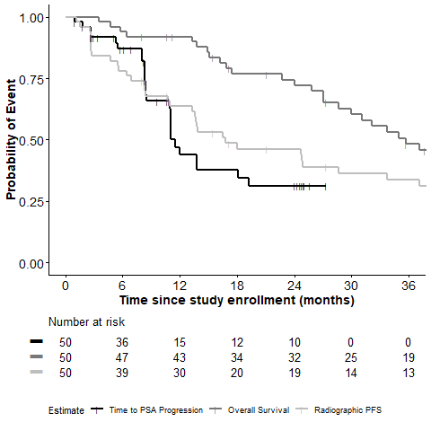
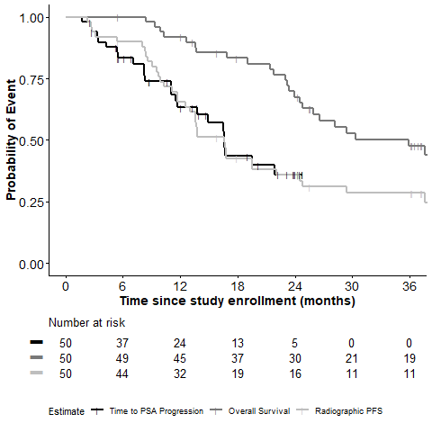
Abiraterone outcomes: Prospective AbiRace Study
White Men with mCRPC
Black Men with mCRPC
Median (mo) | White
rPFS | 16.8 (95% CI 11 – 33.7)
TTP (PSA) | 11.5 (95% CI 8.5 – 19.3)
Overall survival | 35.7 (95% CI 27.1 – NR)
Median (mo) | Black
rPFS | 16.6 (95% CI 12.6 – 22.1)
TTP (PSA) | 16.6 (95% CI 11.5 – NR)
Overall survival | 35.9 (95% CI 24.5 – 43)
George DJ…Armstrong AJ submitted

Slide 42
PSA Changes with Abiraterone by Race
 | % Black (95% CI) | % White (95% CI)
>30% PSA Decline | 82 (0.69, 0.91) | 78 (0.64, 0.88)
>50% PSA Decline | 74 (0.60, 0.85) | 66 (0.51, 0.79)
>90% PSA Decline | 48 (0.34, 0.63) | 38 (0.25, 0.53)
No PSA Decline | 4 (0.004, 0.14) | 10 (0.03, 0.21)
PSA < 0.1 ng/ml | 18 (0.1, 0.3) | 8 (0.02, 0.2)
PSA < 0.2 ng/ml | 26 (0.14, 0.4) | 10 (0.03, 0.21)
Table 2: Proportion of PSA decline from baseline for Black and white men with mCRPC treated with AAP.
George DJ…Armstrong AJ submitted

Slide 43
Abiraterone Toxicities Differ by Race
 | All Grades |  |  | Grades 3 and 4
Adverse Event | B (%) | W (%) | Total (%) | B (%) | W (%) | Total (%)
Fatigue | 26 | 42 | 34 | 4 | 8 | 6
Hypertension | 46 | 40 | 43 | 24 | 16 | 20
Cough | 18 | 30 | 24 | 0 | 0 | 0
Pain | 24 | 24 | 24 | 2 | 6 | 4
Edema limbs | 26 | 16 | 21 | 0 | 0 | 0
Constipation | 28 | 10 | 19 | 0 | 0 | 0
Pain in extremity | 14 | 18 | 16 | 2 | 2 | 2
Nausea | 16 | 16 | 16 | 0 | 0 | 0
Dyspnea | 18 | 14 | 16 | 0 | 0 | 0
Anorexia | 20 | 4 | 12 | 0 | 0 | 0
Headache | 6 | 18 | 12 | 0 | 0 | 0
Hot Flashes | 20 | 2 | 11 | 0 | 0 | 0
Urinary tract infection | 12 | 10 | 11 | 4 | 4 | 4
Fall | 8 | 14 | 11 | 0 | 0 | 0
Vomiting | 6 | 16 | 11 | 0 | 0 | 0
Dyspepsia | 14 | 6 | 10 | 0 | 0 | 0
Urinary Frequency | 10 | 10 | 10 | 0 | 0 | 0
Lab AEs
Hyperglycemia | 26 | 14 | 20 | 10 | 4 | 7
Hypokalemia | 34 | 20 | 27 | 12 | 4 | 8
Anemia | 16 | 14 | 15 | 6 | 2 | 4
Hypomagnesemia | 16 | 8 | 12 | 0 | 0 | 0
Aspartate aminotransferase increased | 10 | 10 | 10 | 2 | 0 | 1
Alanine aminotransferase increased | 10 | 10 | 10 | 0 | 2 | 1
Alkaline phosphatase increased | 10 | 4 | 7 | 4 | 0 | 2
George DJ…Armstrong AJ submitted

Slide 44
Docetaxel outcomes by race
Halabi et al JCO 2018

Slide 45
Conclusions
Black men in the US face a pandemic of lethal prostate cancer, related to a host of potential factors including access to care, early detection, and effective therapies
There may be biologic differences in immune response by race or in RNA splicing by race that could explain some differences in outcome, but these are linked to ancestry and environmental causes likely moreso than race, which is a social/societal and not biologic construct
Black men with prostate cancer in clinical trials are under-represented despite being disproportionately impacted by lethal prostate cancer, and tend to do just as well if not better than white men in these same trials!
Overcoming structural barriers to promote inclusion, early detection and treatment when needed is the main message

Slide 46
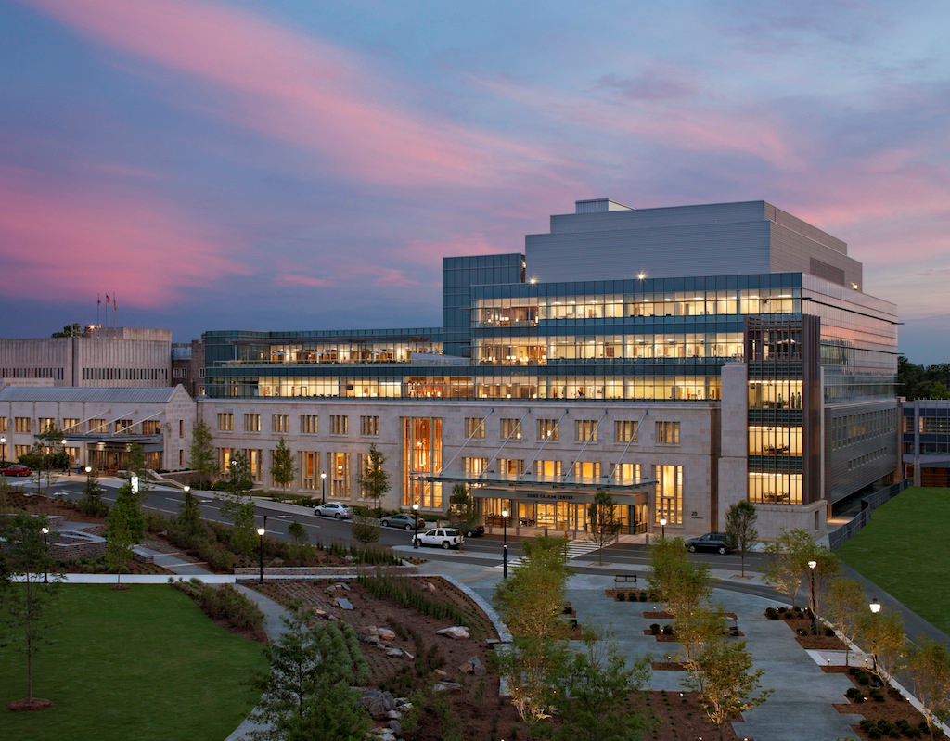

Thank you!

