Slide 1

Stereotactic Body Radiotherapy for Prostate Cancer: A 2023 Update for Patients
Amar U. Kishan, MD
Associate Professor
Vice Chair of Clinical and Translational Research
Department of Radiation Oncology
University of California, Los Angeles
NASPCC Webinar Series
April 25, 2023

Slide 2
Disclosures
Employer:
  University of California, Los Angeles
Honoraria:
  Varian Medical Systems, Inc.
  ViewRay, Inc.
Consulting Fees:
  Varian Medical Systems, Inc.
  Intelligent Automation, Inc.
Research Funding:
  ViewRay, Inc.
  Janssen, Inc.
  Department of Defense
  Prostate Cancer Foundation
  ASTRO

Slide 3

How Does Radiation Kill Cancer?
Cancer cells are defined by an ability to divide uncontrollably
Radiation causes significant damage to cellular DNA, which cancer cells are unable to repair
When cancer cells try to divide with damaged DNA, they die
Christoph Burgstedt, iStockphoto

Slide 4
Radiation Basics
Radiation is a standard of care option for prostate cancer
Two fundamentally different types of radiation treatments exist:
  External beam radiotherapy (EBRT)
  Brachytherapy (implanted radiation)
This presentation will focus on a type of EBRT called “SBRT”

Slide 5
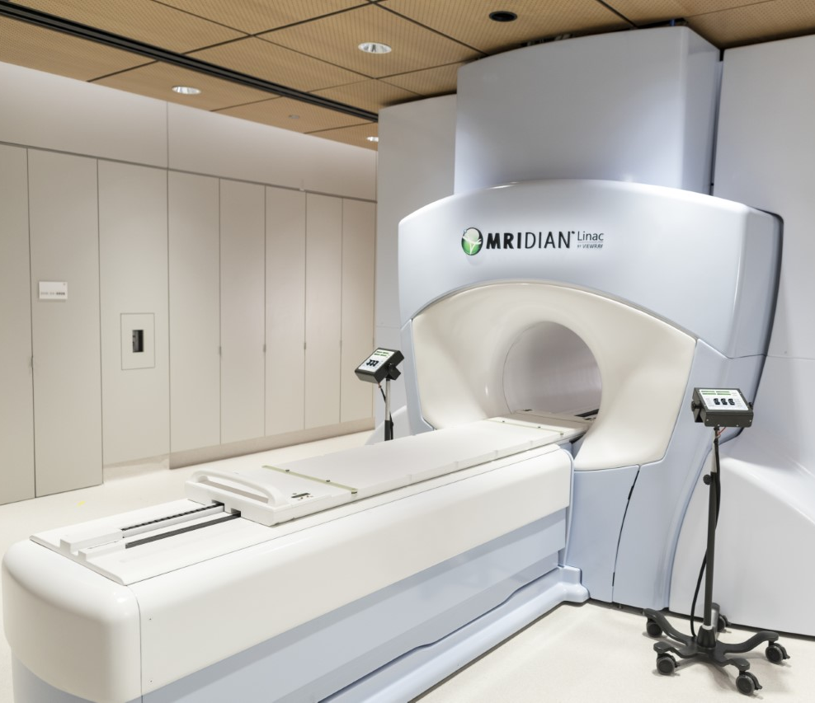
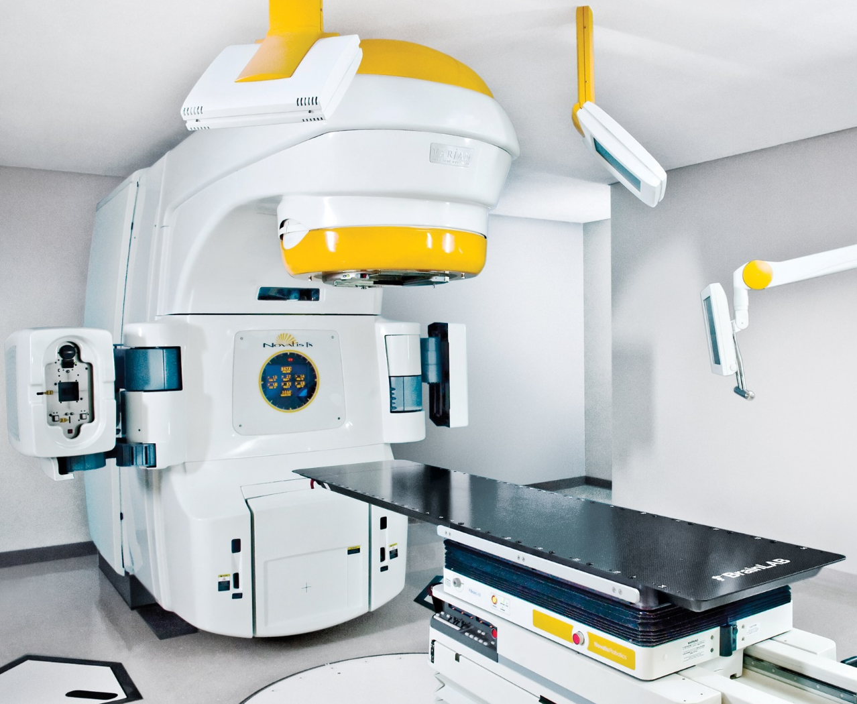
EBRT Principles
High energy X-rays are directed towards the prostate by a linear accelerator
Patients are not radioactive and there is no heating or burning involved
EBRT is completely non-invasive

Slide 6
What are the Types of EBRT?
EBRT is delivered in the form of multiple daily doses of radiation over a certain time period
Prostate cancer is uniquely sensitive to a higher dose per day
Type of Radiation | Dose Per Day | Total Treatments | #of Weeks
Conventional Fractionation | 1.8-2 Gy | 39-45 | 8-9
Moderate Hypofractionation | 2.5-3 Gy | 20-28 | 4-5.5
SBRT | 7.25-8 Gy | 5 | 1.5

Slide 7
An Aside: What Is IMRT?
Intensity Modulated Radiotherapy (IMRT) refers to the use of advanced technologies to deliver external radiation with high precision
Typically, different beams with different orientations are delivered with varying fluence in a way that sculpts the high dose radiation around the target

Slide 8
What is SBRT?
Stereotactic Body RadioTherapy (SBRT, or SABR) is a form of modern radiation treatment in which high doses of radiation are given over one to five treatments using advanced imaging and delivery techniques
Many different platforms exist for delivering SBRT, and these are sometimes referred to by their brand name:
  CyberKnife
  Novalis Tx
  TrueBeam
  MRIdian

Slide 9
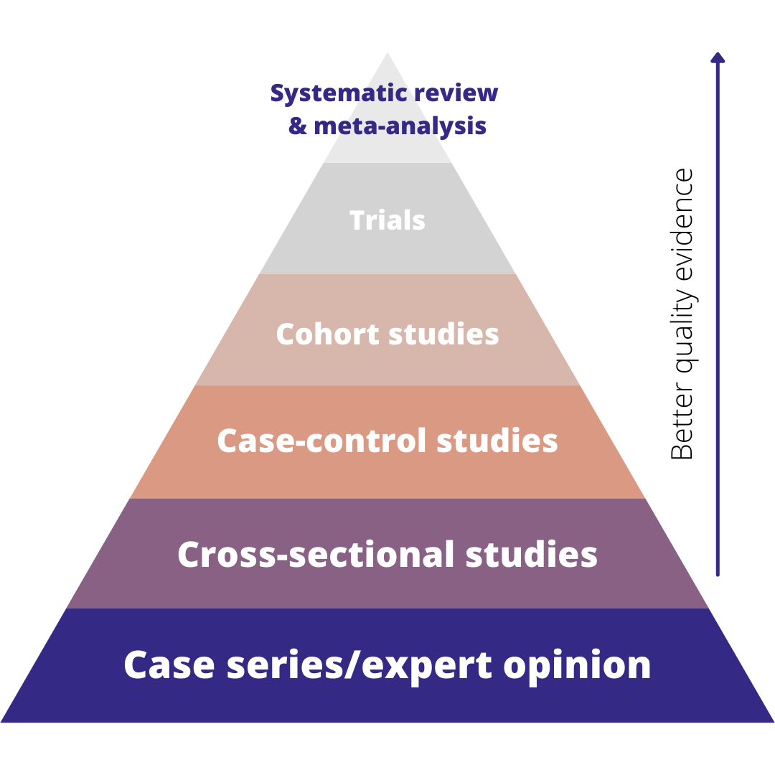
An Aside: Levels of Evidence

Slide 10
What is the Evidence for SBRT?
SBRT is now considered a standard of care option for prostate cancer in the United States
SBRT is supported by multiple high-level studies:
  HYPO-RT-PC
  PACE-B
  UCLA-Led General Consortium Study
  UCLA-Led SHARP Consortium

Slide 11
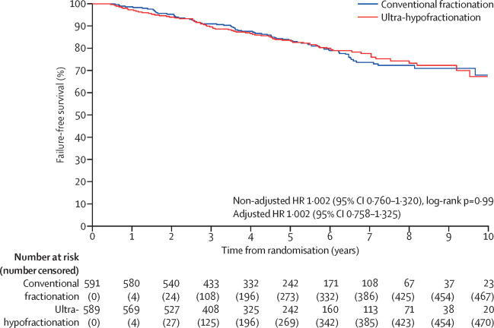
Study #1: HYPO-RT-PC
  What is the HYPO-RT-PC Trial?
    HYPO-RT-PC was a randomized trial out of Sweden that compared a regimen using a very high dose per day (called ultra-hypofractionation) against the 8-week course of radiation
  What did it show?
    It showed no difference in outcome (“failure-free survival”) between the two groups
    It also showed no difference in long-term side effects between the two groups
  What does it mean?
    Provides high-level evidence that treatments using very high doses per day can have similar efficacy and long-term side effects as treatments using a low dose per day
Lancet. 2019 Aug 3;394(10196):385-395.

Slide 12
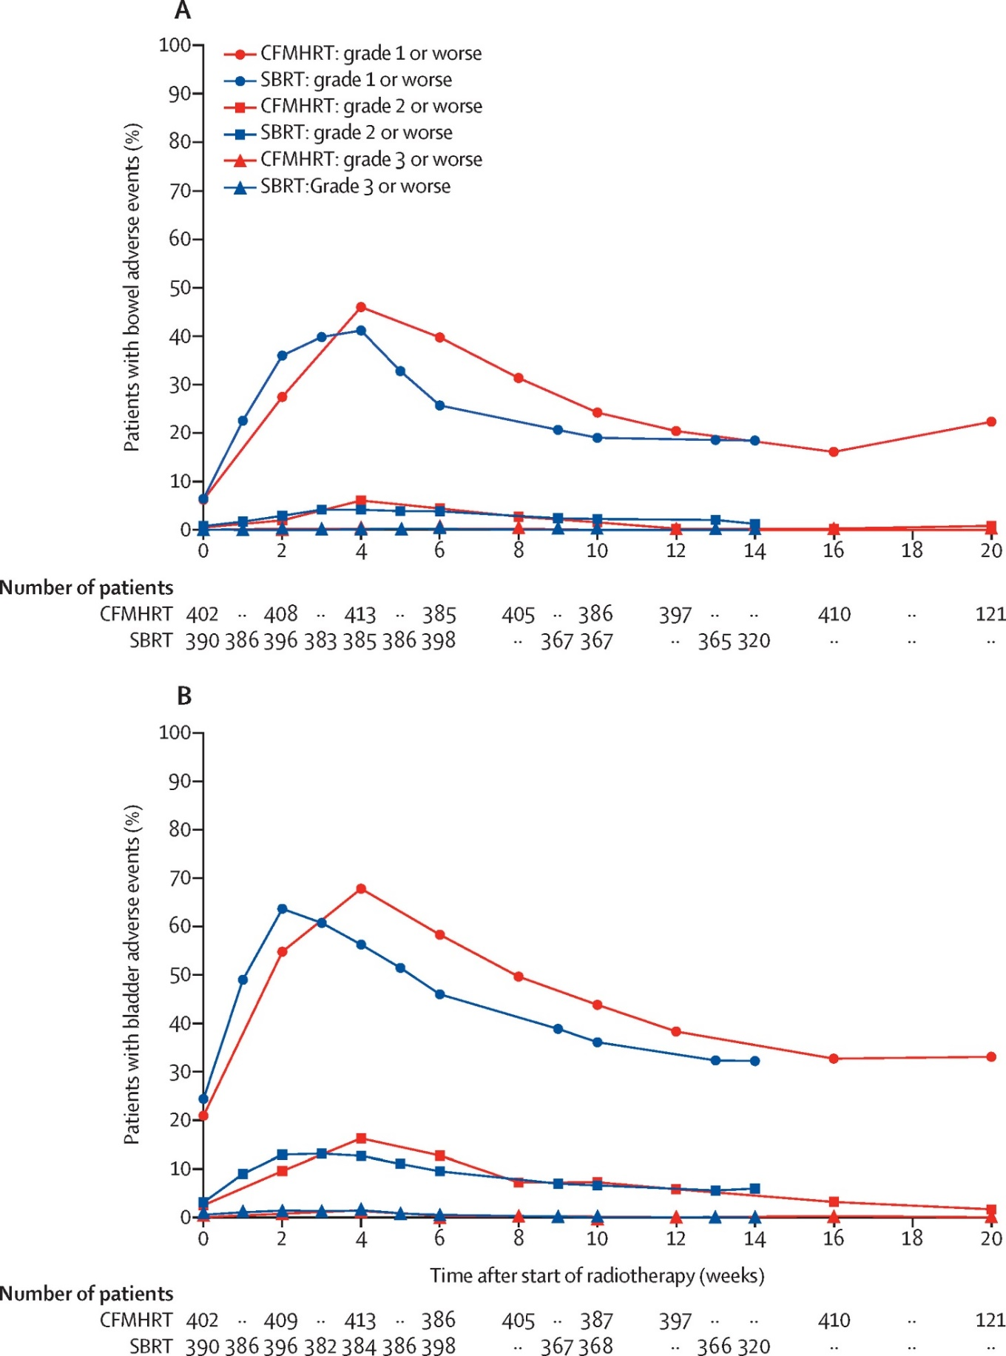
Study #2: PACE-B (Early Results)
  What is PACE-B?
    PACE-B was a randomized trial out of the UK that compared SBRT against moderate hypofractionation and conventional fractionation
  What did the early results show?
    It showed no difference in short-term side effects, either physician-scored or patient-reported
  What do these early results mean?
    Provides high-level evidence that with modern techniques, there is no difference in short-term side effects when comparing SBRT against longer forms of radiation
Lancet Oncol. 2019 Nov;20(11):1531-1543.

Slide 13
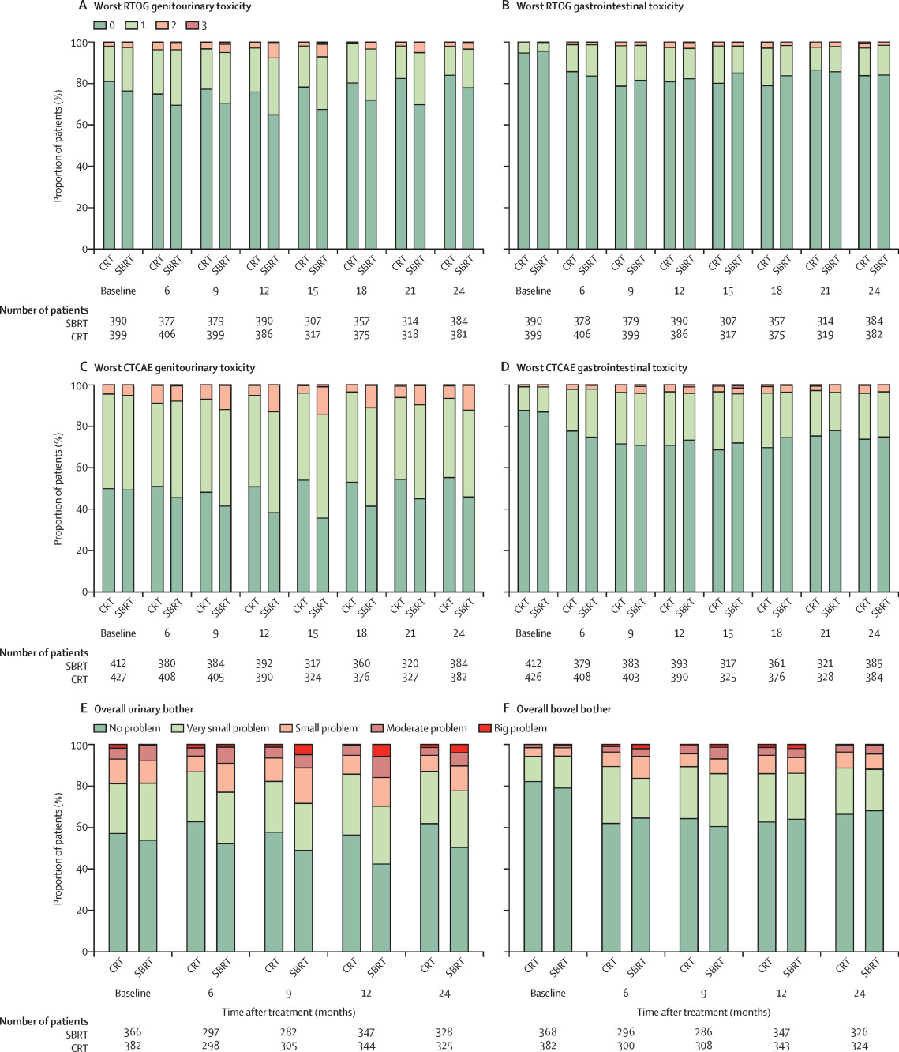
Study #2: PACE-B
(Medium-Term Results)
  What did the recent PACE-B update show?
    Depending on the “scale” used to measure toxicity, subtle differences could be identified
    Moderate urinary toxicity (scored by physicians) was slightly higher with SBRT, but there was evidence that this varied based on technique and center
  What about patient-reported outcomes?
    There was no significant difference in patient-reported outcome metrics for urinary function
    There was a small significant benefit to SBRT in patient-reported bowel metrics
  What does it mean?
    Subtle differences in toxicity might emerge with SBRT versus longer courses of radiation, with possibly more subacute urinary side effects and potentially less bowel bother with SBRT
Lancet Oncol. 2022 Oct;23(10):1308-1320.
Notes:
Lancet Oncol. 2022 Oct;23(10):1308-1320.

Slide 14
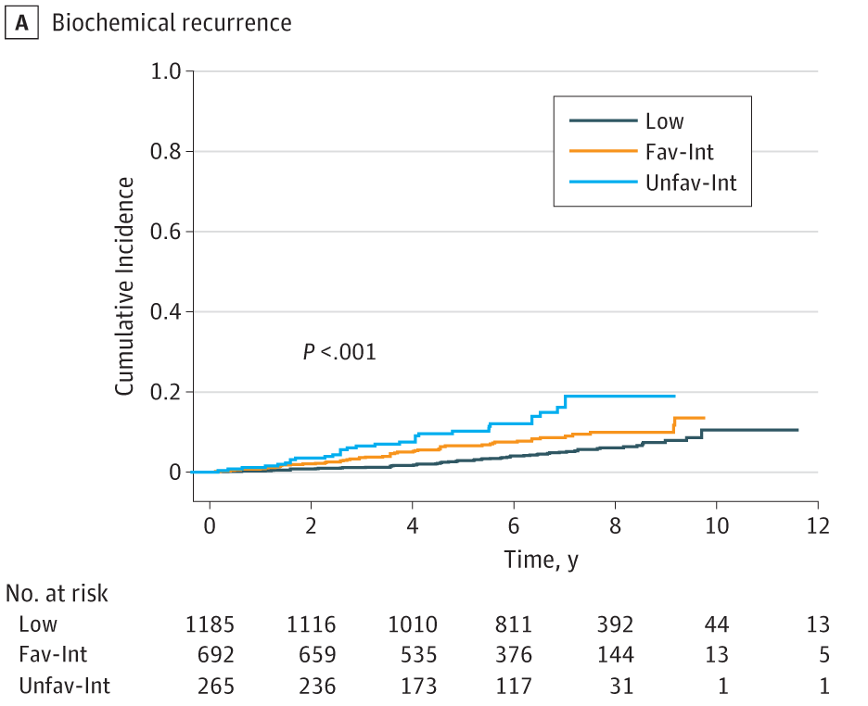
Study #3: UCLA-Led General Consortium
  What is the UCLA Consortium Study?
    This was a pooled study that combined data from multiple North American trials of prostate SBRT together to evaluate safety and efficacy
  What did it show?
    It showed a favorable toxicity and efficacy profile with a median follow-up of 7 years
  What does it mean?
    Long-term follow-up studies suggests that modern SBRT is safe and effective
Risk Group | 7-Year BCR Rate
Low | 4.5%
Favorable Intermediate | 8.6%
Unfavorable Intermediate | 14.9%
JAMA Netw Open. 2019 Feb 1;2(2):e188006.

Slide 15
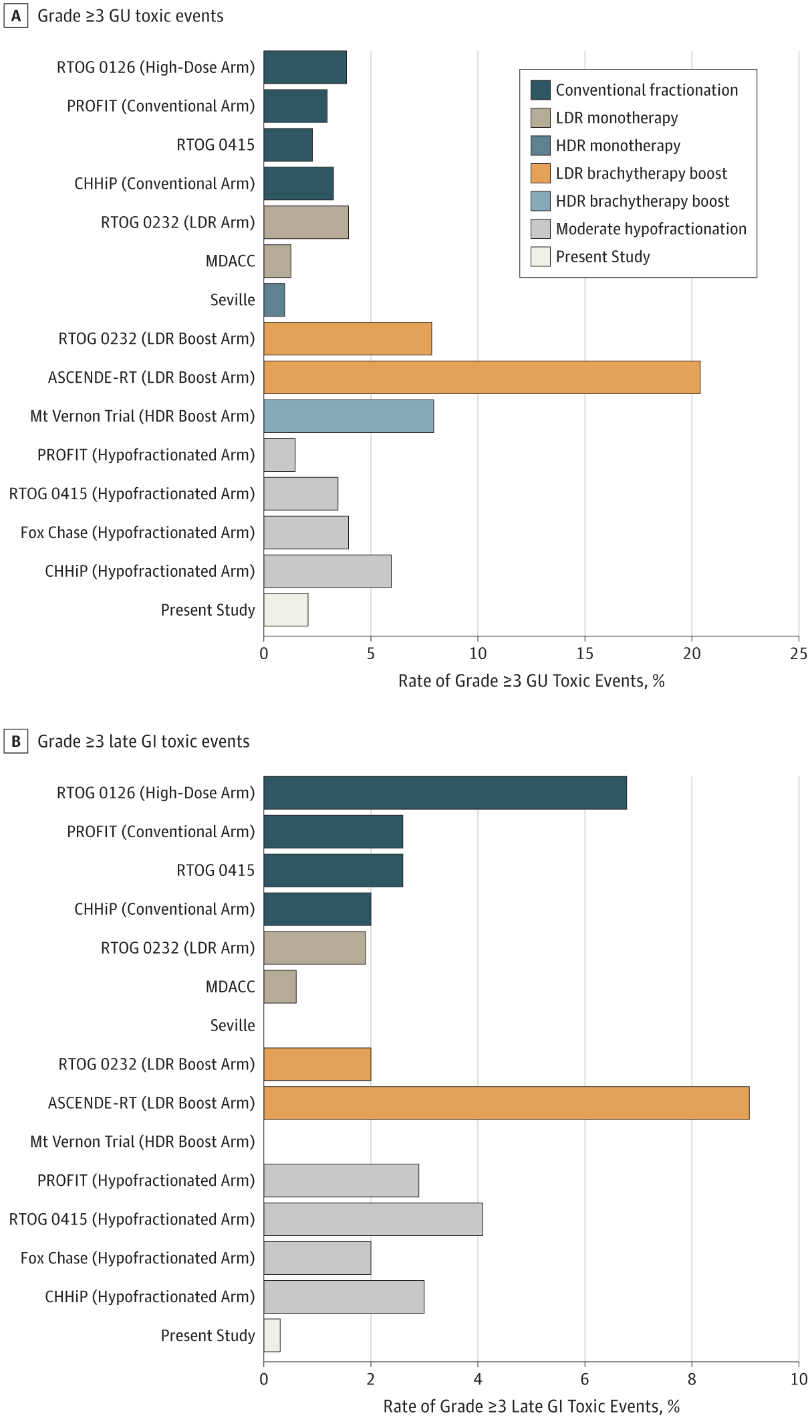
Study #3: UCLA-Led General Consortium
7-year rate of severe GU toxicity: 2.4%
Median onset: 27 months
7-year rate of severe GI toxicity: 0.4%
Median onset: 31 months

Slide 16
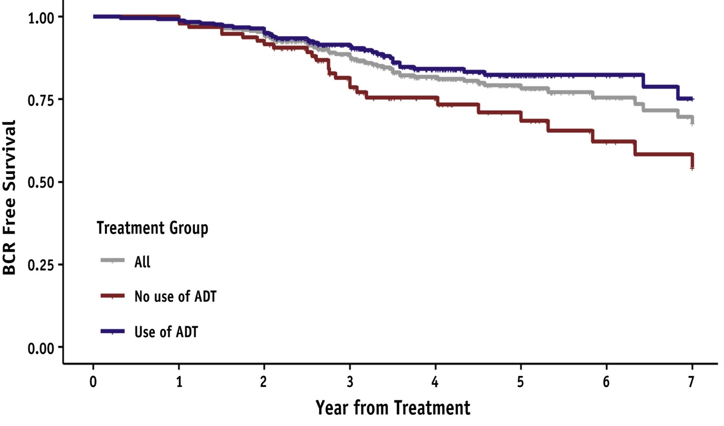
Study #4: UCLA-Led SHARP Consortium
  What is the SHARP Consortium Study?
    This was a pooled study that combined data from seven global trials of prostate SBRT for high-risk prostate cancer (344 men in total were included)
  What did it show?
    SBRT offers a high cure rate with a 4-year BCR-free survival rate of 82% overall, and up to 87% with the use of hormonal therapy
  What does it mean?
    SBRT is effective for high-risk prostate cancer
Int J Radiat Oncol Biol Phys. 2021 Jul 1;110(3):731-737.

Slide 17
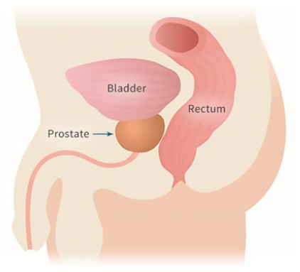
How is SBRT Delivered?
The prostate is a moving target that shifts between treatments and during treatments
Because of this motion and other inherent considerations, a “margin” around the actual clinical target must be treated to ensure the prostate is adequately targeted
https://lmu.com.au/transperineal-insertion-of-gold-seeds-and-spaceoar/

Slide 18
CT-Guided SBRT with Fiducials
3 metal markers (called fiducials) are placed into the prostate in a small outpatient procedure and can be tracked with an X-ray or CT scan
Patients undergo a CT scan prior to treatment to evaluate anatomy as well as X-rays to align to the prostate
X-ray images can be repeated during treatment to re-align to the prostate, or the treatment can be completed very quickly to minimize motion

Slide 19
MRI-Guided SBRT
When doing “MRI-guided” SBRT, fiducial markers are not needed as the prostate can be seen directly using an on-board MRI
With the MRIdian platform, MRIs can then be obtained 4-8 times per second, with the radiation beam being paused automatically if the prostate moves outside of a pre-set margin
The ability to track the prostate so closely allows the margin around the prostate needed for planning to be cut by 50%

Slide 20
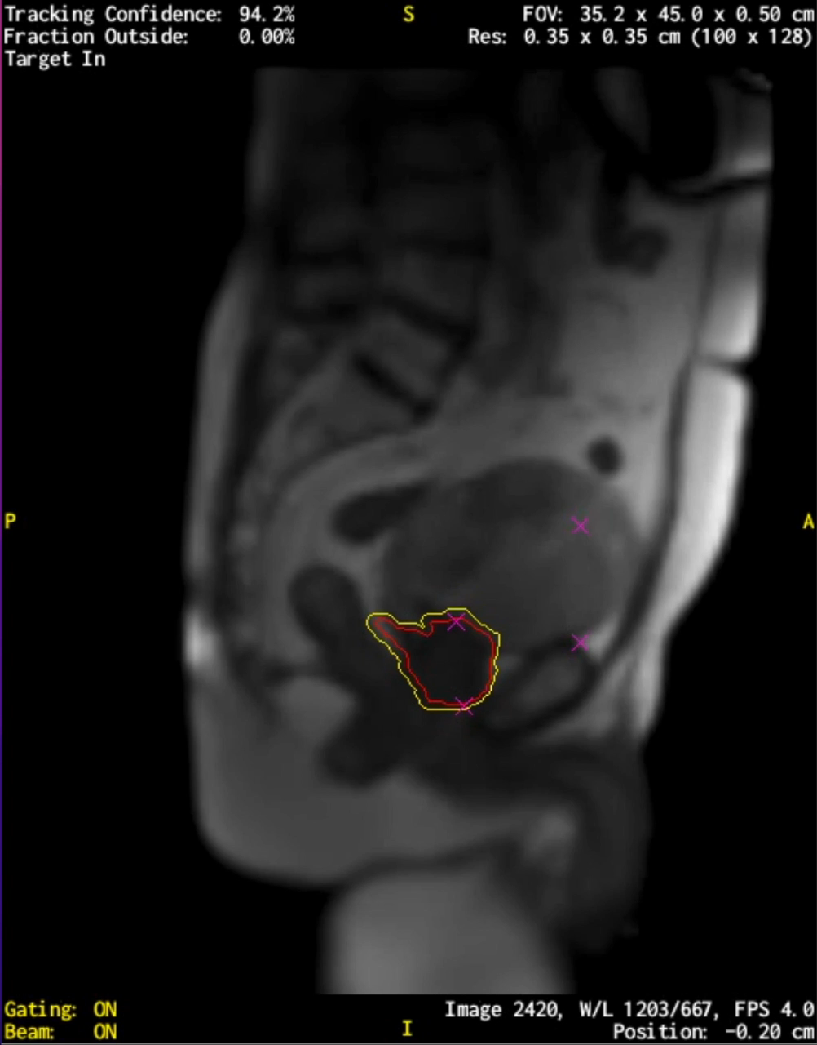
Example of Real-Time Tracking

Slide 21
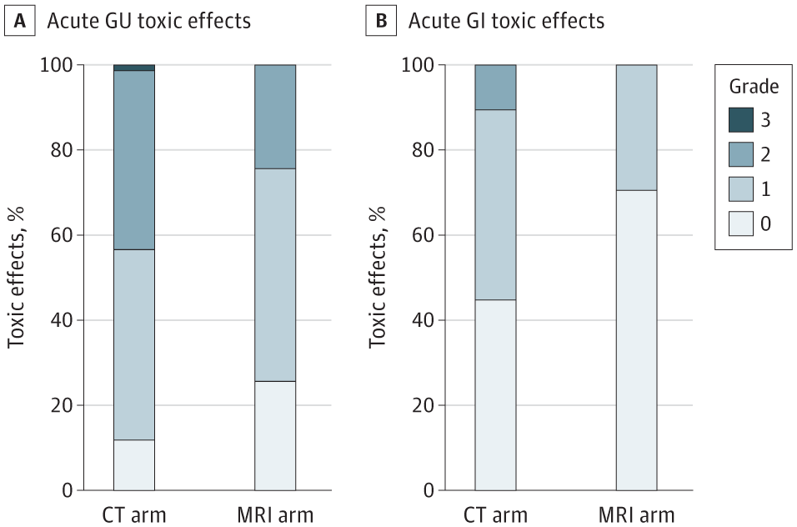
Study #5: MIRAGE Trial
  What is the MIRAGE Trial?
    This was a UCLA-led randomized trial of MRI-guided vs. CT-guided SBRT for prostate cancer
  What did it show?
    MRI-guided SBRT led to a 50% reduction in grade ≥2 GU (i.e., moderate) toxicity
    No incidences of grade ≥2 GI toxicity seen in patients getting MRI-guided SBRT
  What does it mean?
    MRI-guidance is associated with reduced physician-scored and patient-reported side effects compared with CT-guided SBRT
  What is the MIRAGE Trial?
    This was a UCLA-led randomized trial of MRI-guided vs. CT-guided SBRT for prostate cancer
  What did it show?
    MRI-guided SBRT led to a 50% reduction in grade ≥2 (i.e., moderate) toxicity
    No incidences of grade ≥2 GI toxicity seen in patients getting MRI-guided SBRT
  What does it mean?
    MRI-guidance is associated with reduced physician-scored and patient-reported side effects compared with CT-guided SBRT
Grade ≥2: 43.4% vs. 24.4%
Grade ≥2: 10.5% vs. 0%
JAMA Oncol. 2023 Mar 1;9(3):365-373.

Slide 22
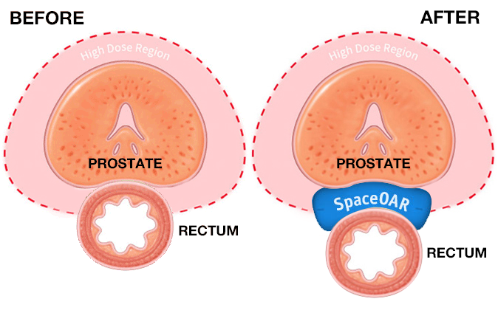
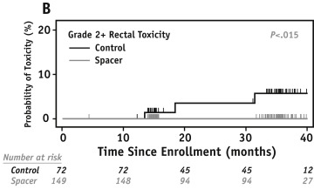
What is SpaceOAR?
  What is SpaceOAR?
    SpaceOAR is an absorbable hydrogel that can be placed between the rectum and the prostate in an outpatient procedure to physically separate the prostate and the rectum
  Has SpaceOAR been studied in a randomized trial?
    It was studied in a randomized trial that used conventional radiation, and was associated with lower late grade ≥2 rectal toxicity
  Who is a good candidate for SpaceOAR?
    Patients with clear evidence of prostate cancer growing outside the capsule of the prostate posteriorly are not good candidates
    Placing SpaceOAR involves a procedure that carries the risk of any procedure, and the overall pros and cons should be discussed with the radiation oncologist
Int J Radiat Oncol Biol Phys. 2017 Apr 1;97(5):976-985.

Slide 23
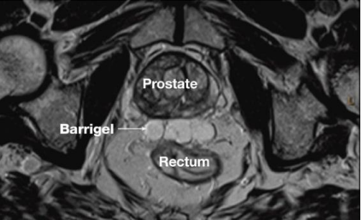
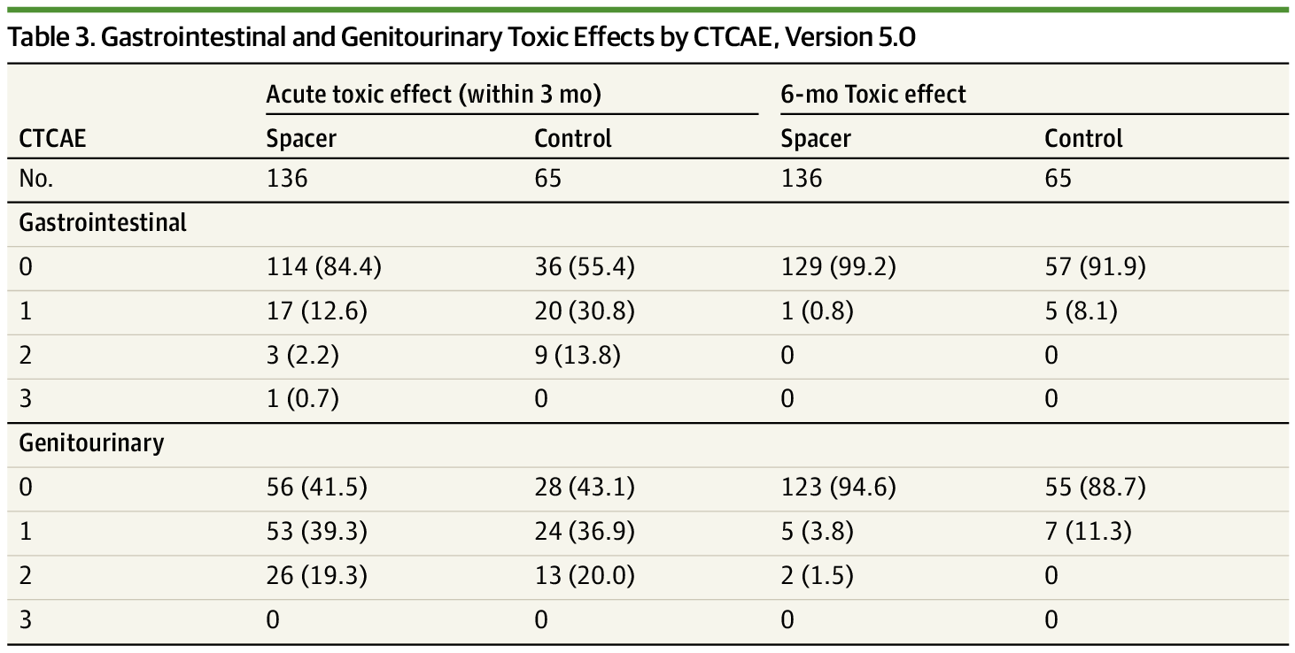
What is Barrigel?
  What is Barrigel?
    Barrigel is a hyaluronic acid spacer, whose benefit would follow the same mechanism as that of SpaceOAR
  Has Barrigel been studied in a randomized trial?
    It was studied in a randomized trial that used moderate radiation, and was associated with lower acute grade ≥2 rectal toxicity
    Similar caveats apply to the use of Barrigel vs. SpaceOAR
JAMA Oncol. 2023 Apr 1;9(4):511-518.
Notes:
JAMA Oncol. 2023 Apr 1;9(4):511-518.

Slide 24
Radiation Side Effects
Side effects from radiation can be divided into acute (within 90 days of radiation) and late (beyond 90 days after radiation)
Typically we are concerned about urinary, bowel, and sexual side effects
Fatigue is another general, acute side effect of radiation

Slide 25
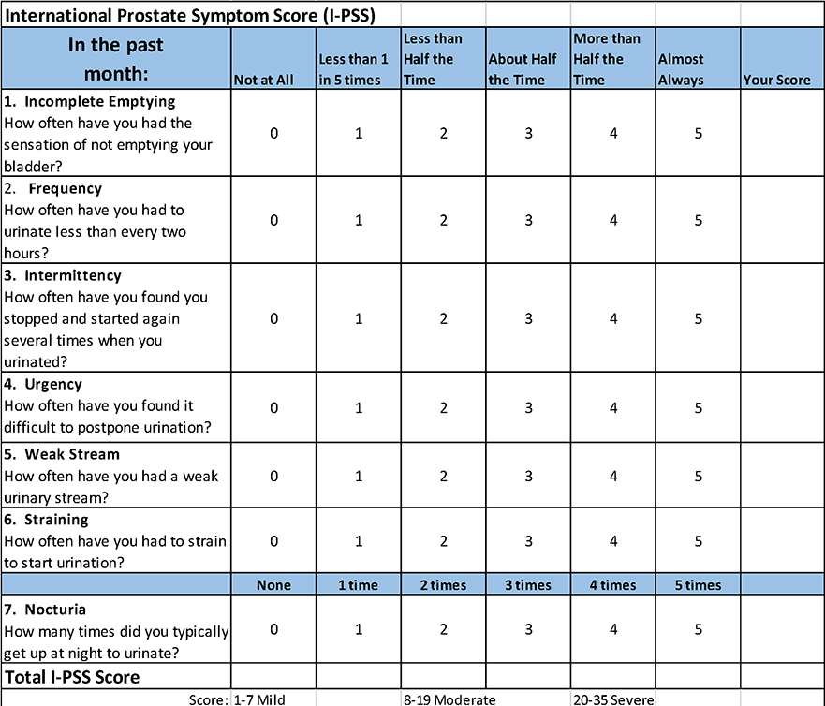
Acute Urinary Effects
Acute urinary “bother” is common
Obstructive symptoms are most commonly treated with NSAIDs (e.g., ibuprofen) and urinary medications such as tamsulosin
Urgency/frequency can occur as well
Incontinence is extremely rare

Slide 26
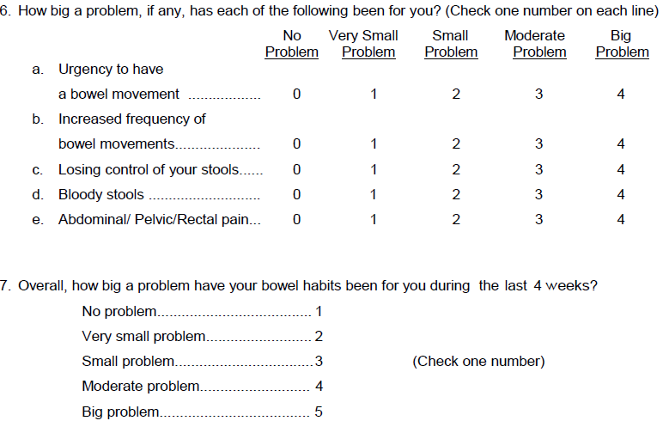
Acute Bowel Effects
Acute bowel “bother” is less common than urinary “bother”
Diarrhea-like symptoms can be treated with over the counter medications such as loperamide
If rectal pain occurs, steroid suppositories can be used as well

Slide 27
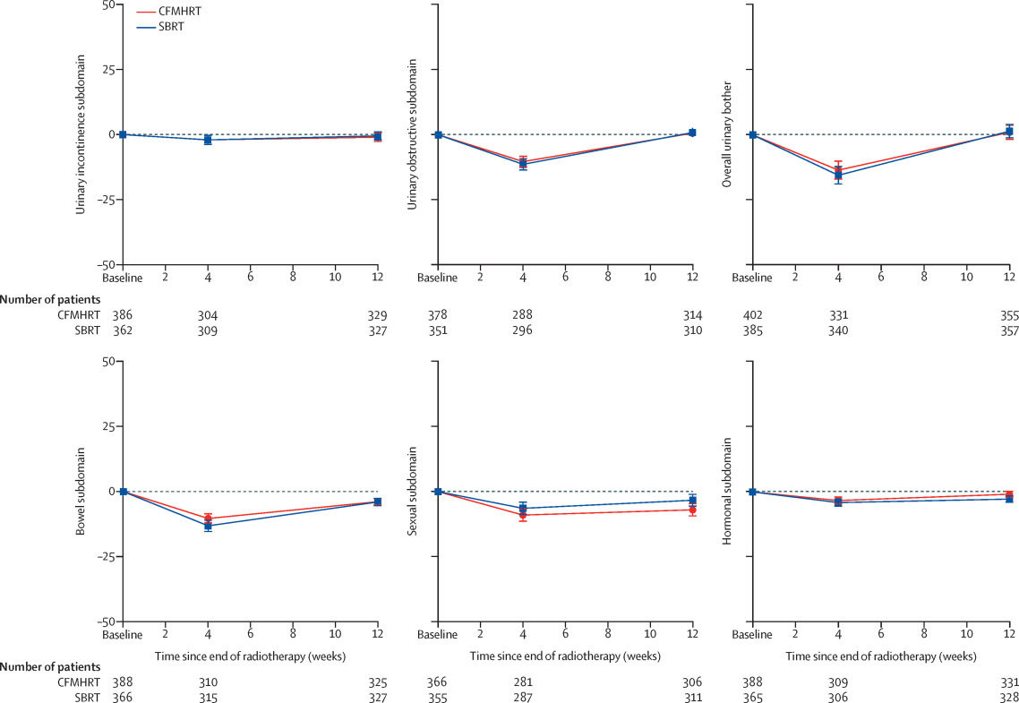
Short-Term Side Effects
Lancet Oncol. 2019 Nov;20(11):1531-1543.

Slide 28
Late Urinary and Bowel Effects
~2-3% chance of significant urinary effects (cystitis, urethritis)
~1% chance of significant bowel effects (proctitis)
Cystitis, urethritis, and proctitis can be treated with hyperbaric oxygen therapy
Very rare chance of radiation-induced cancer

Slide 29
Sexual Side Effects
Acute sexual side effects are rare acutely (though men receiving hormonal therapy will notice some immediate effects from the hormone therapy), and low volume of ejaculate can occur early
The major long-term side effect is erectile dysfunction, which is also age-related and is estimated to occur in ~23% of patients by two years after SBRT
Notes:
https://www.nature.com/articles/s41391-020-0247-x

Slide 30
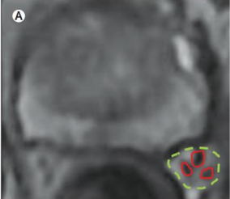
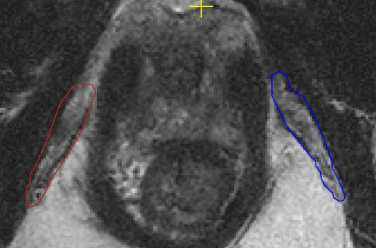
Radiation-Related ED
Lancet Oncol. 2016 May;17(5):e198-208.
https://ars.els-cdn.com/content/image/1-s2.0-S2405630821000963-mmc1.pdf
Neurovascular bundle
Internal Pudendal Artery
Radiation-related ED arises from damage to blood vessels
Low daily doses of sildenafil or tadalafil may help maintain blood flow if taken for 6-12 months during/after RT
Notes:
https://ars.els-cdn.com/content/image/1-s2.0-S2405630821000963-mmc1.pdf

Slide 31
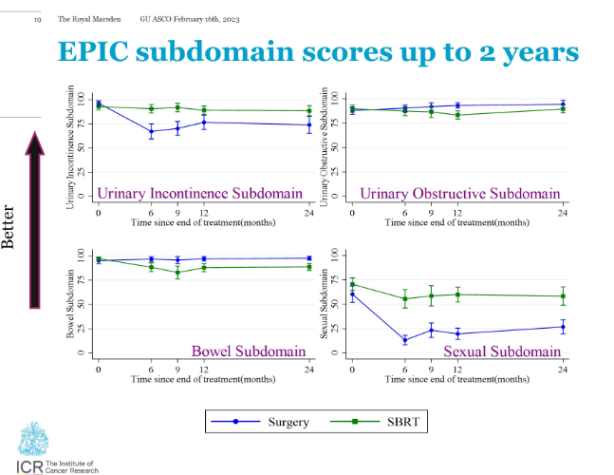
Study #6: PACE-A
  What is the MIRAGE Trial?
    This was a UCLA-led randomized trial of MRI-guided vs. CT-guided SBRT for prostate cancer
  What did it show?
    MRI-guided SBRT led to a 50% reduction in grade ≥2 (i.e., moderate) toxicity
    No incidences of grade ≥2 GI toxicity seen in patients getting MRI-guided SBRT
  What does it mean?
    MRI-guidance is associated with reduced physician-scored and patient-reported side effects compared with CT-guided SBRT
  What is the PACE-A Trial?
    This was a UK-led trial of SBRT vs. radical prostatectomy for favorable prostate cancer
  What did the abstract show?
    Fewer patients needing pads at 2 years with SBRT (4.5%) vs. surgery (46.8%)
    Slightly more bowel bother with SBRT vs. surgery
    Significantly worse sexual function with surgery vs. SBRT
  What does it mean?
    Final publication eagerly anticipated, but provides high quality data comparing modern surgery and SBRT
ASCO GU 2023

Slide 32
Pathways to Further Reducing
SBRT Side Effects
Tighter planning margins (as used on the MIRAGE trial)
Radiogenomics
Real-time adaptive radiotherapy
Notes:
https://pubmed.ncbi.nlm.nih.gov/34489210/

Slide 33
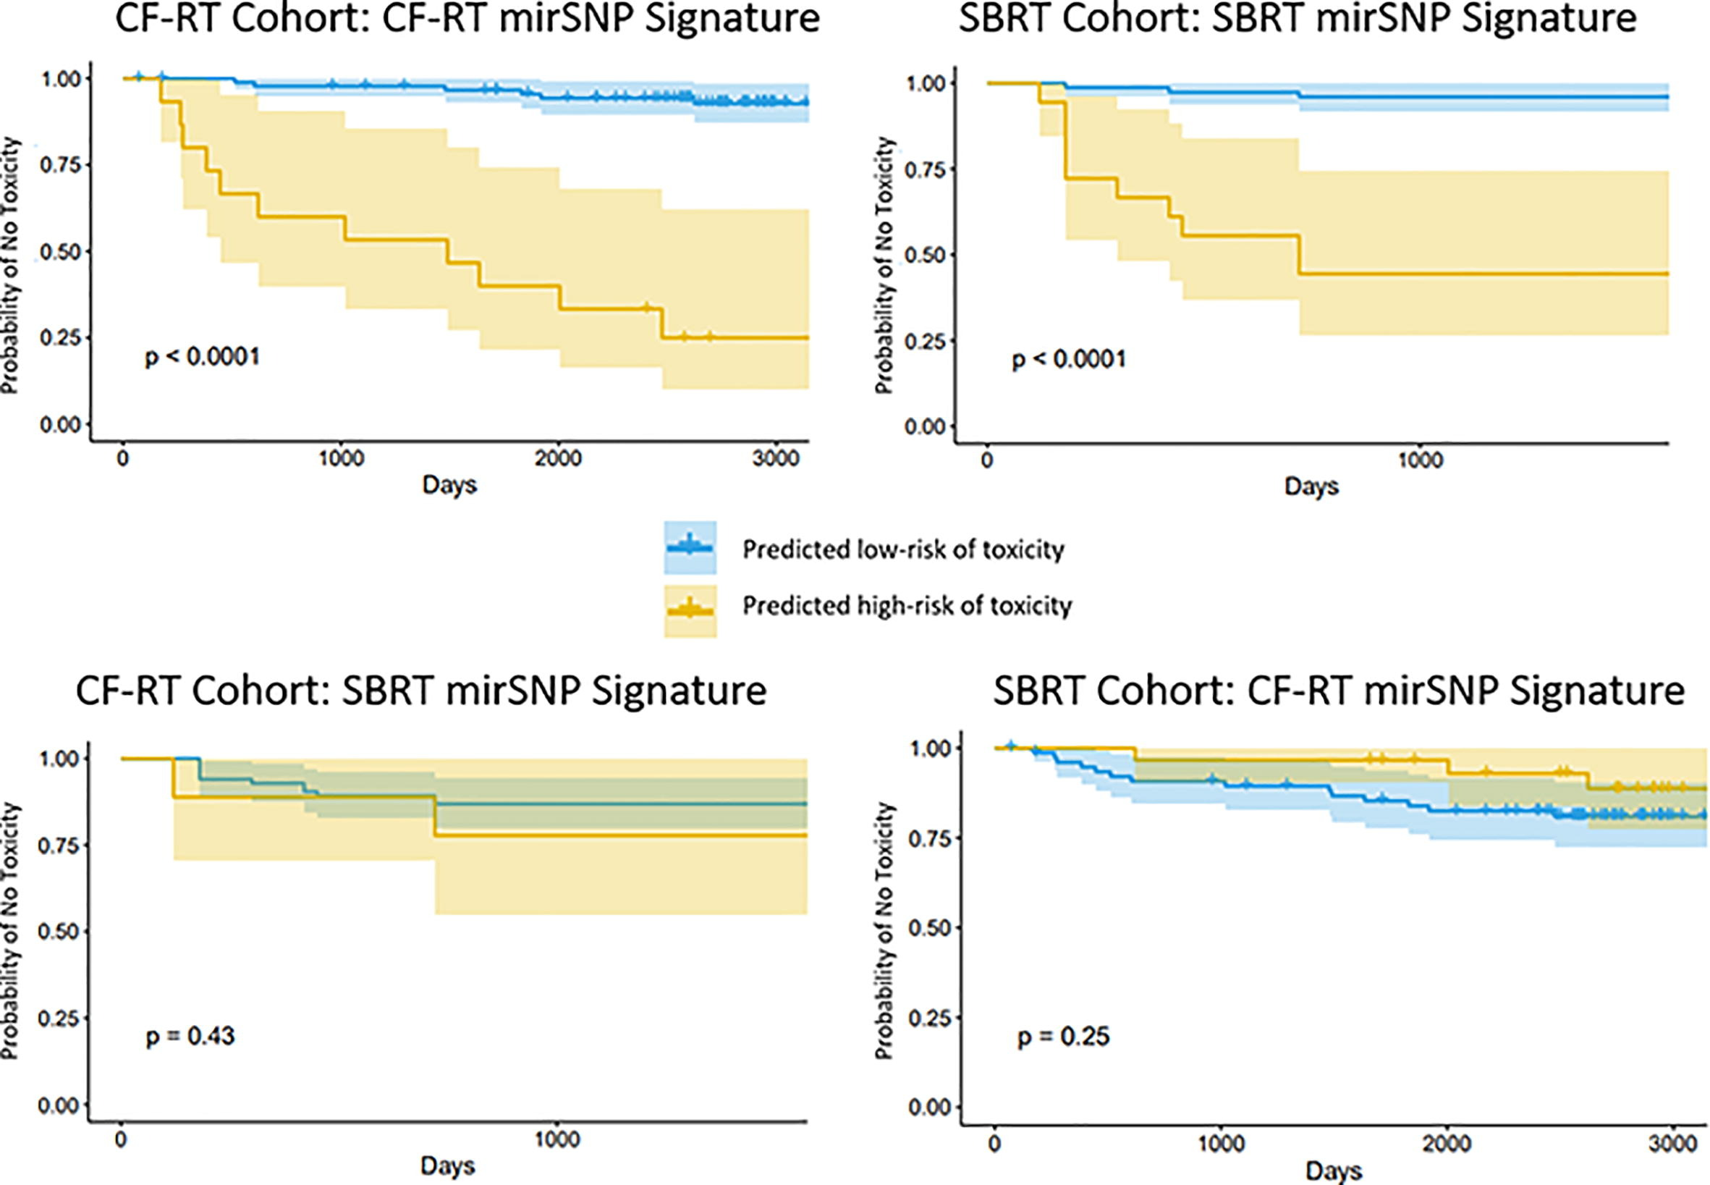
Radiogenomics
  What is radiogenomics?
    This the concept that individual patients may respond differently to radiation, the same way that individual patients may respond differently to different types of medication
  How does this apply to prostate cancer?
    We have developed a genetic test that we believe can identify patients at higher risk of late moderate urinary side effects after radiation
  Are there data to support this?
    We have published our initial discovery results demonstrating success at identifying patients at low-risk of toxicity
Radiother Oncol. 2022 Feb;167:226-232.

Slide 34

Study #7: GARUDA
  What is the GARUDA study?
    This is a prospective study designed to validate whether the aforementioned radiogenomics test will ultimately lead to reduced toxicity following SBRT
  When are results expected?
    The 200th patient was enrolled in May 2022; we will analyze 2-year patient reported outcome and hope to have results by the summer/fall of 2024
NCT04624256

Slide 35
Adaptive Radiotherapy
On a day-to-day basis, the size/shape of the bladder and rectum, and even the size/shape of the prostate itself, can vary significantly
Adaptive radiotherapy is a process wherein a “plan of the day” can be generated after taking these anatomical changes into account
Though it is labor-intensive, it may be more feasible in the future with improvements in software and hardware

Slide 36
Overall Summary
SBRT is a standard of care option for any patient with localized prostate cancer
  For favorable risk patients, this is based on large randomized trials comparing SBRT to longer courses of radiation
  For high risk patients, this is primarily based on a large cohort study
  Early results of a trial comparing SBRT to surgery for favorable patients are also available
MRI-guided SBRT has recently been shown in a randomized trial to reduce short-term side effects (by virtue of improving accuracy/precision)
Significant effort is underway to further reduce side-effects
  Strategies include improved delivery techniques, radiogenomics, and adaptive therapy

Slide 37
Acknowledgements
My patients
NASPCC
Michael Steinberg, Minsong Cao, the UCLA SBRT and GU Teams
ASTRO-PCF
Department of Defense

